Slide 1
APPLICATIONS OF LASERs
Barcode Scanner
Laser Printer

Slide 2
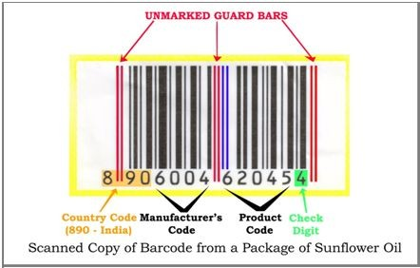
BARCODE SCANNER
A barcode, consisting of bars and spaces, is a machine-readable representation of numerals and characters.
A barcode consists of bars and spaces of varying width that can be read with an optical barcode scanner.

Slide 3
A barcode or bar code is a method of representing data in a visual, machine-readable form.
Initially, barcodes represented data by varying the widths, spacings and sizes of parallel lines.
These barcodes, now commonly referred to as linear or
one-dimensional (1D), can be scanned by special optical scanners, called barcode readers, of which there are several types.
Later, two-dimensional (2D) variants were developed, using rectangles, dots, hexagons and other patterns, called matrix codes or 2D barcodes, although they do not use bars as such.
2D barcodes can be read using purpose-built 2D optical scanners, which exist in a few different forms.
2D barcodes can also be read by a digital camera connected to a microcomputer running software that takes a photographic image of the barcode and analyzes the image to deconstruct and decode the 2D barcode.
A mobile device with an inbuilt camera, such as smartphone, can function as the latter type of 2D barcode reader using specialized application software

Slide 4
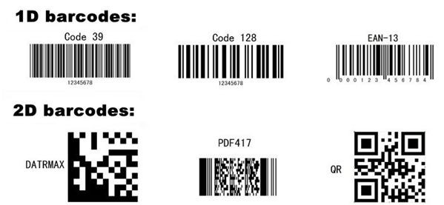

Slide 5
The barcode was invented by Norman Joseph Woodland and Bernard Silver and patented in the US in 1952. The invention was based
on Morse code that was extended to thin and thick bars. However, it took over twenty years before this invention became commercially successful.
Morse code is a method used
in telecommunication to encode text characters as standardized sequences of two different signal durations, called dots and dashes, or dits and dahs.Morse code is named after Samuel Morse, one of the inventors of the telegraph.
Barcodes became commercially successful when they were used to automate supermarket checkout systems, a task for which they have become almost universal.
The first scanning of the now-ubiquitous Universal Product Code (UPC) barcode was on a pack of Wrigley's chewing gum in June 1974 at
a Marsh supermarket in Troy, Ohio, using a scanner made by Photographic Sciences Corporation.

Slide 6

*** Kanji are the logographic Chinese characters taken from the Chinese script and used in the writing of Japanese
A QR code (an initialism for quick response code) is a type of matrix barcode (or two-dimensional barcode) invented in 1994 by the Japanese company Denso Wave. A barcode is a machine-readable optical label that can contain information about the item to which it is attached. In practice, QR codes often contain data for a locator, identifier, or tracker that points to a website or application. QR codes use four standardized encoding modes (numeric, alphanumeric, byte/binary, and kanji) to store data efficiently; extensions may also be used.
A QR code has two dimensions that can support different kinds of data. Numeric data, alphanumeric characters, and Kanji are the three main data types. The components of the QR code include indicators and data code. The QR code has many applications in our life, such as payment, product packaging, and advertising.
The barcode is a one dimension code storing information like ID numbers to specify an item. However, a QR code has an x-axis and y-axis, which means the information it can store will be exponentially larger. There are 40 versions of the QR code. The largest one can store 1850 uppercase characters.

Slide 7
Types Of Barcode Scanners
Laser Scanners
These types of scanners use a laser beam as the light source. Here, either a rotating prism or a reciprocating mirror scans the laser beam to-and-fro across the barcode. A photodiode measures the intensity of light reflected from the barcode.
CCD Readers
These are also known as LED scanners. They use a range of hundreds of tiny light sensors lined up in a row in their head. Each sensor is minute and measures the intensity of light immediately in front of it. Hundreds of sensors are lined-up in a row and a voltage pattern. They are similar to the pattern in the barcode of the reader.
Voltages across each sensor in the row are sequentially measured. So, in effect, a CCD Reader works by measuring emitted ambient light from the barcode.
Pen-Type Readers
Pen-type readers have a light source and a photo-diode. They are placed next to each other at the tip of a pen-like device. A person holding the pen must move the tip of it across the bars at a uniform speed to read the barcode. As the tip crosses each bar and space in the printed code, the photo-diode measures the intensity of the light that is reflected back from the light source. The photo-diode creates a waveform that measures the width of the bars and spaces in the barcode. The dark bars absorb the light, and the white spaces reflect it. So, the voltage waveform generated by the
photo-diode is a representation of the bar and space design of the barcode.
Camera-Based Readers
They are two-dimensional imaging scanners and use a camera and image-processing techniques to scan the barcode.

Slide 8
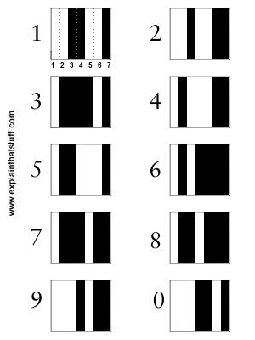
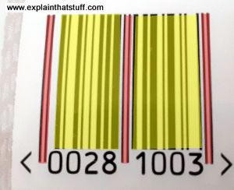
Each digit in a barcode is represented by seven equal-sized vertical blocks. These are colored in either black or white to represent the decimal numbers 0–9. Every number ultimately consists of four fat or thin black and white stripes and its pattern is designed so that, even if you turn it upside down, it can't be confused with any other number.
Two sets of very thin "guard bars" (indicated in red) show where a barcode begins and ends, while a third set in the middle separates the product code (yellow) into two chunks of data (0028 and 1003 in this example). The guard bars make it easier for the scanner to detect a barcode, figure out which way up it is, and help to identify it when it's blurred (down below).

Slide 9
How does a barcode scanner works?
A barcode reader works by directing a beam of light across the barcode and measuring the amount and pattern of the light that is reflected.
The scanner converts the light energy into electrical energy, which is then converted into data by the decoder and forwarded to a computer.
Barcode scanners have to be able to read the black-and-white zebra lines on products extremely quickly and feed that information to a computer or checkout terminal, which can identify them immediately using a product database.
For the sake of this simple example, let's assume that barcodes are simple on-off, binary patterns with each black line corresponding to a one and each white line a zero.

Slide 10
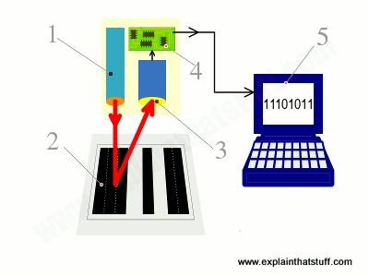
Scanning head shines LED or laser light onto barcode.
Light reflects back off barcode into a light-detecting electronic component called a photoelectric cell. White areas of the barcode reflect most light; black areas reflect least.
As the scanner moves past the barcode, the cell generates a pattern of on-off pulses that correspond to the black and white stripes. So for the code shown here ("black black black white black white black black"), the cell would be "off off off on off on off off.“
An electronic circuit attached to the scanner converts these on-off pulses into digits.
The digital data from the scanner is sent to a computer program, which figures out the final barcode.
In some scanners, there's a single photoelectric cell and, as you move the scanner head past the product (or the product past the scanner head), the cell detects each part of the black-white barcode in turn. In more sophisticated scanners, there's a whole line of photoelectric cells and the entire code is detected in one go.

Slide 11
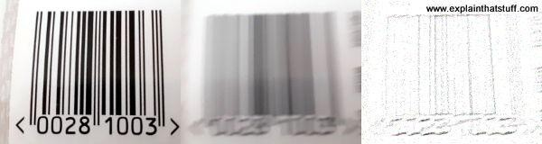
How do scanners cope with moving objects?
One major complication here is that the barcode (or the scanner) is often moving during the scanning process (think how you swipe items at a self-serve grocery checkout) or it might be so far from the scanner that the code is out of focus. That means the pattern the scanner produces is not a crisp set of easy-to-identify black and white stripes, but a blurred smudge made of more ambiguous grey shades. Various different computer algorithms can be used to turn these blurred patterns into accurate barcodes, including edge-detection, which looks for sudden changes in brightness where a zero gives way to a one, or vice-versa.
Left: Barcodes as we see and think of them are clear and crisp zebra patterns.
Middle: Barcodes as scanners capture them may be smudged beyond recognition. Right: Using edge-detection and other algorithms, it's possible to turn blurred images back into something like a usable barcode.

Slide 12
LASER PRINTER

Slide 13
Laser printing is an electrostatic digital printing process.
It produces high-quality text and graphics (and moderate-quality photographs) by repeatedly passing a laser beam back and forth over a negatively-charged cylinder called a "drum" to define a differentially-charged image.
The drum then selectively collects electrically-charged powdered ink (toner), and transfers the image to paper, which is then heated to permanently fuse the text, imagery, or both, to the paper.
As with digital photocopiers, laser printers employ a xerographic printing process.
Laser printing differs from traditional xerography as implemented in analog photocopiers in that in the latter, the image is formed by reflecting light off an existing document onto the exposed drum.
Invented at Xerox PARC in the 1970s, laser printers were introduced for the office and then home markets in subsequent years by IBM, Canon, Xerox, Apple, Hewlett-Packard and many others.
Over the decades, quality and speed have increased as prices have decreased, and the once cutting-edge printing devices are now ubiquitous.

Slide 14
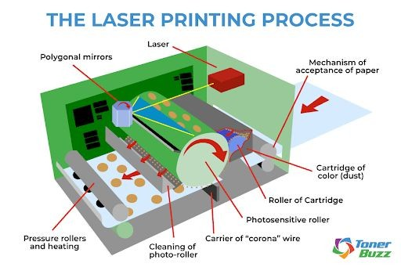

Slide 15
Steps involved in LASER PRINTING
Step 1: Sending
To begin the laser printer process, the document is broken down into digital data and sent from the respective computer to the printer.
In a feat of binary wizardry, printers reassemble this computer data into a printed image. Laser printers will capture the data and process the digital document.
Step 2: Cleaning
Laser printers leave a residue on the printer drum. Cleaning is a physical and electrical process carried out in order to remove the previous print job and prepare the photosensitive drum for the new print job.
During the cleaning process, remnants of toner on the drum are scraped away by a rubber-cleaning blade into a debris cavity. Electrical charges remaining on the drum from the prior print job are defused by electrostatic erase lamps inside laser printers.
Lubrication is then applied to the heat roller in order to make sure an adequate amount of heat is evenly applied to transfer the incoming image.

Slide 16
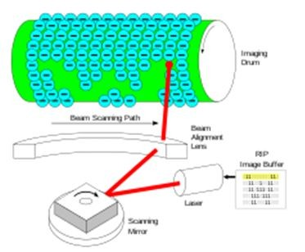
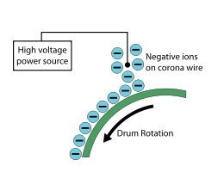
Step 3: Conditioning
The process called conditioning involves applying a charge to the drum unit and the paper as it passes through the corona wire. Adding a static charge to the paper allows an image to be electrostatically transferred to the laser printer page.
(static electricity).
The primary charge roller springs to life, spinning the adjacent organic photoconductor (OPC) drum. Ions on the corona wire coat the drum with static electricity. The electro-photographic process begins at the molecular level. The drum completes its revolution, slathered with a negative charge.

Slide 17
Step 4: Exposing
Here, the photosensitive drum is exposed to a laser beam. Every area of the drum exposed to the laser has its surface charge reduced to about 100 volts DC.
An invisible latent print is generated as the printer's drum turns. The image that will ultimately be printed exists for the first time as a thin layer of electrons on the OPC drum.
The darkness within the printer cartridge is broken by the glow of the laser. The beam bounces off a spinning, multi-sided mirror and breaks into countless rays of information, spraying the OPC drum with its knowledge, turning the negative charges positive.
Line-by-line, the laser speaks to the revolving surface of the drum unit, describing a page with the language of charged toner particles. The drum wears a positively charged image on its surface, ready to transfer onto the paper.

Slide 18
Step 5: Developing
In the developing stage, toner is applied to the latent image on the drum. Toner is composed of negatively charged powdered plastics — black, cyan, magenta, and yellow. The drum is held at a microscopic distance from the toner by a control blade.
Toner is 85-95% finely ground plastic. Other toner ingredients used in printers include colored pigments, fumed silica, and control agents.
Silica keeps the toner particles from clumping and sticking together. It also helps the toner flow smoothly from the cartridge to the printer. Bits of zinc, iron, and chromium are used as control agents to retain the negative electrostatic charge of the toner particles.
A variety of pigments are used to create colored printer toner cartridges.

Slide 19
Step 6: Transferring
Next comes transferring. The secondary corona wire, or transfer roller, applies a positive charge onto the paper. The agitator unit inside the toner cartridge hopper spins, and the toner begins to heat up.
The toner adder spins, pulling toner in, gathering toner dust on its surface. A doctor blade sweeps over the adjacent developer roller, leveling the toner to a precise height.
All the spinning and commotion has left the magenta particles on its surface with a negative charge, and when it comes in contact with the positively charged image on the OPC drum, the laws of attraction take over. The negatively charged toner on the surface of the drum is magnetically attracted to the positively charged areas on the paper.
The magenta toner particles are pulled from the developer onto the drum according to the precise instructions left by the laser. A few magenta toner particles here, several there, and a bunch more that will blend with black, yellow, and blue to form a rainbow of beautiful colors.
The sheet of paper passes over each color cartridge -- magenta, yellow, cyan, and finally black — as the image is transferred onto the paper.

Slide 20
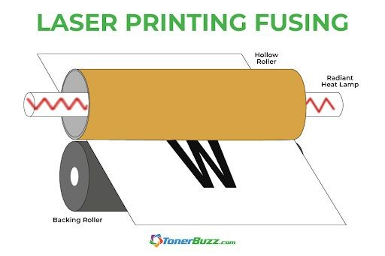
Step 7: Fusing
The final phase is fusing. Heat and pressure are applied to the toner by the fuser unit. The toner generates a permanent bond as it is pressed and melted into the paper. Teflon covers the fuser unit as a light silicon oil is applied in order to remove any possibility of the sheet of paper sticking to them.
The fuser unit essentially melts the toner powder onto the page, creating the image. A wiper blade cleans any remaining particles off the OPC drum and deposits them into a waste bin. Any latent charge left on areas of the drum surface is erased, restored, refreshed, and ready for the laser printer to sing again.
Excess toner not transferred to the OPC drum is scrubbed from the developer unit and returned to the hopper to be used again on the next printed page. Toner that remains on the OPC drum and not transferred is wiped into a waste toner bin.

Slide 21
Advantages of Laser Printer
Performance
Laser printers are designed for printing large volumes. They are able to print multiple pages without experiencing jams and other problems. In the future it is expected to see more performances while reduction in the price.
Speed
The laser beam which the laser printer uses is known to move at very fast rate, thus making the printing process more faster. Compared to an inkjet or a dot matrix printer, laser printers are way faster. Especially if you need to print high volumes of paper, then laser printers will be the best option. Even the slowest versions of laser printers are able to print around 20 sheets of papers per minute. High speed in essence can lead to more productivity and efficiency as well.
Reliability
Even though laser printer is a mechanical device, they are more reliable and durable. Unlike ink cartridges, toners are free from drying out and evaporating. They are on default built to last. The toners can generally last for printing 1500-60,000 pages. If used with proper care, a laser printer can last for many years.

Slide 22
Overall Cost
Al though the initial cost of a laser printer is higher, a laser printer can print more papers for a cheaper price. Unlike inkjet printers, there is no ink cartridges used here. The laser printers use toners which can print more papers than a ink cartridge of the same price.
Quality
In terms of sharpness and quality, there is nothing that can beat a laser printer. Especially texts can be seen more sharp and precise. This is mainly due to the usage of laser technology that use toners to get fused into the paper directly. Hence, it is completely free from smears and smudges.
Noise Emission
Most at times while in operations, a laser printer produce no noise. It is optimized in such a way that rarely emits noises. However unless it is a quiet room the noises are barely noticeable. While working this noises can be disturbing and distracting.

Slide 23
Disadvantages of Laser Printer
Implementation Cost
Laser printers involve high implementation costs. The average price of a laser printer is almost 3 times that of an inkjet printer. That is the reason why inkjet printers are more often preferred for home and personal use where there are lower levels of printing.
Especially for those that of color printers since they comes with all in one functions.
Paper Options
Not all the types of papers can be utilized on a laser printer. There are specifically designed laser papers for this purpose. If any low quality papers are used, you will get into the risk of damaging your printer. And also heat sensitive medias are known to cause jams on a laser printer.
Physical Size
Generally laser printers are much heavier and bulkier compared to an inkjet printer. They contain imaging drum and other delicate components that makes them larger. Therefore, this limits their portability making them discourages to carry around.
Graphics Handling
Al though laser printers are able to produce simple color prints, they cannot handle high quality graphics images. This makes them not recommended for printing photographs and other complex graphics materials. The only preferred option here is the inkjet printer.

Slide 24
5. Power Consumption
Laser printers consumes high amount of power even when it is in idle. This is because the fuser element inside the printer can get hot releasing heat. Eventually your room may get very warm. That is the reason why laser printers are not preferred to use in hot and humid climate conditions. However latest models of laser printers comes with '' Power Saver '' mode that helps printer save some power.
6. Health Issues
Toners which the laser printer uses is dangerous to humans. This toner contains powder particles that can be inhaled causing some health risks including respiratory diseases. Additionally, since high amount of voltages are required for the printers functioning, there are also ozone released constituting to ozone layer depletion.

