Slide 1
Analysis and Design of Algorithms 23IS4PCADA

Slide 2
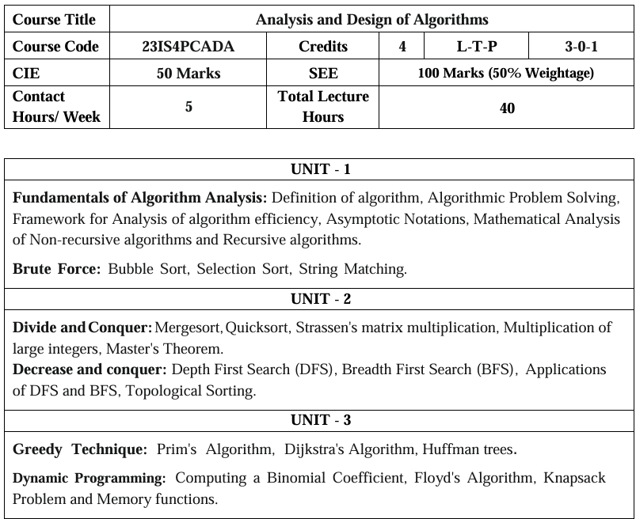

Slide 3
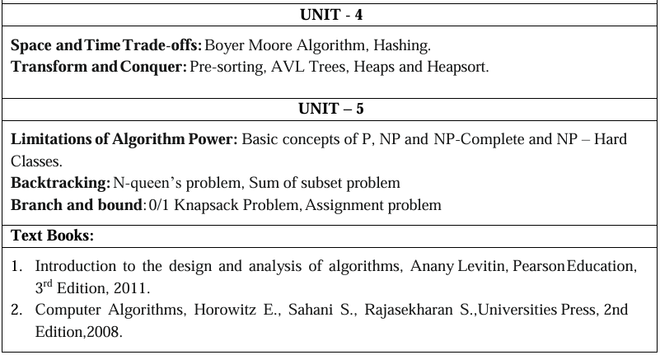
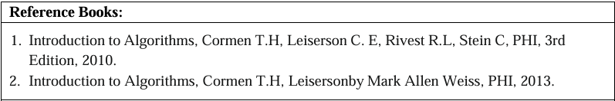

Slide 4
Course objectives
To Introduce various designing techniques and methods for algorithms.
Performance analysis of Algorithms using asymptotic and empirical approaches.
Demonstrate a familiarity with major algorithms and data structures.
To give a clear idea of algorithmic design paradigms like Brute Force, Divide-and-Conquer, Dynamic Programming, Greedy, Branch and Bound, Backtracking etc.
To understand the basic concepts of complexity classes like P, NP, NP Complete and NP Hard classes.

Slide 5
Course Outcome
At the end of the course, you will be able to;
  Demonstrate solving of a computing problem for various datasets to aid the visualization of the algorithm.
  Examine the working of the algorithm and infer its time complexity by applying suitable techniques.
  Design and implement algorithms to solve real time computing problems using suitable algorithmic design techniques.

Slide 6
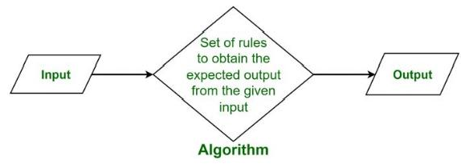
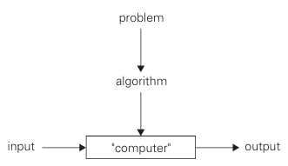
Algorithm
Figure: The notion of the algorithm

Slide 7
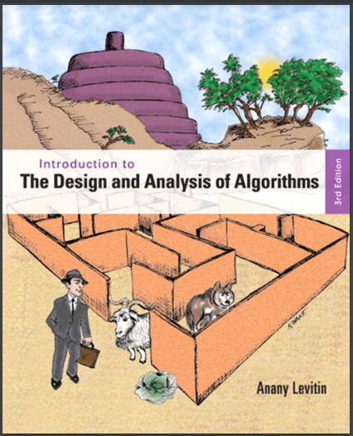

Text Book -1

Slide 8
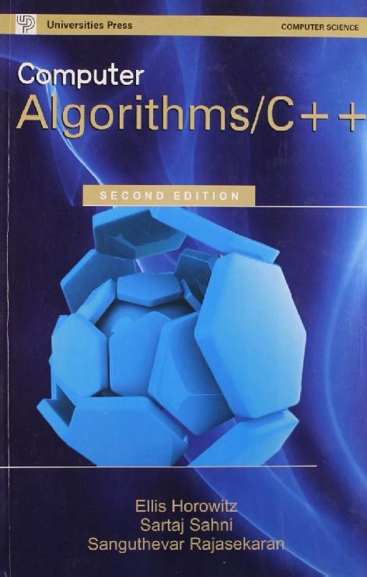
Text Book -2

Slide 9
Unit 1 – Outline
Fundamentals of Algorithm Analysis
Definition of algorithm
Algorithmic Problem Solving
Framework for Analysis of algorithm efficiency
Asymptotic Notations
Mathematical analysis of Non-Recursive algorithms
Mathematical analysis of Recursive algorithms
Brute Force
Bubble Sort
Selection Sort
String Matching

Slide 10
Unit 1 – Outline
Fundamentals of Algorithm Analysis
Definition of algorithm
Algorithmic Problem Solving
Framework for Analysis of algorithm efficiency
Asymptotic Notations
Mathematical analysis of Non-Recursive algorithms
Mathematical analysis of Recursive algorithms
Brute Force
Bubble Sort
Selection Sort
String Matching

Slide 11
What is an Algorithm?
An algorithm is a finite sequence of unambiguous instructions to solve a particular problem.
In addition, all algorithms must satisfy the following criteria:
  Input: Zero or more quantities are externally supplied.
  Output: At least one quantity is produced.
  Definiteness: Each instruction is clear and unambiguous.
  Finiteness: algorithm terminates after a finite number of steps.
  Effectiveness: Every instruction must be very basic so that it can be carried out-using only pencil and paper.

Slide 12
Algorithm specification
An algorithm can be specified in
  Simple English
  Graphical representation like flow chart

Slide 13
Sample Algorithm
Write an algorithm to add two numbers entered by user.
Step 1: Start
Step 2: Declare variables num1, num2 and sum.
Step 3: Read values of num1 and num2.
Step 4: Add num1 and num2 and assign the result to sum.
sum←num1+num2
Step 5: Display sum
Step 6: Stop

Slide 14
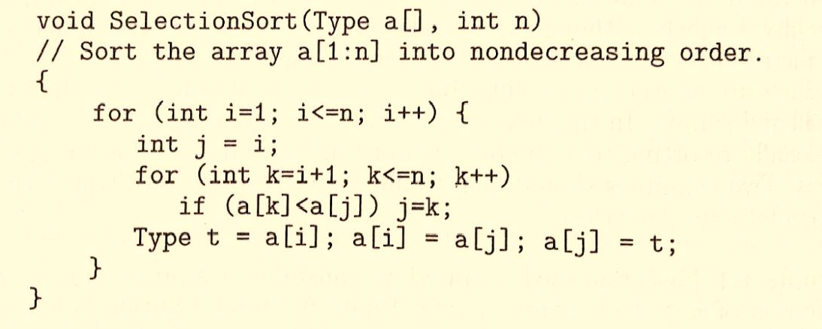
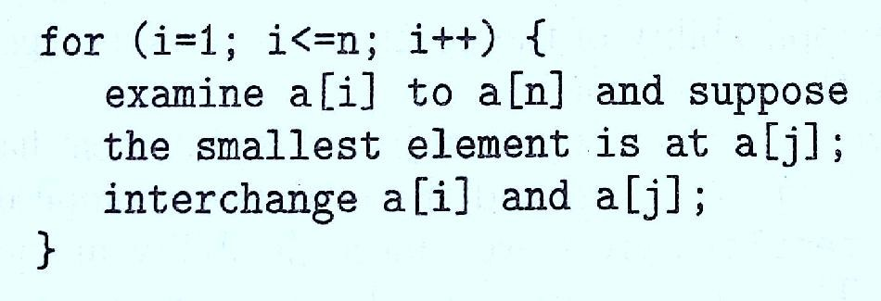
Pseudocode

Slide 15
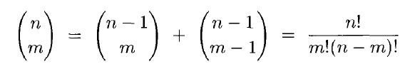
Recursive Algorithm
An algorithm is said to be recursive if the same algorithm is invoked in the body (direct recursive).
Algorithm A is said to be indirect recursive if it calls another algorithm which in turn calls A.
Example 1: Factorial computation n! = n * (n-1)!
Example 2: Binomial coefficient computation
Example 3: Tower of Hanoi problem
Example 4: Permutation Generator

Slide 16
Unit 1 – Outline
Fundamentals of Algorithm Analysis
Definition of algorithm
Algorithmic Problem Solving
Framework for Analysis of algorithm efficiency
Asymptotic Notations
Mathematical analysis of Non-Recursive algorithms
Mathematical analysis of Recursive algorithms
Brute Force
Bubble Sort
Selection Sort
String Matching

Slide 17
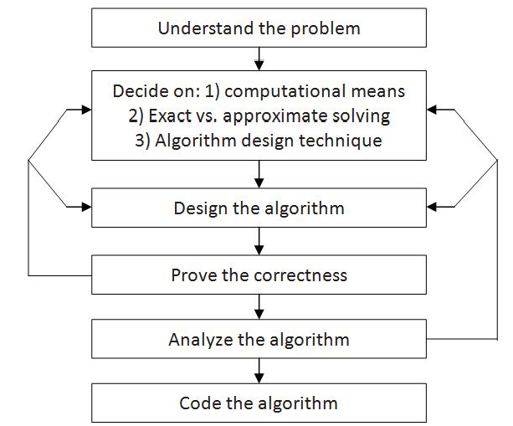

Fundamentals of Algorithmic Problem Solving

Slide 18
(i) Understanding the Problem
This is the first step in designing of algorithm.
Understand the problem statement and in case of any ambiguity, clarify it in hand.
Identify the problem types and use existing algorithm to find solution.
If not able to find any readily available algorithm, then design own algorithm according to problem statement
Input (instance) to the problem and range of the input get fixed.

Slide 19
(ii) Decision Making
The Decision making is done on the following:
(a) Ascertaining the Capabilities of the Computational Device
  Algorithms designed to be executed on RAM machines are called sequential algorithms.
  In some newer computers, operations are executed concurrently, i.e., in parallel. Algorithms that take advantage of this capability are called parallel algorithms.
  Usually, it is preferred to study algorithms in terms independent of specification of a particular parameter-speed and memory available on a particular computer system
(b) Choosing between Exact and Approximate Problem Solving
  An algorithm used to solve the problem exactly and produce correct result is called an exact algorithm.
  If the problem is so complex and not able to get exact solution, then one should opt for an algorithm called an approximation algorithm. i.e., produces an approximate answer. E.g., extracting square roots, solving nonlinear equations, and evaluating definite integrals.

Slide 20
(ii) Decision Making (Contd…)
Why approximation algorithm is then used
Some important problems cannot be solved exactly for most of their instances.
An approximation algorithm can be a part of a more sophisticated algorithm that solves a problem exactly.
(c) Deciding on the appropriate Data Structure
Choosing data structures appropriate for the operations performed by the algorithm is very important.
Some algorithm design techniques depend intimately on structuring or restructuring data to specify a problem’s instance.
Algorithms + Data Structures = Programs
In the new world of object-oriented programming, data structures remain crucially important for both design and analysis of algorithms.

Slide 21
(III) Algorithm Design Techniques
An algorithm design technique (or “strategy” or “paradigm”) is a general approach to solving problems algorithmically that is applicable to a variety of problems from different areas of computing.
Methods of Specifying an Algorithm
There are three ways to specify an algorithm. They are:
  Natural language
  Pseudocode
  Flowchart
Method of Specifying Algorithms
Natural Language
Pseudocode
Flowchart

Slide 22
Methods of Specifying an Algorithm
Natural Language
Simple and easy.
Many times specification of algorithm by using natural language is not clear and creates ambiguity.
Example:
An algorithm to perform addition of two numbers.
  Step 1: Read the first number, say a.
  Step 2: Read the first number, say b.
  Step 3: Add the above two numbers and store the result in c.
  Step 4: Display the result from c.

Slide 23
Methods of Specifying an Algorithm (Contd..)
Pseudocode
  mixture of a natural language and programming language constructs
  usually more precise than natural language.
  For Assignment operation left arrow “←”, for comments two slashes “//”,if condition, for, while loops are used.
ALGORITHM Sum(a,b)
  //Problem Description: This algorithm performs addition of two numbers
  //Input: Two integers a and b
  //Output: Addition of two integers
  c←a+b
  return c
c. Flow Chart
  proved to be inconvenient for complex algorithms
  used for very simple programs

Slide 24
(iv) Proving an Algorithm’s Correctness
Once an algorithm has been specified then its correctness must be proved.
An algorithm must yield a required result for every legitimate input in a finite amount of time.
The notion of correctness for approximation algorithms is less straight forward than it is for exact algorithm.
It is usual that error produced by algorithm does not exceed a predefined limit.

Slide 25
(v) Analyzing an Algorithm
The factors to analyze the algorithm are
  Efficiency
  Simplicity
  Generality
Efficiency
For an algorithm, the most important factor required is efficiency.
There are two kinds of algorithm efficiency. They are:
  Time efficiency, indicating how fast the algorithm runs, and
  Space efficiency, indicating how much extra memory it uses.
Simplicity
  Simpler algorithms are easier to understand and program
  It usually contains fewer bugs
  Ex : Euclid’s algorithm is simpler than Middle School Procedure
Generality
Algorithm is preferred to be designed in general way than to opt for complicated way.
For Example: to determine whether two integers are relatively prime, then their common divisor will be 1, then it is preferred to use GCD of two numbers.

Slide 26
(vi) Coding an Algorithm
The coding / implementation of an algorithm is done by a suitable programming language like C, C++, JAVA.
It is very essential to write an optimized code (efficient code) to reduce the burden of compiler.
Thus, as a rule
A good algorithm is a result of repeated effort and rework

Slide 27
Fundamentals of The Analysis of Algorithm Efficiency
The algorithm efficiency can be analyzed by the following ways:-
Analysis Framework.
Asymptotic Notations and its properties.
Mathematical analysis for Recursive algorithms.
Mathematical analysis for Non-recursive algorithms.

Slide 28
Analysis Framework
The main purpose of algorithm analysis is to design efficient algorithms
There are two kinds of efficiencies to analyze the efficiency of any algorithm. They are:
Space efficiency, indicating how much extra memory it uses.
Time efficiency, indicating how fast the algorithm runs
Measuring an Input’s Size
run longer on larger inputs
Units for Measuring Running time
Basic operation
Order of Growth

Slide 29
Space Efficiency
Space complexity of an algorithm depends on following factors
Program Space
Data Space
Stack Space

Slide 30
Measuring an Input’s Size
Most algorithms run longer on larger inputs.
It takes longer time to sort larger arrays, multiply larger matrices and so on
Therefore, it is logical to investigate an algorithm’s efficiency as a function of some parameter “n” indicating the algorithm’s input size.
Here, the parameter “n” differs based on problem statement
Ex 1: Parameter “n” will be the size of the list for problems like searching, sorting.
Ex 2 : In case of evaluating a polynomial of degree n, parameter will be in terms of polynomial degree or the number of coefficients.

Slide 31
Using some standard unit of time for measuring running time like seconds, milliseconds has its own drawbacks
Speed of a particular computer
Compiler used in generating the machine code
Programming language used
Quality of a program
So, we need a metric to measure an algorithm time efficiency that does not depend on these extraneous factors.
Units for Measuring Running Time

Slide 32
The operation that is most time-consuming operation in an algorithm, which is in the innermost loop in an algorithm.
This operation is contributing the most to the total running time.
The basic operation is computed by the number of times it is executed
For Example :
// Addition of two matrices void addmatrix(int a[][], int b[][])
{ int i,j,c[][]; for i=1 to n for j=1 to n c[i][j]=a[i][j]+b[i][j] end for end for
}
Basic Operation

Slide 33
Theoretical analysis of time efficiency
Time efficiency is analyzed by determining the number of repetitions of the basic operation as a function of input size
Basic operation: the operation that contributes most towards the running time of the algorithm
T(n) ≈ c_{op}C(n)
input size
running time
Number of times basic operation is executed
execution time
for basic operation

Slide 34
Order of Growth
Order of growth of an algorithm is a way of stating how execution time or memory occupied by it changes with the input size.
The algorithm is expected to work faster for all values of “n”.
Some algorithms execute faster for smaller values of n, but as the value of “n” increases, they tend to be slow.
Why emphasis on large input sizes?
Because for large values of n, it is the function's order of growth that counts.
This change in behavior of the algorithm and algorithm’s efficiency can be analyzed by considering the highest order of “n”.

Slide 35
What is Highest order of “n”
Example 1:
for(i=0;i<n;i++)
sum=sum+a[i];
O(n)=n
Example 2:
for(i=0;i<n;i++)
for(i=0;i<n;i++)
sum[i][j]=a[i]+b[i];
O(n)=n^2

Slide 36
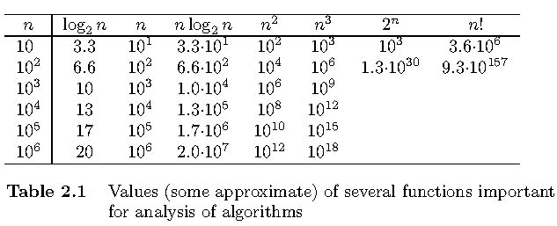
Values of some important functions as n → ∞

Slide 37
Order of Growth
Order of growth | Meaning | Example
logn | indicates the running time of algorithm is logarithmic | Binary Search
N | indicates the running time of algorithm is linear | Linear search
nlogn | indicates the running time of algorithm is nlogn | Quick sort
n² | indicates the running time of algorithm is quadratic | Bubble sort
n³ | indicates the running time of algorithm is cubic | Matrix multiplication
2^{n} | indicates the running time of algorithm is exponential | Subset problem
n! | indicates the running time of algorithm is factorial | TSP

Slide 38
Order of Growth (Contd..)
The function growing slower among these is logarithmic
The exponential and factorial function grow so fast that their values becomes astronomically large even for smaller values of “n”
The exponential and factorial function are practical for solving only problems of small size.
So, it can be ordered according to order of growth as shown below
1 < logn < n < nlogn < n² < n³ < 2^{n} < n!

Slide 39
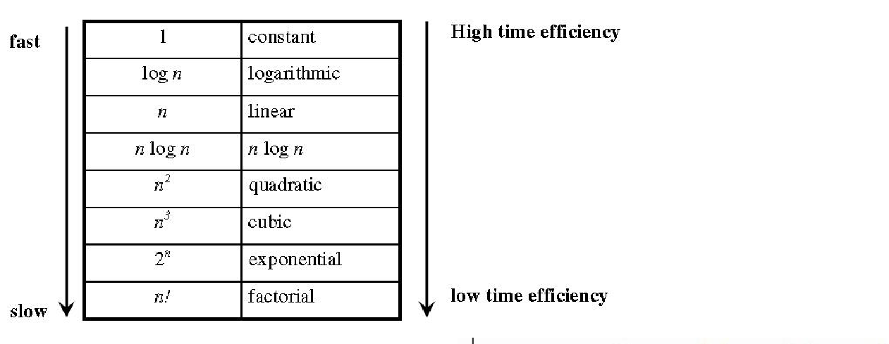
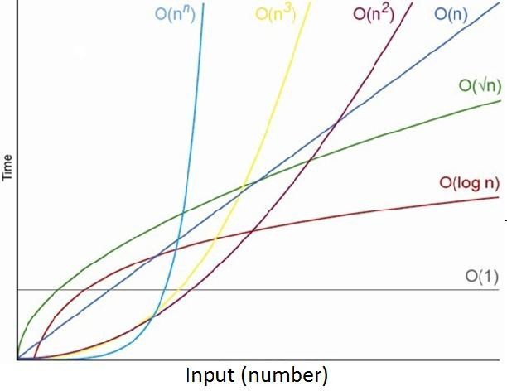

Slide 40

Analysis Framework
Worst-Case
Best-Case
Average-Case Efficiencies

Slide 41
Best-case, Average-case, Worst-case
Algorithm: Linear Search(K,a[],n)
// Purpose : Searches for a given value in a given array by sequential search
// Inputs:
// n – The number of items present in the table
// a – the elements of an array
// K – the items to be searched in array
// Output
// The index of the first element of a[] that matches K
or -1 if there are no matching elements
i 0
while i<n and a[i]!=k do
i i+1
if i<n return i
else return -1

Slide 42
Best-case, average-case, worst-case
Best case efficiency
The best-case efficiency of an algorithm is its efficiency for the best-case input of size n.
The algorithm runs the fastest among all possible inputs of that size n.
In sequential search, If we search a first element in list of size n. (i.e. first element equal to a search key), then the running time is C_{best}(n)=1.
Worst-case efficiency
The worst-case efficiency of an algorithm is its efficiency for the worst-case input of size n.
The algorithm runs the longest among all possible inputs of that size.
For the input of size n, the running time is C_{worst}(n) = n.
Average case efficiency
The Average case efficiency lies between best case and worst case.
The average number of comparisons made by sequential search is C_{avg}=(n+1)/2

Slide 43
Summary of analysis framework
Both time and space efficiencies are measured as functions of the algorithm's input size.
  Time efficiency - basic operation
  Space efficiency - extra memory units
The efficiencies of some algorithms may differ significantly for inputs of the same size.
  For such algorithms, we need to distinguish between the worst-case, average-case, and best-case efficiencies.
The primary interest lies in the order of growth of the algorithm's running time (or extra memory units consumed) as its input size goes to infinity.

Slide 44
Asymptotic notation
Asymptotic analysis is the process of calculating the running time of an algorithm in mathematical units to find the program's limitations, or “run-time performance.”
The goal is to determine the best case, worst case and average case time required to execute a given task.
The main idea of asymptotic analysis is to have a measure of the efficiency of algorithms that don’t depend on machine-specific constants and doesn’t require algorithms to be implemented and time taken by programs to be compared.
Asymptotic notations are mathematical tools to represent the time complexity of algorithms for asymptotic analysis.
To compare and rank order of growth, computer scientists use three notations
  O (big oh)
  Ω (big omega)
  Θ (big theta)

Slide 45
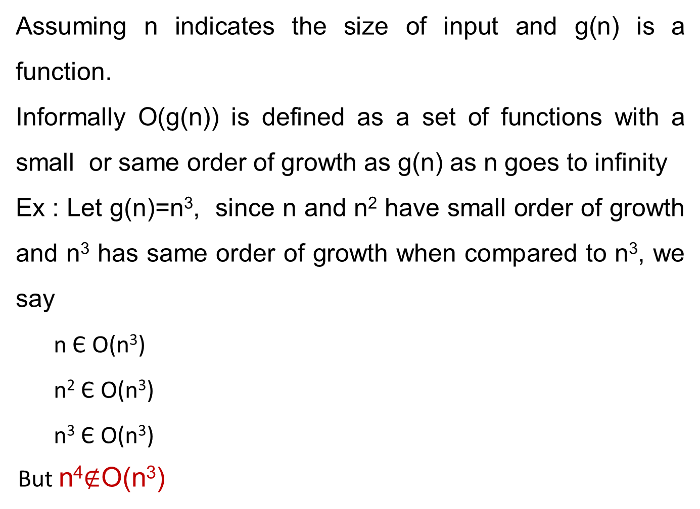
Informal definition: Big Oh(O)
Assuming n indicates the size of input and g(n) is a function.
Informally O(g(n)) is defined as a set of functions with a small or same order of growth as g(n) as n goes to infinity
Ex : Let g(n)=n³, since n and n² have small order of growth and n³ has same order of growth when compared to n³, we say
  n Є O(n³)
  n² Є O(n³)
  n³ Є O(n³)
But n⁴$∉$O(n³)

Slide 46
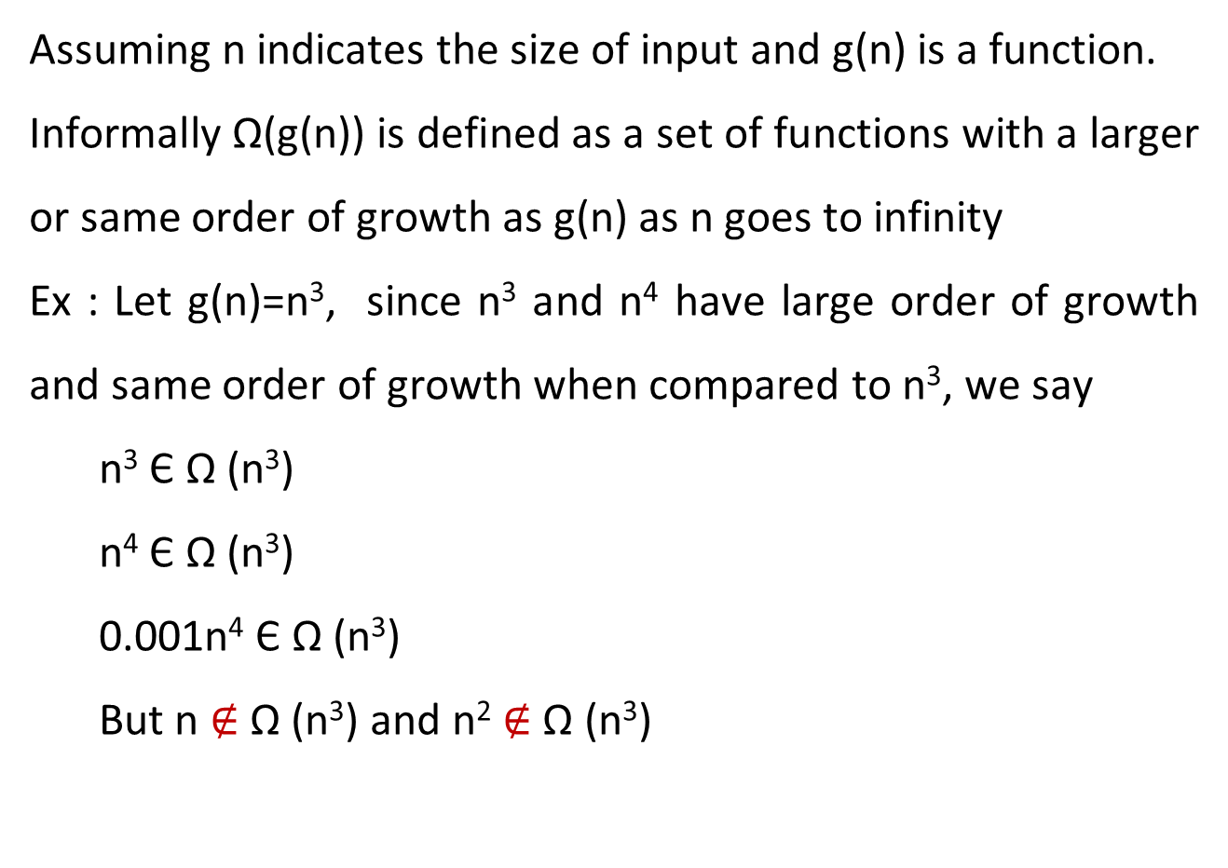
Informal definition: Big Omega(Ω )
Assuming n indicates the size of input and g(n) is a function.
Informally Ω(g(n)) is defined as a set of functions with a larger or same order of growth as g(n) as n goes to infinity
Ex : Let g(n)=n³, since n³ and n⁴ have large order of growth and same order of growth when compared to n³, we say
  n³ Є Ω (n³)
  n⁴ Є Ω (n³)
  0.001n⁴ Є Ω (n³)
  But n $∉$ Ω (n³) and n² $∉$ Ω (n³)

Slide 47
Informal definition of Big Theta(Θ )
Assuming n indicates the size of input and g(n) is a function.
Informally Θ(g(n)) is defined as a set of functions that have same order of growth as g(n) as n goes to infinity
Ex : Let g(n)=n², since an²+bn+c for a>0 and n²+log have same order of growth as that of n², we say
  an²+bn+c Є Θ(n²)

Slide 48
Formal definition: Big - Oh(O) Notation
A function t(n) is said to be in O(g(n)), denoted t(n) ∈ O(g(n)), if t(n) is bounded above by some constant multiple of g(n) for all large n, i.e., if there exist some positive constant c and some nonnegative integer n₀ such that
t(n) ≤ c.g(n) for all n≥n₀.
Example: Let us formally prove that 100n + 5∈ O(n²)
100n +5 ≤ 100n+n(for all n≥5) = 101n ≤ 101n².
Thus, as values of the constants c and n₀ required by the definition, we can take 101 and 5, respectively.

Slide 49
Example : Big - Oh(O) Notation
Let f(n) =2n²+5n+1
Condition to satisfy f(n)<=c.g(n)
So, here let choose g(n)=n² and c=4
2n²+5n+1<=4n²
When n=1, 8<=4, false
When n=2, 19<=16, false
When n=3, 34<=36, true
When n=4, 53<=64, true
So, f(n)=O(n²) for all n>=3, c=4
Let f(n) =2n²+5n+1
Condition to satisfy f(n)<=c.g(n)
So, here let choose g(n)=n³ and c=4
2n²+5n+1<=4n³
When n=1, 8<=4, false
When n=2, 19<=32, true
So, f(n)=O(n³) for all n>=2, c=4

Slide 50
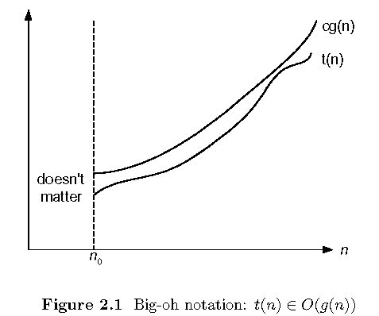
Big-oh

Slide 51
Formal definition: Big Omega(Ω) Notation
A function t(n) is said to be in (g(n)), denoted t(n)∈ (g(n)), if t (n) is bounded below by some positive constant multiple of g(n) for all large n, i.e., if there exist some positive constant c and some nonnegative integer n₀ such that
t(n) ≥ c.g(n) for all n≥n₀.
Example: Let us formally prove that n³ ∈ (n²)
n³ ≥ n² for all n≥0,
i.e., we can select c = 1 and n₀ = 0

Slide 52
Example: Big Omega(Ω) Notation
Let f(n) =2n²+5n+1
Condition to satisfy f(n)>=c.g(n)
So, here let us choose g(n)=n² and c=2
2n²+5n+1>=2n²
When n=1, 8>=4, true
So, f(n)= Ω(n²) for all n>=1, c=2

Slide 53

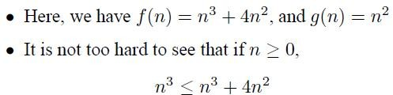


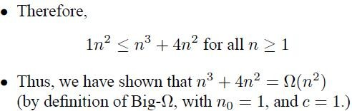

Slide 54
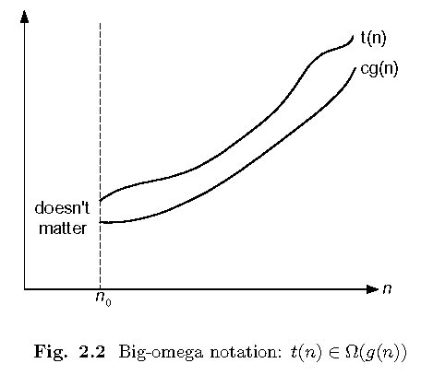
Big-omega

Slide 55
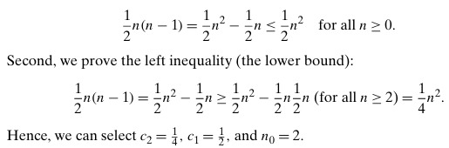
Formal definition: Θ Theta notation
A function t(n) is said to be in (g(n)), denoted t(n)∈(g(n)), if t(n) is bounded both above and below by some positive constant multiples of g(n) for all large n, i.e., if there exist some positive constants c1 and c2 and some nonnegative integer n₀ such that c2g(n) ≤ t(n) ≤ c1g(n) for all n ≥ n₀
For example, let us prove that 1/2n(n−1)∈ Θ(n²).
First, we prove the right inequality (the upper bound):

Slide 56
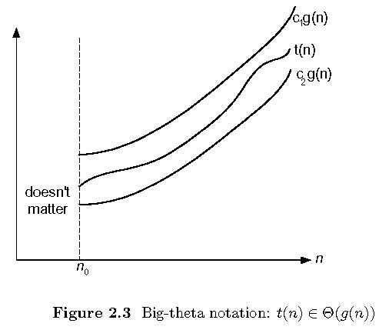
Big-theta

Slide 57
Example: Theta(Θ) Notation
Let f(n) =3n+2
Condition to satisfy c1.g(n)<=f(n)<=c2.g(n)
So, here let choose g(n)=n and c₁=1, c₂=4
1n <= 3n+2 <= 4n
When n=1, 1<=5<=4, false
When n=2, 2<=8<=8, true
So, f(n)= Θ(n) for all n>=2, c₁=1, c₂=4

Slide 58
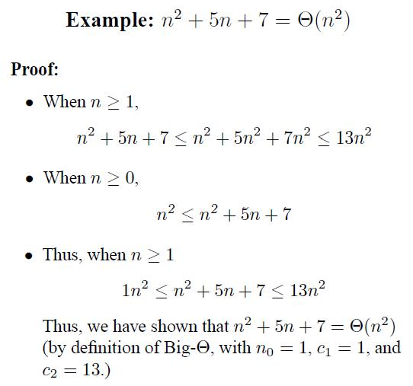

Slide 59
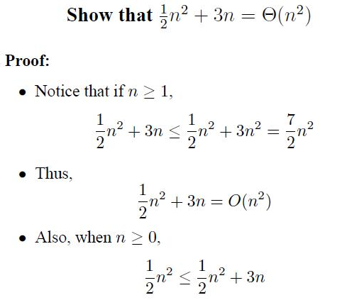
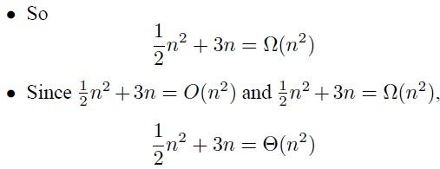

Slide 60
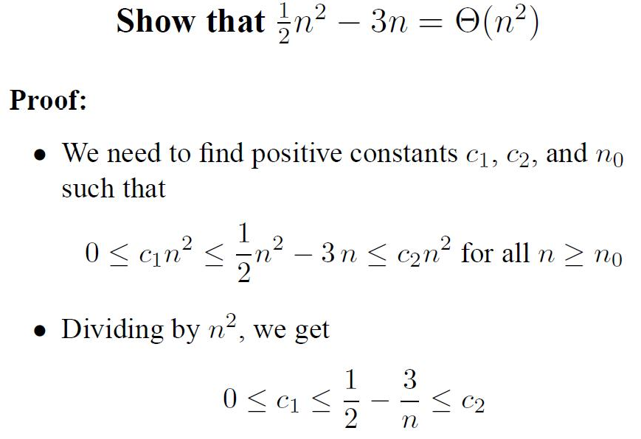

Slide 61
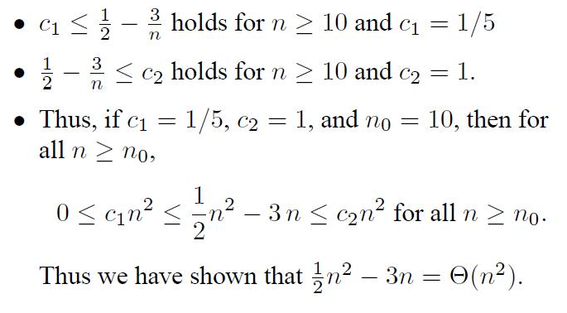

Slide 62
Establishing order of growth using limits
0 order of growth of t(n) < order of growth of g(n)
lim t(n)/g(n) =
c > 0 order of growth of t(n) = order of growth of g(n)
n→∞
∞ order of growth of t(n) > order of growth of g(n)
Examples:
10n vs. n²
n(n+1)/2 vs. n²

Slide 63
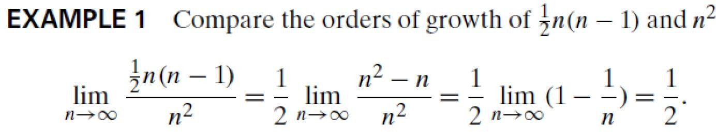



Slide 64
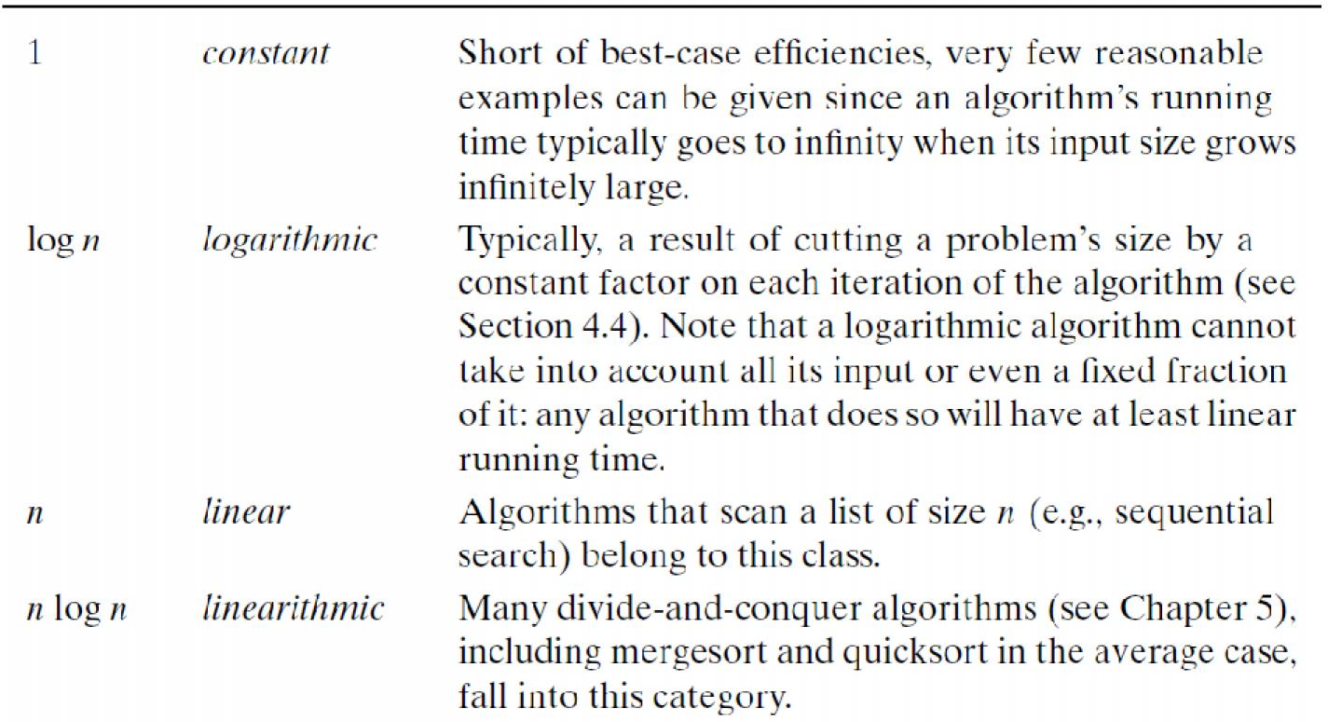
Basic Efficiency classes
Class
Name Comments

Slide 65
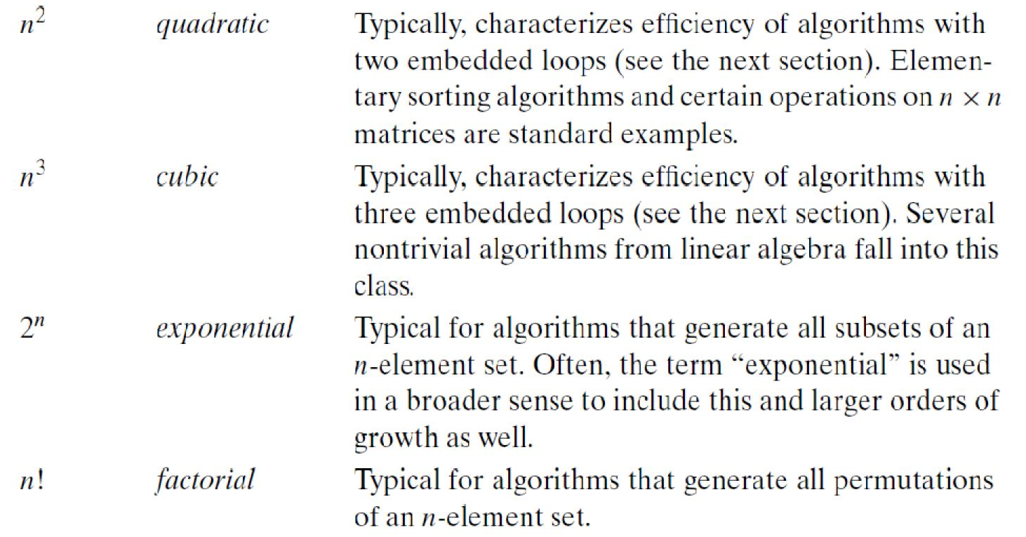
Comments
Basic Efficiency classes (Contd.)
Class
Name

Slide 66
Mathematical Analysis of Non- recursive Algorithm
Steps
  Decide on parameter n indicating input size
  Identify algorithm‘s basic operation(located in its innermost loop)
  Check whether the no. of times the basic operation is executed depends only on the size of an input. If it also depends on some additional property, then the worst case, average case and if necessary best case efficiencies have to be investigated separately.
  Set up sum expressing the no. of times the algorithm’s basic operation is executed.
  Simplify summation using standard formulas

Slide 67
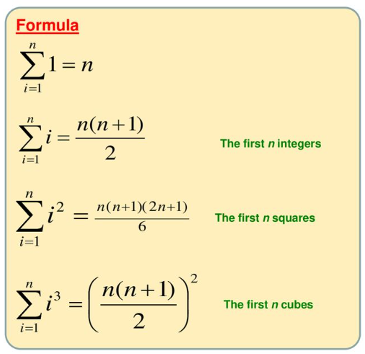



Basic Rules of Sum Manipulation
Summation Formulas

Slide 68
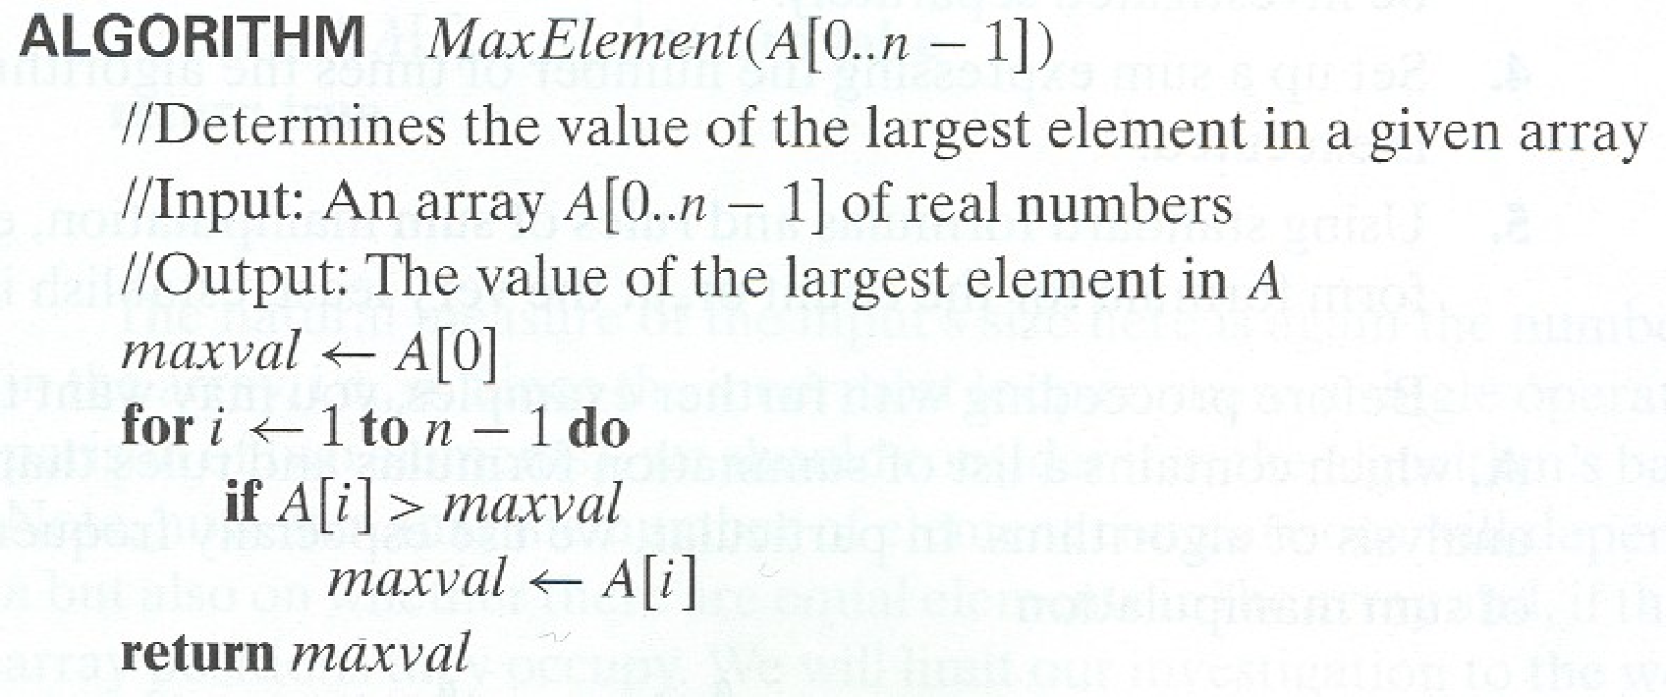
Example 1 : Max Element

Slide 69
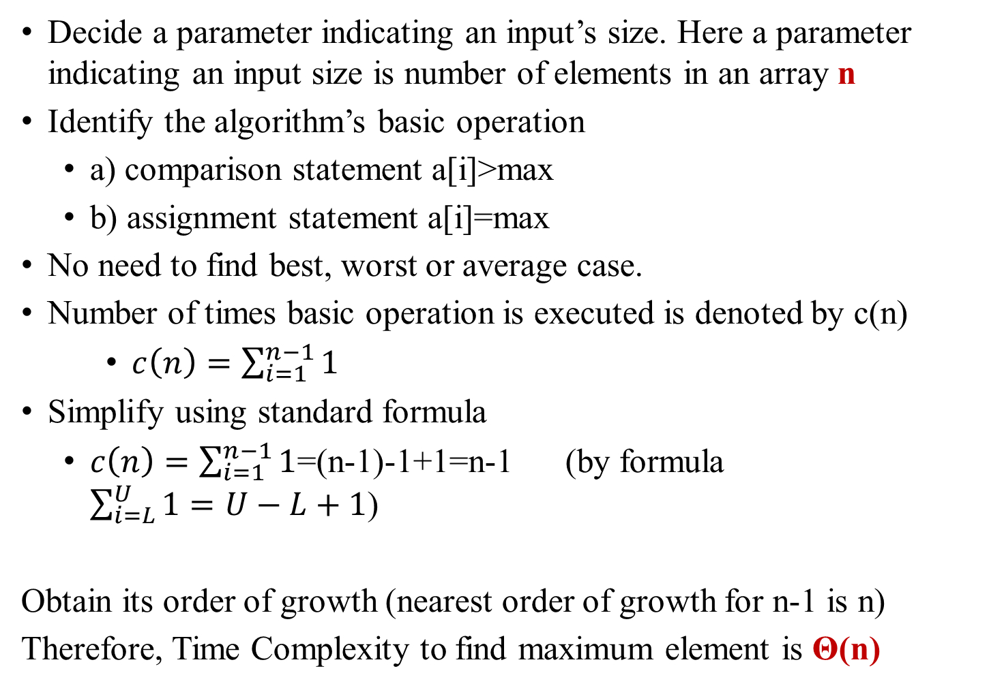
Analysis
Decide a parameter indicating an input’s size. Here a parameter indicating an input size is number of elements in an array n
Identify the algorithm’s basic operation
  a) comparison statement a[i]>max
  b) assignment statement a[i]=max
No need to find best, worst or average case.
Number of times basic operation is executed is denoted by c(n)
    $c\left(n\right)=\sum_{i=1}^{n−1}{1}$
Simplify using standard formula
  $c\left(n\right)=\sum_{i=1}^{n−1}{1}$=(n-1)-1+1=n-1 (by formula $\sum_{i=L}^{U}{1=U−L+1}$)
Obtain its order of growth (nearest order of growth for n-1 is n)
Therefore, Time Complexity to find maximum element is Θ(n)

Slide 70
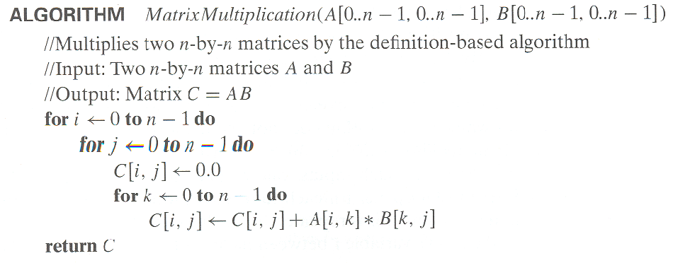
Example 2: Matrix multiplication

Slide 71
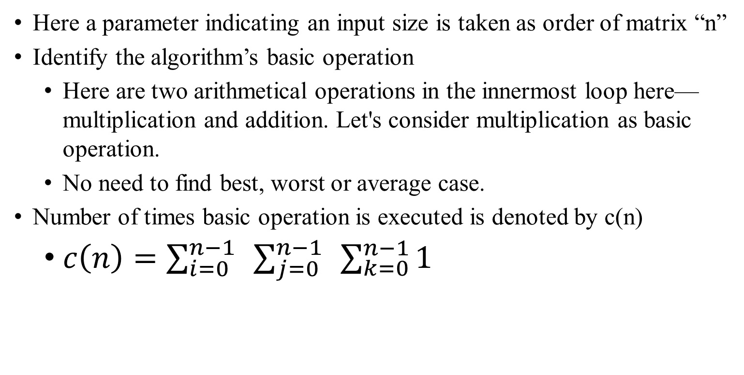
Analysis
Here a parameter indicating an input size is taken as order of matrix “n”
Identify the algorithm’s basic operation
  Here are two arithmetical operations in the innermost loop here—multiplication and addition. Let's consider multiplication as basic operation.
  No need to find best, worst or average case.
Number of times basic operation is executed is denoted by c(n)
  $c\left(n\right)=\sum_{i=0}^{n−1}{ }\sum_{j=0}^{n−1}{ }\sum_{k=0}^{n−1}{1}$

Slide 72
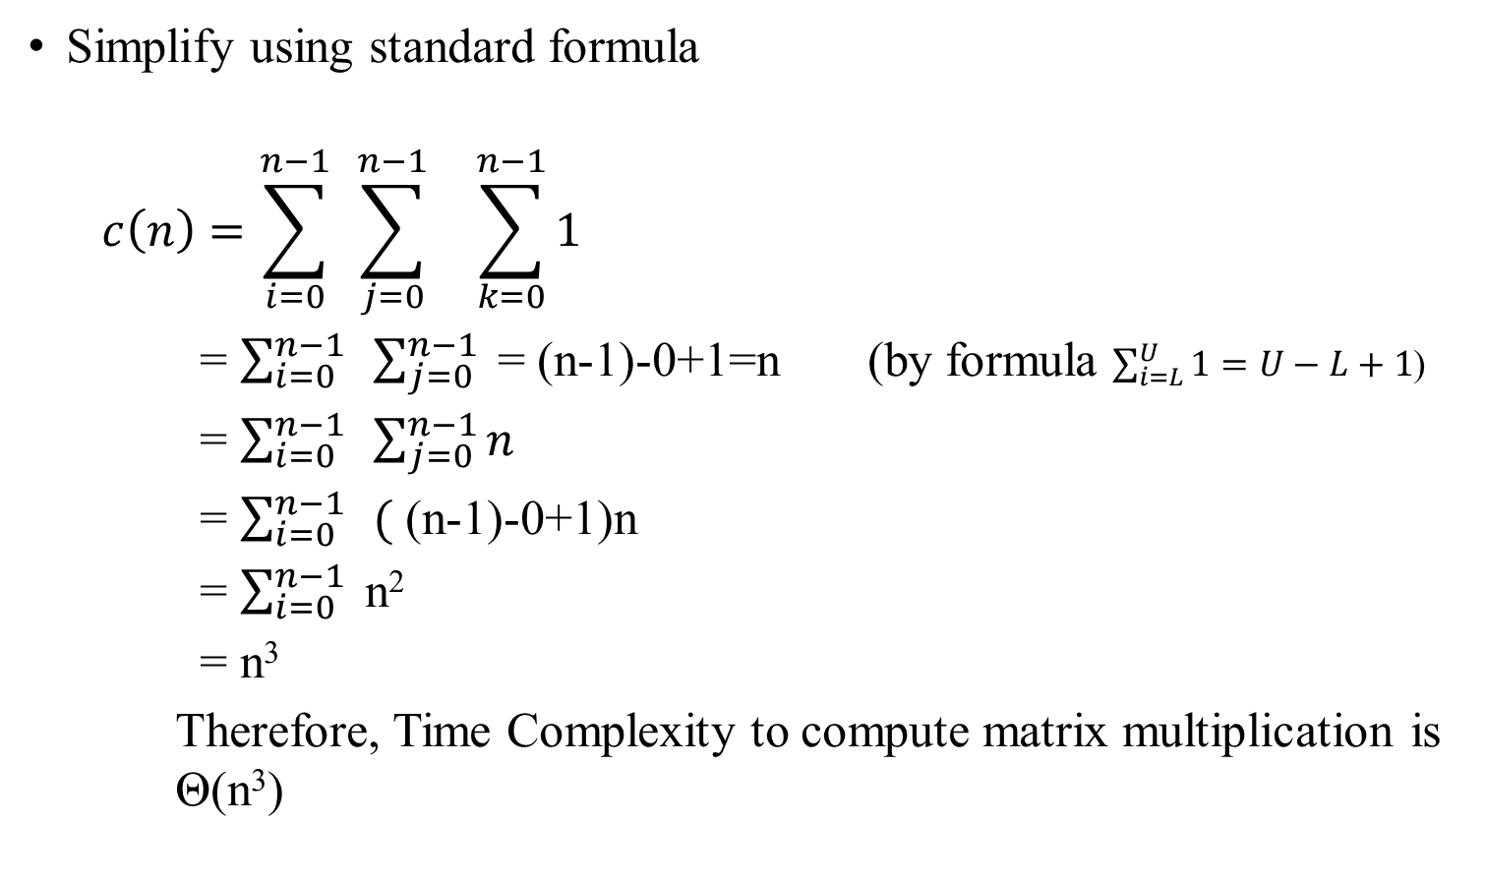
Simplify using standard formula
  $$c\left(n\right)=\sum_{i=0}^{n−1}{ }\sum_{j=0}^{n−1}{ } \sum_{k=0}^{n−1}{1}$$
    = $\sum_{i=0}^{n−1}{ }\sum_{j=0}^{n−1}{ }$= (n-1)-0+1=n (by formula $\sum_{i=L}^{U}{1=U−L+1}$)
    = $\sum_{i=0}^{n−1}{ }\sum_{j=0}^{n−1}{n}$
    = $\sum_{i=0}^{n−1}{ }($ (n-1)-0+1)n
    = $\sum_{i=0}^{n−1}{ }$n²
    = n³
    Therefore, Time Complexity to compute matrix multiplication is Θ(n³)

Slide 73
Algorithm : Linear Search
Algorithm: Linear Search(K, a[],n)
// Purpose : Searches for a given value in a given array by sequential search
// Inputs:
// n – The number of items present in the table
// a – the elements of an array
// K – the items to be searched in array
// Output
// The index of the first element of a[] that matches K
or -1 if there are no matching elements
for(i=0; i<n-1; i++)
if(a[i]==k)
return i;
end if
end for
return -1;

Slide 74
Analysis : Linear Search
Decide a parameter indicating an input’s size. Here a parameter indicating an input size is number of elements in an array
Identify the algorithm’s basic operation, i.e if (a[i]==key).
Here, number of times the basic operation execution depends on position of key value, hence best case, worst case and average case need to be calculated separately.
  Best case: O(1)
  Worst case: O(n)
  Average Case: O(n)

Slide 75
Average case Analysis of Linear Search
Let:
n be the number of elements in the array.
The search key is equally likely to be at any position in the array.
Each comparison takes constant time O(1).
Number of Comparisons
If the element is at the first position, we make 1 comparison.
If the element is at the second position, we make 2 comparisons.
If the element is at the third position, we make 3 comparisons.
…
If the element is at the last position (nth position), we make n comparisons.
Since we assume the search key is equally likely to be at any position, the average number of comparisons is the expected value (E) of the number of comparisons required.

Slide 76

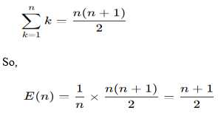

Average case Analysis of Linear Search (Contd.)
Expected Number of Comparisons
The expected number of comparisons for a successful search is:
Using the formula for the sum of the first n natural numbers:
Asymptotic Complexity
Since Big-O notation ignores constants and lower-order terms:
In Big-O notation, we drop constants: O(n)

Slide 77
Mathematical Analysis of Recursive Algorithms
Decide on a parameter indicating an input’s size.
Identify the algorithm’s basic operation.
Check whether the number of times the basic op. is executed may vary on different inputs of the same size. (If it may, the worst, average, and best cases must be investigated separately.)
Set up a recurrence relation with an appropriate initial condition expressing the number of times the basic op. is executed.
Solve the recurrence (or, at the very least, establish its solution’s order of growth) by backward substitutions or another method.

Slide 78
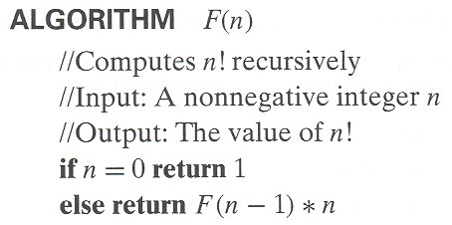
Example 1: Recursive evaluation of n!
Definition: n ! = 1 ∗ 2 ∗ … ∗(n-1) ∗ n for n ≥ 1 and 0! = 1
Recursive definition of n!: F(n) = F(n-1) ∗ n for n ≥ 1 and F(0) = 1

Slide 79
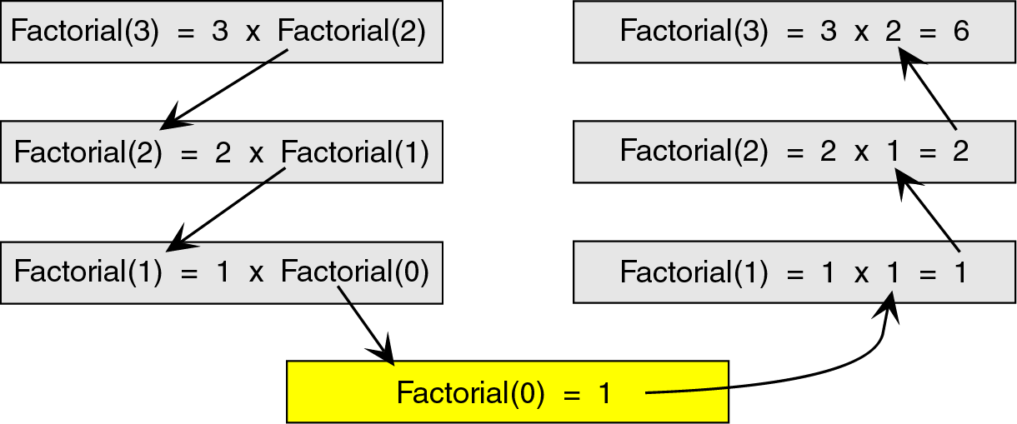
Recursion
To see how the recursion works, let’s break down the factorial function to solve factorial(3)

Slide 80
Breakdown
Here, we see that we start at the top level, factorial(3), and simplify the problem into 3 x factorial(2).
Now, we have a slightly less complicated problem in factorial(2), and we simplify this problem into 2 x factorial(1).

Slide 81
Breakdown
We continue this process until we are able to reach a problem that has a known solution.
In this case, that known solution is factorial(0) = 1.
The functions then return in reverse order to complete the solution.

Slide 82
Analysis of Factorial
Recurrence Relation
  M(n) = M(n-1) + 1 for n>0
  M(0) = 0 (Initial Condition)
Solve by the method of backward substitutions
    M(n) = M(n-1) + 1
    = [M(n-2) + 1] + 1 = M(n-2) + 2 substituted M(n-2) for M(n-1)
    = [M(n-3) + 1] + 2 = M(n-3) + 3 substituted M(n-3) for M(n-2)
    .. a pattern evolves
    = M(n-n)+n
    =M(0) + n
    = 0+n
    M(n) = n
    Therefore, M(n) ε Θ(n)
To compute
F(n-1)
To multiple
F(n-1) by n

Slide 83
Example 2: Tower of Hanoi
A
B
C
A
B
C
Given: Three Pegs A, B and C
  Peg A initially has n disks, different size, stacked up,
  larger disks are below smaller disks
Problem: to move the n disks to Peg C, subject to
  Can move only one disk at a time
  Smaller disk should be above the larger disk
  Can use another peg as intermediate

Slide 84
Example 2:Tower of Hanoi
How to Solve: Strategy…
  Generalize first: Consider n disks for all n ≥ 1
  Our example is only the case when n=4
Look at small instances…
  How about n=1
    Of course, just “Move disk 1 from A to C”
  How about n=2?
    “Move disk 1 from A to B”
    “Move disk 2 from A to C”
    “Move disk 1 from B to C”

Slide 85
Tower of Hanoi (Solution!)
General Method:
  First, move first (n-1) disks from A to B (with peg C as intermediate)
  Now, can move the largest disk from A to C (directly)
  Then, move first (n-1) disks from B to C (with peg A as intermediate)
Try this method for n=3
    “Move disk 1 from A to C”
    “Move disk 2 from A to B”
    “Move disk 1 from C to B”
    “Move disk 3 from A to C”
    “Move disk 1 from B to A”
    “Move disk 2 from B to C”
    “Move disk 1 from A to C”

Slide 86
Algorithm for Towel of Hanoi (recursive)
Recursive Algorithm
  when (n=1), we have simple case
  Else (decompose problem and make recursive-calls)
Hanoi(n, A, B, C);
(* Move n disks from A to C via B *)
begin
if (n=1) then “Move top disk from A to C”
else (* when n>1 *)
Hanoi (n-1, A, C, B); //Hanoi(n-1, src, aux, dest)
“Move top disk from A to C”
Hanoi (n-1, B, C, A); //Hanoi(n-1, aux, dest, src)
endif
end;

Slide 87
Analysis of TOH
Recursive relation for moving n discs
  M(n) = M(n-1) + 1 + M(n-1) = 2M(n-1) + 1 for n>1
  IC: M(1) = 1
Solve using backward substitution
  M(n) = 2M(n-1) + 1
  = 2[2M(n-2) + 1] +1 = 2²M(n-2) + 2+1
  =2²[2M(n-3) +1] + 2+1 = 2³M(n-3) + 2² + 2 + 1
  ..
  M(n) = 2^{i}M(n-i) + 2^{i}-1
  ...
  M(n) = 2^{n-1}M(n-(n-1)) + 2^{n-1}-1 = 2^{n-1}M(1) + 2^{n-1}-1 = 2^{n-1} + 2^{n-1}-1 = 2.2^{n-1}-1
  = 2^{n}-1
  M(n) ε Θ(2^{n})

Slide 88
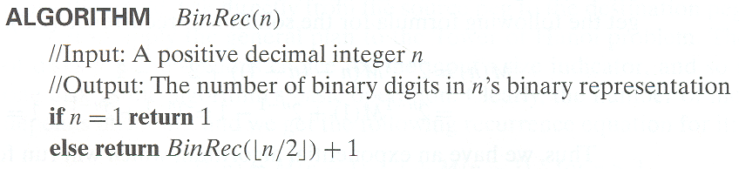
Example 3: Counting #bits

Slide 89
Analysis of Counting # of bits
Recursive relation including initial conditions
  A(n) = A(floor(n/2)) + 1 for n>1
  IC A(1) = 0
substitute n = 2^{k} (also k = lg(n))
  A(2^{k}) = A(2^{k-1}) + 1 and IC A(2⁰) = 0
  A(2^{k}) = [A(2^{k-2}) + 1] + 1 = A(2^{k-2}) + 2
  = [A(2^{k-3}) + 1] + 2 = A(2^{k-3}) + 3
  ...
  = A(2^{k-i}) + i (i^{th} term)
  ...
  = A(2^{k-k}) + k = A(1)+k
  A(2^{k}) = k
Substitute back k = lg(n)
A(n) = lg(n) ε Θ(lg n)

Slide 90
Iteration vs. Recursion
After looking at both iterative and recursive methods, it appears that the recursive method is much longer and more difficult.
If that’s the case, then why would we ever use recursion?
It turns out that recursive techniques, although more complicated to solve by hand, are very simple and elegant to implement in a computer.

Slide 91
BRUTE FORCE
A simple and straightforward approach to solve a problem by trying every possible solution until finding the best one.
It does not use any clever tricks or shortcuts to reduce the search space or improve the efficiency.
Usually, can solve small sized instances of a problem
Examples:
Computing a^{n} (a > 0, n a nonnegative integer)
Selection Sort, Bubble Sort
String Matching
Multiplying two matrices
Searching for a key of a given value in a list

Slide 92
Selection Sort
Logic:
Scan the array to find its smallest element and swap it with the first element. Then, starting with the second element, scan the elements to the right of it to find the smallest among them and swap it with the second elements. Generally, on pass i (0 ≤ i ≤ n-2), find the smallest element in A[i..n-1] and swap it with A[i]:
A[0] ≤ . . . ≤ A[i-1] | A[i], . . . , A[min], . . ., A[n-1]
in their final positions

Slide 93
Algorithm : Selection Sort
Algorithm: SelectionSort(a[],n)
// Purpose : sorts a given array using selection sort
// Inputs:
// n – The number of items present in the table
// a – the items to be sorted in array
// Output
// a – contains a sorted list
  for i<-0 to n-2 do
  min<-i
  for j<-i+1 to n-1 do
  if a[j]<a[min]
  min<-j
  end if
  end for
  swap a[i] and a[min]
  end for

Slide 94


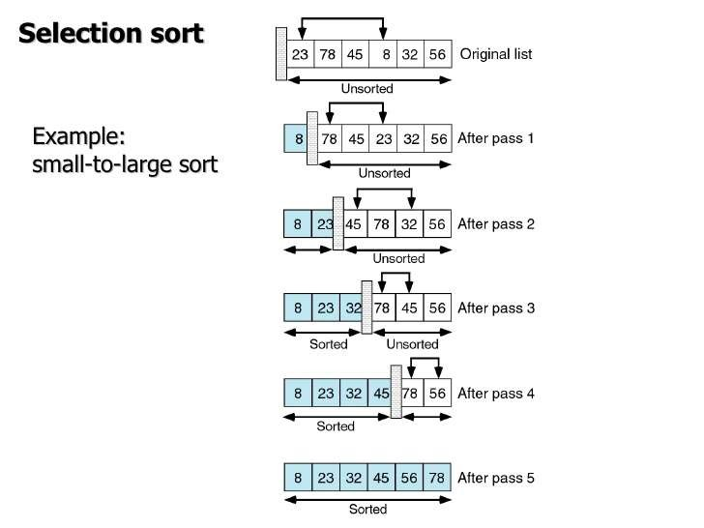

Slide 95
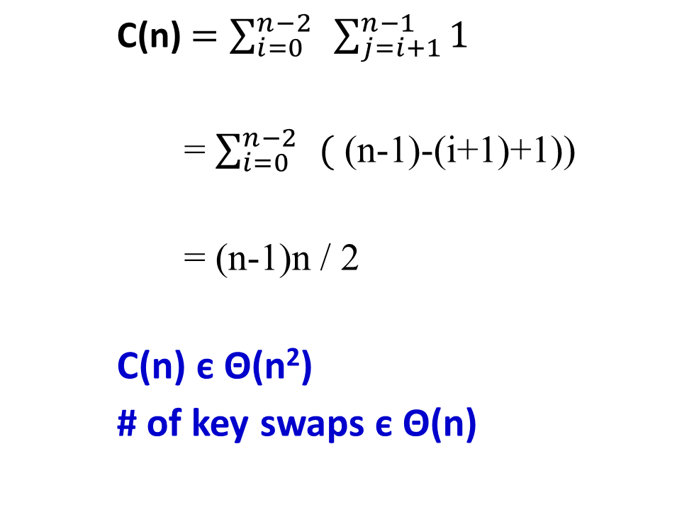
Analysis of Selection Sort
    C(n) $=\sum_{i=0}^{n−2}{ }\sum_{j=i+1}^{n−1}{1}$
    = $\sum_{i=0}^{n−2}{ }($ (n-1)-(i+1)+1))
    = (n-1)n / 2
    C(n) є Θ(n²)
    # of key swaps є Θ(n)

Slide 96
Bubble Sort
Compare adjacent elements and exchange them if out of order
Essentially, it bubbles up the largest element to the last position
?
A₀, … …, A_{j} <-> A_{j+1}, … …, A_{n-i-1} | A_{n-i} ≤ … ≤ A_{n-1}

Slide 97
Algorithm for Bubble Sort
Algorithm: BubbleSort(a[],n)
// Purpose : sorts a given array by bubble sort
// Inputs:
// n – The number of items present in the table
// a – the items to be sorted in array
// Output
// a – contains a sorted list
for j<-1 to n-1 do
for i<-0 to n-j-1 do
if(a[i]>a[i+1])
temp<-a[i]
a[i]<-a[i+1]
a[i+1]=temp
end if
end for
end for

Slide 98
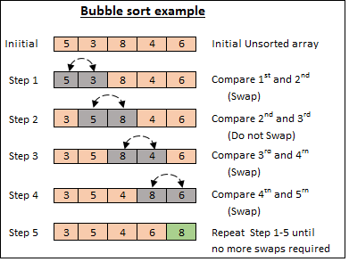
Analysis:
C(n) є Θ(n²)
S_{worst}(n) = C(n)

Slide 99
Brute-force String Matching
pattern: a string of m characters to search for
text: a (longer) string of n characters to search in
problem: find a substring in the text that matches the pattern
Brute-force algorithm
Step 1: Align pattern at beginning of text
Step 2: Moving from left to right, compare each character of
pattern to the corresponding character in text until
    all characters are found to match (successful search); or
    a mismatch is detected
Step 3: While pattern is not found and the text is not yet
exhausted, realign pattern one position to the right and
repeat Step 2

Slide 100
Algorithm: Brute Force String Matching
Algorithm BruteForceMatch(T,P):
Input: Strings T with n characters and P with m characters
Output: String index of the first substring of T matching P, or an
indication that P is not a substring of T
for i=0 to n-m do
{
for (j=0;j<m-1; j++)
{
if(T[i+j]!=P[j])
} break;
if j=m then return i
}
return “ there is no substring of T matching P.”

Slide 101
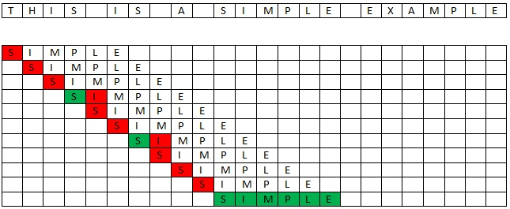
Algorithm: Brute Force String Matching
Let us consider a Main string of length n
Let us consider a Pattern string of length m
We have to search for the Pattern String in the Main String
The characters are matched from the first character till the last character
If the Pattern String is not found, then the Pattern String is shifted to the right by only 1 position.
This makes the Brute Force Pattern Matching Algorithm take more time and effort.
Consider the following Main String with length 24 (n=24)
Consider the Pattern String “SIMPLE” of length 6 (m=6)

Slide 102
Let us see how the Pattern String is searched in the Main String
Analysis: Θ(mn) comparisons (in the worst case)

Slide 103
End of Unit-1

