Slide 1
Unit 2: Decrease and Conquer

Slide 2
Module 2 – Outline Decrease and Conquer
Advantages and Disadvantages of Divide & Conquer
Decrease and Conquer Approach
Depth First Search (DFS)
Breadth First Search (BFS)
Applications of DFS and BFS
Algorithm: Topological Sort

Slide 3
Advantages and Disadvantages of Divide & Conquer
Parallelism: Divide and conquer algorithms tend to have a lot of inherent parallelism.
Cache Performance: Once a sub-problem fits in the cache, the standard recursive solution reuses the cached data until the sub-problem has been completely solved.
It allows solving difficult and often impossible looking problems like the Tower of Hanoi
X Recursion is slow
– sometimes it can become more complicated than a basic iterative approach, the same sub problem can occur many times. It is solved again.

Slide 4
Module 2 – Outline Decrease and Conquer
Advantages and Disadvantages of Divide & Conquer
Decrease and Conquer Approach
Depth First Search (DFS)
Breadth First Search (BFS)
Applications of DFS and BFS
Algorithm: Topological Sort

Slide 5
Decrease and Conquer Approach
The decrease-and-conquer technique is based on exploiting the relationship between a solution to a given instance of a problem and a solution to a smaller instance of the same problem.
Once such a relationship is established, it can be exploited either top down (recursively) or bottom up (without a recursion).
There are three major variations of decrease-and- conquer:
  decrease-by-a-constant variation: e.g., insertion sort
  decrease-by-a-constant-factor: e.g., binary search
  variable-size-decrease: e.g., Euclid’s algorithm

Slide 6
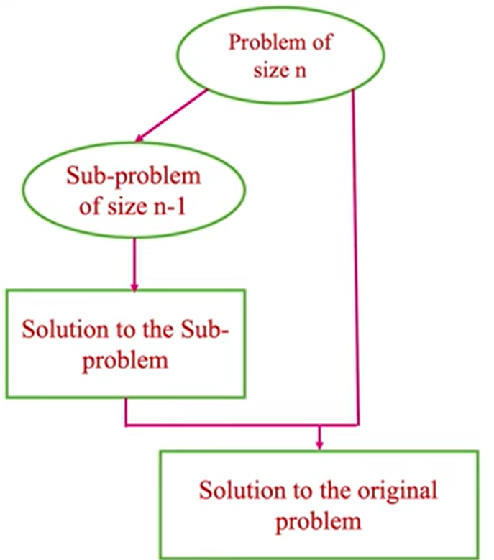
Decrease by a constant variation
In the decrease-by-a-constant variation, the size of an instance is reduced by the same constant on each iteration of the algorithm-most often by one.
Figure: Decrease(by one) – and – conquer technique

Slide 7
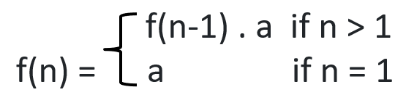
Decrease by a constant variation (contd..)
For example, consider the exponentiation problem of computing a^{n} for positive integer exponents:
The relationship between a solution to an instance of size n and an instance of size n-1 is obtained by the formula:
a^{n} = a^{n-1} . a
So, the function f(n) = a^{n} can be computed “top down” by using its recursive definition:
Function f(n) = a^{n} can be computed “bottom up” by multiplying a by itself n-1 times.

Slide 8
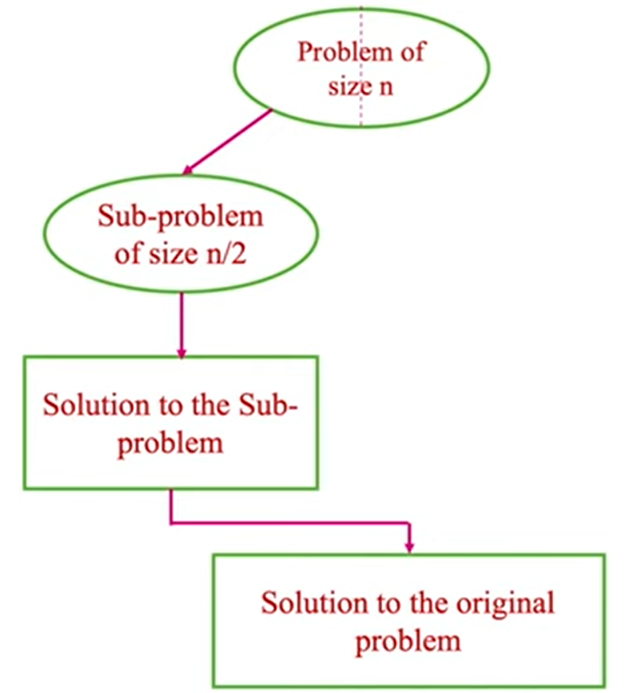
Decrease-by-a-constant factor variation
In the decrease-by-a-constant factor variation, the size of a problem instance is reduced by the same constant factor on each iteration of the algorithm. In most applications, this constant factor is equal to two.
Figure: Decrease (by half) – and – conquer technique.

Slide 9
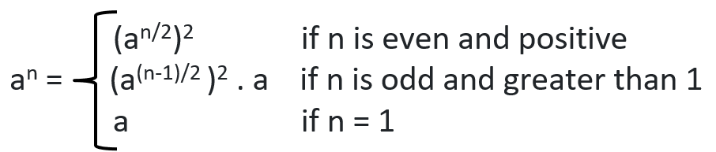
Decrease-by-a-constant factor variation (contd..)
For example,
Consider the exponentiation problem of computing a^{n} for positive integer exponents:
If the instance of size n is to compute a^{n}, the instance of half its size will be to compute a^{n/2}, with an obvious relationship between the two:
a^{n}= (a^{n/2})²
If n is odd, we have to compute a^{n-1} by using the rule for even-valued exponents and then multiplying the result by a.
To summarize, we have the following formula:
If we compute a^{n} recursively according to the above formula and measure the algorithm’s efficiency by a number of multiplications, then algorithm is expected to be in O(log n) because, on each iteration, the size is reduced by at least one half at the expense of no more than two multiplications.

Slide 10
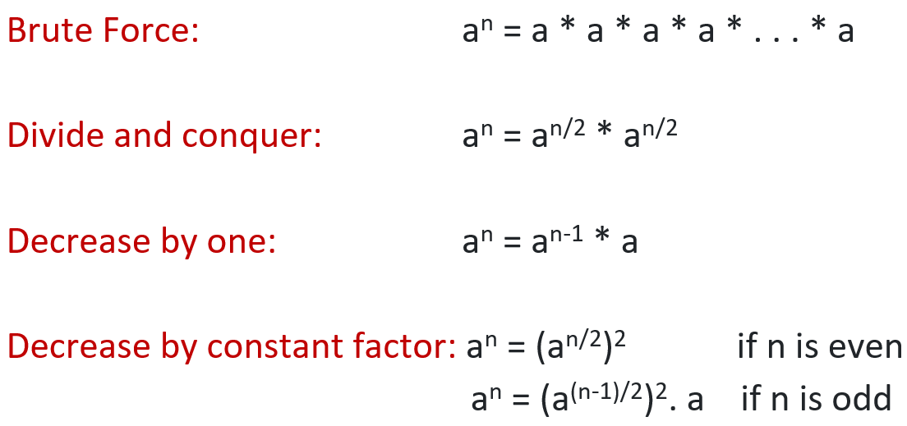
Example:
Consider the problem of exponentiation: Compute a^{n}

Slide 11
Variable-size-Decrease
In this variation, the size reduction pattern varies from one iteration of an algorithm to another.
Euclid’s algorithm for computing the GCD provides a good example of such a situation:
gcd(m, n) = gcd(n, m mod n)
Though the arguments on the right-hand side are always smaller than those on the left-hand side, they are smaller neither by a constant nor by a constant factor.

Slide 12
Graph Traversal
Many problems require processing all graph vertices ( and edges) systematically.
For traversing a binary tree, we have 3 tree traversal methods:
Preorder Traversal
Inorder Traversal
Postorder Traversal
For traversing a Graph, we have 2 graph traversal methods:
Breadth First Search (BFS)
Depth First Search (DFS)

Slide 13
Graph Traversal (Contd..)
Depth-First Search (DFS) and Breadth-First Search (BFS):
Two elementary traversal algorithms that provide an efficient way to “visit” each vertex and edge exactly once.
Both work on directed or undirected graphs.
Many advanced graph algorithms are based on the concepts of DFS or BFS.
The difference between the two algorithms is in the order in which each “visit” vertices.

Slide 14
Module 2 – Outline Decrease and Conquer
Advantages and Disadvantages of Divide & Conquer
Decrease and Conquer Approach
Depth First Search (DFS)
Breadth First Search (BFS)
Applications of DFS and BFS
Algorithm: Topological Sort

Slide 15
Depth-First-Search (DFS)
Visits graph’s vertices by always moving away from last visited vertex to an unvisited one, backtracks if no adjacent unvisited vertex is available.
Recursive or it uses a stack
  a vertex is pushed onto the stack when it’s reached for the first time
  a vertex is popped off the stack when it becomes a dead end, i.e., when there is no adjacent unvisited vertex
“Redraws” graph in tree-like fashion (with tree edges and back edges for undirected graph)

Slide 16
Types of Graphs Edges
While exploring a graph from a source node, edges can be of 4 types.
Tree Edges: Tree edges connect a parent to its child node. The terms parent and child come up in reference to the graph exploration algorithm being used, i.e., when you use BFS or DFS to traverse a graph, a new child node you discover by examining the neighbors of the parent node is connected via a tree edge. Only tree edges make up the BFS/DFS traversal. All other edges fall in the other three categories.
Forward Edges: Forward edges link a node to its descendent that has already been traversed.
Back Edges: Back edges link a node to its ancestor that has already been traversed.
Cross Edges: Cross edges connect two nodes that don't share any ancestor-descendent relation.

Slide 17
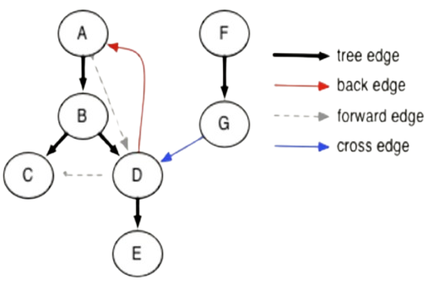
Example

Slide 18
Depth-first search
Depth-first search starts visiting vertices of a graph at an arbitrary vertex by marking it as having been visited.
On each iteration, the algorithm proceeds to an unvisited vertex that is adjacent to the one it is currently in. (If there are several such vertices. a tie can be resolved arbitrarily. This process continues until a dead end-a vertex with no adjacent unvisited vertices-is encountered.
At a dead end, the algorithm backs up one edge to the vertex it came from and tries to continue visiting unvisited vertices from there.
The algorithm eventually halts after backing up to the starting vertex, with the latter being a dead end.

Slide 19
Depth-first search
By then, all the vertices in the same connected component as the starting vertex have been visited.
If unvisited vertices still remain, the depth-first search must be restarted at any one of them.
It is convenient to use a stack to trace the operation of depth-first search.
We push a vertex onto the stack when the vertex is reached for the first time (i.e., the visit of the vertex starts), and we pop a vertex off the stack when it becomes a dead end (i.e., the visit of the vertex ends).

Slide 20
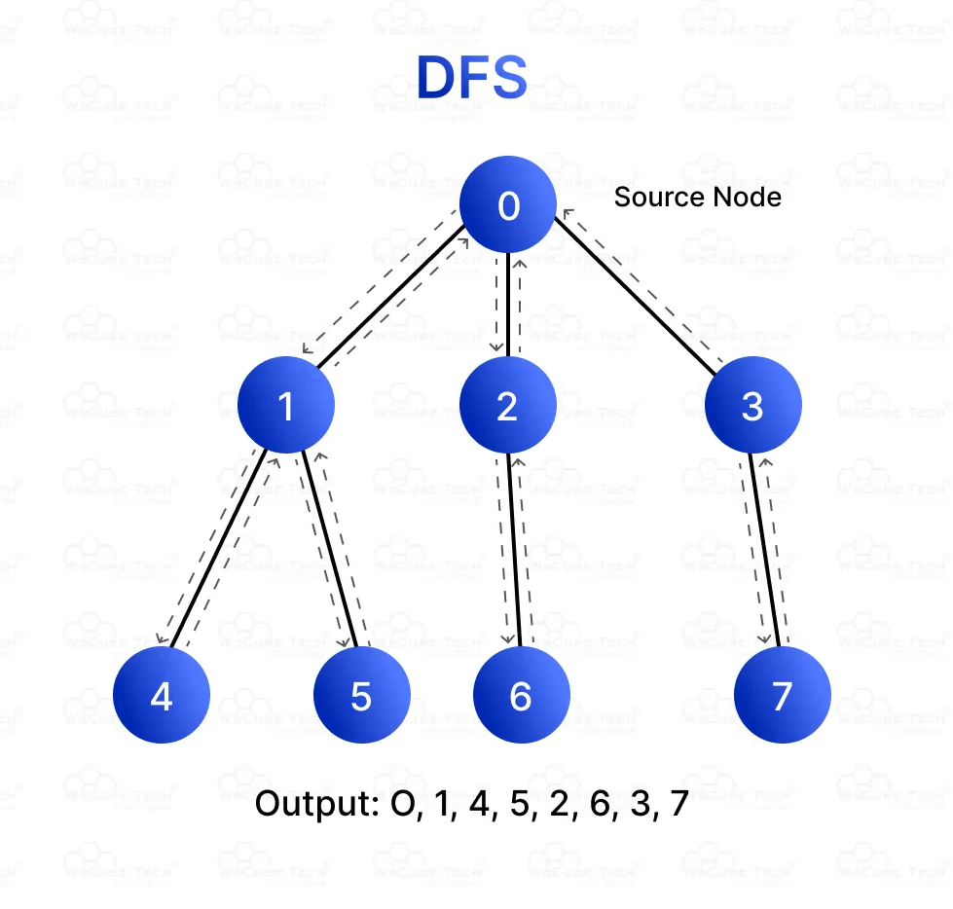
Example
Traversal Order:
Starting from node 0:
Visit node 0 → Visit node 1 → Visit node 4 (deepest) → Backtrack to node 1 → Visit node 5 → Backtrack to node 0 → Visit node 2 → Visit node 6 → Backtrack to node 2 → Visit node 3 → Visit node 7.
Output: 0, 1, 4, 5, 2, 6, 3, 7

Slide 21
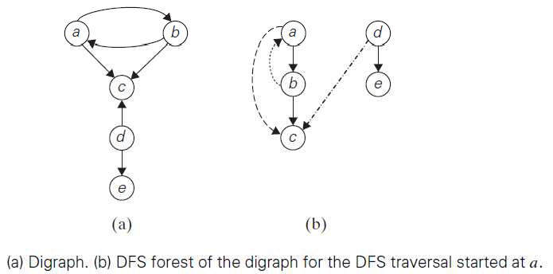
Example

Slide 22
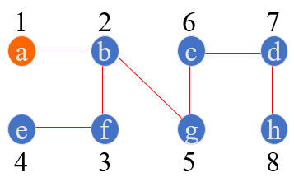
Example: DFS traversal of undirected graph
a
b
c
d
DFS Traversal Stack
e
f
g
h
DFS Tree
a
ab
abf
abfe
abf
ab
abg
abgc
abgcd
abgcdh
abgcd
…
DFS Traversal: a b f e g c d h

Slide 23
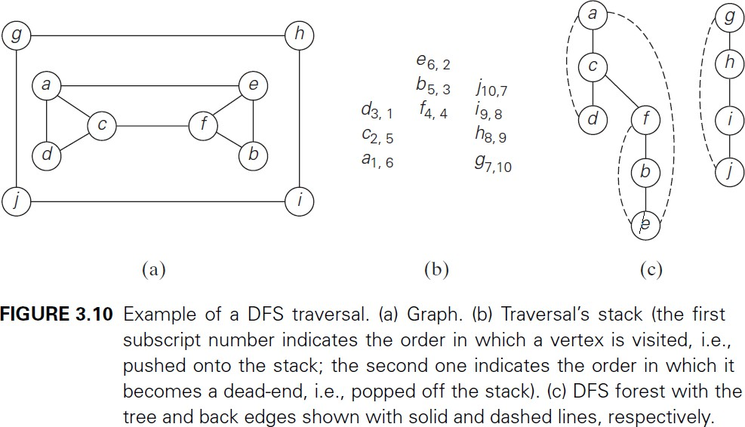

Slide 24
DFS Algorithm using Stack
void DFS(int start){
push start; // Push the source node
while (stack not empty) { // While stack is not empty
node = pop() // Pop a node
if (!visited[node]) { // If not visited
printf("%d ", node);
visited[node] = 1;
// Push all unvisited adjacent nodes onto the stack (reverse order for correct sequence)
for (int j = n; j >= 1; j--) {
if (a[node][j] == 1 && !visited[j]) {
stack[++top] = j;
}
}
}
}
}
// Function to handle disconnected graphs
void DFS_Disconnected()
{
for (int i = 1; i <= n; i++)
{
if (!visited[i])
{
// If a node is unvisited, start DFS from there
DFS(i);
}
}
}

Slide 25
DFS Algorithm using recursion
void DFS(int node)
{
printf("%d ", node); // Process the node
visited[node] = 1; // Mark as visited
// Recursively visit all unvisited adjacent vertices
for (int j = 1; j <= n; j++)
{
if (a[node][j] == 1 && !visited[j])
{
DFS(j);
}
}
}
// Function to handle disconnected graphs
void DFS_Disconnected()
{
for (int i = 1; i <= n; i++)
{
if (!visited[i])
{
// If a node is unvisited, start DFS from there
DFS(i);
}
}
}

Slide 26
Summary of DFS
DFS can be implemented with graphs represented as:
  adjacency matrices: Θ(|V|²).
  adjacency lists: Θ(|V|+|E|).
Yields two distinct ordering of vertices:
  order in which vertices are first encountered (pushed onto stack)
  order in which vertices become dead-ends (popped off stack)
Applications:
  Checking connectivity, finding connected components
  Checking acyclicity (if no back edges)
  Finding articulation points and biconnected components
  Searching the state-space of problems for solutions (in AI)

Slide 27
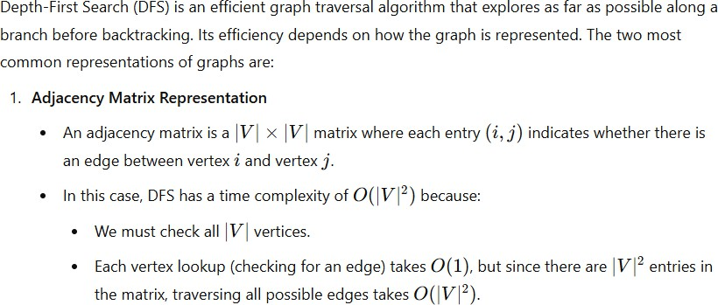

Slide 28
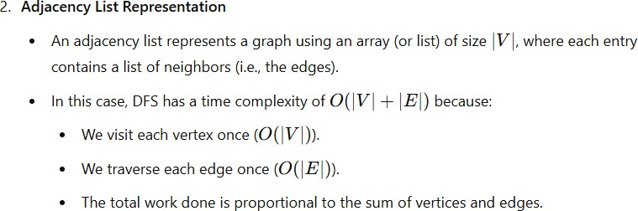

Slide 29
Module 2 – Outline Decrease and Conquer
Advantages and Disadvantages of Divide & Conquer
Decrease and Conquer Approach
Depth First Search (DFS)
Breadth First Search (BFS)
Applications of DFS and BFS
Algorithm: Topological Sort

Slide 30
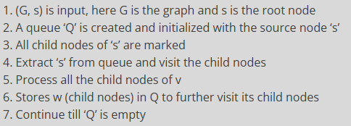
BFS Procedure

Slide 31
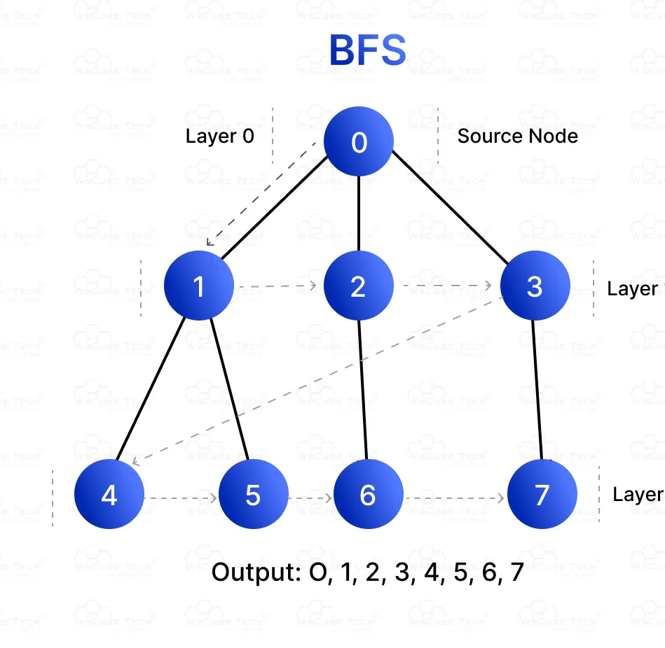
Example
Traversal Order:
Starting from node 0:
Layer 0: Visit node 0 (source node).
Layer 1: Visit nodes 1, 2, 3 (neighbors of node 0).
Layer 2: Visit nodes 4, 5, 6, 7 (neighbors of nodes 1, 2, 3).
Output: 0, 1, 2, 3, 4, 5, 6, 7.

Slide 32
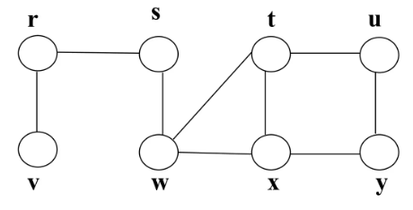
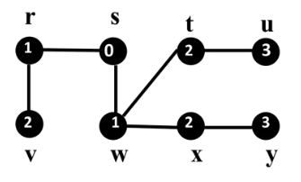
Example
BFS Tree

Slide 33
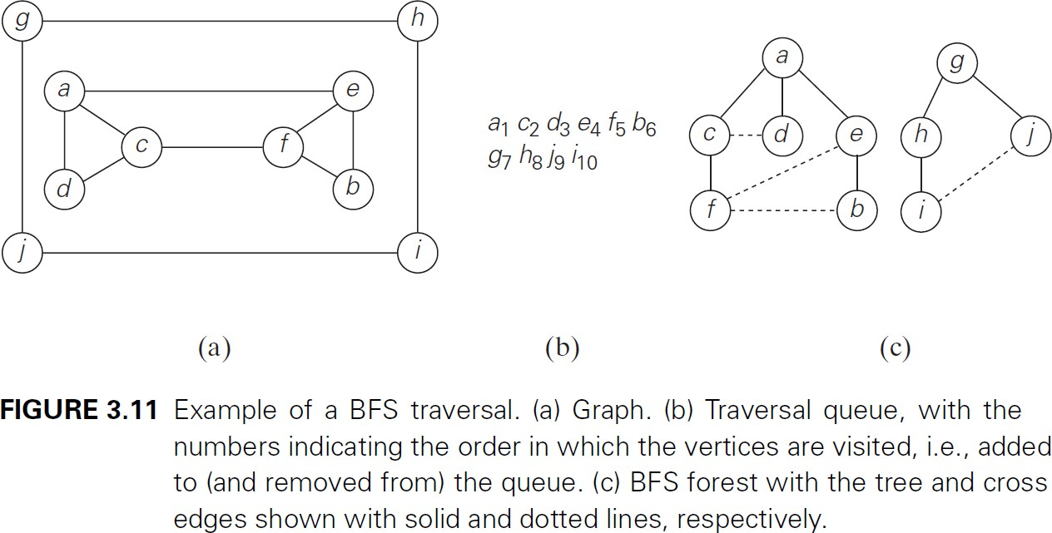

Slide 34
BFS Algorithm
BFS (G, s) //Where G is the graph and s is the source node
let Q be queue.
Insert(s) //Insert s into the queue
for each vertex v ∈ V[G] do
visited[v]<-0
end for
mark s as visited.
while (Q is not empty)
//Removing that vertex from queue,whose neighbour will be visited now
v = delete()
//processing all the neighbours of v
for all neighbours w of v in Graph G
if w is not visited
insert(w) //Stores w into Q
mark w as visited.

Slide 35
BFS
BFS has same efficiency as DFS and can be implemented with graphs represented as:
  adjacency matrices: Θ(V²)
  adjacency lists: Θ(|V|+|E|)
Yields single ordering of vertices (order added/deleted from queue is the same)
Applications: same as DFS, but can also find paths from a vertex to all other vertices with the smallest number of edges

Slide 36

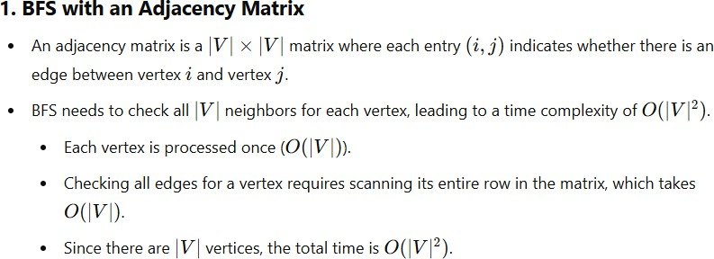

Slide 37
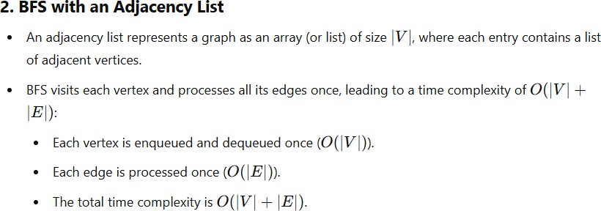

Slide 38
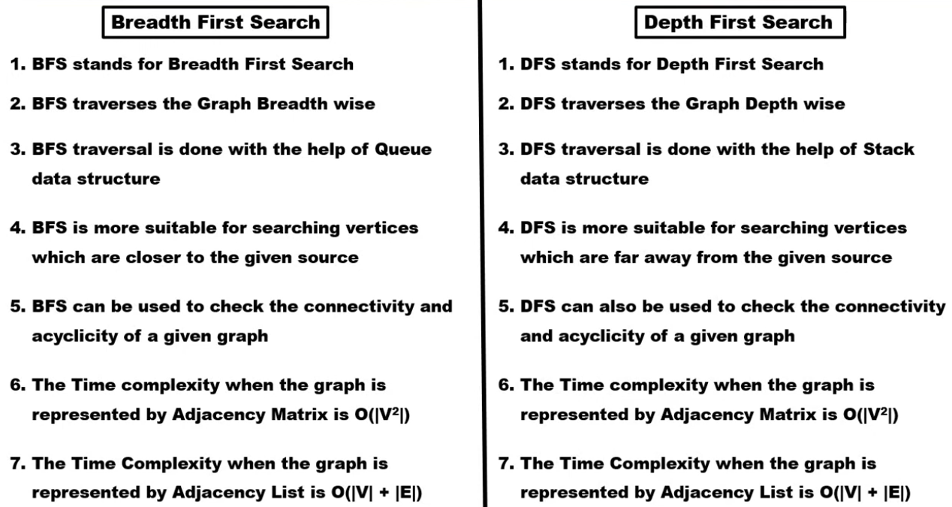
Difference between BFS and DFS

Slide 39
Module 2 – Outline Decrease and Conquer
Advantages and Disadvantages of Divide & Conquer
Decrease and Conquer Approach
Depth First Search (DFS)
Breadth First Search (BFS)
Applications of DFS and BFS
Algorithm: Topological Sort

Slide 40
Applications of DFS
Finding any path between two vertices u and v in the graph.
Finding the number of connected components present in a given undirected graph.
For doing topological sorting of a given directed graph.
Finding strongly connected components in the directed graph.
Finding cycles in the given graph.
To check if the given graph is bipartite.

Slide 41
Applications of BFS
To find minimum spanning tree for unweighted graphs
In peer-to-peer network like bit-torrent, BFS is used to find all neighbor nodes
Search engine crawlers use BFS to build index. Starting from source page, it finds all links in it to get new pages
Using GPS navigation system BFS is used to find neighboring places.
In networking, when we want to broadcast some packets, we use the BFS algorithm.
Finding all reachable Nodes from a given Vertex

Slide 42
Difference Between DFS and BFS with Example
We will take an example to understand the difference between DFS and BFS:
BFS
Approach: BFS explores the graph level by level, starting from the source node.
It visits all the nodes at one level before moving to the next.
BFS uses a queue to keep track of nodes that need to be explored.
How it works: From the source node, BFS moves to all its direct neighbors (Layer 1), then moves to the next layer (Layer 2), continuing until all nodes are visited.

Slide 43
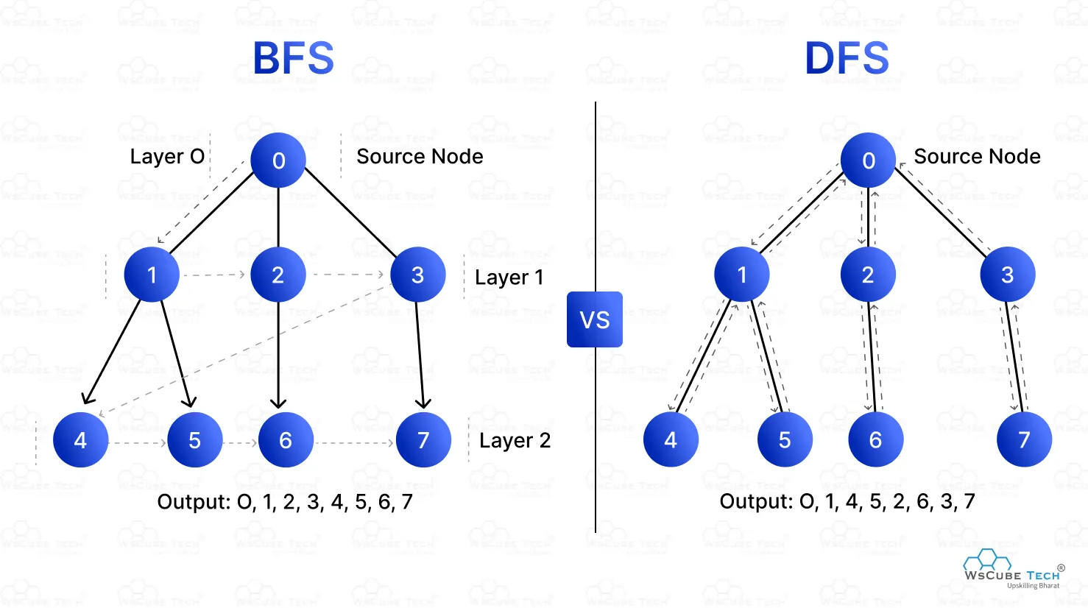
Example

Slide 44
When to Use DFS:
Exploring All Paths: DFS is useful when you need to explore all possible paths, such as in maze solving or finding connected components in a graph.
Backtracking Problems: DFS is great for problems that involve backtracking, like solving puzzles, detecting cycles, or performing topological sorting in a graph.
Memory Efficiency in Deep Graphs: DFS uses less memory on deep but narrow graphs, as it only needs to store a single branch at a time.
Tree Traversal: DFS is used for pre-order, in-order, and post-order traversal of trees.

Slide 45
When to Use BFS:
Shortest Path in Unweighted Graphs: BFS is ideal for finding the shortest path in unweighted graphs because it explores all nodes at the current level before moving deeper.
Level-Order Traversal: BFS is perfect for level-order traversal of trees or graphs, visiting all nodes at the same depth.
Shallow/Wide Graphs: BFS works well on shallow but wide graphs, as it explores level by level and efficiently handles many nodes at a given depth.
Minimum Moves or Steps: Problems like finding the minimum number of moves (e.g., puzzles like Word Ladder) are better solved with BFS.

Slide 46
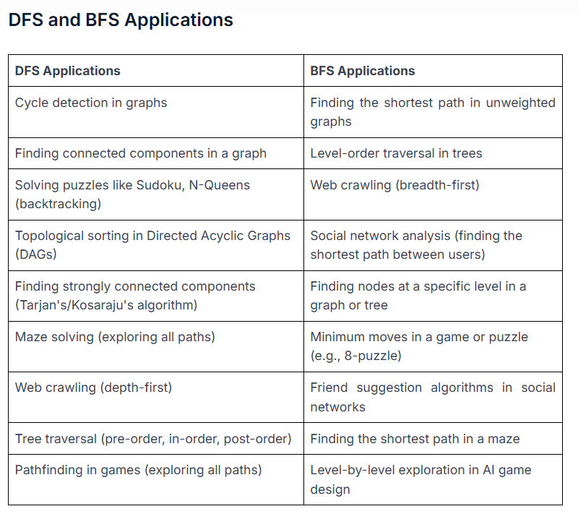
DFS and BFS Applications

Slide 47
Real-world applications of BFS and DFS
Finds shortest paths between users to identify connections (LinkedIn)
Identifies clusters or communities based on user interactions (Facebook groups)
Recommendations of friends or connections based on shared interests (Twitter suggestions)
Discovers and indexes web pages for search engines (Google)
Finds shortest routes between locations for GPS navigation (Google Maps)
Suggests friends, products, or content based on graph proximity (Amazon)
Performs collaborative filtering and personalized recommendations (Netflix)

Slide 48
Module 2 – Outline Decrease and Conquer
Advantages and Disadvantages of Divide & Conquer
Decrease and Conquer Approach
Depth First Search (DFS)
Breadth First Search (BFS)
Applications of DFS and BFS
Algorithm: Topological Sort

Slide 49
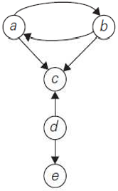
Digraph
A directed cycle in a digraph is a sequence of three or more of its vertices that starts and ends with the same vertex
For example, a, b, a is a directed cycle in the digraph in Figure given below.
Conversely, if a DFS forest of a digraph has no back edges, the digraph is a dag - directed acyclic graph.

Slide 50
Topological Sorting
In directed graphs, there are various applications involving prerequisite-restricted tasks.
The question is whether we can list the vertices of the directed graph in such an order that for every edge in the graph, the vertex where the edge starts is listed before the vertex where the edge ends. This problem is called topological sorting.
Topological Sorting of DAG is a linear ordering of vertices such that for every directed edge from vertex ‘u’ to vertex ‘v’, vertex ‘u’ comes before ‘v’ in the ordering.
Topological Sorting for a graph is not possible if the graph is not a DAG.
It is useful in scheduling problems where tasks depend on the completion of other tasks.
Applications: Project scheduling, dependency resolution, task scheduling, deadlock detection, course scheduling, event management etc.,

Slide 51
Topological Sort
For topological sorting to be possible, a digraph in question must be a DAG.
There are two efficient algorithms that both verify whether a digraph is a dag and, if it is, produce an ordering of vertices that solves the topological sorting problem.
  The first one is based on depth-first search
  the second is based on a direct application of the decrease-by-one technique.

Slide 52
Topological Sorting based on DFS
Method
Perform a DFS traversal and note the order in which vertices become dead-ends
Reversing this order yields a solution to the topological sorting problem,
provided, no back edge has been encountered during the traversal.
If a back edge has been encountered, the digraph is not a dag, and topological sorting of its vertices is impossible.

Slide 53
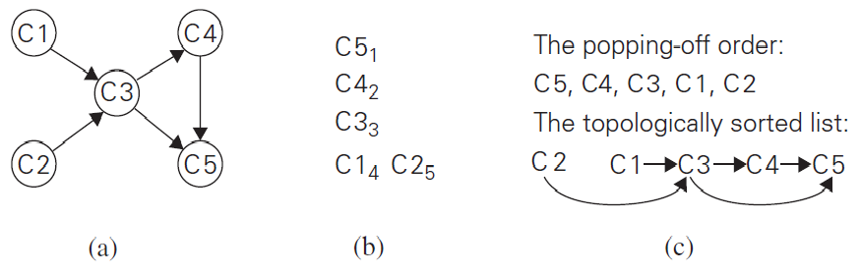

Slide 54
Topological Sorting using decrease-and-conquer technique:
Method: The algorithm is based on a direct implementation of the decrease-(by one)-and-conquer technique:
Repeatedly, identify in a remaining digraph a source, which is a vertex with no incoming edges, and delete it along with all the edges outgoing from it.
(If there are several sources, break the tie arbitrarily. If there are none, stop because the problem cannot be solved.)
The order in which the vertices are deleted yields a solution to the topological sorting problem.

Slide 55
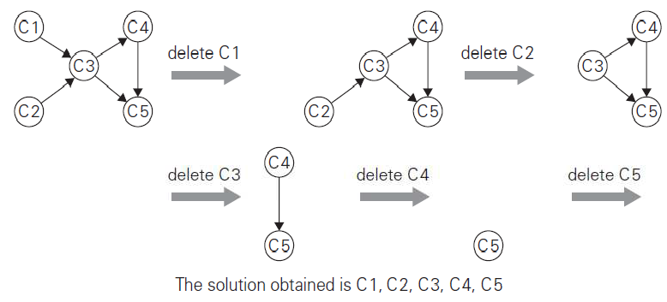
Illustration

Slide 56
Applications of Topological Sorting
Instruction scheduling in program compilation
Cell evaluation ordering in spreadsheet formulas,
Resolving symbol dependencies in linkers.
Determine the optimal order of tasks with dependencies in task scheduling
In managing software projects with multiple modules or libraries, it assists in resolving dependencies between software components.
Used in resource allocation systems to detect deadlocks, which occur when processes are waiting for resources that are blocked by other processes.
Help create efficient course schedules in educational institutions that ensure prerequisites are met.

Slide 57
End of Unit - 2

Slide 58
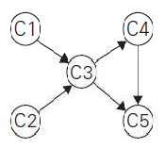
Motivation for topological sorting
Consider a set of five required courses {C1, C2, C3, C4, C5} a part-time student has to take in some degree program.
The courses can be taken in any order as long as the following course prerequisites are met:
  C1 and C2 have no prerequisites,
  C3 requires C1 and C2,
  C4 requires C3, and
  C5 requires C3 and C4.
The student can take only one course per term.
In which order should the student take the courses?
This problem is called topological sorting.

