Slide 1
Unit 2: Divide and Conquer

Slide 2
Unit 2 – Outline Divide and Conquer
General method
Recurrence equation
Algorithm: Merge sort
Algorithm: Quick sort
Algorithm: Strassen’s matrix multiplication
Multiplication of large integers
Decrease and Conquer Approach
Algorithm: Depth First Search (DFS)
Algorithm: Breadth First Search (BFS)
Applications of DFS and BFS
Algorithm: Topological Sort

Slide 3
Unit 2 – Outline Divide and Conquer
General method
Recurrence equation
Algorithm: Merge sort
Algorithm: Quick sort
Algorithm: Strassen’s matrix multiplication
Multiplication of large integers
Decrease and Conquer Approach
Algorithm: Depth First Search (DFS)
Algorithm: Breadth First Search (BFS)
Applications of DFS and BFS
Algorithm: Topological Sort

Slide 4
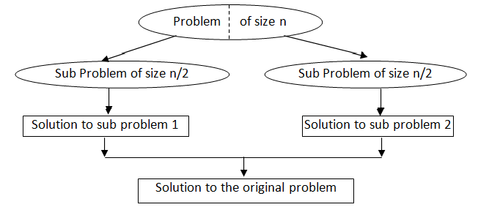
Divide and Conquer

Slide 5
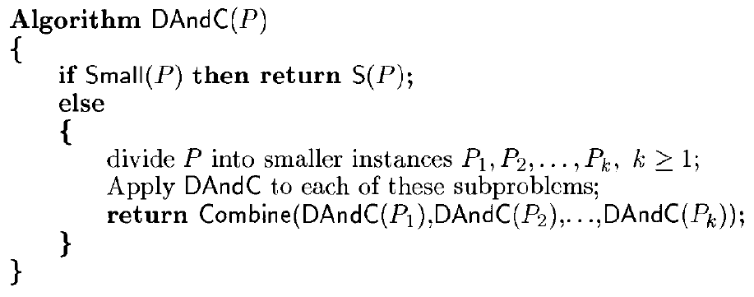
Control Abstraction for Divide &Conquer

Slide 6
Module 2 – Outline Divide and Conquer
General method
Recurrence equation
Algorithm: Merge sort
Algorithm: Quick sort
Algorithm: Strassen’s matrix multiplication
Multiplication of large integers
Decrease and Conquer Approach
Algorithm: Depth First Search (DFS)
Algorithm: Breadth First Search (BFS)
Applications of DFS and BFS
Algorithm: Topological Sort

Slide 7

Recurrence equation for Divide and Conquer
If the size of problem ‘p’ is n and the sizes of the ‘k’ sub problems are n₁, n₂ ….n_{k}, respectively, then
Where,
T(n) is the time for divide and conquer method on any input of size n and
g(n) is the time to compute answer directly for small inputs.
The function f(n) is the time for dividing the problem ‘p’ and combining the solutions to sub problems.

Slide 8

Recurrence equation for Divide and Conquer
Generally, an instance of size n can be divided into b
instances of size n/b,
Assuming n = b^{k} ,
where f(n) is a function that accounts for the time spent on dividing the problem into smaller ones and on combining their solutions.

Slide 9
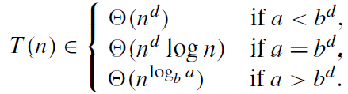

Solving recurrence relation using Master theorem
It states that, in recurrence equation T(n) = aT(n/b) + f(n), If f(n)∈ Θ (n^{d} ) where d ≥ 0 then
b
Analogous results hold for the Ο and Ω notations, too. Example:
Here a = 2, b = 2, and d = 0; hence, since a >b^{d},

Slide 10
Module 2 – Outline Divide and Conquer
General method
Recurrence equation
Algorithm: Merge sort
Algorithm: Quick sort
Algorithm: Strassen’s matrix multiplication
Multiplication of large integers
Decrease and Conquer Approach
Algorithm: Depth First Search (DFS)
Algorithm: Breadth First Search (BFS)
Applications of DFS and BFS
Algorithm: Topological Sort

Slide 11
Merge Sort
Merge sort is a perfect example of divide-and conquer technique.
It sorts a given array by
  dividing it into two halves,
  sorting each of them recursively, and
  then merging the two smaller sorted arrays into a single sorted one.

Slide 12
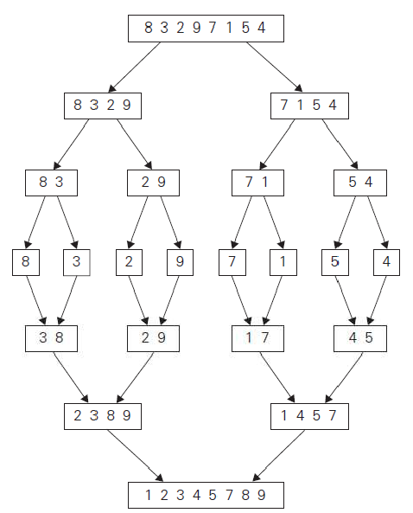
Merge sort - example

Slide 13
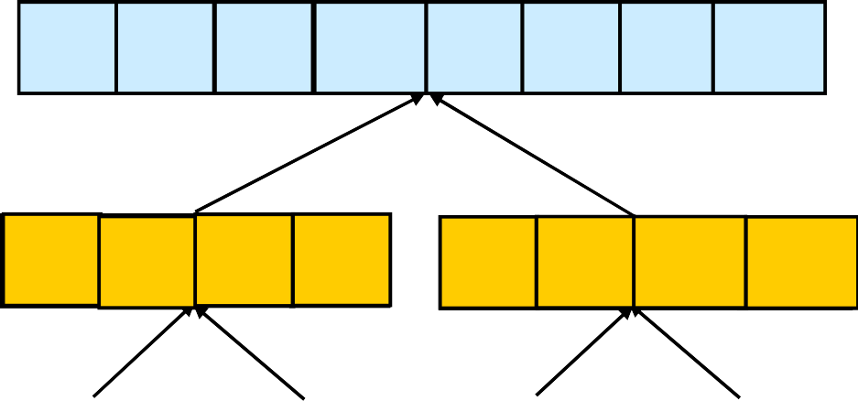
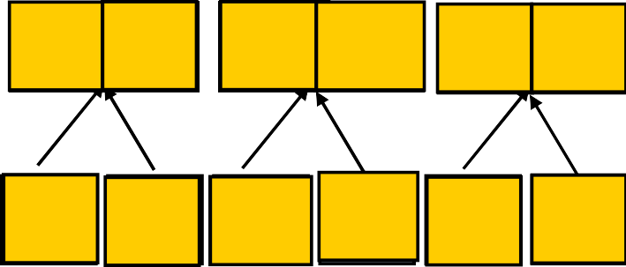
Merge Sort - Example
Original Sequence
Sorted Sequence
1 6 9 15 18 26 32 43
18 | 26 | 32 | 6 | 43 | 15 | 9 | 1
18
26
32
6
43
15
9
1
18 | 26 | 32 | 6 |  | 43 | 15 | 9 | 1
6
18
26 32
1 9 15 43
18
26
32
6
43
15
9
1
6
18
26
32
1
9
15
43
18 | 26 |  |  | 32 | 6 |  |  | 43 | 15 | 9 | 1
18 26
6 32
15 43
1 9
18
26
32
6
43
15
9
1
18
26
6
32
15
43
1
9
 | 18 |  | 26 |  | 32 |  | 6 | 43 | 15 | 9 | 1 |  | 18 | 26 | 32 | 6 | 43 1 | 5 9 | 1
 | 18 |  | 26 |  | 32 |  | 6 | 43 | 15 | 9 | 1
18
26
32
6
43
15
9
1
18
26
32
6
43
15
9
1
18
26
32
6
43
15
9
1

Slide 14
Merge Sort
Algorithm Mergesort(a, low, high)
{
if(low<high)
{
//Divide Problem into subproblems
//Find where to split the array
mid=(low+high)/2
//solve the subproblems
Mergesort(a, low, mid)
Mergesort(a, mid+1, high)
//combine the solutions of subproblems
Merge(a, low, mid, high)
}
}

Slide 15
Merge
Algorithm Merge(a, low, mid, high)
{
int b[];
i=low, j=mid+1, k=low, l
while(i<= mid and j<=high)
{
if(a[i]<=a[j])
{
b[k]=a[i]
i++
}
else
{
b[k]=a[j];
j++
}
k++
}
while(i<=mid)
{
b[k++]=a[i]
i++
}
while(j<=high)
{
b[k++]=a[j]
j++
}
for (l=low; l<high; l++)
{
a[l]=b[l]
}
}

Slide 16
Analysis
Basic operation - key comparison.
Best Case, Worst Case, Average Case exists?
  Execution does not depend on the order of the data
  Best case and average case runtime are the same as worst case runtime.
Worst case:
  During key comparison, neither of the two arrays becomes empty before the other one contains just one element

Slide 17
Analysis – Worst Case
Assuming for simplicity that total number of elements n is a power of 2, the recurrence relation for the number of key comparisons C(n) is
C_{merge}(n) - the number of key comparisons performed during the merging stage.
At each step, exactly one comparison is made, total comparisons are (n-1)

Slide 18
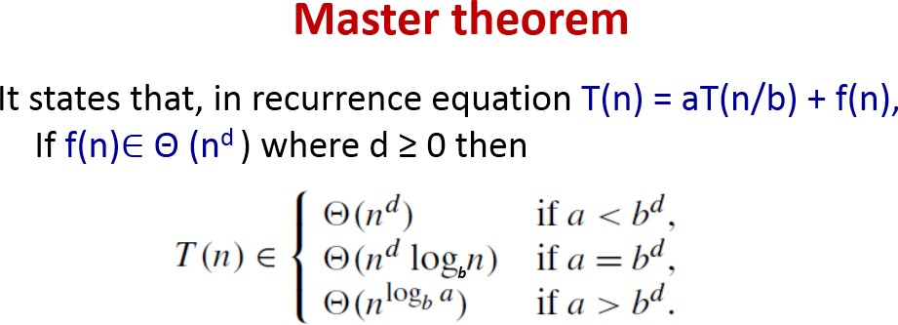
Analysis
Here a = 2, b = 2, f (n) = n-1 = Θ (n) => d = 1.
Therefore 2 = 2¹, case 2 holds in the master theorem
C_{worst} (n) = Θ (n^{d} log n) = Θ (n¹ log n) = Θ (n log n)
Therefore C_{worst}(n) = Θ (n log n)

Slide 19
Advantages
Number of comparisons performed is nearly optimal.
For large n, the number of comparisons made by this algorithm in the average case turns out to be about 0.25n less and hence is also in Θ(n log n).
Mergesort will never degrade to O(n²)
Another advantage of mergesort over quicksort is its stability.
(A sorting algorithm is said to be stable if two objects with equal keys appear in the same order in sorted output as they appear in the input array to be sorted. )

Slide 20
Limitations
The principal shortcoming of mergesort is the linear amount O(n) of extra storage the algorithm requires.
Though merging can be done in-place, the resulting algorithm is quite complicated and of theoretical interest only.

Slide 21
Module 2 – Outline Divide and Conquer
General method
Recurrence equation
Algorithm: Merge sort
Algorithm: Quick sort
Algorithm: Strassen’s matrix multiplication
Multiplication of large integers
Decrease and Conquer Approach
Algorithm: Depth First Search (DFS)
Algorithm: Breadth First Search (BFS)
Applications of DFS and BFS
Algorithm: Topological Sort

Slide 22
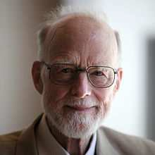
Quick Sort
It is a Divide and Conquer method
Sorting happens in Divide stage itself.
Charles Antony Richard Hoare ( also known as Tony Hore), prominent British computer scientist invented quicksort.

Slide 23
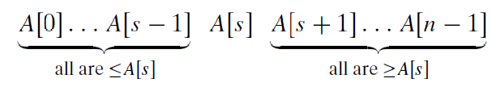
Quick Sort
Quicksort divides (or partitions) array according to the value of some pivot element A[s]
Divide-and-Conquer:
  If n=1 terminate (every one-element list is already sorted)
  If n>1, partition elements into two; based on pivot element, such that

Slide 24
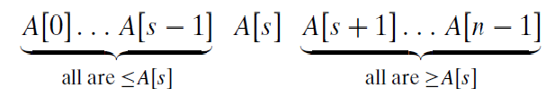
Quick Sort
Algorithm Quicksort(a, p, q)
{
if(p < q)
{
j=partition(a, p, q); // partition array into parts
quicksort(a, p, j-1); // sort left part of array
quicksort(a, j+1, q); // sort right part of array
}
}

Slide 25
How do we partition?
There are several different strategies for selecting a pivot and partitioning.
We use the sophisticated method suggested by
C.A.R. Hoare, the inventor of quicksort.
Select the subarray’s first element as pivot: p = A[0].
Now scan the subarray from both ends, comparing the subarray’s elements to the pivot.

Slide 26
How do we partition?
Algorithm partition(a[], m, p)
{
v=a[m]; // first element is pivot element
i=m+1;
j=p;
while(i < j)
{
while(a[i] < v and i<=p)
i++;
while(a[j] > v and j>=m+1)
j--;
if(i < j)
swap(a[i], a[j]) //swap the contents
}
swap(a[m], a[j]) //swap pivot and a[j]
return j;
}

Slide 27
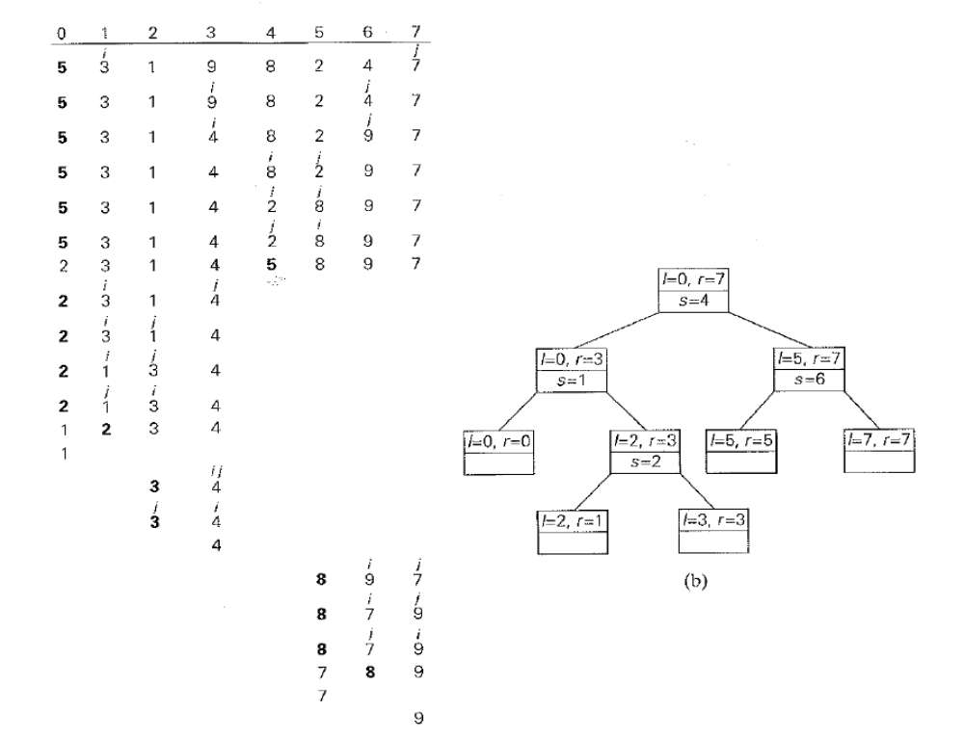

Slide 28
Analysis
Basic Operation : Key Comparison
Best case exists
  all the splits happen in the middle of subarrays,
  So the depth of the recursion is log₂n
– As per Master Theorem, C_{best}(n) ∈ Θ(n log₂ n);

Slide 29
Best case scenario for the Quick Sort algorithm
The Quick Sort algorithm performs the best when the pivot is the middle value in the array.
In the best case, the input array is divided into 2 arrays each containing approximately n/2 elements.
Summary of the execution:
QuickSort( input array with n elements )
{ ....
partition(array with n elements );
QuickSort( array with n/2 elements );
QuickSort( array with n/2 elements );
}
Therefore:
T(n) = partition(n) + T(n/2) + T(n/2)
= partition(n) + 2*T( n/2 ) // partition(n) = n
= n + 2*T(n/2)
= 2*T(n/2) + n
T(1) = 1 // For the if-check operation

Slide 30
Best case for the Quick Sort algorithm
T(n) = 2*T(n/2) + n // T(n/2) = 2*T(n/4) + (n/2)
= 2*[ 2*T(n/4) + n/2 ] + n
= 2²*T(n/4) + n + n
= 2²*T(n/4) + 2n // T(n/4) = 2*T(n/8) + (n/4)
= 2²*[ 2*T(n/8) + (n/4) ] + 2n
= 2³*T(n/8) + 2²*(n/4) + 2n
= 2³*T(n/8) + n + 2n
= 2³*T(n/8) + 3n
= 2⁴*T(n/16) + 4n
and so on....
= 2^{k}*T(n/(2^{k})) + k*n // Keep going until: n/(2^{k}) = 1 <==> n = 2^{k}
= 2^{k}*T(1) + k*n
= 2^{k}*1 + k*n
= 2^{k} + k*n // n = 2^{k}
= n + k*n
= n + (lg(n))*n
= n*( lg(n) + 1 )
~= n*lg(n))
T(n) = n*log(n)

Slide 31
Analysis
Worst Case
  Splits will be skewed to the extreme
  This happens if the input is already sorted
In the worst case, partitioning always divides the size n array into these three parts:
A length one part, containing the pivot itself
A length zero part, and
A length n-1 part, containing everything else
Recurring on the length n-1 part requires (in the worst case) recurring to depth n-1

Slide 32
Analysis
Worst Case
if A[0..n − 1] is a strictly increasing array and we use A[0] as the pivot,
  the left-to-right scan will stop on A[1] while the right-to- left scan will go all the way to reach A[0], indicating the split at position 0
  n + 1 comparisons required
Total comparisons

Slide 33
worst case performance of Quick Sort
Running time of partition( array of n elements ) is equal to:
= (n − 1) (while loop) + 1 (copying the pivot back)
= n
T(n) = partition(n) + T(n-1) // partition(n)
= n + T(n-1)
= T(n-1) + n
T(1) = 1 // For the if-check operation
Solving the recurrence relation:
T(n) = T(n-1) + n // T(n-1) = T(n-2) + (n-1)
= [T(n-2) + (n-1) ]+ n
= [T(n-3) + (n-2) ]+ (n-1) + n
= ...
= T(1) + 2 + 3 + ... + (n-1) + n // T(1) = 1
= 1 + 2 + 3 + ... + (n-1) + n
n (n+1)
= ---------
2
Therefore: T(n) = n (n+1) = O(n²)
---------
2

Slide 34
Analysis
Average Case
Let C_{avg}(n) be the average number of key comparisons made by quicksort on a randomly ordered array of size n.
A partition can happen in any position s (0 ≤ s ≤ n−1)
n+1 comparisons are required for partition.
After the partition, the left and right subarrays will have s and n − 1− s elements, respectively.

Slide 35
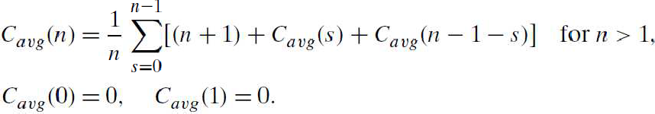

Analysis
Average Case
Assuming that the partition split can happen in each position s with the same probability 1/n, we get

Slide 36
Pros and Cons
Pros
  Good average case time complexity
Cons
  It is not stable.
  It requires a stack to store parameters of subarrays that are yet to be sorted.

Slide 37
Module 2 – Outline Divide and Conquer
General method
Recurrence equation
Algorithm: Merge sort
Algorithm: Quick sort
Algorithm: Strassen’s matrix multiplication
Multiplication of large integers
Decrease and Conquer Approach
Algorithm: Depth First Search (DFS)
Algorithm: Breadth First Search (BFS)
Applications of DFS and BFS
Algorithm: Topological Sort

Slide 38
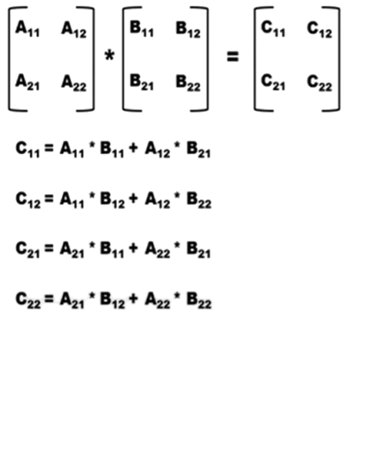
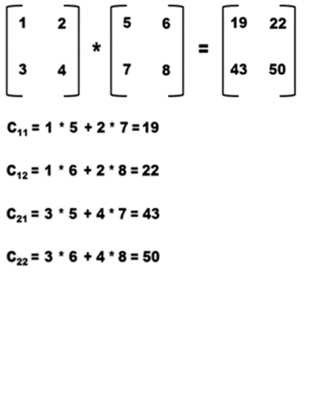
Matrix Multiplication
Direct Method to multiply two 2 X 2 matrices:

Slide 39
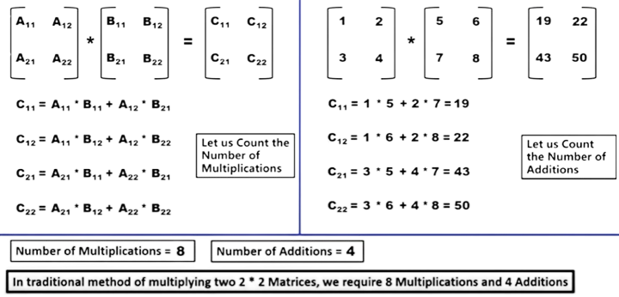
Matrix Multiplication
Direct Method to multiply two 2 X 2 matrices example:

Slide 40

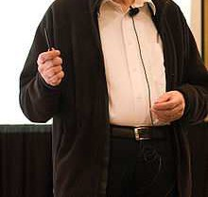
Stressen’s matrix multiplication
Multiplication of 2 × 2 matrices:
By using divide-and-conquer approach we can reduce the number of multiplications.
Such an algorithm was published by
V. Strassen in 1969.

Slide 41
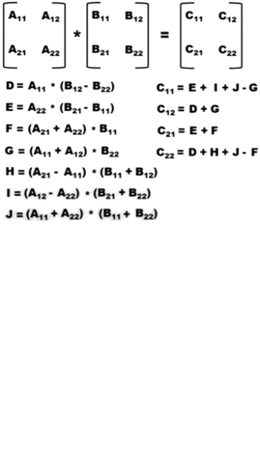
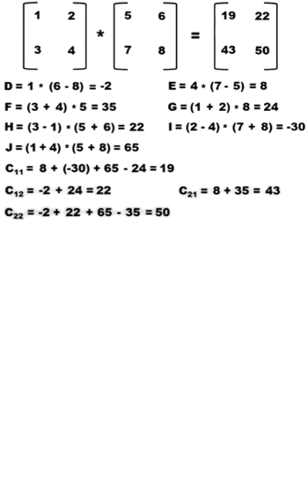
Strassen’s Method: Let us consider the Strassen’s Method of multiplying two 2 * 2 matrices
Number of Multiplications = 7 and Number of Additions = 18

Slide 42
Strassen’s Method
In the traditional method of multiplying two 2 * 2 matrices, we require 8 multiplications and 4 additions.
In the Strassen’s method of multiplying two 2 * 2 matrices, we require 7 multiplications and 18 additions.
Note: Time taken to perform addition is significantly less compared to time taken to perform multiplication.
The time saved is very less when Strassen’s Method is used only once to multiply two 2 * 2 matrices.
But the time saved will be more and significant when Strassen’s Method is used to multiply large number of two 2 * 2 matrices.

Slide 43
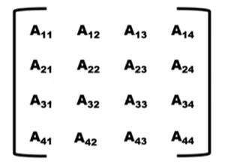
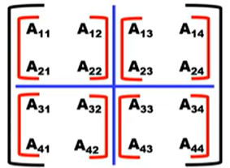
Strassen’s Matrix Multiplication
Consider the following 4 * 4 Matrix
This 4 * 4 Matrix can be divided into four 2 * 2 Matrices
Similarly, an 8 * 8 Matrix can be divided into four 4 * 4 matrices, which in turn can be further divided into four 2 * 2 matrices.
Similarly, a 16 * 16 Matrix can be divided into four 8 * 8 matrices, each 8 * 8 matrix can be divided into four 4 * 4 matrices, which in turn can be further divided into four 2 * 2 matrices.

Slide 44
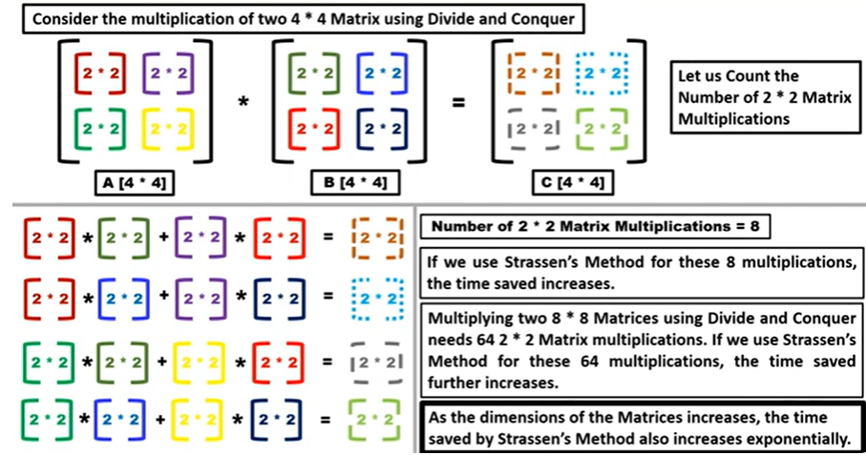
Strassen’s Matrix Multiplication (Contd..)

Slide 45
Strassen’s Matrix Multiplication (Contd..)
If Strassen’s Method is used to multiply 2 * 2 matrices only once, it saves a very less time and is almost insignificant.
If Strassen’s Method is used to multiply large number of 2 * 2 matrices, then the time saved is huge.
During the multiplication of two big dimension matrices, we apply Divide and Conquer to get large number of 2 * 2 matrices. Then, we go on multiplying these 2 * 2 matrices using Strassen’s method and hence enormous amount of time is saved.
In Summary,
Strassen’s Method is almost insignificant without Divide and Conquer.
Strassen’s Method becomes very much significant with Divide and Conquer.

Slide 46
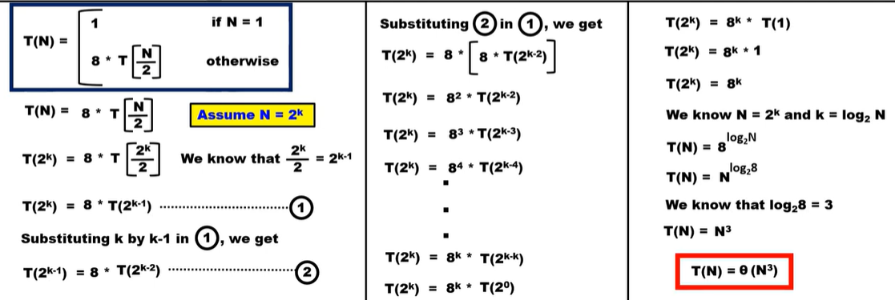
Analysis of Traditional Method
In the Traditional Method, we have 8 multiplications and multiplication is the primary operation and also divide and conquer is used to multiply large-dimension matrices.
Hence, the recurrence relation is as shown below:

Slide 47
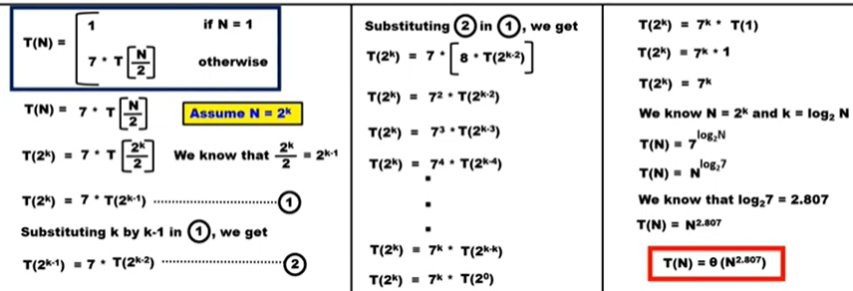
Analysis of Strassen’s Method
In Strassen’s Method, we have 7 multiplications and multiplication is the primary operation and also divide and conquer is used to multiply large-dimension matrices.
Hence, the recurrence relation is as shown below:

Slide 48
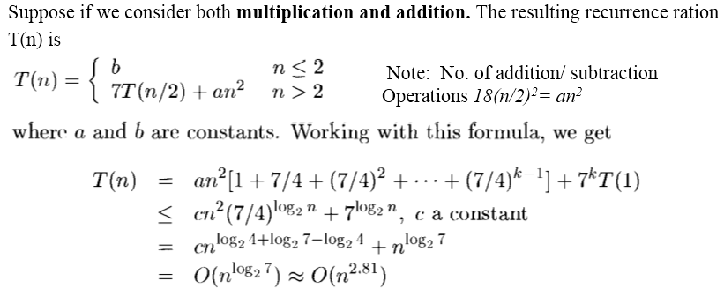
Analysis of Strassen’s Method

Slide 49
Unit 2 – Outline Divide and Conquer
General method
Recurrence equation
Algorithm: Merge sort
Algorithm: Quick sort
Algorithm: Strassen’s matrix multiplication
Multiplication of large integers
Decrease and Conquer Approach
Algorithm: Depth First Search (DFS)
Algorithm: Breadth First Search (BFS)
Applications of DFS and BFS
Algorithm: Topological Sort

Slide 50
Multiplication of large integers
Multiplying large integers
0981
X 1234
1210554
The traditional method algorithm takes O(n²)
Divide and Conquer method:
w = 09 y = 12
x = 81 z = 34
981 = 10²w + x
1234 = 10²y + z

Slide 51
Multiplication of large integers (Contd..)
The required product can be computed as
981 X 1234 = (10²w + x) * (10²y + z)
= 10⁴wy + 10²wz + 10²xy + xz
= 10⁴wy + 10² (wz + xy) + xz ---- (1)
= 1080000 + 127800 + 2754
= 1210554
The above procedure still needs four half-size multiplications (for wy, wz, xy, xz).
Is it possible to obtain wz + xy at the cost of a single multiplication?
r = (w + x) * (y + z)
= wy + (wz + xy) + xz

Slide 52
Multiplication of large integers (Contd..)
After only one multiplication, we obtain the sum of all three terms needed to calculate the designed product.
P = wy = 09 * 12 = 108
Q = xz = 81 * 34 = 2754
R = (w + x) * (y + z)
Finally, 981 * 1234 = 10⁴wy + 10² (wz + xy) + xz ---- (1)
= 10⁴p + 10² (r – p - q) + q
= 1080000 + 127800 + 2754
= 1210554
Thus, the product of 981 and 1234 can be reduced to three multiplications of two-digit numbers.
09 * 12
81 * 34 Total three multiplications only
90 * 46
When the operands are large, the time required for the additions and shift becomes negligible compared to the time taken by a single multiplication.

Slide 53
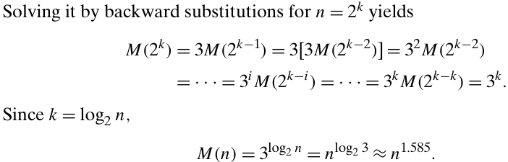
Analysis of Multiplication of large integers
How many digit multiplications does this algorithm make?
Since multiplication of n-digit numbers requires three multiplications of n/2-digit numbers, the recurrence for the number of multiplications M(n) is
M(n) = 3M(n/2) for n > 1, M(1) = 1

Slide 54
Analysis of Multiplication of large integers
But what about additions and subtractions?
Let A(n) be the number of digit additions and subtractions executed by the above algorithm in multiplying two n-digit decimal integers.
Besides 3A(n/2) of these operations needed to compute the three products of n/2-digit numbers, the above formulas require five additions and one subtraction.
Hence, we have the recurrence
A(n) =3A(n/2)+cn for n > 1, A(1)=1
Applying the Master Theorem,
we obtain A(n) ∈ (nlog₂3)
which means that the total number of additions and subtractions have the same asymptotic order of growth as the number of multiplications.

