Slide 1
Unit 3: Dynamic Programming

Slide 2
Outline
Introduction to Dynamic Programming
  General method with Examples
Computing a Binomial Coefficient
All Pairs Shortest Paths:
  Floyd's Algorithm
  Knapsack Problem and Memory Functions
2

Slide 3
Outline
Introduction to Dynamic Programming
  General method with Examples
Computing a Binomial Coefficient
All Pairs Shortest Paths:
  Floyd's Algorithm
  Knapsack Problem and Memory Functions
3

Slide 4
Dynamic Programming
Dynamic programming is a technique for solving problems with overlapping subproblems.
  subproblems arise from a recurrence relating a given problem’s solution to solutions of its smaller subproblems.
  DP suggests solving each of the smaller subproblems only once and recording the results in a table from which a solution to the original problem can then be obtained.
The Dynamic programming can be used when the solution to a problem can be viewed as the result of sequence of decisions.
4

Slide 5
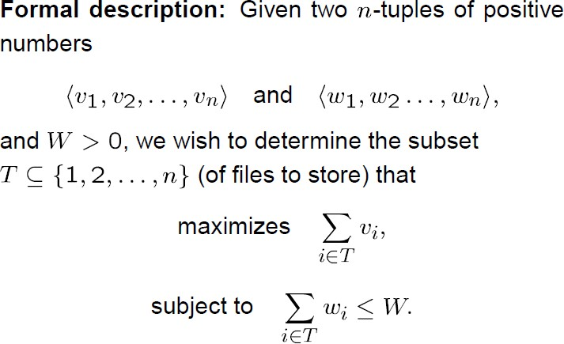
Example-1: Knapsack Problem
5

Slide 6
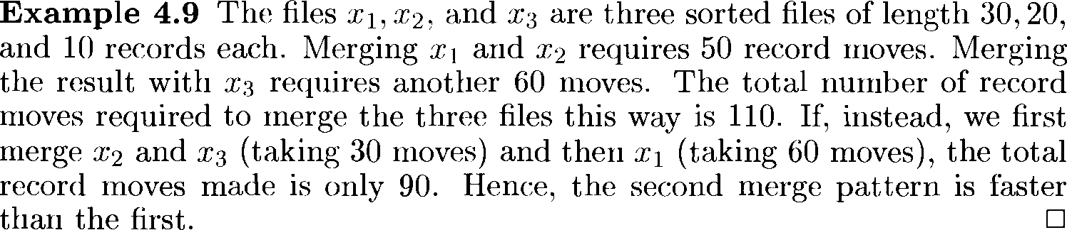
Example-2: File merging problem
6

Slide 7
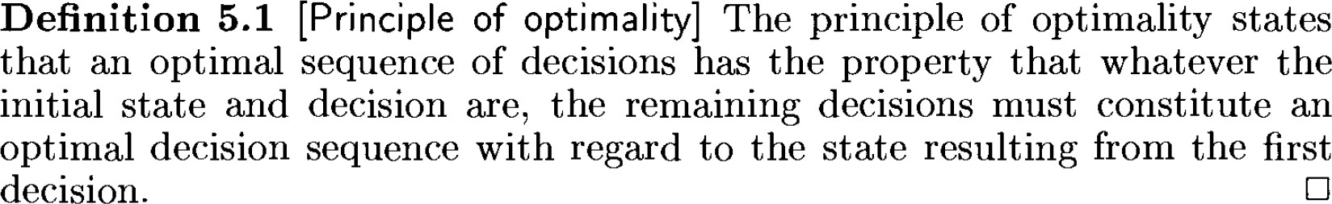
Principle of Optimality
Difference between greedy and DP?
7

Slide 8
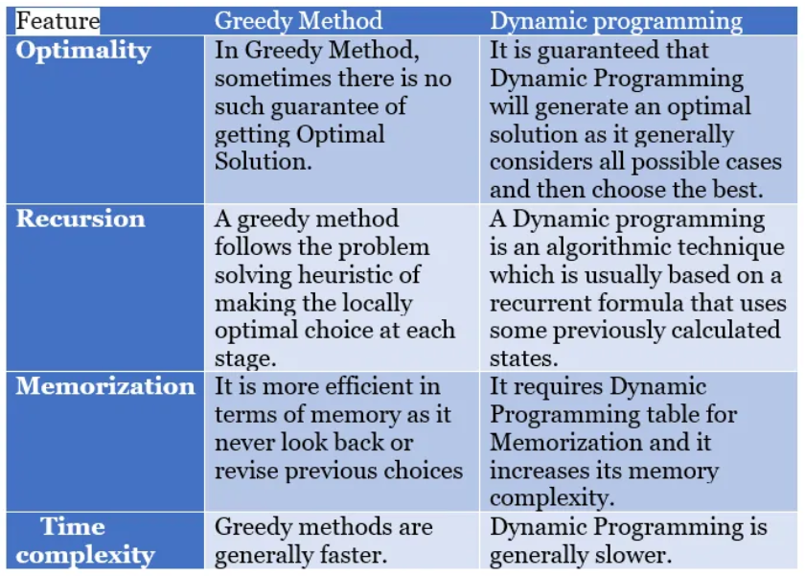
Difference between greedy and DP?

Slide 9
Outline
Introduction to Dynamic Programming
  General method with Examples
Computing a Binomial Coefficient
All Pairs Shortest Paths:
  Floyd's Algorithm
  Knapsack Problem and Memory Functions
9

Slide 10
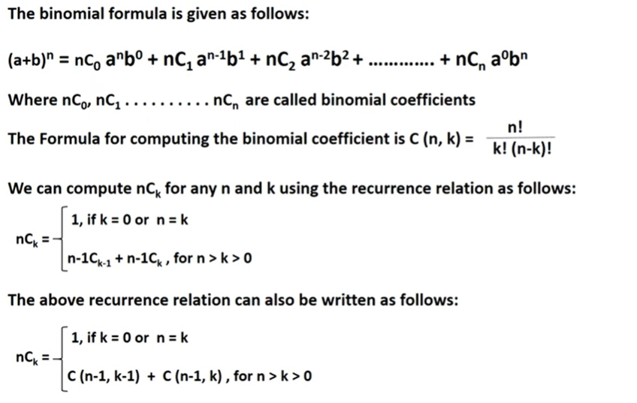
Computing a Binomial Coefficient

Slide 11
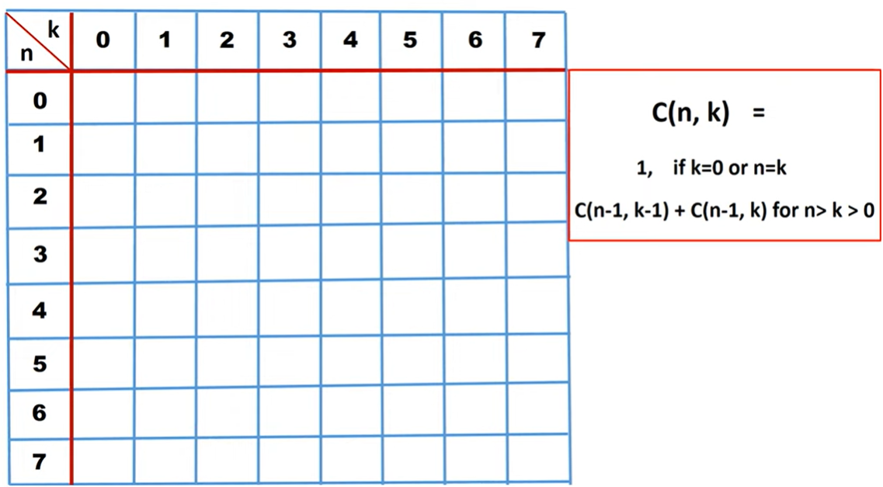
Computing a Binomial Coefficient (Contd..)

Slide 12
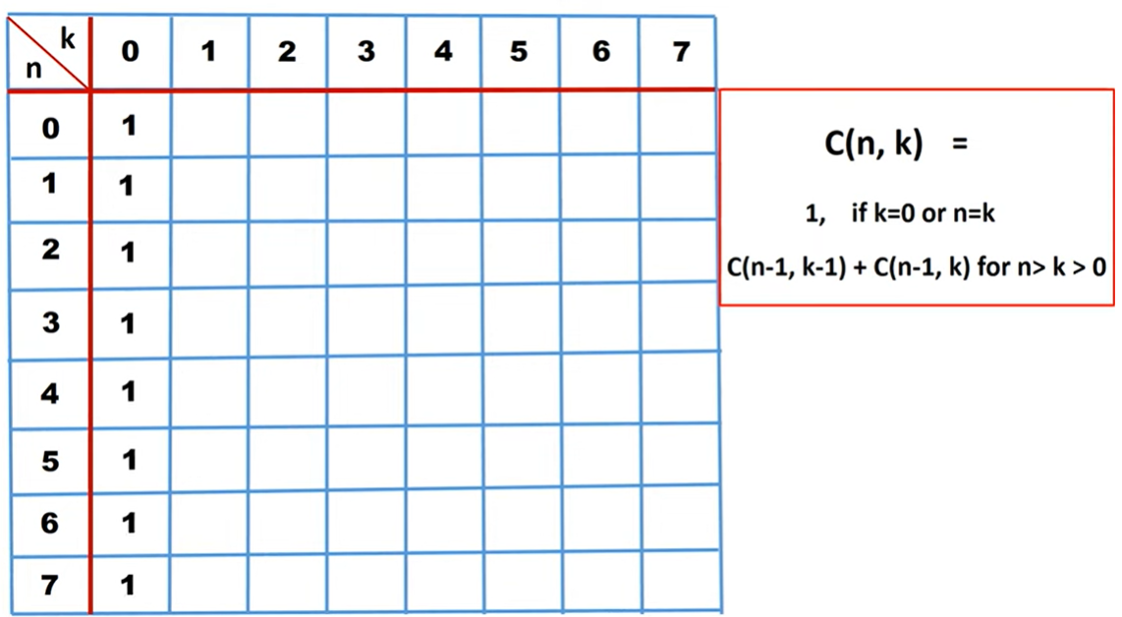
Computing a Binomial Coefficient (Contd..)

Slide 13
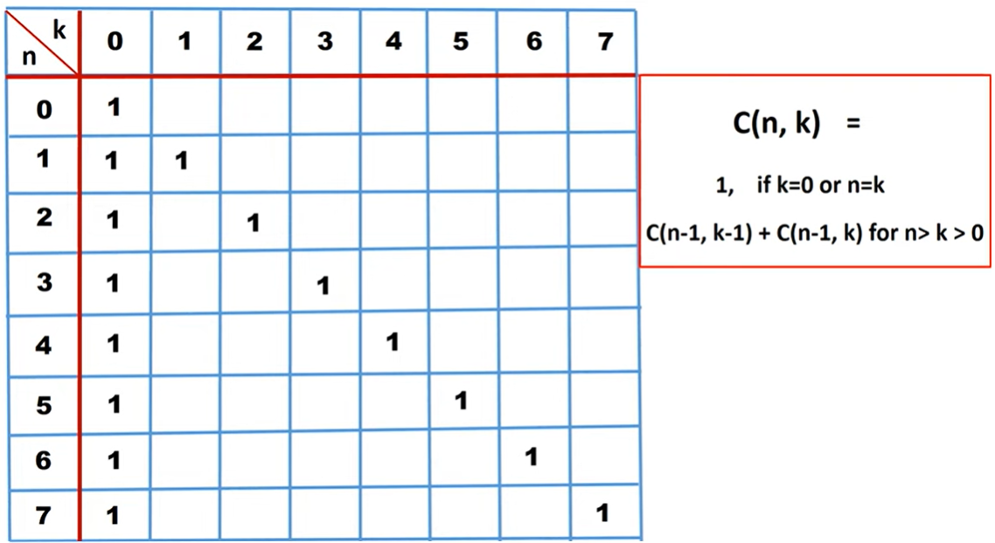
Computing a Binomial Coefficient (Contd..)

Slide 14
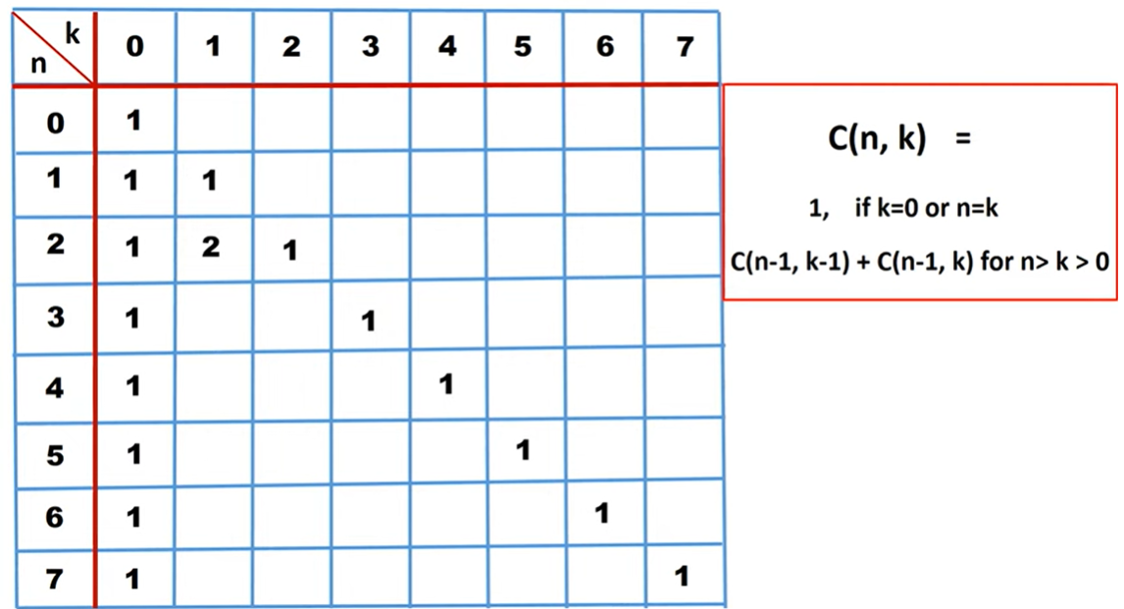


Computing a Binomial Coefficient (Contd..)

Slide 15
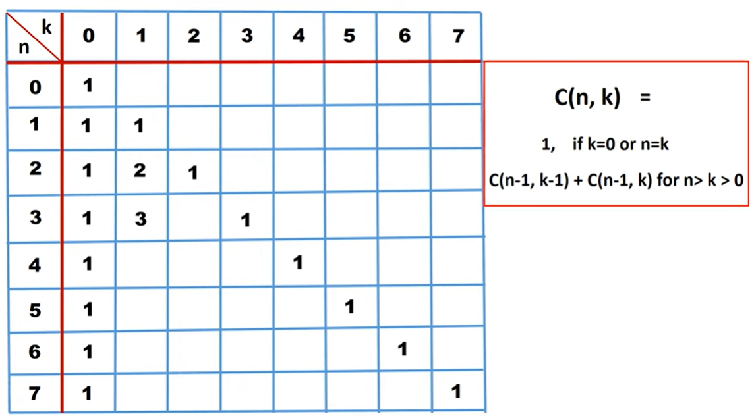



Computing a Binomial Coefficient (Contd..)

Slide 16
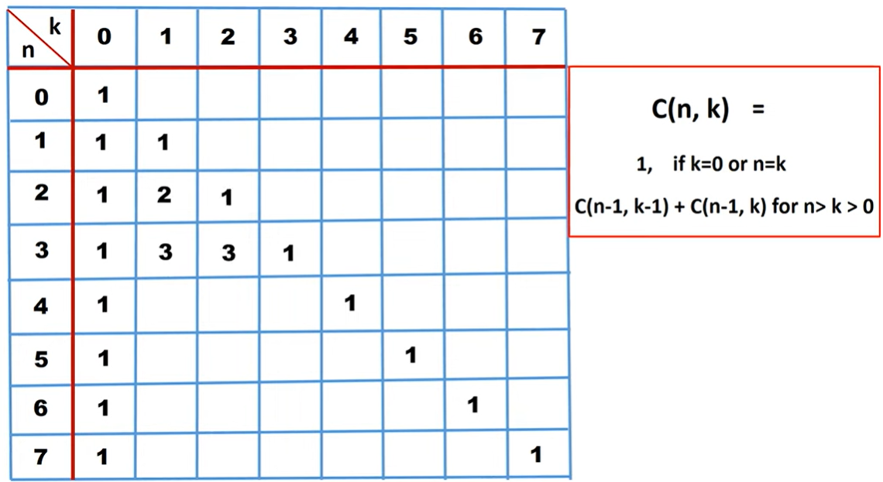



Computing a Binomial Coefficient (Contd..)

Slide 17
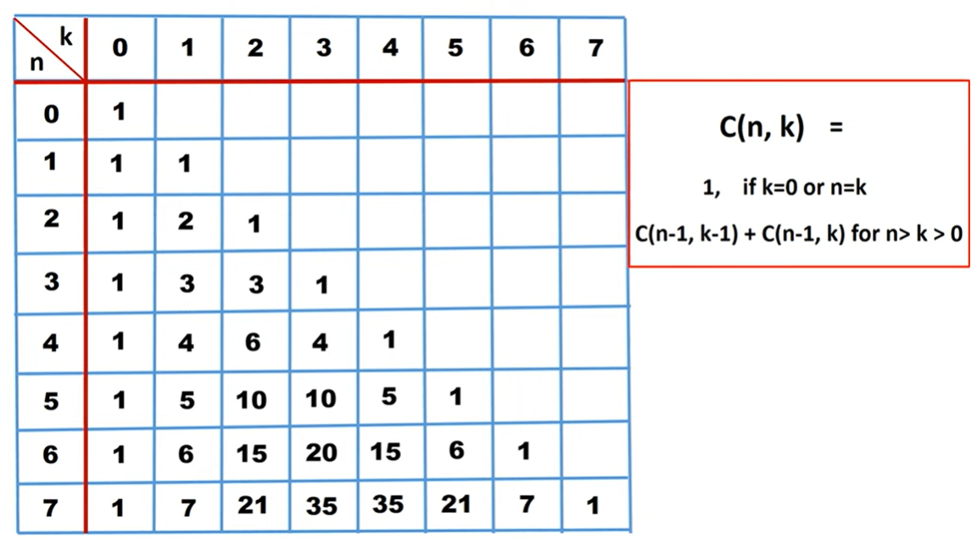
Computing a Binomial Coefficient (Contd..)
Similarly, we get all other values

Slide 18
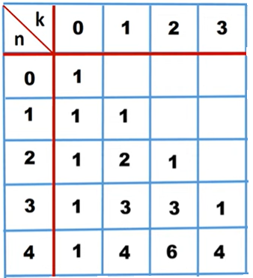
Example
To compute 4C₃

Slide 19
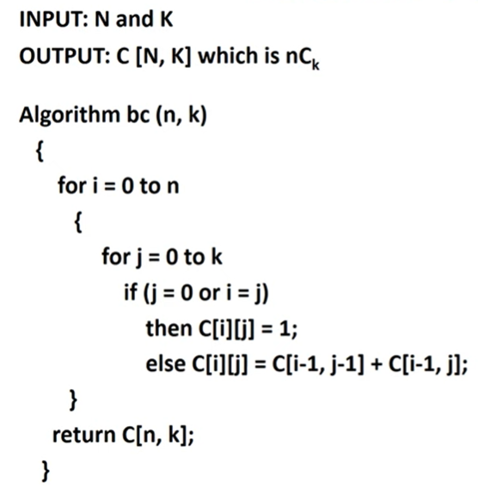
Binomial Coefficient Algorithm

Slide 20
Outline
Introduction to Dynamic Programming
  General method with Examples
Computing a Binomial Coefficient
All Pairs Shortest Paths:
  Floyd's Algorithm
  Knapsack Problem and Memory Functions
20

Slide 21
All Pairs Shortest Paths
Floyd’s Algorithm is also called as All pair shortest path algorithm.
In a given connected, directed, and weighted graph G, the objective of this algorithm is to find the minimum cost from any vertex to every other vertex in the graph G.
From a vertex i to vertex j, there may be many paths, but we have to find a path with minimum value, and the dynamic programming principle is applied for this.
A vertex k is considered as a vertex which comes in between the path from vertex i to vertex j. Now, the path value { cost(i, k) + cost(k, j) } is calculated and checked if it is minimum than cost(i, j).
This process is repeated for all possible values of k to obtain the All-Pair Shortest Path matrix.
This is given by the following recurrence relation:
D^{k}(i, j) = min { D^{k-1}(i, j) , D^{k-1}(i, k) + D^{k-1}(k, j) }

Slide 22
All Pairs Shortest Paths
Problem definition: Given a weighted connected graph (undirected or directed), the all-pairs shortest paths problem asks to find the distances—i.e., the lengths of the shortest paths - from each vertex to all other vertices.

Slide 23
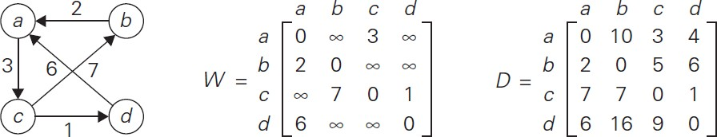
All Pairs Shortest Paths
(a) Digraph.
(b) Its weight matrix.
(c) Its distance matrix

Slide 24
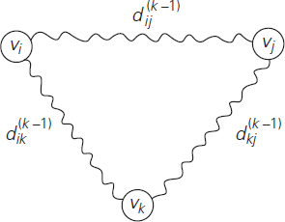
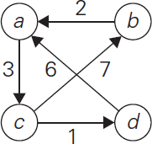
Floyds Algorithm

Slide 25
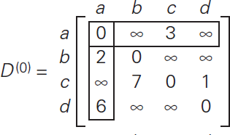
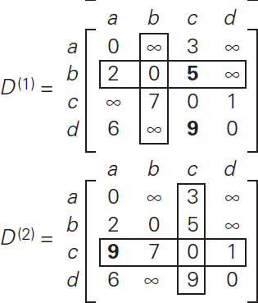
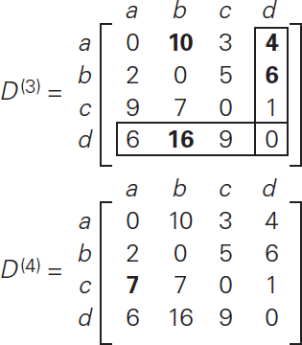
Example

Slide 26
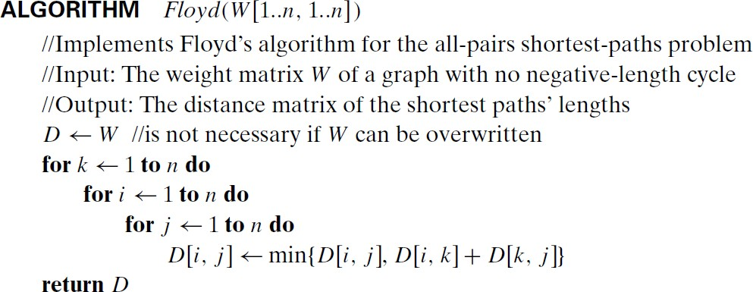
Floyds Algorithm
Analysis
Its time efficiency is Θ(n³)

Slide 27
Applications of Floyd’s Algorithm
  To route data packets efficiently in networking.
  To identify strong bonds between people in a social network.
  Optimize routes for public transportation and find the quickest paths to all destinations in a city.
  Pre-computing distances for motion planning in computer games.

Slide 28
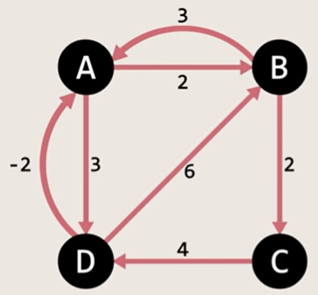
Home Work

Slide 29
Solution for Home Work
 | A | B | C | D
A | 0 | 2 | ∞ | 3
B | 3 | 0 | 2 | ∞
C | ∞ | ∞ | 0 | 4
D | -2 | 6 | ∞ | 0
 | A | B | C | D
A | 0 | 2 | 4 | 3
B | 3 | 0 | 2 | 6
C | ∞ | ∞ | 0 | 4
D | -2 | 0 | 2 | 0
D⁰ =
D³ =
 | A | B | C | D
A | 0 | 2 | ∞ | 3
B | 3 | 0 | 2 | 6
C | ∞ | ∞ | 0 | 4
D | -2 | 0 | ∞ | 0
 | A | B | C | D
A | 0 | 2 | 4 | 3
B | 3 | 0 | 2 | 6
C | 2 | 4 | 0 | 4
D | -2 | 0 | 2 | 0
D¹ =
D⁴ =
 | A | B | C | D
A | 0 | 2 | 4 | 3
B | 3 | 0 | 2 | 6
C | ∞ | ∞ | 0 | 4
D | -2 | 0 | 2 | 0
D² =

Slide 30
Outline
Introduction to Dynamic Programming
  General method with Examples
Computing a Binomial Coefficient
All Pairs Shortest Paths:
  Floyd's Algorithm
  Knapsack Problem and Memory Functions
30

Slide 31
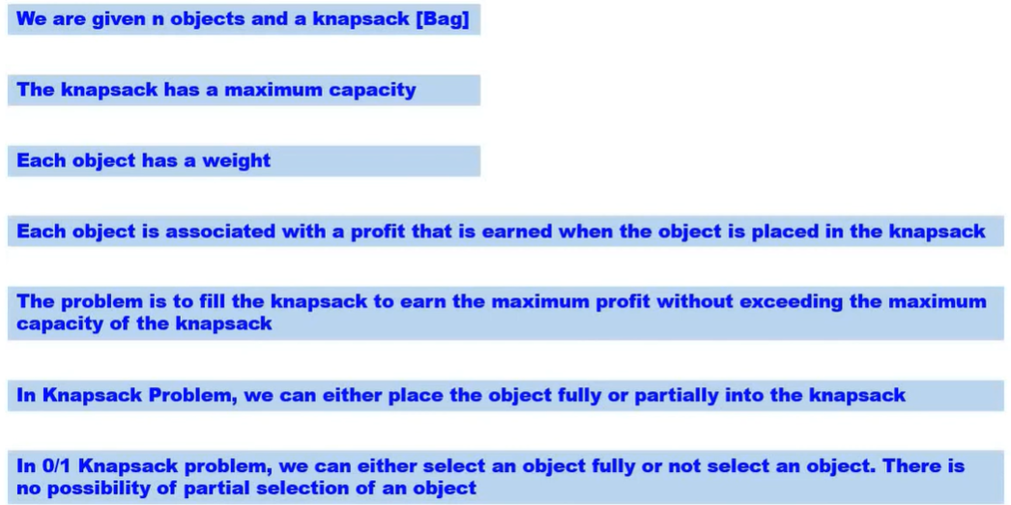
Knapsack problem using DP

Slide 32
Knapsack problem using DP
Given n items of known weights w₁, . . . , w_{n} and values v₁, . . . , v_{n} and a knapsack of capacity W, find the most valuable subset of the items that fit into the knapsack.
To design a DP algorithm, we need to derive a recurrence relation that expresses a solution in terms of its smaller sub instances.
Let us consider an instance defined by the first i items, 1≤ i ≤ n, with weights w₁, . . . , w_{i}, values v₁, . . .
, v_{i} , and knapsack capacity j, 1 ≤ j ≤ W.

Slide 33
Knapsack problem using DP
Let F(i, j) be the value of an optimal solution to this instance.
We can divide all the subsets of the first i items that fit the knapsack of capacity j into two categories:
  those that do not include the i^{th} item
  and those that do.
Among the subsets that do not include the i^{th} item,
  the value of an optimal subset is, by definition,
– i.e F(i , j) = F(i − 1, j).

Slide 34
Knapsack problem using DP
Let i represent the ith object in question to be selected or not, to get the max profit with weight wi and profit pi with remaining capacity j.
F[i,j] is the profit obtained by considering all i objects with capacity j.
The various cases to be considered are:
Case 1: If there are no objects (ie i=0) or capacity of knapsack itself is 0(ie j=0), then profit will be 0.
Therefore, F[i,j]=0 if(i=0 or j=0)----1
Case 2: Suppose we have a situation that weight of ith object wi is greater than remaining capacity j, in such case ith obj cannot be selected. So, the profit obtained is
F[i,j]=F[i-1,j] if(wi>j)----2

Slide 35
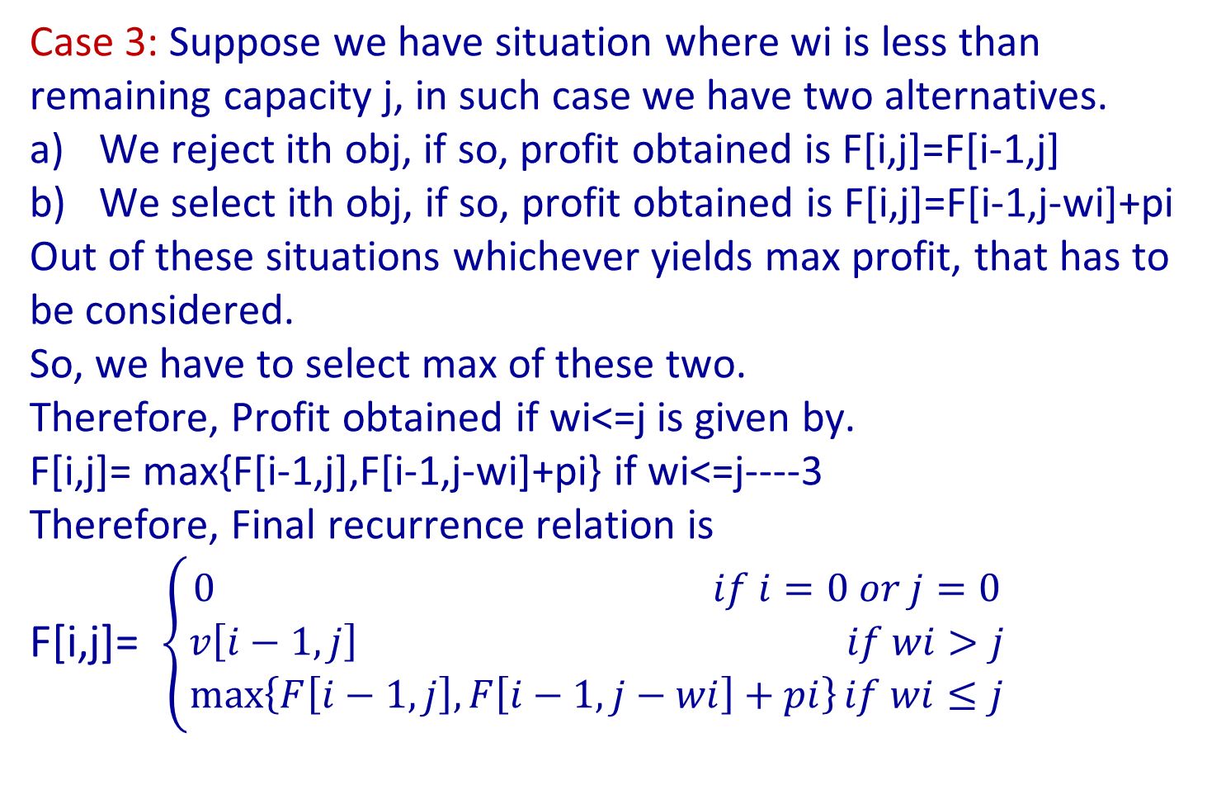
Knapsack problem using DP
Case 3: Suppose we have situation where wi is less than remaining capacity j, in such case we have two alternatives.
We reject ith obj, if so, profit obtained is F[i,j]=F[i-1,j]
We select ith obj, if so, profit obtained is F[i,j]=F[i-1,j-wi]+pi
Out of these situations whichever yields max profit, that has to be considered.
So, we have to select max of these two.
Therefore, Profit obtained if wi<=j is given by.
F[i,j]= max{F[i-1,j],F[i-1,j-wi]+pi} if wi<=j----3
Therefore, Final recurrence relation is
F[i,j]= $\left\{\begin{aligned}0 if i=0 or j=0 \\ v\left[i−1,j\right] if wi>j \\ \max\left\{F\left[i−1,j\right],F\left[i−1,j−wi\right]+pi\right\}if wi≤j\end{aligned}\right.$

Slide 36
Knapsack problem using DP
Among the subsets that do include the i^{th} item
(hence, j − w_{i} ≥ 0),
  an optimal subset is made up of this item and
  an optimal subset of the first i−1 items that fits into the knapsack of capacity j − w_{i} .
  The value of such an optimal subset is F(i , j) = v_{i} + F(i − 1, j − w_{i})
Thus, optimal solution among all feasible subsets of the first i items is the maximum of these two values.

Slide 37
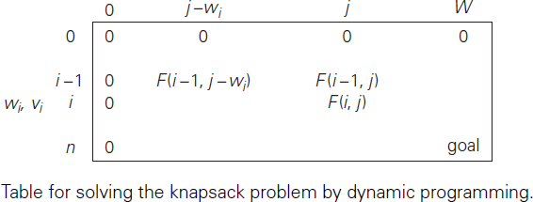
Knapsack problem using DP
It is convenient to define the initial conditions as follows: F(0, j) = 0 for j ≥ 0 and F(i, 0) = 0 or i ≥ 0.
Our goal is to find F(n, W), the maximal value of a subset of the n given items that fit into the knapsack of capacity W, and an optimal subset itself.

Slide 38
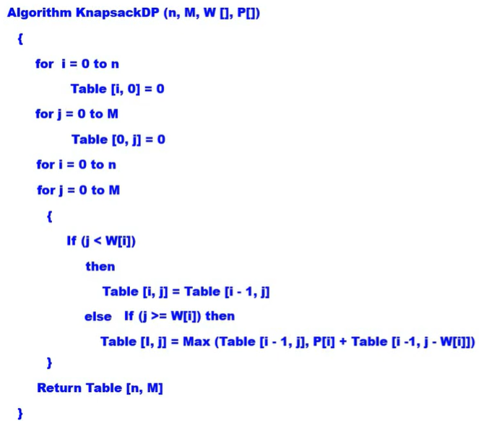
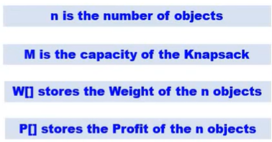
Algorithm

Slide 39
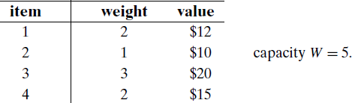
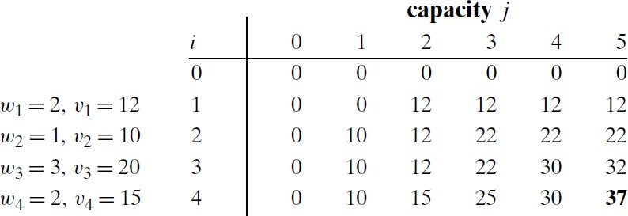
Example-1
Find the composition of an optimal subset by backtracing the computations

Slide 40
Method for filling the matrix
For F[i, j], first shift left wi times, if shifting left goes out of the matrix, then copy the value in previous row.
If shift left is within the matrix, then check whether wi>j, if so, copy the previous row value.
If not, go to previous row after shifting wi times, then add profit of ith object to previous row value, compare resulted value with previous row value of same column(ie i-1th row, jth column), write max value out of them.

Slide 41
Example-1
Find the composition of an optimal subset by backtracing the computations

Slide 42
Analysis
The classic dynamic programming approach, works bottom up: it fills a table with solutions to all smaller subproblems, each of them is solved only once.
Drawback: Some unnecessary subproblems are also solved
The time efficiency and space efficiency of this algorithm are both in Θ(nW).
The time needed to find the composition of an optimal solution is in O(n).

Slide 43
Discussion
The direct top-down approach to finding a solution to such a recurrence leads to an algorithm that solves common subproblems more than once and hence is very inefficient.
Since this drawback is not present in the bottom-up approach, it is natural to try to combine the strengths of the top-down and bottom-up approaches.
The goal is to get a method that solves only subproblems that are necessary and does so only once. Such a method exists; it is based on using memory functions.

Slide 44
Algorithm MFKnapsack(i, j)
Implements the memory function method for the knapsack problem
Input: A nonnegative integer i indicating the number of the first items being considered and a nonnegative integer j indicating the knapsack capacity
Output: The value of an optimal feasible subset of the first i items
Note: Uses as global variables input arrays Weights[1..n], Values[1..n], and table F[0..n, 0..W ] whose entries are initialized with −1’s except for row 0 and column 0 initialized with 0’s

Slide 45
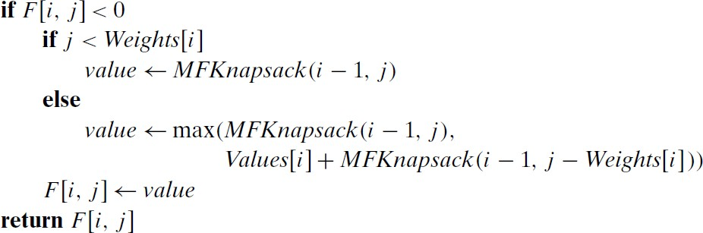
Algorithm MFKnapsack(i, j )

Slide 46
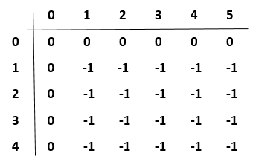
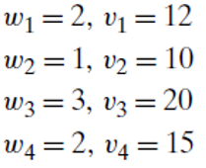
Example

Slide 47
V[4, 5] = max ( V[3, 5] , V[3, 3] + 15 )
V[3, 5] = max ( V[2, 5] , V[2, 2] + 20 )
V[3, 3] = max ( V[2, 3] , V[2, 0] + 20 )
V[2, 5] = max ( V[1, 5] , V[1, 4] + 10 )
V[2, 2] = max ( V[1, 2] , V[1, 1] + 10 )
V[2, 3] = max ( V[1, 3] , V[1, 2] + 10 )
V[2, 0] = 0

Slide 48
V[1, 5] = max ( V[0, 5] , V[0, 3] + 12 )
= max ( 0 , 0 + 12) = 12
V[1, 4] = max ( V[0, 4] , V[0, 2] + 12 )
= max ( 0 , 0 + 12 ) = 12
V[1, 2] = max ( V[0, 2] , V[0, 0] + 12 )
= max ( 0 , 0 +12 ) = 12
V[1, 1] = V[0, 1] = 0
V[1, 3] = max ( V[0, 3] , V[0, 1] + 12 )
= max ( 0 , 0 + 12 ) = 12

Slide 49
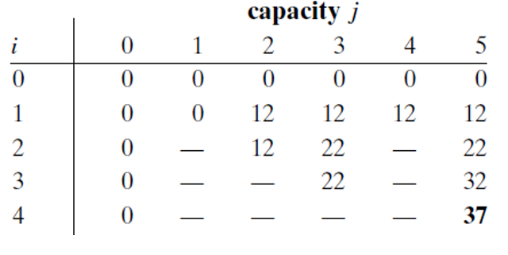
V[2, 3] = max ( V[1, 3] , V[1, 2] + 10 )
= max ( 12 , 12 + 10 ) = 22
V[2, 2] = max ( V[1, 2] , V[1, 1] + 10 )
= max ( 12 , 0 + 10 ) = 12
V[2, 5] = max ( V[1, 5] , V[1, 4] + 10 )
= max ( 12 , 12 + 10 ) = 22
V[3, 3] = max ( V[2, 3] , V[2, 0] + 20 )
= max ( 22 , 0 + 20 ) = 22
V[3, 5] = max ( V[2, 5] , V[2, 2] + 20 )
= max ( 22 , 12 + 20 ) = 32
V[4, 5] = max ( V[3, 5] , V[3, 3] + 15 )
= max ( 32 , 22 + 15 ) = 37

