Slide 1
Unit 3: Greedy Method

Slide 2
Unit 3: Greedy Method - Outline
Introduction to Greedy Method
  General method
Minimum cost spanning trees:
  Prim’s Algorithm
Single Source shortest paths
  Dijkstra's Algorithm
  Optimal Tree problem:
  Huffman Trees and Codes

Slide 3
Unit 3: Greedy Method - Outline
Introduction to Greedy Method
  General method
Minimum cost spanning trees:
  Prim’s Algorithm
Single Source shortest paths
  Dijkstra's Algorithm
  Optimal Tree problem:
  Huffman Trees and Codes

Slide 4
Greedy – General Method
The greedy approach suggests
  constructing a solution through a sequence of steps
  each expanding a partially constructed solution obtained so far,
  until a complete solution to the problem is reached.
On each step the choice made must be:
  feasible, i.e., it has to satisfy the problem’s constraints
  locally optimal, i.e., it has to be the best local choice among all feasible choices available on that step
  irrevocable, i.e., once made, it cannot be changed on subsequent steps of the algorithm

Slide 5
General method
Given n inputs choose a subset that satisfies some constraints.
A subset that satisfies the constraints is called a feasible solution.
A feasible solution that maximises or minimises a given (objective) function is said to be optimal.
Often it is easy to find a feasible solution but difficult to find the optimal solution.

Slide 6
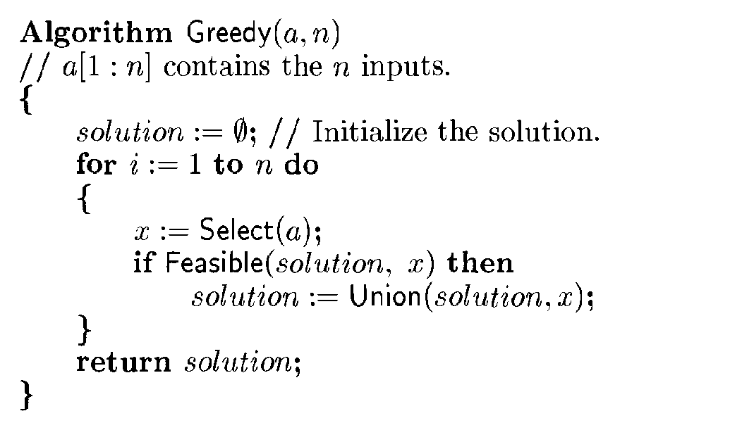
Greedy Method

Slide 7
Unit 3: Greedy Method - Outline
Introduction to Greedy Method
  General method
Minimum cost spanning trees:
  Prim’s Algorithm
Single Source shortest paths
  Dijkstra's Algorithm
  Optimal Tree problem:
  Huffman Trees and Codes

Slide 8
Minimum Spanning Tree MST
A spanning tree of a connected graph is its connected acyclic subgraph (i.e., a tree) that contains all the vertices of the graph.
A minimum spanning tree of a weighted connected graph is its spanning tree of the smallest weight, where the weight of a tree is defined as the sum of the weights on all its edges.
The minimum spanning tree problem is the problem of finding a minimum spanning tree for a given weighted connected graph.

Slide 9
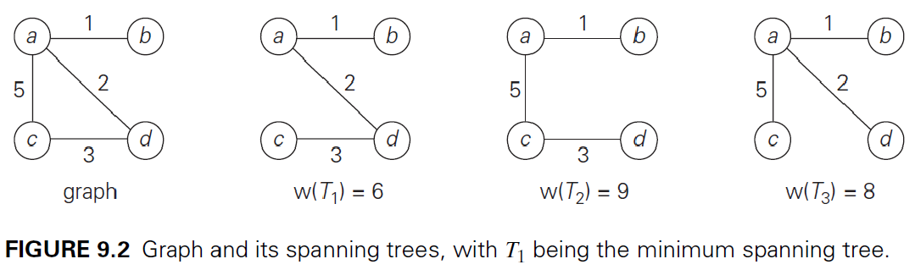
MST - Example

Slide 10
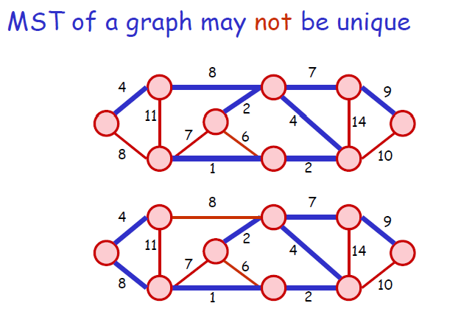
Cost = 37
Cost = 37

Slide 11
Unit 3: Greedy Method - Outline
Introduction to Greedy Method
  General method
Minimum cost spanning trees:
  Prim’s Algorithm
Single Source shortest paths
  Dijkstra's Algorithm
  Optimal Tree problem:
  Huffman Trees and Codes

Slide 12
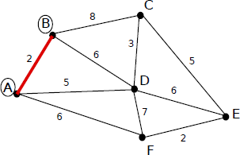
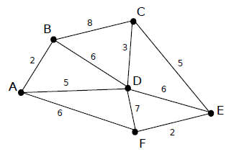
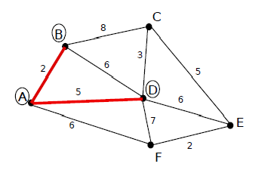
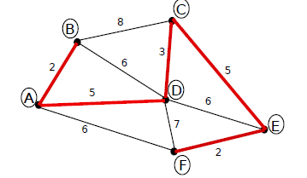
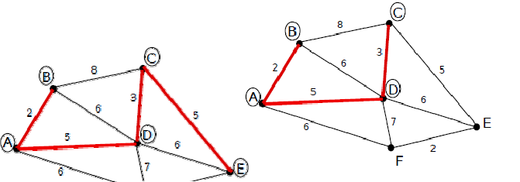
Prims Algorithm-Example

Slide 13
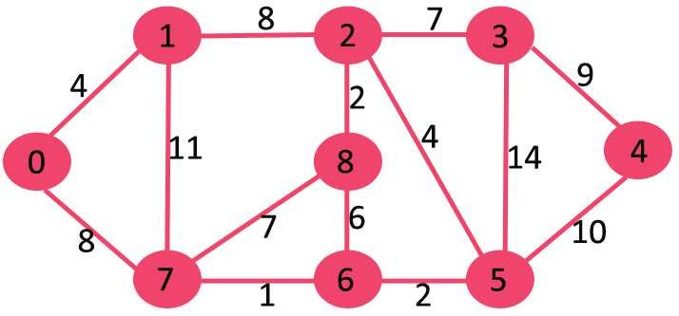

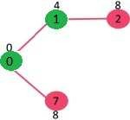
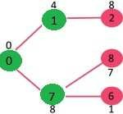
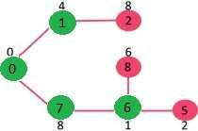
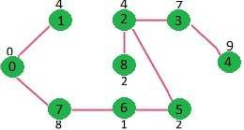
Prim’s Algorithm - Example
…

Slide 14
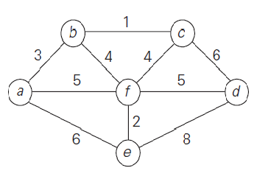
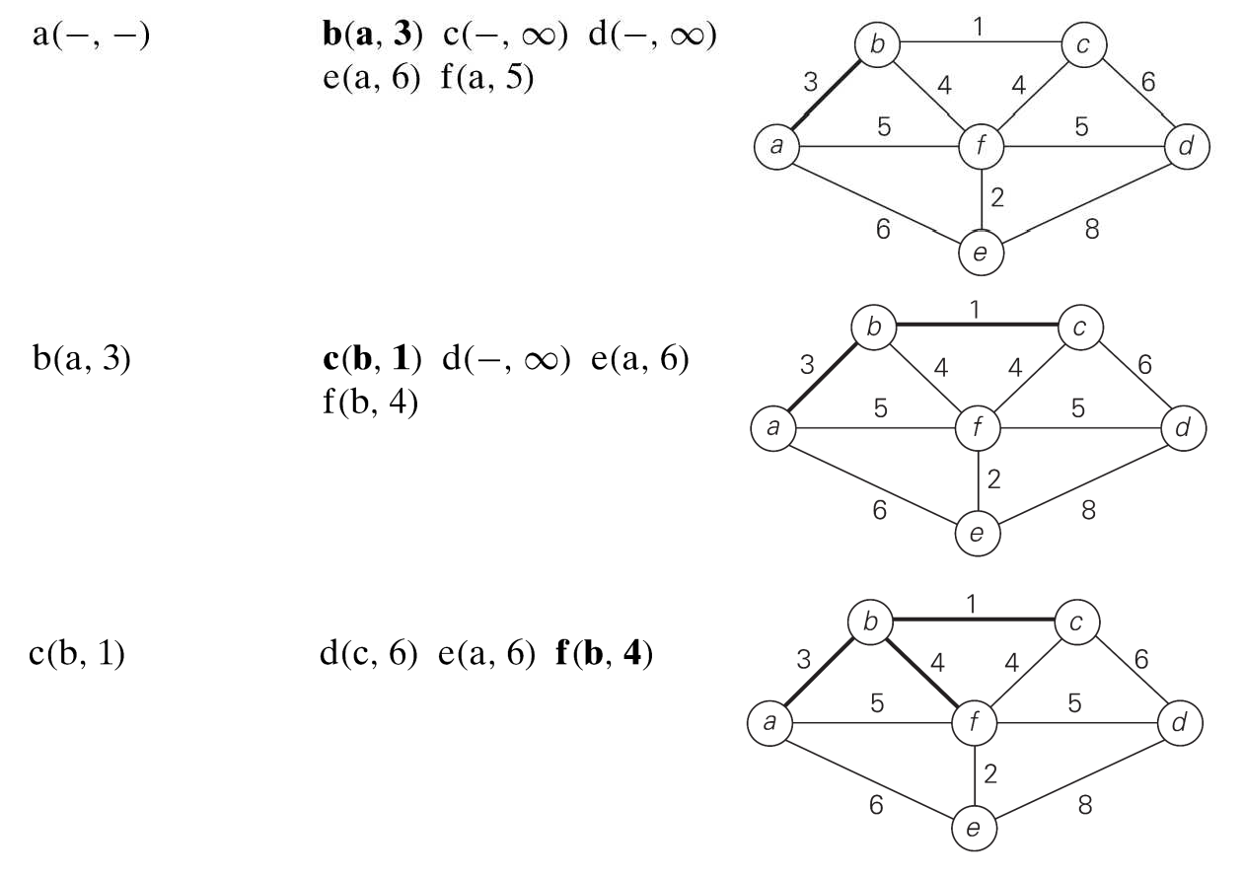
Example from Text book
Tree vertices
Remaining vertices
Illustration

Slide 15
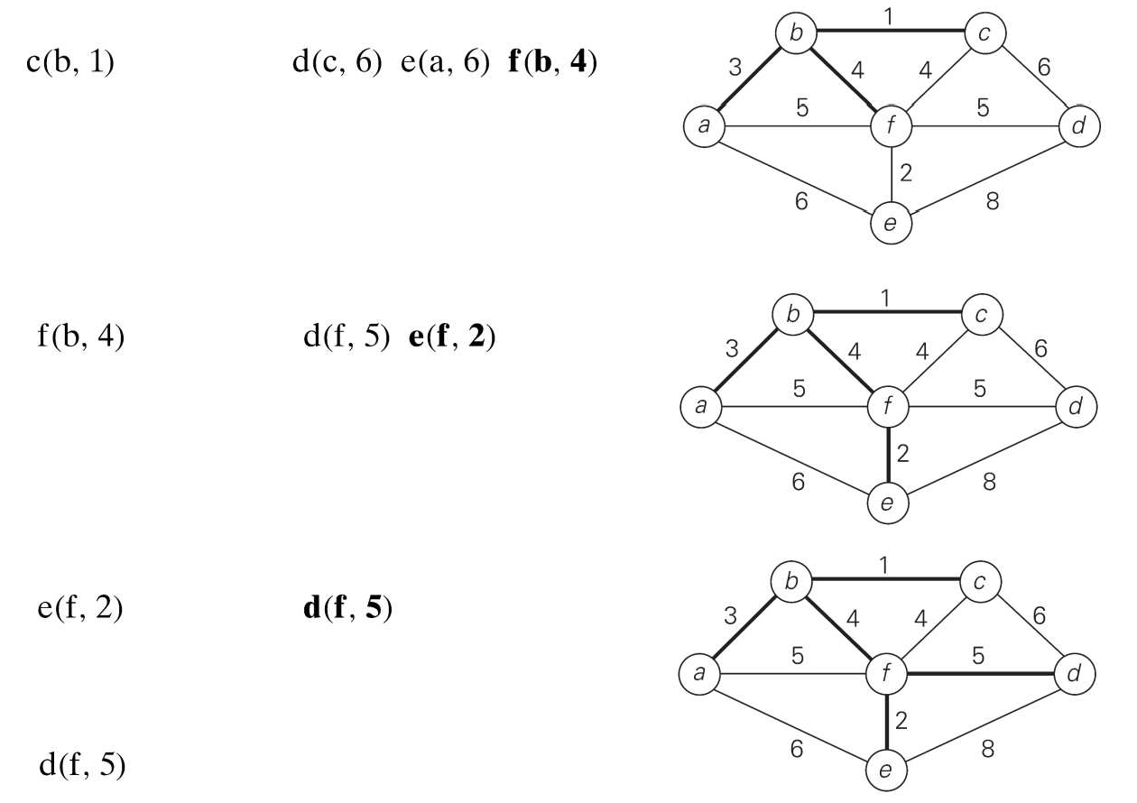
Example from Text book
Tree vertices
Remaining vertices
Illustration

Slide 16
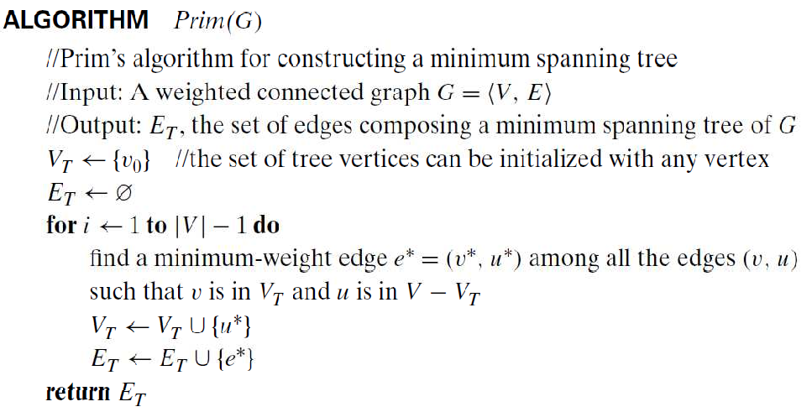
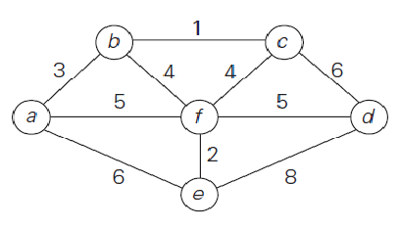
Prim’s Algorithm

Slide 17
Analysis of Efficiency
Depends on the data structures chosen
  for the graph & for the priority queue of the set V − V_{T} whose vertex priorities are the distances to the nearest tree vertices.
If graph representation - weight matrix,
priority queue - is implemented as an unordered array,
the running time will be in Θ(|V|²).
If a graph is represented as adjacency lists and the priority queue is implemented as a min-heap,
  the running time is in O(|E| log |V|).

Slide 18
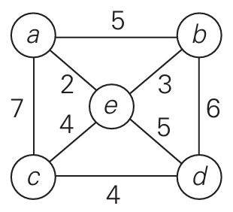
Home Work
Apply Prim’s algorithm to find the MST of the following graph.

Slide 19
Unit 3: Greedy Method - Outline
Introduction to Greedy Method
  General method
Minimum cost spanning trees:
  Prim’s Algorithm
Single Source shortest paths
  Dijkstra's Algorithm
  Optimal Tree problem:
  Huffman Trees and Codes

Slide 20
Single Source Shortest Path
Problem Statement
Given a graph and a source vertex in graph,
find shortest paths from source to all vertices in the given graph
Dijkstra's Algorithm is the best-known algorithm
It is similar to Prim’s algorithm
This algorithm is applicable to undirected and directed graphs with nonnegative weights only.

Slide 21
Dijkstra's Algorithm
Working
First, it finds the shortest path from the source to a vertex nearest to it, then to a second nearest, and so on
In general, before its i^{th} iteration commences, the algorithm has already identified the shortest paths to i-1 other vertices nearest to the source.

Slide 22


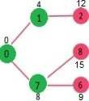
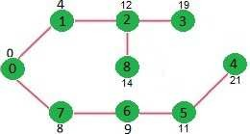

Slide 23
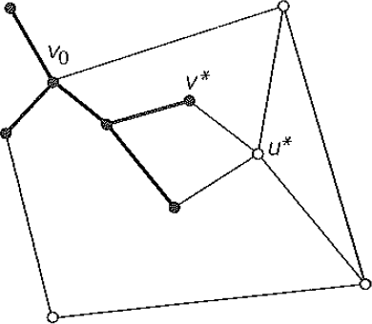
The source, and the edges of the shortest paths leading to them from the source form a subtree T_{i} of the given graph shown in the figure.
The next vertex nearest to the source can be found among the vertices adjacent to the vertices of T_{i}. called as "fringe vertices";
They are the candidates from which Dijkstra's algorithm selects the next vertex nearest to the source.

Slide 24
To identify the i^{th} nearest vertex, the algorithm computes, for every fringe vertex u,
– the sum of the distance to the nearest tree vertex v and the length d (shortest path from the source to v) (already computed !!!)
then selects the vertex with the smallest such sum.

Slide 25

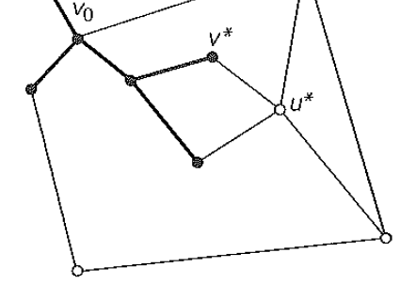
To facilitate the algorithm's operations, we label each vertex with two labels.
  The numeric label d indicates the length of the shortest path from the source to this vertex found by the algorithm so far
  The other label indicates the parent of the vertex in
the tree being constructed.
Source
Vertex (parent, d)
With such labelling, finding the next nearest vertex u* becomes a simple task of finding a fringe vertex with the smallest d value.

Slide 26
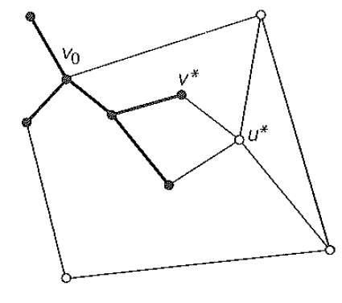
After we have identified a vertex u* to be added to the tree, we need to perform two operations:
  Move u* from the fringe to the set of tree vertices.
  For each remaining fringe vertex u that is connected to u* by an edge of weight w (u*, u) such that
d_{u*}+ w(u*, u) < d_{u} ,
update the labels of u by u* and d_{u*} + w(u*, u), respectively.

Slide 27

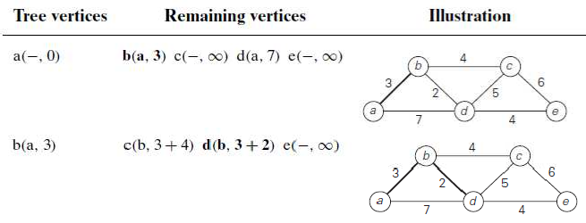

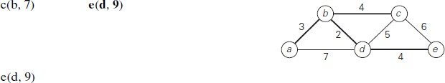

Slide 28

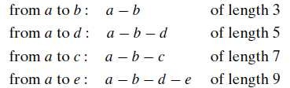
The shortest paths (identified by following nonnumeric labels backward from a destination vertex in the left column to the source) and their lengths (given by numeric labels of the tree vertices) are as follows:

Slide 29
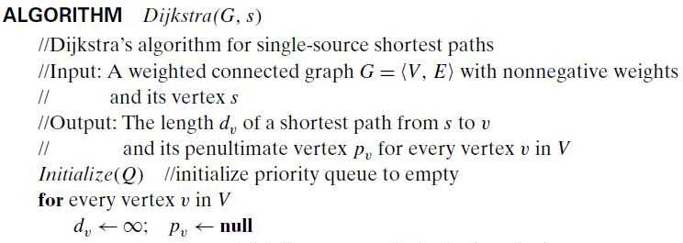

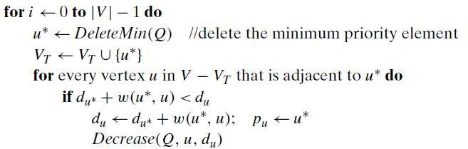
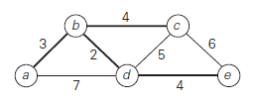
Dijkstra’s Algorithm

Slide 30
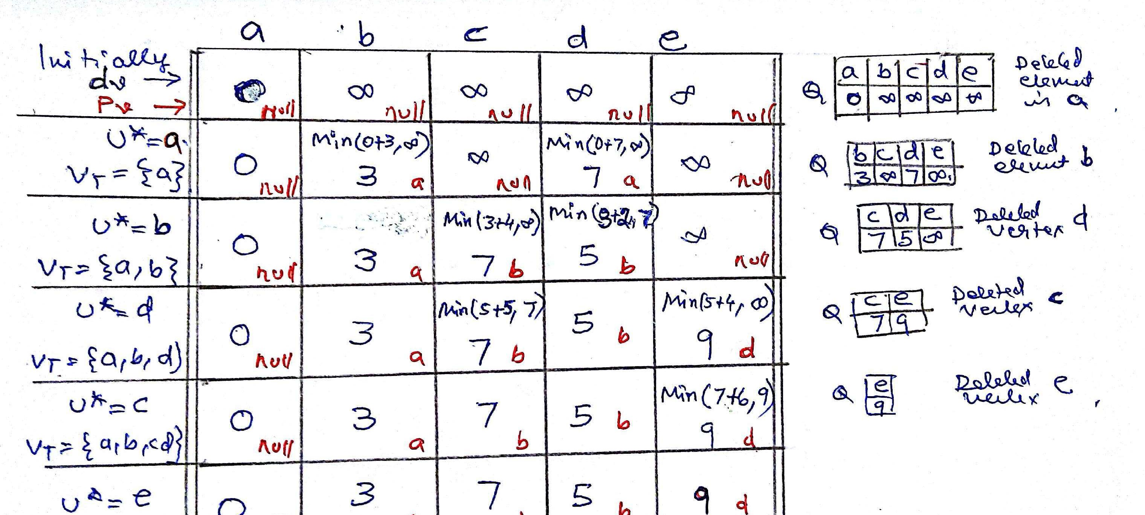
Dijkstra’s Algorithm
…
…

Slide 31
Analysis
Efficiency is Θ(|V|²) for graphs represented by their weight matrix and the priority queue implemented as an unordered array.
For graphs represented by their adjacency lists and the priority queue implemented as a min-heap, it is in O ( |E| log |V| )
31

Slide 32
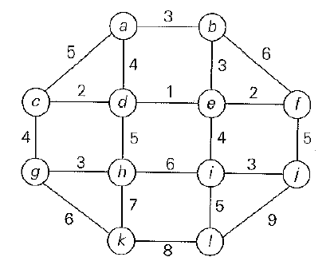
Home Work
Apply Dijkstra's Algorithm to the following graph. Consider a as source vertex
32

Slide 33
Unit 3: Greedy Method - Outline
Introduction to Greedy Method
  General method
Minimum cost spanning trees:
  Prim’s Algorithm
Single Source shortest paths
  Dijkstra's Algorithm
  Optimal Tree problem:
  Huffman Trees and Codes

Slide 34
Optimal Tree Problem
Background
Suppose we have to encode a text that comprises characters from some n-character alphabet
Encode by assigning to each of the text's characters some sequence of bits called the codeword.
There are two types of encoding:
  Fixed-length encoding,
  Variable-length encoding
34

Slide 35
Optimal Tree Problem
Fixed length Coding
This method assigns to each character a bit string of the same length m.
Example: ASCII code.
Drawback?
  How to overcome the drawback?
  assigning shorter code-words to more frequent characters and longer code-words to less frequent characters.
35

Slide 36
Optimal Tree Problem
Variable length Coding
This method assigns code-words of different lengths to different characters
Prefix-free codes (prefix codes) are used; Here no codeword is a prefix of a codeword of another character.
We can simply scan a bit string until we get the first group of bits that is a codeword for some character
36

Slide 37
Optimal Tree Problem
Variable length Coding
If we want to create a binary prefix code for some alphabet,
  it is natural to associate the alphabet's characters with leaves of a binary tree in which all the left edges are labelled by 0 and all the right edges are labelled by 1 (or vice versa).
Many trees that can be constructed in this manner for a given alphabet
Example...
37

Slide 38
Optimal Tree Problem
For known frequencies of the character occurrences,
Construction of such a tree that would assign
  shorter bit strings to high-frequency characters and
  longer ones to low-frequency characters can be done by the greedy algorithm, invented by David
Huffman.
38

Slide 39
Optimal Tree Problem
Variable length Coding
This method assigns code-words of different lengths to different characters
Prefix-free codes (prefix codes) are used; Here no codeword is a prefix of a codeword of another character.
we can simply scan a bit string until we get the first group of bits that is a codeword for some character
39

Slide 40
Unit 3: Greedy Method - Outline
Introduction to Greedy Method
  General method
Minimum cost spanning trees:
  Prim’s Algorithm
Single Source shortest paths
  Dijkstra's Algorithm
  Optimal Tree problem:
  Huffman Trees and Codes

Slide 41
Huffman Trees and Codes
Huffman's Algorithm
Step 1: Initialize n one-node trees and label them with the characters of the alphabet. Record the frequency of each character in its tree's root to indicate the tree's weight.
Step 2: Repeat the following operation until a single tree is obtained.
– Find two trees with the smallest weight. Make them the left and right subtree of a new tree and record the sum of their weights in the root of the new tree as its weight.
A tree constructed by the above algorithm is called a Huffman tree. It defines-in the manner described-a Huffman code.
41

Slide 42


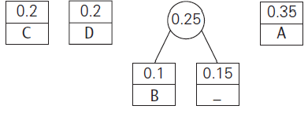
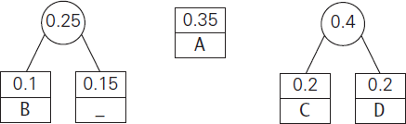
Example
42

Slide 43
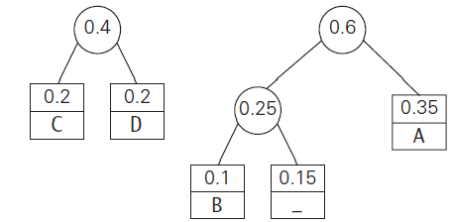
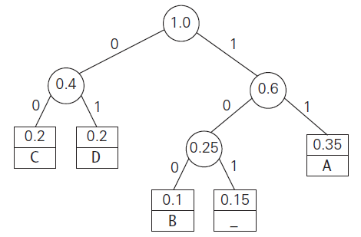
43

Slide 44
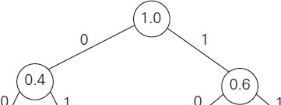
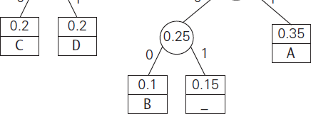
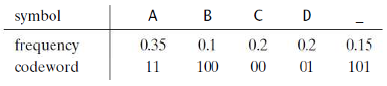
Huffman codes
The resulting codewords are as follows:
DAD is encoded as 011101
1001101101001101 is decoded as
44

Slide 45
Analysis
Average number of bits per symbol in this code
2 * 0.35 + 3 * 0.1+ 2 * 0.2 + 2 * 0.2 + 3 * 0.15 = 2.25.
Compression ratio (3−2.25)/3*100 = 25%
In other words, Huffman’s encoding of the above text will use 25% less memory than its fixed-length encoding.
45

Slide 46
Home work
Represent the text “ABCDEBCDECDEDEE” using huffman coding.
46

