Slide 1
Unit 5: Backtracking

Slide 2
Backtracking
Some problems can be solved, by exhaustive search.
Backtracking is a more intelligent variation of this approach.
The principal idea is to construct solutions one component at a time and evaluate such partially constructed candidates as follows.
  If a partially constructed solution can be developed, continue.
  If there is no legitimate option for the next component, backtrack to replace the last component of the partially constructed solution with its next option.

Slide 3
Backtracking
State-space tree, represents the processing
Its root represents an initial state
The nodes of the first level in the tree represent the choices made for the first component of a solution
The nodes of the second level represent the choices for the second component, and so on.
A node in a state-space tree is said to be promising
  if it corresponds to a partially constructed solution that may still lead to a complete solution;
  otherwise, it is called nonpromising.
Leaves represent either nonpromising dead ends or complete solutions found by the algorithm.

Slide 4
Backtracking
In the majority of cases, a states-pace tree for a backtracking algorithm is constructed in the manner of depth-first search.
If the algorithm reaches a complete solution to the problem, it either stops (if just one solution is required) or continues searching for other possible solutions.

Slide 5
N-Queens Problem
Problem Definition
The problem is to place n queens on an n × n chessboard so that no two queens attack each other by being in the same row or in the same column or on the same diagonal.
So let us consider the 4-queens problem and solve it by the backtracking technique.

Slide 6
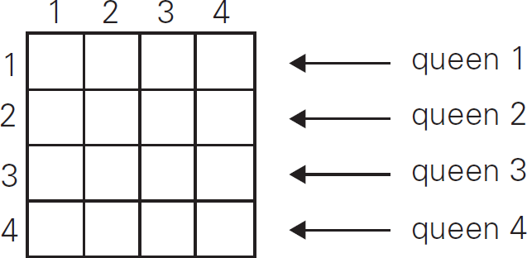
4-Queens problem
Since each of the four queens has to be placed in its own row, all we need to do is to assign a column for each queen on the board presented in figure.

Slide 7
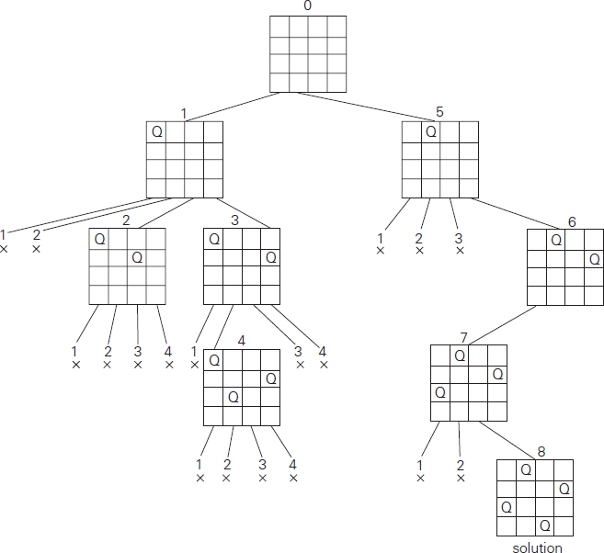
4-Queens problem
The state-space tree of this search is shown in figure.
Note: This tree shows expansion of nodes till it gets a solution. For multiple solutions it need to be expanded further

Slide 8
4-queens problem
If other solutions need to be found, the algorithm can simply resume its operations at the leaf at which it stopped.
Alternatively, we can use the board’s symmetry for this purpose.
Finally, it should be pointed out that a single solution to the n-queens problem for any n ≥ 4 can be found in linear time.

Slide 9
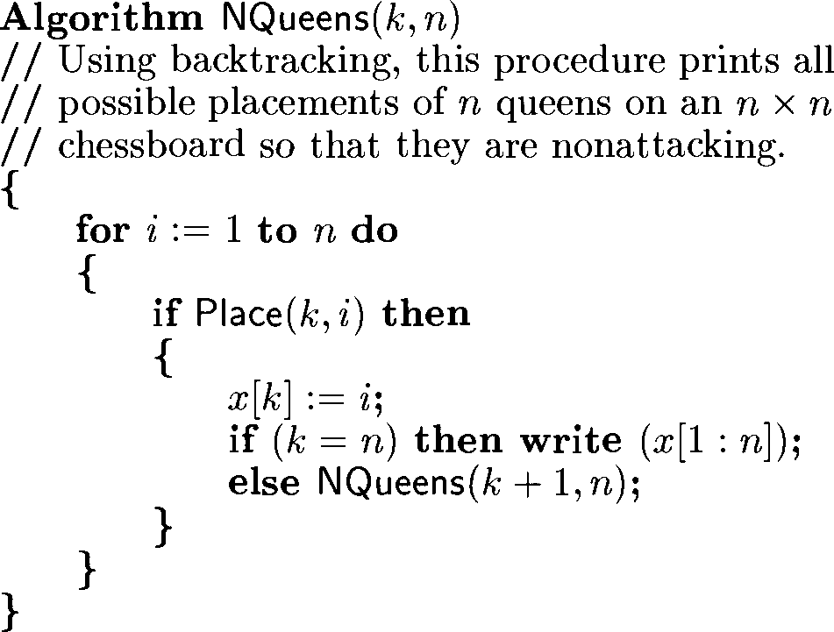
N-queens prblem
Algorithm to find all solutions of n-queens problem

Slide 10
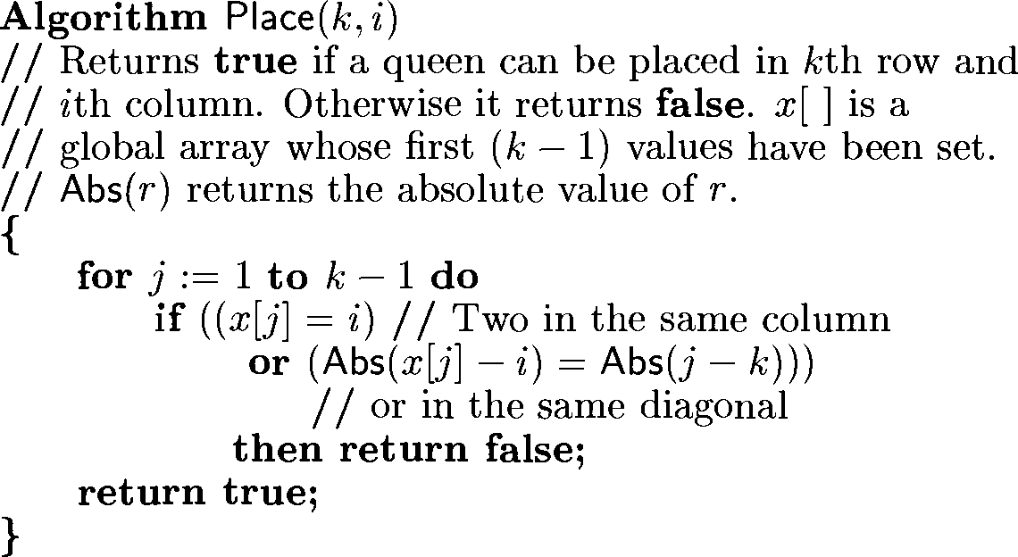
N-queens problem

Slide 11
Sum of Subsets Problem
Problem definition
Find a subset of a given set A = {a₁, . . . , a_{n} } of n positive integers whose sum is equal to a given positive integer d.
Example
For A = {1, 2, 5, 6, 8} and d = 9, there are two solutions: {1, 2, 6} and {1, 8}.
Of course, some instances of this problem may have no solutions.
State space tree is shown in next slide

Slide 12
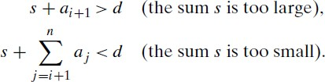
Sum of Subsets Problem
It is convenient to sort the set’s elements in increasing order.
In the state space tree at a node, If sum is not equal to d, we can terminate the node as non-promising if either of the following two inequalities holds:

Slide 13
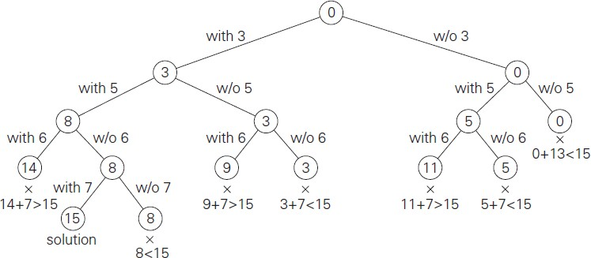
Sum of Subsets Problem
State space tree of A={3, 5, 6, 7} and d=15

Slide 14
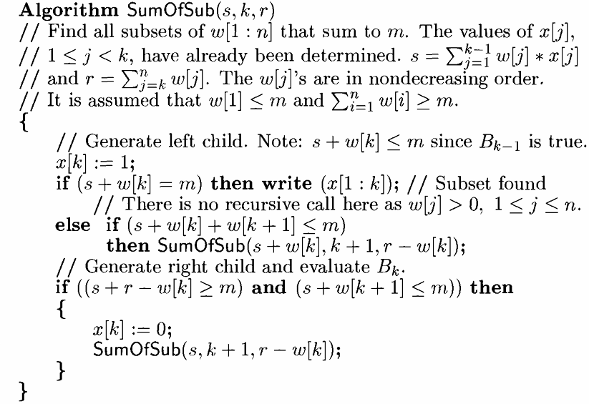
Sum of Subsets Problem Algorithm

Slide 15
Branch and Bound
Backtracking - cut off a branch of the problem’s state-space tree as soon as we can deduce that it cannot lead to a solution
This idea can be strengthened further if we deal with an optimization problem.
An optimization problem seeks to minimize or maximize some objective function like
  a tour length – in TSP,
  the value of items selected – in knapsack
subject to some constraints.
An optimal solution is a feasible solution with the best value of the objective function

Slide 16
Branch and Bound
Compared to backtracking, branch-and-bound requires two additional items:
a way to provide, for every node of a state-space tree, a bound on the best value of the objective function on any solution,
that can be obtained by adding further components to the partially constructed solution represented by the node
the value of the best solution seen so far

Slide 17
Branch and Bound
In general, we terminate a search path for any one of the following three reasons:
The value of the node’s bound is not better than the value of the best solution seen so far.
The node represents no feasible solutions because the constraints of the problem are already violated.
The subset of feasible solutions represented by the node consists of a single point (and hence no further choices can be made)

Slide 18
Assignment Problem
Problem Definition
Assigning n people to n jobs so that the total cost of the assignment is as small as possible.
An instance of the assignment problem is specified by an n × n cost matrix C
We can state the problem as follows:
“select one element in each row of the matrix so that no two selected elements are in the same column and their sum is the smallest possible”

Slide 19
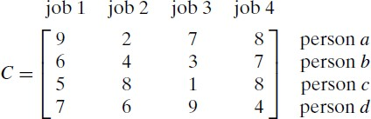
Example
How can we find a lower bound on the cost of an optimal selection without actually solving the problem?
We can do this by several methods.
  For example, optimal solution cannot be smaller than the sum of the smallest elements in each of the matrix’s rows.
  For the instance here, this sum is 2 + 3+ 1+ 4 = 10.

Slide 20
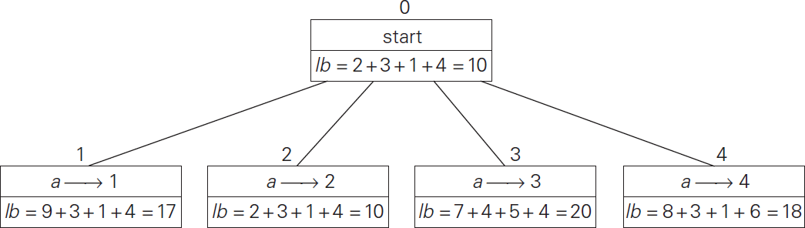
Figure: Lower bound computation
Note: Avoid the assigned jobs column for computation of lb, as it is not feasible

Slide 21
Rather than generating a single child of the last promising node as we did in backtracking, we will generate all the children of the most promising node among non-terminated leaves in the current tree.
How can we tell which of the nodes is most promising?
  We can do this by comparing the lower bounds of the live nodes.
  It is sensible to consider a node with the best bound as most promising (as of now)
This variation of the strategy is called the best-first branch-and-bound.

Slide 22
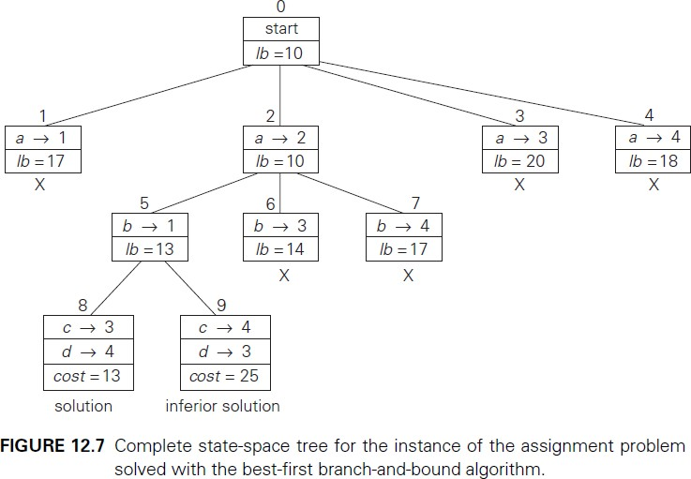
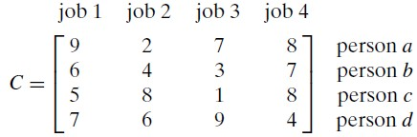
Note: After Computation of 9th Node, We have to explore nodes that have better lb than 13.
In this example we do not have such nodes. So we stop at 9.

Slide 23
Note: After Computation of 9th Node, We have to explore nodes that have better lb than 13.
In this example we do not have such nodes. So we stop at 9.

Slide 24
0/1 Knapsack problem
Branch and Solution to 0/1 Knapsack problem
Problem Definition
Given n items of known weights w_{i} and values v_{i} , i = 1, 2, . . . , n, and a knapsack of capacity W, find the most valuable subset of the items that fit in the knapsack.

Slide 25
0/1 Knapsack problem
It is convenient to order the items of a given instance in descending order by their value-to-weight ratios.
Each node on the i^{th} level of this tree, 0 ≤ i ≤ n, represents all the subsets of n items that include a particular selection made from the first i ordered items
We record the total weight w and the total value v of this selection in the node, along with some upper bound ub

Slide 26
How to compute the upper bound?
A simple way to compute the upper bound ub is to
  add to v, the total value of the items already selected,
  the product of the remaining capacity of the knapsack W − w and the best per unit payoff among the remaining items, which is v_{i+1}/w_{i+1}
ub = v + (W − w)(v_{i+1}/w_{i+1}).

Slide 27
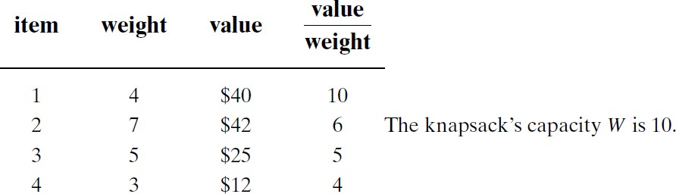
Example
Consider the following problem.
The items are already ordered in descending order of their value-to-weight ratios.
Let us apply the branch-and-bound algorithm.

Slide 28
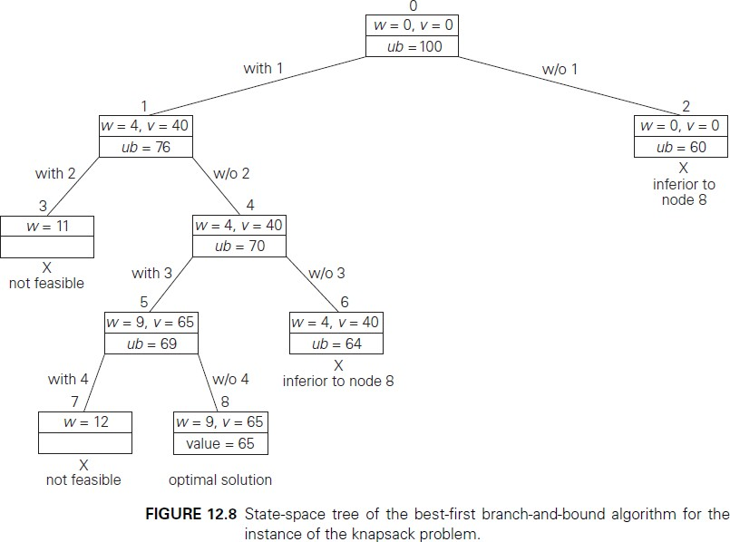
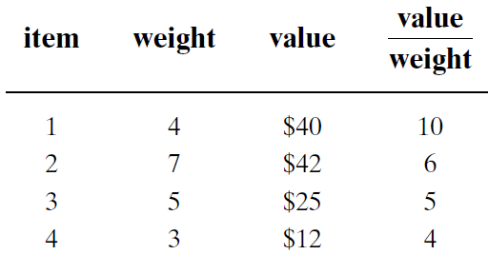


Slide 29
61

Slide 30
Basic Concepts
For many of the problems we know and study, the best algorithms for their solution have computing times can be clustered into two groups;
  Solutions are bounded by the polynomial- Examples include Binary search O(log n), Linear search O(n) or in general O(n^{k}) where k is a constant.
  Solutions are bounded by a non-polynomial - Examples include travelling salesman problem O(n²2^{n}) & knapsack problem O(2^{n/2}).
As the time increases exponentially, even moderate size problems cannot be solved.

Slide 31
Basic Concepts
So far, no one has been able to device an algorithm which is bounded by the polynomial for the problems belonging to the non-polynomial.
However impossibility of such an algorithm is not proved.

Slide 32
Non deterministic algorithms
We also need the idea of two models of computer (Turing machine): deterministic and non- deterministic.
A deterministic computer is the regular computer we always thinking of.
When the result of every operation is uniquely defined then it is called deterministic algorithm.
A non-deterministic computer is one that is just like we’re used to except that it has unlimited parallelism, so that any time you come to a branch, you spawn a new “process” and examine both sides.

Slide 33
Non deterministic algorithms
When the outcome is not uniquely defined but is limited to a specific set of possibilities, we call it non deterministic algorithm.

Slide 34
Decision vs Optimization algorithms
An optimization problem tries to find an optimal solution.
A decision problem tries to answer a yes/no question.
Most of the problems can be specified in decision and optimization versions.
For example, TSP can be stated as two ways
  Optimization - find hamiltonian cycle of minimum weight
  Decision - is there a hamiltonian cycle of weight ≤k?
81

Slide 35
Decision vs Optimization algorithms
For graph coloring problem,
  Optimization – find the minimum number of colors needed to color the vertices of a graph so that no two adjacent vertices are colored the same color
  Decision - whether there exists such a coloring of the graph’s vertices with no more than m colors?
Many optimization problems can be recast in to decision problems with the property that,
  the decision algorithm can be solved in polynomial time if and only if the corresponding optimization
82

Slide 36
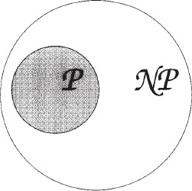
P, NP
NP stands for Non-deterministic Polynomial time.
Definition: P is a set of all decision problems solvable by a deterministic algorithm in polynomial time.
Definition: NP is the set of all decision problems solvable by a nondeterministic algorithm in polynomial time.
This also implies P ⊆NP
i.e. Problems known to be in P are trivially in NP

Slide 37
P
P is a complexity class that represents the set of all decision problems that can be solved in polynomial time.
That is, given an instance of the problem, the answer yes or no can be decided in polynomial time.
Example
  Given a connected graph G, can its vertices be coloured
using two colours so that no edge is monochromatic?
  Algorithm: start with an arbitrary vertex, color it red and all of its neighbours blue and continue. Stop when you run out of vertices or you are forced to make an edge have both of its endpoints be the same color.

Slide 38
NP
NP is a complexity class that represents the set of all decision problems for which the instances where the answer is "yes" have proofs that can be verified in polynomial time.
This means that if someone gives us an instance of the problem and a certificate (sometimes called a witness) to the answer being yes, we can check that it is correct in polynomial time.

Slide 39
NP - Example
Integer factorisation is in NP.
This is the problem that given integers n and m, is there an integer f with 1 < f < m, such that f divides n (f is a small factor of n)?
This is a decision problem because the answers are yes or no.
If someone hands us an instance of the problem (so they hand us integers n and m) and an integer f with 1 < f < m, and claim that f is a factor of n (the certificate), we can check the answer in polynomial time by performing the division n / f.
86

Slide 40
P, NP
But there are some problems which are known to be in NP but don’t know if they’re in P.
The example is the decision-problem version of the Travelling Salesman Problem (decision-TSP).
It’s not known whether decision-TSP is in P:
  there’s no known poly-time solution,
  but there’s no proof such a solution doesn’t exist.
The most famous unsolved problem in computer science is “whether P=NP or P≠NP? ”
87

Slide 41
NP-Complete
Reducible Problems
Given decision problems P and Q, if an algorithm can transform a solution for P into a solution for Q in polynomial time, it’s said that Q is poly-time reducible (or just reducible) to P.
Definition: NP-Complete
A decision problem D is said to be NP-complete if:
it belongs to class NP
every problem in NP is polynomially reducible to D

Slide 42
NP-Complete
NP-Complete is a complexity class which represents the set of all problems X in NP for which it is possible to reduce any other NP problem Y to X in polynomial time.
Intuitively this means that we can solve Y quickly if we know how to solve X quickly.
Precisely, Y is reducible to X, if there is a polynomial time algorithm f to transform instances y of Y to instances x = f(y) of X in polynomial time, with the property that the answer to y is yes, if and only if the answer to f(y) is yes.

Slide 43
NP Complete
Informally, these are the hardest problems in the class NP
If any NP-complete problem can be solved by a polynomial time deterministic algorithm,
– then every problem in NP can be solved by a polynomial time deterministic algorithm
But Till date, no polynomial time deterministic algorithm is known to solve any of them

Slide 44
NP-Complete
Example for NP-complete is CNF-satisfiability problem.
The CNF-satisfiability problem deals with boolean expressions.
This is given by Cook in 1971.
The CNF-satisfiability problem asks whether or not one can assign values true and false to variables of a given boolean expression in its CNF form to make the entire expression true.

Slide 45
Example for NP-Complete
Traveling salesman problem
Hamiltonian cycle problem
Clique problem
Subset sum problem
Boolean satisfiability problem
Many thousands of other important computational problems in computer science, mathematics, economics, manufacturing, communications, etc.

Slide 46
NP-Hard Problems
These problems need not have any bound on their running time.
If any NP-Complete Problem is polynomial time reducible to a problem X, that problem X belongs to NP-Hard class.
All NP-Complete problems are also NP-Hard.
In other words if a NP-Hard problem is non- deterministic polynomial time solvable, it is a NP- Complete problem.
Example of a NP problem that is not NPC is Halting Problem.

Slide 47
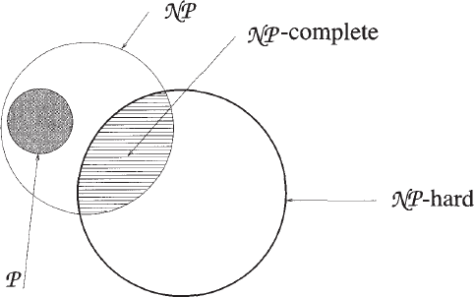
NP-Hard Problems
Figure: Commonly believed relationship between P, NP, NP-Complete and NP-hard problems

Slide 48
NP-Hard Problems
If a NP-Hard problem can be solved in polynomial time then all NP-Complete can be solved in polynomial time.
“All NP-Complete problems are NP-Hard but not all NP-Hard problems are not NP-Complete.”
NP-Complete problems are subclass of NP-Hard
The more conventional optimization version of TSP for finding the shortest route is NP-hard, not strictly NP-complete.

Slide 49
NP-Hard
Intuitively, these are the problems that are at least as hard as the NP-complete problems.
Note that NP-hard problems do not have to be in NP, and they
do not have to be decision problems.
The precise definition here is that a problem X is NP-hard, if there is an NP-complete problem Y, such that Y is reducible to X in polynomial time.
But since any NP-complete problem can be reduced to any other NP-complete problem in polynomial time, all NP- complete problems can be reduced to any NP-hard problem in polynomial time.
Then, if there is a solution to one NP-hard problem in polynomial time, there is a solution to all NP problems in polynomial time.

Slide 50
NP-Hard
Example: The halting problem is an NP-hard problem.
This is the problem that given a program P and input I, will it halt? This is a decision problem but it is not in NP. It is clear that any NP-complete problem can be reduced to this one. As another example, any NP-complete problem is NP-hard.

