Slide 1
Unit-4
Transform and Conquer

Slide 2
Transform and Conquer
A problem that can be solved by transforming a given problem instance into an intermediate instance and then determining the solution.
This technique work in two-stage procedures.
Transformation stage: the problem’s instance is modified to be more inclined to solution, for one reason or another.
Conquering stage: problem instance is solved.

Slide 3

Transform and Conquer (Contd..)
There are three major variations that differ by what we transform a given instance to:
Instance simplification: Transformation to a simpler or more convenient instance of the same problem. Ex: Presorting, AVL Trees
Representation change: Transformation to a different representation of the same instance. Ex: Heapsort
Problem reduction: Transformation to an instance of a different problem for which an algorithm is already available. Ex: LCM(=(a*b)/GCD(a,b)

Slide 4
Presorting(Instance Simplification)
Presorting is not a direct problem-solving method/ technique, it is an intermediate stage to solve the problem.
Example: Checking element uniqueness in an array
Brute-force - worst-case efficiency - O(n²).

Slide 5
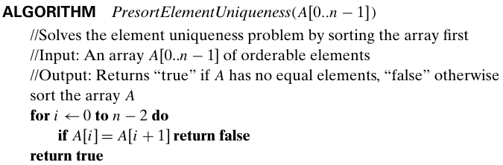
Presort Element Uniqueness
First sort, then check only its consecutive elements: if the array has equal elements, a pair of them must be next to each other.

Slide 6

Example 2: Computing a mode
A mode is a value that occurs most often in a given list of numbers.
For example, for 5, 1, 5, 7, 6, 5, 7, the mode is 5.
Brute-force - scan the list and compute the frequencies of all its distinct values, then find the value with the largest frequency.
Worst-case time efficiency

Slide 7
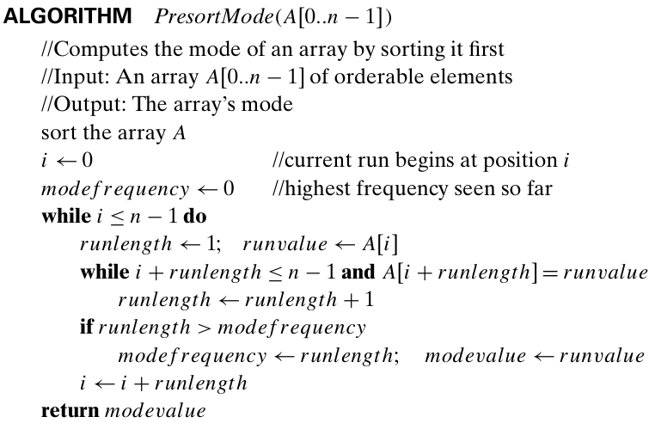
Presort Mode
Time Complexity: T(n) = T_{sort}(n) + (n-1)
= θ(nlogn) + θ(n)
T(n) = θ(nlogn)

Slide 8
Example 3: Searching Problem
Consider the problem of searching for a given value v in a given array of n sortable items.
Brute-force: Linear search - needs n comparisons in the worst case.
If the array is sorted first, then apply binary search, - requires only log2 n +1 comparisons in the worst case.
Assuming the most efficient n log n sort, the total running time of such a searching algorithm in the worst case will be

Slide 9
AVL Tree
An AVL tree is a binary search tree in which the balance factor of every node, which is defined as the difference between the heights of the node’s left and right subtrees, is either 0 or +1 or −1.
The height of the empty tree is defined as -1.

Slide 10
AVL Tree (Contd..)
If an insertion of a new node makes an AVL tree unbalanced, we transform the tree by a rotation.
A rotation in an AVL tree is a local transformation of its subtree rooted at a node whose balance has become either +2 or −2.
If there are several such nodes, we rotate the tree rooted at the unbalanced node that is the closest to the newly inserted leaf.

Slide 11
AVL Tree (Contd..)
There are only four types of rotations;
The first rotation type is called the single right rotation, or R-rotation.
The second rotation type is called the single left rotation, or L-rotation.
The third rotation type is called the double left-right rotation (LR rotation).
The fourth rotation type is called the double-right-left rotation (RL-rotation).

Slide 12
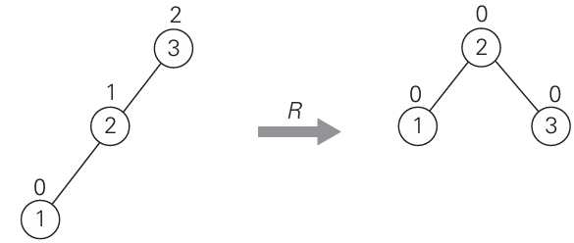
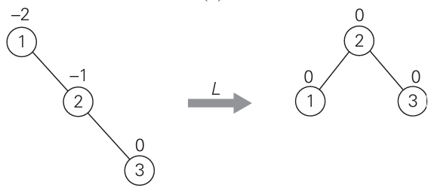
AVL Tree (Contd..)
Single R-Rotation
Single L-Rotation

Slide 13
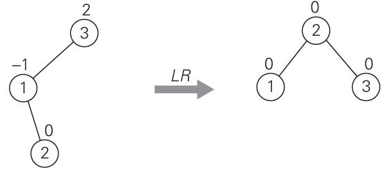
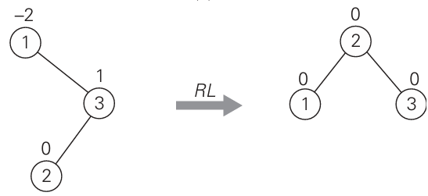
AVL Tree (Contd..)
Double LR-rotation
Double RL-rotation

Slide 14
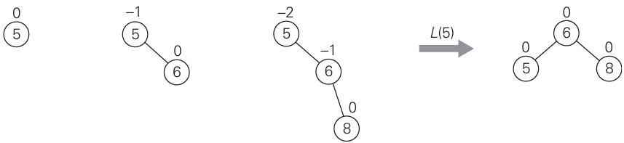
Example: Construction of AVL tree
Construction of an AVL tree for the list 5, 6, 8, 3, 2, 4, 7

Slide 15
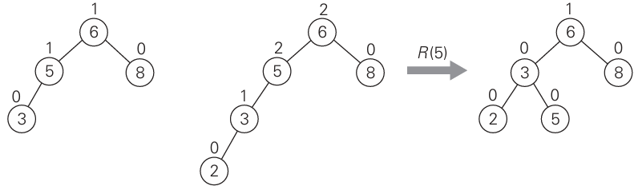
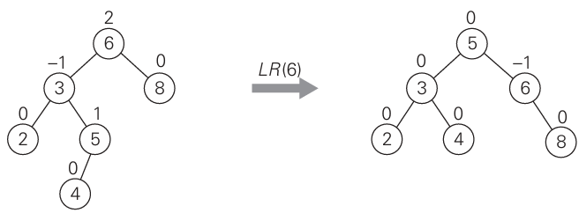
Example: Construction of AVL tree (Contd..)

Slide 16
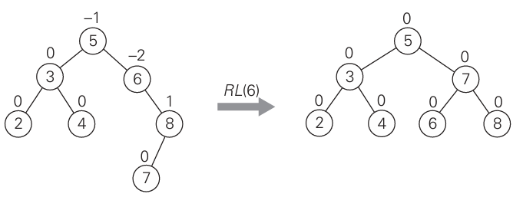
Example: Construction of AVL tree (Contd..)

