Slide 1


Entrepreneurship
Management and IPR

Slide 2


Introduction
Entrepreneur – Who is an Entrepreneur?
An entrepreneur is an individual who creates a new business, bearing most of the risks and enjoying most of the rewards.
... Entrepreneurs who prove to be successful in taking on the risks of a startup are rewarded with profits, fame, and continued growth opportunities.

Slide 3
Entrepreneur
A person who undertakes the risk of starting a new business venture is called and entrepreneur.
An entrepreneur creates a firm, which aggregates capital and labour in order to produce goods or services for profit.
Entrepreneurship is an important driver of economic growth and innovation.
Entrepreneurship is high-risk, but also can be high-reward as it serves to generate economic wealth, growth, and innovation.

Slide 4
Entrepreneurship
What is Entrepreneurship?
Entrepreneurship is the act of creating a business or businesses while building and scaling it to generate a profit.
Transforming the world by solving big problems.
Bringing about social change or creating an innovative product that challenges the status quo of how we live our lives on a daily basis.

Slide 5
Becoming an Entrepreneur?
Ensure Financial Stability
Build a Diverse Skill Set
Once a person has strong finances, it is important to build a diverse set of skills and then apply those skills in the real world.
Consume Content Across Multiple Channels
Collecting information is important whilst the channels.
Identify a Problem to Solve
Solve That Problem
- Successful start-ups solve specific pain points for other companies or for the public.

Slide 6
Entrepreneur Vs. Buisnessman
The key difference between entrepreneurs and businessmen lies in the fact that an entrepreneur is a person who comes with a unique business idea and starts his own startup company on that idea whereas a businessman is a person who starts his company using an old business concept or an idea.
An entrepreneur creates a new market for his revolutionary and innovative products whereas a businessman applies different methods and proven strategies to make his way into an already established market.
It’s easy to mix Entrepreneurs and Businessman but they are different. “Entrepreneur” is a creative person and makes his path to start any business or set up a company.

Slide 7
Entrepreneur Vs. Buisnessman
Parameter of Comparison | Entrepreneur | Businessman
Definition | A creative person who introduces new ideas to run businesses. | A person who follows the already existing ideas.
Nature | Innovative | Traditional
Goal | Customer oriented | Profit oriented
Risk margin | High | low
Market position | Market leader | Market player
Orientation | Opportunity oriented | Resource oriented

Slide 8
Entrepreneur Vs. Manager
BASIS FOR COMPARISON | ENTREPRENEUR | MANAGER
Meaning | Entrepreneur refers to a person who creates an enterprise, by taking financial risk in order to get profit. | Manager is an individual who takes the responsibility of controlling and administering the organization.
Focus | Business startup | Ongoing operations
Primary motivation | Achievement | Power
Approach to task | Informal | Formal
Status | Owner | Employee
Reward | Profit | Salary
Decision making | Intuitive | Calculative
Driving force | Creativity and Innovation | Preserving status quo
Risk orientation | Risk taker | Risk averse

Slide 9
Youngest Entrepreneurs of India…

Slide 10





From sources across the web
Ritesh Agarwal: Ritesh Agarwal is the founder and CEO of OYO Rooms.
In 2011, Agarwal started an Airbnb equivalent called "Oravel Stays".
The company was launched as OYO Rooms in May 2013.
Age: 29 years (November 16, 1993)
Sreelakshmi Suresh: She is mainly known for her work designing websites in India which gained her media coverage as early as 2006.
Age: 25 years (February 5, 1998)
Tilak Mehta : A 13 year old young boy Tilak mehta ,has founded paper n parcel,A logstic company that targets same day delivery.
Age: 17 years (2006)
Trishneet Arora : He is the founder and chief executive officer of TAC Security, a cyber security company in 2013
Age: 30 years (November 2, 1993)
Sachin Bansal:The founder of Flipkart. In 2007, Sachin Bansal and Binny Bansal (not related) founded Flipkart
Age: 42 years (August 5, 1981)

Slide 11
Byju Raveendran
Age: About 43 years (1980)
Divya Gandotra Tandon
Age: 21 years (June 5, 2002)
Suumit Shah
Age: 32 years (December 25, 1990)
Gaurav Munjal

Slide 12
The Entrepreneurial Perspective

Slide 13
The Nature of Entrepreneurship
Entrepreneurship plays an important role in the creation and growth of businesses, as well as in the growth and prosperity of regions and nations.
Entrepreneurial action begins at opportunities…
Entrepreneurial opportunities are “those situations in which new goods, services, raw materials, and organizing methods can be introduced and sold at greater than their cost of production”.
An existing technological product in one market is introduced in other market.
Creating a new technological product for an existing market.
Or both i.e, new technological product/service in a new market.

Slide 14
The Nature of Entrepreneurship
The recurring theme is that an entrepreneurial opportunity represents something new.
The possibilities for exploring the opportunities require an enterprising individual or a group of enterprising individuals to recognize, evaluate, and exploit the situations as possible opportunities.
Therefore, entrepreneurship requires action— entrepreneurial action through the creation of new products/processes and/or the entry into new markets, which may occur through a newly created organization or within an established organization.

Slide 15
The Nature of Entrepreneurship
Entrepreneurs act in what they believe as opportunities.
Opportunities (create and/or generate) comes with high uncertainty.
Entrepreneurial judgement whether or not to act.
A key to understanding entrepreneurial action is being able to assess the amount of uncertainty perceived to surround a potential opportunity and the individual’s willingness to bear that uncertainty.
The individual’s prior knowledge can decrease the amount of uncertainty, and his or her motivation indicates a willingness to bear uncertainty.

Slide 16
The McMullen-Shepherd model

Slide 17

How Entrepreneurs think?
Entrepreneurs think differently from nonentrepreneurs.
Entrepreneurs must often make decisions in highly uncertain environments.
Given the nature of an entrepreneur’s decision-making environment, he or she must sometimes
(1) Think structurally,
(2) Engage in bricolage,
(3) Effectuate, and
(4) Cognitively adapt.

Slide 18
Think Structurally
Forming opportunity beliefs often requires creative mental leaps.
These creative mental leaps are from sources like one’s existing knowledge about
Existing Technology
Existing market
Existing Technology
New market
New Technology
New Market
Making these connections between a new product (or new service, new business model, or new technology) and a target market where it can be introduced is aided by the superficial and structural similarities between the source (e.g., the market) and the destination (e.g., technology).

Slide 19

Superficial similarities Vs. Structural similarities
Superficial similarities exist when the basic (relatively easy to observe) elements of the technology resemble the basic (relatively easy to observe) elements of the market.
In contrast, Structural similarities exist when the underlying mechanisms of the technology resemble (or match) the underlying mechanisms of the market.
The entrepreneurial challenge often lies in making creative mental leaps based on structural similarities.

Slide 20


Engage in Bricolage
Entrepreneurs making do by applying combinations of the resources at hand to new problems and opportunities

Slide 21
Tim Grayson was a farmer whose land was crisscrossed by abandoned coal mines.
He knew that the tunnels—a nuisance to farmers because of their tendency to collapse, causing mammoth sinkholes in fields—also contained large quantities of methane.
Methane is another nuisance, a toxic greenhouse gas that poisons miners and persists in abandoned mines for generations.
Grayson and a partner drilled a hole from Grayson’s property to an abandoned mine shaft, then acquired a used diesel generator from a local factory and crudely retrofitted it to burn methane.
During the conversion process, Grayson was repeatedly blown off his feet when the odorless, colorless gas exploded.
His bricolage produced electricity, most of which he sold to the local utility company using scavenged switchgear.
Because Grayson’s generator also produced considerable waste heat, he built a greenhouse for hydroponic tomatoes, which he heated with water from the generator’s cooling system. He also used electricity generated during off-peak hours to power special lamps to speed plant growth.

Slide 22
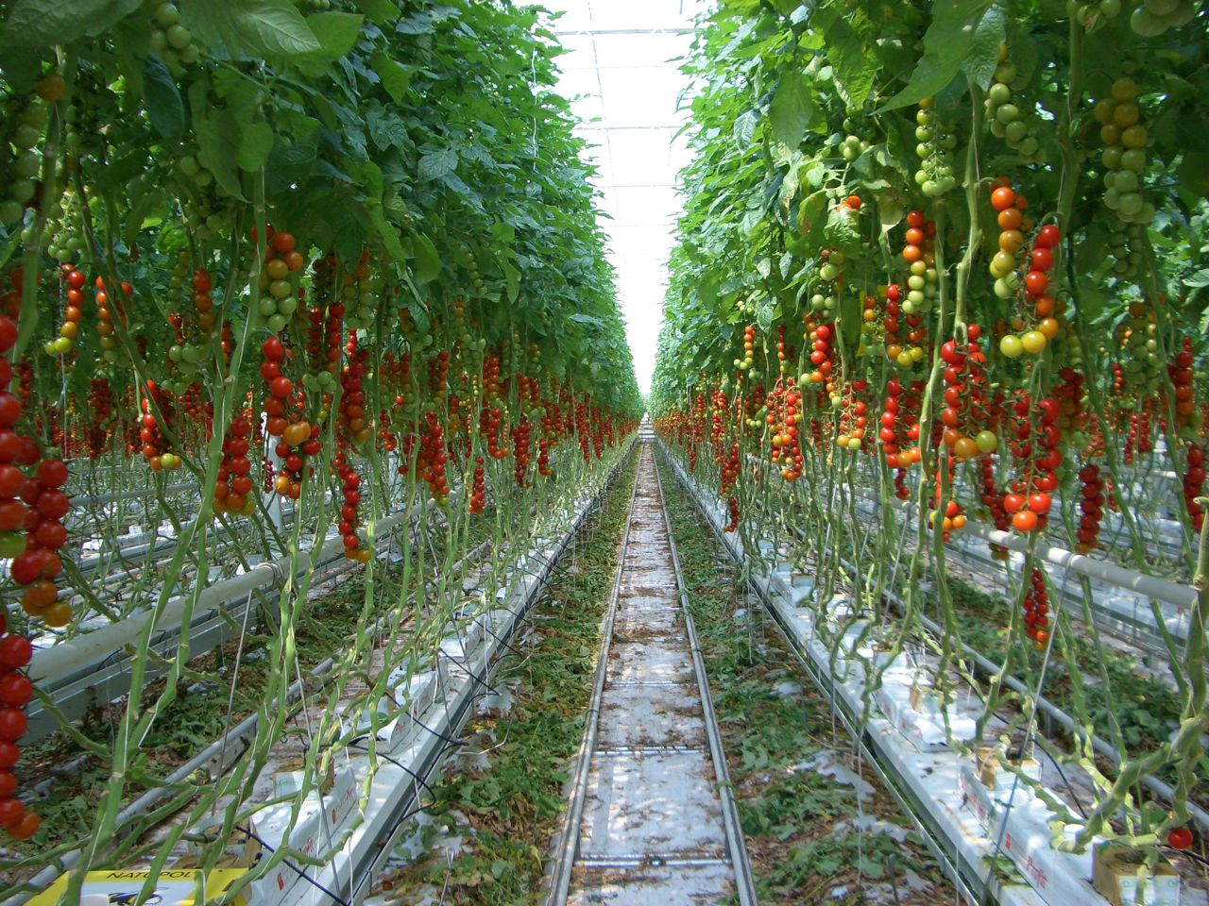
Hydroponic tomato farming

Slide 23

With the availability of a greenhouse full of trenches of nutrient-rich water that were heated “for free,” Grayson realized he might be able to raise tilapia, a tropical delicacy increasingly popular in the United States. He introduced the fish to the waters that bathed the tomato roots and used the fish waste as fertilizer. Finally, with abundant methane still at hand, Grayson began selling excess methane to a natural gas company.
Tilapia: They only have five basic needs: clean water, oxygen, food, light and room to swim. Give your tilapia these things and they will stay healthy and grow

Slide 24
Effectuation
Entrepreneurs take what they have and select among possible outcomes.
causal process - A process that starts with a desired outcome and focuses on the means to generate that outcome.
effectuation process - A process that starts with what one has (who they are, what they know, and whom they know) and selects among possible outcomes.

Slide 25
Curry in a Hurry – Sarasvathy’s thought
It is an imaginary restaurant.
In 2001 – Prof Sarasvathy tried the concept of Effectuation and Causation on the imaginary restaurant.
Causal process A process that starts with a desired outcome and focuses on the means to generate that outcome
Effectuation process A process that starts with what one has (who they are, what they know, and whom they know) and selects among possible outcomes

Slide 26
Cognitive adaptability
Describes the extent to which entrepreneurs are-
Dynamic, flexible, self regulating and engaged in the process of generating multiple decision frameworks.
Focused on sensing and processing changes in their environments and then acting on them.

Slide 27
Comprehension : Questions designed to increase entrepreneur’s understanding of the nature of the environment.
(2) Connection: Tasks designed to stimulate entrepreneurs to think about the current situation in terms of similarities to and differences from situations previously faced and solved.
(3) Strategy: Tasks - designed to stimulate entrepreneurs to think about which strategies are appropriate for solving the problem (and why) or pursuing the opportunity(and how).
(4) Reflection: Tasks designed to stimulate entrepreneurs to think about their understanding and feelings as they progress through the entrepreneurial process

Slide 28
Cognitive adaptability
Comprehension questions – Questions designed to increase entrepreneur’s understanding of the nature of the environment.
connection tasks – Tasks designed to stimulate entrepreneurs to think about the current situation in terms of similarities to and differences from situations previously faced and solved.
strategic tasks Tasks - designed to stimulate entrepreneurs to think about which strategies are appropriate for solving the problem (and why) or pursuing the opportunity(and how).
reflection tasks – Tasks designed to stimulate entrepreneurs to think about their understanding and feelings as they progress through the entrepreneurial process

Slide 29
Cognitive Adaptability
Entrepreneurs who are able to increase cognitive adaptability have an improved ability to :
Adapt to new situations—that is, it provides a basis by which a person’s prior experience and knowledge affect learning or problem solving in a new situation;
(2) Be creative—that is, it can lead to original and adaptive
ideas, solutions, or insights; and
(3) Communicate one’s reasoning behind a particular response.

Slide 30
Entrepreneur Background and Characteristics
Age – A career can be initiated between the age of 22 and 45.
Work history - The past work experience of an individual.
Experience in the following areas is particularly
important: financing, product or service development,
manufacturing, and the development of distribution
channels.
Role models - Individuals whose example an entrepreneur can aspire to and copy.
Role models can be parents, brothers or sisters, other relatives, or other entrepreneurs.
Role models can also serve in a supportive capacity as mentors during and after the launch of a new venture.

Slide 31
Entrepreneur Background and Characteristics
Moral Support Network - Individuals who give psychological support to an entrepreneur.
It is important for each entrepreneur to establish a moral-support network of family and friends—a cheering squad.
Professional-support network Individuals who help the entrepreneur in business activities.
Apart from the encouragement, an entrepreneur needs advice and counsel throughout the establishment of the new venture.
This advice can be obtained from a mentor, business associates, trade associations, or personal affiliations—all members of a professional support network.

Slide 32

Reasons for interest in Corporate Entrepreneurship
Entrepreneurial action within an established organization.
Interest in entrepreneurship within established businesses has intensified due to a variety of events occurring on social, cultural, and business levels.
Corporate entrepreneurship is one method of stimulating, and then capitalizing on, individuals in an organization who think that something can be done differently and better.

Slide 33
Reasons for interest in Corporate Entrepreneurship
The resistance against flexibility, growth, and diversification can, in part, be overcome by developing a spirit of entrepreneurship within the existing organization, called corporate entrepreneurship.
An increase in corporate entrepreneurship reflects an increase in social, cultural, and business pressures toward entrepreneurial action.
Corporate entrepreneurship is most strongly reflected in entrepreneurial activities as well as in top management orientations in organizations.
These entrepreneurial endeavors consist of the following four key elements:
New business venturing, Innovativeness, Self-renewal, and Proactiveness.

Slide 34
Corporate Entrepreneurship
New business venturing refers to the creation of a new business within an existing organization.
Organizational innovativeness refers to product and service innovation with an emphasis on development and innovation in technology.
Self-renewal is the transformation of an organization through the renewal of the key ideas on which it is built.
Includes redefinition of buisness concept, reorganization, and introduction of systemwide changes to increase innovation.
Proactiveness – initiative of risk taking, competitive aggressiveness and boldness which are particularly reflected in the orientations and activities of top management.

Slide 35
Managerial versus Entrepreneurial Decision Making

Slide 36
Characteristics of an Entrepreneurial environment

Slide 37
Leadership Characteristics of a Corporate Entrepreneur

Slide 38
New Entry
One of the essential acts of entrepreneurship is new entry. New entry refers to:
(1) offering a new product to an established or new market,
(2) offering an established product to a new market, or
(3) creating a new organization (regardless of whether the product or the market is new to competitors or customers).

Slide 39
New Entry
Whether associated with a new product, a new market, and/or the creation of a new organization, “newness” is like a double-edged sword.
On the one hand, newness represents something rare, which can help differentiate a firm from its competitors.
On the other hand, newness creates a number of challenges for entrepreneurs.

Slide 40
Entrepreneurial Strategy: The Generation and Exploitation of New Entry Opportunities

Slide 41
New Entry
Figure illustrates the important elements of an entrepreneurial strategy.
An entrepreneurial strategy has three key stages:
the generation of a new entry opportunity,
(2) the exploitation of a new entry opportunity, and
(3) a feedback loop from the culmination of a new entry generation and exploitation back to stage 1.

Slide 42
Generation of a new entry opportunity
Resources as a Source of Competitive Advantage
Resources are the basic building blocks to a firm’s functioning and performance. A firm’s resources are simply the inputs into the production process, such as machinery, financial capital, and skilled employees.
These resources can be combined in different ways and it is this bundle of resources that provides a firm to succeed.
A bundle of resources is:
• Valuable - when it enables the firm to pursue opportunities,
neutralize threats, and offer products and services that are
valued by customers.
Rare - when it is possessed by few, if any, (potential) competitors.
• Inimitable - when replication of this combination of resources
would be difficult and/or costly for (potential) competitors.

Slide 43
Generation of a new entry opportunity
Creating a Resource Bundle - that is Valuable, Rare, and inimitable.
The ability to obtain, and then recombine, resources into a bundle that is valuable, rare, and inimitable is itself is a entrepreneurial resource.
Knowledge is the basis of the entrepreneurial resource and this knowledge is built up over time through experience and it resides in the mind of the entrepreneur as well as in the collective mind of management and employees.
Therefore, knowledge is important for generating a bundle of resources that will lead to the creation of a new venture with a long and prosperous life.

Slide 44
Generation of a new entry opportunity
Market Knowledge - Market knowledge refers to the entrepreneur’s possession of information, technology, know-how, and skills that provide insight into a market and its customers.
Technological Knowledge - Technological knowledge is also a basis for generating new entry opportunities.
-Technological knowledge refers to the entrepreneur’s
possession of information, technology, know-how, and
skills that provide insight into ways to create new
knowledge.
- This technological knowledge might lead to a technology.

Slide 45
Fig: The decision to exploit or not to exploit the new entry opportunity

Slide 46
Entry Strategy for New Entry Exploitation
The common catchphrase used by entrepreneurs when asked about their source of competitive advantage is, “Our competitive advantage comes from being first. We are the first movers.”
- Whether they are the first to introduce a new product and/or the first to create a new market, these claims have some merit. Being first can result in a number of advantages that can enhance performance.

Slide 47
Entry Strategy for New Entry Exploitation
First movers develop a cost advantage.
First movers face less competitive rivalry.
First movers can secure important channels.
First movers are better positioned to satisfy customers.
First movers gain expertise through participation.

Slide 48
Tata Sons had acquired a 100 per cent stake in loss-making Air India on January 27, 2022, through its fully owned subsidiary, Talace Private Limited.
Later, it announced that Air India and Vistara will be merged into one entity, which is estimated to be completed by March 2024. Singapore Airlines will have a 25 per cent stake in the newly merged entity.

Slide 49
Entry Strategy for New Entry Exploitation
First Mover Disadvantages
Demand uncertainty - Difficulty in estimating the potential size of the market, how fast it will grow, and the key dimensions along which it will grow.
No “role model” to follow.

Slide 50
Entry Strategy for New Entry Exploitation
Technological uncertainty
Difficulty in assessing whether the technology will perform and whether alternate technologies will emerge and leapfrog over current technologies.
Adaptation Difficulties - Hardship in adapting to new environmental conditions.
- Entrepreneurial attributes of persistence and determination can inhibit the ability of the entrepreneur to detect, and implement change.

Slide 51
Entry Strategy for New Entry Exploitation (cont.)
Customer Uncertainty - Difficulty in accurately assessing whether the new product or service provides value for them.
Overcome customer uncertainty by:
Informational advertising
Creating a frame of reference for potential customer
Educating customers through demonstration and documentation
Beta testing

Slide 52
Entry Strategy for New Entry Exploitation (cont.)
Lead Time Strategies for First Movers
Lead time - The grace period in which the first mover operates in the industry under conditions of limited competition.
Extend lead time by:
- Building customer loyalties.
- Building switching costs.
- Protecting product uniqueness.
Securing access to important sources of supply and
distribution.

Slide 53
Risk Reduction Strategies for new entry exploitation
A new entry involves considerable risk for the entrepreneur and his or her firm. Risk here refers to the probability, and magnitude, of downside loss, which could result in bankruptcy.
Market scope strategies :
- A choice about which customer groups to serve and how
to serve them.
- The choice of market scope ranges from a narrow- to a broad-scope strategy and depends on the type of risk the entrepreneur believes is more important to reduce.

Slide 54

Digital Counter
Digital Electronic Mini Finger Ring Head Hand Tally Japa Counter

Slide 55
Digital Counter: 75/-

Slide 56
Risk Reduction Strategies for new entry exploitation
Narrow-Scope Strategy - A narrow-scope strategy offers a small product range to a small number of customer groups to satisfy a particular need.
a) The narrow scope can reduce the risk that the firm will face competition with larger, more established firms in a number of ways.
(i) A narrow-scope strategy focuses the firm on producing customized products, localized business operations, and high levels of product quality.
(ii) By focusing on a specific group of customers, the entrepreneur can build up specialized expertise and knowledge that provide an advantage over companies that are competing more broadly.
(iii) The high end of the market typically represents a highly profitable niche that is well suited to those firms that can produce customized products, localized business operations, and high levels of product quality.

Slide 57
Risk Reduction Strategies for new entry exploitation
b) If customers don’t value product qualities or are unwilling to pay a premium price for it, the narrow scope strategy provides little protection against competition.
c) Larger established firms can develop products targeted at an attractive market niche.
d) A narrow scope strategy is vulnerable to the risk that market demand does not materialize as expected.
e) Having a narrow-scope strategy is like putting all your eggs in one basket.

Slide 58
Risk Reduction Strategies for new entry exploitation
Broad-Scope Strategy - A broad-scope strategy can be thought of as taking a “portfolio” approach to dealing with uncertainties about the attractiveness of different market segments.
a) By offering a range of products across many different market segments, the entrepreneur can gain an understanding of the whole market by determining which products are the most profitable.

Slide 59
Risk Reduction Strategies for new entry exploitation
Narrow scope Vs. Broad Scope :
A narrow-scope strategy requires the entrepreneur to be certain about the market.
A broad-scope strategy is opening the firm up to many different “fronts” of competition.
A narrow-scope strategy reduces some competition-related risks but increases the risks associated with market uncertainties.
A broad-scope strategy reduces risks from market uncertainties but increases exposure to competition.

Slide 60
Risk Reduction Strategies for new entry exploitation
Narrow scope Vs. Broad Scope (contd.) :
When the risk of competition is great and market uncertainties are minimal, a narrow-scope strategy is more effective at reducing risk.
But if new entry involves creation of a new market, a broad-scope strategy reduces the major risk–uncertainties over customer preferences.

