Slide 1
UNIT - II

Slide 2
INNOVATION
Innovation is the key to the economic development of any company, region of a country, or country itself.
As technologies change, older products/services decrease in sales and old industries dwindle.
Inventions and innovations are the building blocks of the future of any economic unit.
Thomas Edison reportedly said that innovative genius is 1 percent inspiration and 99 percent perspiration.

Slide 3
INNOVATION
- There are various levels of degree of innovation based on the uniqueness of the idea.
Fig. below shows the three major types of innovation in the decreasing order of uniqueness.
Breakthrough innovation
Technological innovation
Ordinary innovation

Slide 4
INNOVATION

Slide 5
Innovation
Types of Innovation
  Breakthrough
    Fewest number of innovations.
    Establishes the platform on which future innovations in an area are developed.
    Should be protected by patents, trademarks, and copyrights.
  Technological
    Occurs more frequently; not at the same level of breakthrough inventions.
    Offers advancements in the product/market area.
    Needs to be protected.

Slide 6
Innovation (cont.)
  Ordinary
    Occurs most frequently.
    Extends a technological innovation into a better product or service or one that has a different market appeal.
    Usually come from market analysis and pull, not technology push.

Slide 7
Innovation (cont.)
Defining a New Innovation (Product or Service)
  Newness can be:
    In the consumer concept.
    A change in the package or container.
    Slight changes or modifications in the appearance of the product. (Industrial market)
  Companies also add products to their product line that are already marketed by other companies; products are new to the manufacturer but not the consumer.

Slide 8
Innovation (cont.)
Classification of New Products
  Consumer’s Viewpoint
    The continuum proposed by Thomas Robertson is based on the disrupting influence that use of the product has on established consumption patterns.
      Continuous innovations.
      Dynamically continuous.
      Discontinuous innovations.
    This approach is consistent with the marketing philosophy that “satisfaction of consumer needs” is fundamental to a venture’s existence.

Slide 9
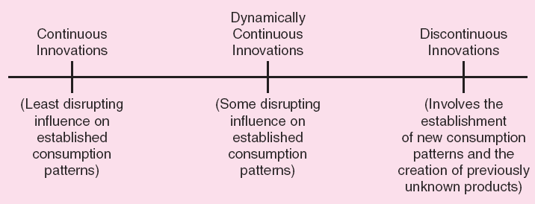
Figure 4.3 - Continuum for Classifying New Products

Slide 10

Chetan Maini
Chetan was born in Bangalore, India on March 11 1970. He is the son of the late Sudarshan K Maini and Reva Maini. His father was the founder of the Maini group of industries, the manufacturer of India's first electric car, REVA.^{[7]} As a child, Chetan used to take apart and build cars. He received a master's degree in hybrid electric technology from Stanford. While he was an undergraduate student at the University of Michigan, he was involved in the solar car project and the subsequent solar car race. His team built and raced a solar car in the U.S. — and, as it happened, came in first. Later that year, in 1990, General Motors sponsored the team to race in the World Solar Challenge in Australia where they came in third. Their vehicle, called “Sunrunner,” beat many of the big American auto companies.

Slide 11
Innovation (cont.)
  Firm’s Viewpoint
    Distinction can be made between new products and new markets.
    Situations with a new technology and a new market are the most complicated and pose the highest degree of risk.

Slide 12
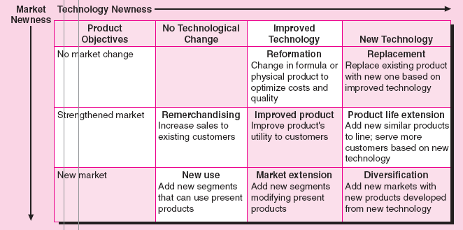
Figure 4.4 - New Product Classification System

Slide 13
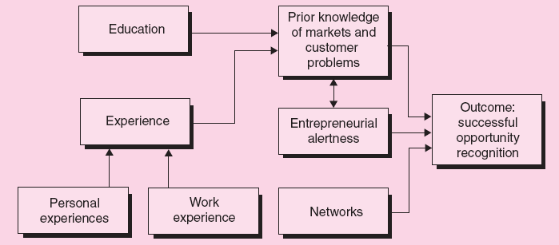
Figure 4.5 - A Model of the
Opportunity Recognition Process

Slide 14
Product Planning and Development Process
Establishing Evaluation Criteria
  Criteria should be established at each stage of the product planning and development process.
  It should be all-inclusive and quantitative in nature.
  Criteria should evaluate the idea in terms of:
    Market opportunity.
    Competition.
    Marketing system.
    Financial factors.
    Production factors.

Slide 15
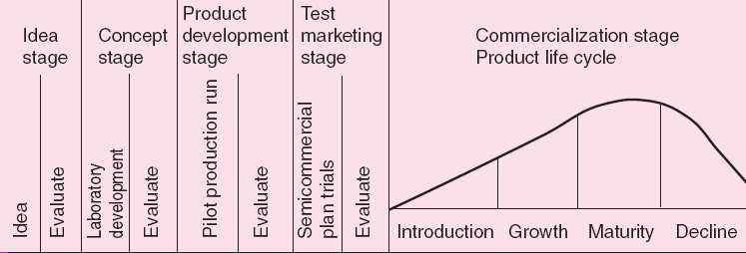
Figure 4.6 - The Product Planning and Development Process

Slide 16
Product Planning and Development Process (cont.)
Idea Stage
  Promising ideas should be identified and impractical ones eliminated.
  Evaluation method – Systematic market evaluation checklist.
  Determine the need for the new idea as well as its value to the company.
Concept Stage
  Refined idea is tested to determine consumer acceptance which can be measured through the conversational interview method.

Slide 17
Product Planning and Development Process (cont.)
Product Development Stage
    Consumer reaction to the product/service is determined.
    A consumer panel is given a product sample and preference is determined through methods such as multiple brand comparisons, risk analysis, etc.
Test Marketing Stage
    Increases certainty of successful commercialization.
    Actual sales reflect consumer acceptance.
    A teaser lets you know in less than 30 seconds that something is coming soon (a film but also a conference). Instead, a trailer lasts 1 to 2 minutes and tries to convince you to take action.

Slide 18
E-commerce and Business Start-up
E-commerce offers entrepreneurs an opportunity to be creative and innovative.
Factors that facilitate high-growth in electronic commerce:
    Widespread use of personal computers.
    Adoption of intranets in companies.
    Acceptance of the Internet as a business communications platform.
    Faster and more secure systems.

Slide 19
E-commerce and Business Start-up (cont.)
Using E-Commerce Creatively
  Entrepreneurs have to decide whether to:
      Run Internet operations within the company.
      Outsource these operations to Internet specialists.
      Use e-commerce packages provided by software companies.
    The integration of front-end and back-end operations represents the greatest challenge for doing Internet business.

Slide 20
E-commerce and Business Start-up (cont.)
Web Sites
  Ease of use.
  Structure and organization of information.
  Search capability.
  E-mail response system.
  Speed.
  Compatibility with different browsers and platforms.

Slide 21
E-commerce and Business Start-up (cont.)
Tracking Customer Information
  Electronic databases track the activity of the industry, segment, and company.
  It supports personal marketing targeted at individual clients.
  Care must be taken to follow the laws protecting the privacy of individuals.

Slide 22
E-commerce and Business Start-up (cont.)
Doing E-Commerce as an Entrepreneurial Company
  Products should be delivered economically and conveniently.
  Products need to interest a wide market; company must be ready to ship the product outside its own geographical location.
  Online operations should bring significant cost reductions.
  Company must be able to economically draw customers to its Web site.

