Slide 1
International Vs. Domestic Entrepreneurship

Slide 2
International Vs. Domestic Entrepreneurship
Although there is a similarity between international and domestic entrepreneurship about cost , sales and profit. There is variation of relative factors such as :
Economics, Politics , Culture and Technology that differentiate Domestic from International Entrepreneurship.
International entrepreneurial decisions are more complex due to the above factors.

Slide 3
International Vs. Domestic Entrepreneurship
Political
As government continues to play a greater role in regulating business activity, it is important that the entrepreneur understand all the political and legal aspects that can facilitate or impede business growth.
- This includes the following:
• Methods of enacting public policy
• Influencers on policymaking
• Wars and conflicts between governments
• Government stability and risk

Slide 4


International Vs. Domestic Entrepreneurship
Methods of Enacting Public Policy :
Nearly all countries today have a republic form of government whereby an executive or head of state works together with a parliament or legislative body to enact laws.
This includes regulation, treaties, executive orders, and court decisions.
Regulations can also impact advertising strategies in the copy, labelling, ingredients, and packaging or in the support needed for advertising claims in different countries.
For example, in certain European countries, the term “diet” is not used to describe low-calorie foods and beverages so Coca-Cola sells its Diet Coke product as Coca-Cola Light

Slide 5
International Vs. Domestic Entrepreneurship
Influencers on Policymaking
Prior to policy entering into force, there are a number of ways it can be influenced.
Primarily this involves lobbying and interest groups, which have strong ties to government officials.
Interest groups in the United States such as the National Association of Manufacturers or the Chamber of Commerce are often staffed with former government officials and, likewise, government officials may have prior experience on the outside having worked for interest groups.

Slide 6
International Vs. Domestic Entrepreneurship
Wars and Conflicts :
- Conflicts and changes in the solvency of the country are major risks to an entrepreneur in a particular country.
- While most entrepreneurs prefer to do business in stable and freely governed countries, good business opportunities often occur in different conditions.
- For example, oil companies such as ExxonMobil have been active in countries such as Nigeria since 1955.
- Nigeria and other developing world oil exporting nations are often perceived as difficult places to conduct business.

Slide 7
International Vs. Domestic Entrepreneurship
Government Stability and Risk A final political analysis to understand is the likelihood of how long a government will be in power and the political risk associated with that stability

Slide 8
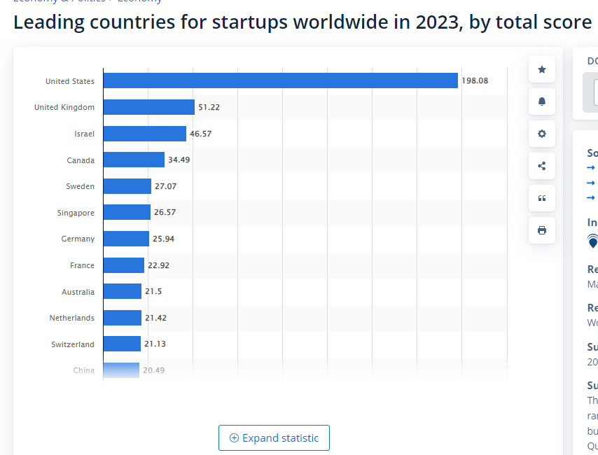

Slide 9
International Vs. Domestic Entrepreneurship
Economic
- A country’s political environment is inextricably tied to the economic environment, especially when issues of taxation and trade are concerned.
- The following are some of the important factors to consider when conducting a proper economic environment analysis:
• Taxation and trade
• Monetary policy
• Distribution
• Trends

Slide 10
International Vs. Domestic Entrepreneurship
Taxation and Trade Taxation
It has two key components: general and specific.
General taxation may refer to the overall tax that is imposed on products, services income, and property, to name a few.
For example, pricing decisions in a country that has a value-added tax (VAT) will differ from pricing decisions made by the same entrepreneur in a country with no value-added tax.
Some products are singled out for higher or lower levels of taxation and this too should be understood before entering a new market.
In some cases, such as cigarettes, the amount of tax imposed exceeds wholesale price itself.
Trade policy can act as a form of taxation as well, especially if countries impose tariffs on goods that a company is often forced to then pass along to a consumer in the form of higher prices.

Slide 11
International Vs. Domestic Entrepreneurship
Monetary policy
Monetary policy refers to interest and exchange rates that further have an impact on inflation.
A country’s past and future outlook on inflation plays a significant role in product affordability.
In addition, it has an impact on currency exchange rates.
With the present system of flexible exchange rates, a country’s current account (the difference between the value of a country’s imports and exports over time) affects the valuation of its currency.
The valuation of one country’s currency affects business transactions between countries.

Slide 12
International Vs. Domestic Entrepreneurship
Distribution
- One final economic analysis relates to market routes and distribution.
While needing to adjust the business plan according to regional differences, an entrepreneur doing business only in the United States does not have to worry about significant lack of such fundamental infrastructures as : roads, electricity, communication systems, banking facilities and systems, adequate educational systems, a well-developed legal system, and established business ethics and norms.
These factors vary greatly in other countries, which impacts a firm’s ability to successfully engage in international business.

Slide 13
Barter system example
Pepsi-Cola began considering the possibility of marketing in the former U.S.S.R. as early as 1959, following the visit of U.S. Vice President Richard Nixon.
When Premier Nikita Khrushchev expressed his approval of Pepsi’s taste, the slow wheels of East-West trade began moving, with Pepsi entering the former U.S.S.R. 13 years later.
Instead of using its traditional type of franchise bottler in this entry, Pepsi used a barter-type arrangement that satisfied both the socialized system of the former U.S.S.R. and the U.S. capitalist system.
In return for receiving technology and syrup from Pepsi, the former U.S.S.R. provided the company with Soviet vodka and the distribution rights in the United States.
Many such barter or third-party arrangements have been used to do business in countries in various stages of development and transition.

Slide 14

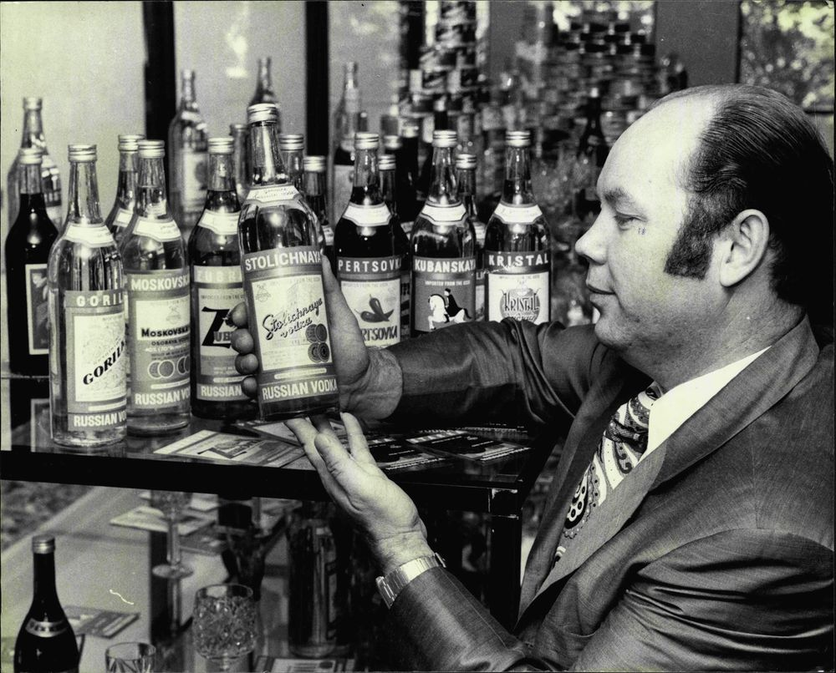

Slide 15


Slide 16
International Vs. Domestic Entrepreneurship
Trends
- No market entry strategy is without risk.
- An entrepreneur can mitigate that risk by understanding data and
market trends.
Trends can be influenced by celebrities, word of mouth, media, lifestyle, seasonality, and technology, just to name a few.
One of the best times to enter a new market is when the entire market or product category is budding/developing.
This is because consumer preferences on factors such as brand and pricing are just being formed, which gives an entrepreneur an opportunity to test different strategies for market acceptance.
Especially in new industries, data can be easy to obtain, but difficult to validate and trust.

Slide 17
International Vs. Domestic Entrepreneurship
Social Trends
- Social Trends are closely related to social influencers that should be analysed to ensure your product has market appeal.
Four types of social factors include:
• Psychographics
• Language
• Ethics
• Major events
Psychographics - Psychographics refer to interests, activities, and opinions and help explain what consumer value is and how they make their choices.

Slide 18
International Vs. Domestic Entrepreneurship
Language - Sometimes, one of the biggest problems for the entrepreneur is finding a translator and having an appropriate translation of the message.
Ethics - Spoken language, even when not translated, can impact another social factor: ethics. Cultural ethics deals with the values and morals of a society and how they translate to societal acceptance.
One of the best ways to understand these cross-cultural differences is by having a local partner, especially one with experience in your home market and aboard, who can help you navigate the cultural differences.
Major Events
Major events can create sudden shifts in public opinion or new buying markets overnight. For example, after the September 11 terrorist attacks, the Airports around the United States made significant investments in security scanning technology. Sporting events such as the World Cup and the Olympics create new opportunities for companies to provide housing, transportation, and food to support both the domestic and transient populations.

Slide 19
International Vs. Domestic Entrepreneurship
Major Events
Major events can create sudden shifts in public opinion or new buying markets overnight.
For example, after the September 11 terrorist attacks, the Airports around the United States made significant investments in security scanning technology.
Sporting events such as the World Cup and the Olympics create new opportunities for companies to provide housing, transportation, and food to support both the domestic and transient populations.

Slide 20
International Vs. Domestic Entrepreneurship
Technological
Technology, like social factors, varies significantly across countries.
The rate of technology adoption (such as the Internet connection speed) and general technology maturity and availability are often surprising, particularly to an entrepreneur from a developed country.
While U.S. firms produce mostly standardized, relatively uniform products that can be sorted to meet industry standards, this is not the case in many countries, making it more difficult to achieve a consistent level of quality.

Slide 21
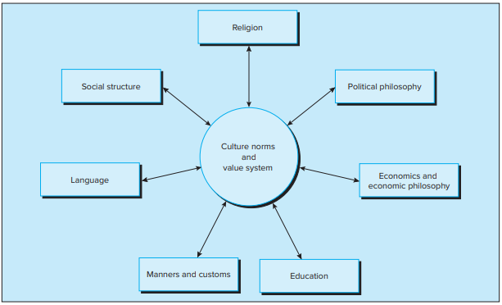
International Vs. Domestic Entrepreneurship
Cultural

