Slide 1
SOFTWARE ENGINEERING AND OBJECT ORIENTED MODELING DESIGN
20IS5PCSEO
Credits 4
L-T-P 3-1-0

Slide 2
SYLLABUS
UNIT – 1
Introduction: Software Engineering -What Is Software Engineering? Software Engineering Concepts, Software Engineering Development Activities, Managing Software Development, Software Process Models , Process Activities
UNIT – 2
Modeling with UML :An Overview of UML, Modeling Concepts, A Deeper View into UML, Use Case Diagrams, Interaction Diagrams, State Machine Diagrams, Activity Diagrams.
UNIT – 3
Requirement Elicitation: An Overview of Requirements Elicitation, Requirements Elicitation Concepts- Functional requirements; Non-functional requirements; completeness, consistency, clarity and correctness; realism, verifiability and traceability; green filed engineering, re-engineering and interface engineering.
UNIT – 4
Testing: An Overview of Testing, Testing Concepts: Faults, Erroneous states, and failures; Test cases, test stub and drivers; corrections, Testing Activities: Component inspection; usability testing; unit testing; integration testing; system testing.
UNIT - 5
Architectural Patterns: Model-View-Controller (MVC) pattern, Layered architecture , Repository architecture, Client–server architecture, Pipe and filter architecture.
Agile software development: Agile methods, Agile development techniques, agile project management, Scaling Agile methods. Project Management: Project scheduling, Agile planning

Slide 3
TEXT BOOKS
1. Object-Oriented Software Engineering-Using UML, Patterns, and Java™,Third Edition-Bernd Bruegge & Allen H. Dutoit
2. Software Engineering by Ian Sommerville, 10e , Pearson.

Slide 4
UNIT 1
Book 1
Software Engineering -What Is Software Engineering?
Software Engineering Concepts,
Software Engineering Development Activities,
Managing Software Development
Book 2
Software Process Models ,
Process Activities

Slide 5


Slide 6


Slide 7
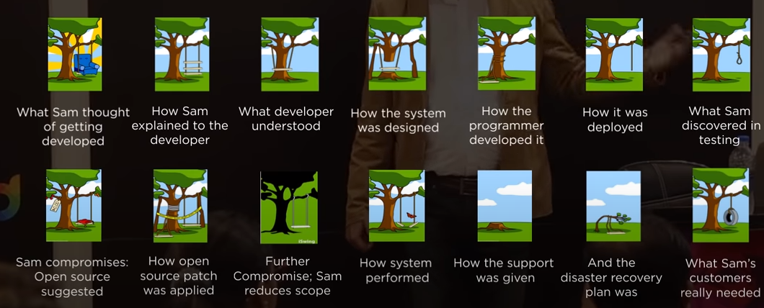

Slide 8
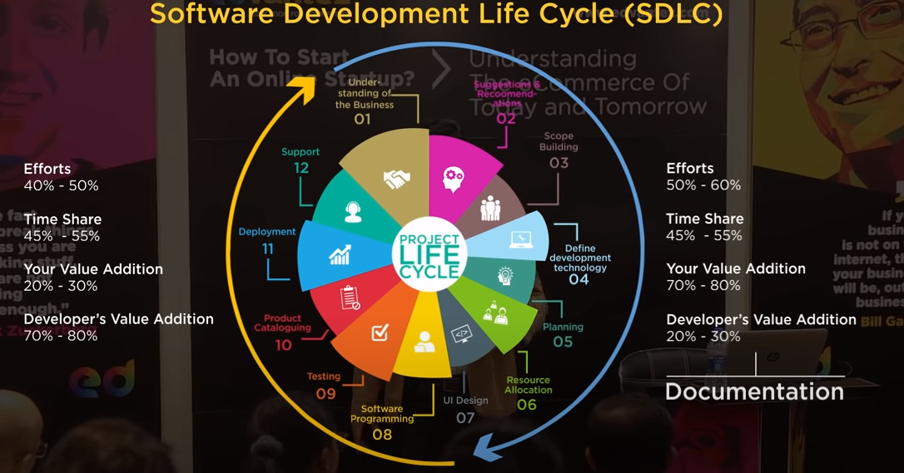

Slide 9

Software Crisis
  Example 1: 2009,Computer glitch delays flights
Saturday 3rd October 2009-London, England (CNN)
Dozens of flights from the UK were delayed Saturday after a glitch in an air traffic control system in Scotland, but the problem was fixed a few hours later.
The agency said it reverted to backup equipment as engineering worked on the system.
The problem did not create a safety issue but could cause delays in flights.
Read more at:
http://edition.cnn.com/2009/WORLD/europe/10/03/uk.flights.delayed

Slide 10

Software Crisis
  Example 2: Ariane 5 Explosion
  European Space Agency spent 10 years and $7 billion to produce Ariane 5.
  Crash after 36.7 seconds.
  Caused by an overflow error. Trying to store a 64-bit number into a 16-bit space.
  Watch the video: http://www.youtube.com/watch?v=z-r9cYp3tTE

Slide 11

Software Crisis
  Example 3: 1992, London Ambulance Service
  Considered the largest ambulance service in the world.
  Overloaded problem.
  It was unable to keep track of the ambulances and their statuses. Sending multiple units to some locations and no units to other locations.
  Generates many exceptions messages.
  46 deaths.

Slide 12
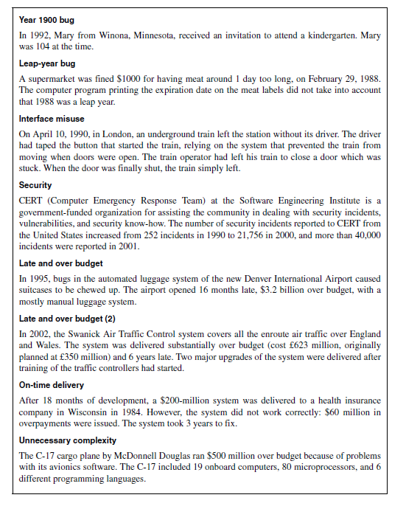
1.1 Introduction: Software Engineering Failures

Slide 13
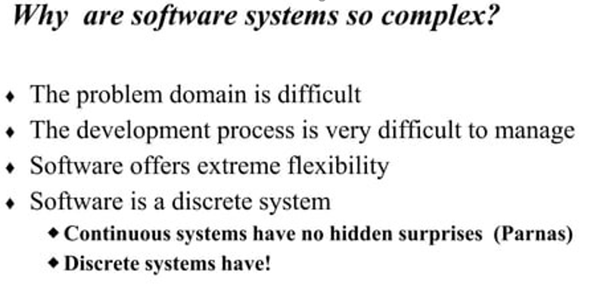

Slide 14
1.2 What Is Software Engineering?
Software engineering is a modeling activity –
  One of the primary methods for design.
  Software engineers deal with complexity through modeling, by focusing at any one time on only the relevant details and ignoring everything else.
  Software engineers build many different models of the system and of the application domain.
Software engineering is a problem-solving activity –
  Software engineers do not have infinite resources and are constrained by budget and deadlines.
  Lack of a fundamental theory, often have to rely on empirical methods to evaluate the benefits of different alternatives.

Slide 15
1.2 What Is Software Engineering?
Software engineering is a knowledge acquisition activity –
  In modeling the application and solution domain, software engineers collect data, organize it into information, and formalize it into knowledge.
  Knowledge acquisition is a non-linear process.
  Adding a single piece of additional data can invalidate complete models/previous knowledge.
  All activities are interrelated.
Software engineering is a rationale-driven activity –
  When acquiring knowledge and making decisions about the system or its application domain, software engineers also need to capture the context in which decisions were made and the rationale behind these decisions.
  Represented as a set of issue models, enables software engineers to understand the implication of a proposed change when revisiting a decision.

Slide 16
More detail software engineering from the perspectives of modeling, problem solving, knowledge acquisition, and rationale. For each of these activities, software engineers have to work under people, time, and budget constraints. In addition, we assume that change can occur at any time.
1.2.1 Modeling
1.2.2 Problem Solving
1.2.3 Knowledge Acquisition
1.2.4 Rationale

Slide 17
1.2.1 Modeling
One of the basic methods of science is modeling.
A model is an abstract representation of a system that enables us to answer questions about the system.
Models are useful when dealing with systems that are too large, too small, too complicated, or too expensive to experience firsthand.
Models also allow us to visualize and understand systems that either no longer exist or that are only claimed to exist.
Software engineers face similar challenges as fossil biologists and high-energy physicists.
  First, software engineers need to understand the environment in which the system has to operate.
  For a train traffic control system, software engineers need to know train signaling procedures.
  For a stock trading system, software engineers need to know trading rules.
  The software engineer does not need to become a fully certified train dispatcher or a stock broker; they only need to learn the application domain concepts that are relevant to the system.
  In other terms, they need to build a model of the application domain.

Slide 18
1.2.1 Modelling
Second, software engineers need to understand:
  The systems they could build, to evaluate different solutions and trade-offs.
  Most systems are too complex to be understood by any one person, and most systems are expensive to build.
  To address these challenges, software engineers describe important aspects of the alternative systems they investigate.
  In other terms, they need to build a model of the solution domain.
Object-oriented methods combine the application domain and solution domain modeling activities into one.
The application domain is first modeled as a set of objects and relationships.
This model is then used by the system to represent the real-world concepts it manipulates.
A train traffic control system includes train objects representing the trains it monitors.
A stock trading system includes transaction objects representing the buying and selling of commodities.
Then, solution domain concepts are also modeled as objects.
The set of lines used to depict a train or a financial transaction are objects that are part of the solution domain. The idea of object-oriented methods is that the solution domain model is a transformation of the application domain model.
Developing software translates into the activities necessary to identify and describe a system as a set of models that addresses the end user’s problem.

Slide 19
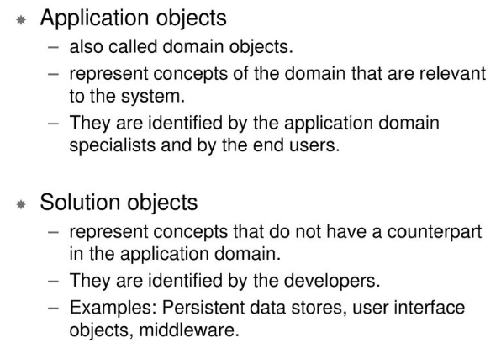
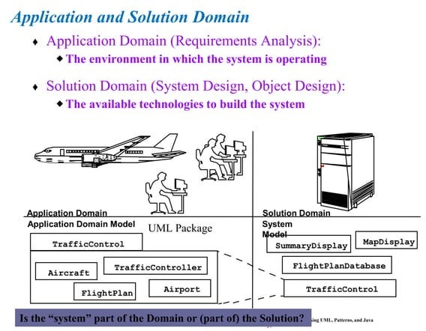

Slide 20
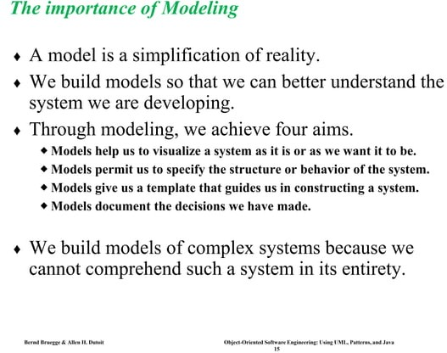

Slide 21
1.2.2 Problem Solving
Engineering is a problem-solving activity.
Engineers search for an appropriate solution:
  trial and error,
  evaluating alternatives empirically,
  with limited resources and incomplete knowledge.
In its simplest form, the engineering method includes five steps:
  1. Formulate the problem.
  2. Analyze the problem.
  3. Search for solutions.
  4. Decide on the appropriate solution.
  5. Specify the solution.
Software engineering is an engineering activity. It is not algorithmic.
Activities: experimentation, pattern reuse, incremental evolution, reviews of problem and solution models

Slide 22
1.2.2 Problem Solving
Object-oriented software development typically includes six development activities:
requirements elicitation,
analysis,
system design,
object design,
implementation, and
testing.
The engineering method:
  1. Formulate the problem (requirements elicitation and
  2. Analyze the problem analysis)
  3. Search for solutions (system design and
  4. Decide on the appropriate solution object design)
  5. Specify the solution (implementation)

Slide 23
During requirements elicitation and analysis, software engineers formulate the problem with the client and build the application domain model.
Requirements elicitation and analysis correspond to steps 1 and 2 of the engineering method. During system design, software engineers analyse the problem, break it down into smaller pieces, and select general strategies for designing the system.
During object design, they select detail solutions for each piece and decide on the most appropriate solution.
System design and object design result in the solution domain model.
System and object design correspond to steps 3 and 4 of the engineering method.
During implementation, software engineers realize the system by translating the solution domain model into an executable representation.
Implementation corresponds to step 5 of the engineering method. What makes software engineering different from problem solving in other sciences is that change occurs in the application and the solution domain while the problem is being solved.
Software development also includes activities whose purpose is to evaluate the appropriateness of the respective models.

Slide 24
During the analysis review, the application domain model is compared with the client’s reality, which in turn might change as a result of modeling.
  During the design review, the solution domain model is evaluated against project goals.
  During testing, the system is validated against the solution domain model, which might be changed by the introduction of new technologies.
  During project management, managers compare their model of the development process (i.e., the project schedule and budget) against reality (i.e., the delivered work products and expended resources).
  requirements elicitation and analysis - application domain model
  System design and object design - solution domain model.
  Implementation - application and the solution domain

Slide 25
1.2.3 Knowledge Acquisition
In modeling application and solution domains
  Data collection
  Information organization
  Knowledge formalization
Non-linear knowledge acquisition
  Single piece of data can invalidate complete models
  Linear software development process
    Water fall model
  Non-linear software process
    Risk-based development
      develop higher risks first
    Issue-based development
      Develop all issues in parallel

Slide 26
1.2.3 Knowledge Acquisition
There are several software processes that deal with this problem by avoiding the sequential dependencies inherent in the waterfall model.
Risk-based development attempts to anticipate surprises late in a project by identifying the high-risk components.
Issue-based development attempts to remove the linearity altogether.
Any development activity—analysis, system design, object design, implementation, testing, or delivery—can influence any other activity. In issue based development, all these activities are executed in parallel. The difficulty with nonsequential development models, however, is that they are difficult to manage.

Slide 27
1.2.4 Rationale
Rationale of the system
The context and rationale in which each design decision was made
To be captured and understood by software engineer
Represents a set of issue models with larger amount of information than the solution models
Not explicit (without explicitly evaluating different alternatives)
Enables software engineers to understand the implication of a proposed change when revising a decision

Slide 28
1.2.4 Rationale
Change introduced by new technology often allows the formulation of new functional or nonfunctional requirements. A typical task of software engineers is to change a currently operational software system to incorporate this new enabling technology. To change the system, it is not enough to understand its current components and behavior. It is also necessary to capture and understand the context in which each design decision was made. This additional knowledge is called the rationale of the system.
Capturing and accessing the rationale of a system is not trivial.
First, for every decision made, several alternatives may have been considered, evaluated, and argued. Consequently, rationale represents a much larger amount of information than do the solution models.
Second, rationale information is often not explicit. Developers make many decisions based on their experience and their intuition, without explicitly evaluating different alternatives.

Slide 29
1.3 Software Engineering Concepts
A Project, whose purpose is to develop a software system, is composed of a number of Activities.
Each Activity is in turn composed of a number of Tasks.
A Task consumes Resources and produces a WorkProduct.
A WorkProduct can be either a System, a Model, or a Document.
Resources are either Participants, Time, or Equipment.
Example:
  Metro construction- project
  Activities : pillars, containers, rail links, escalators,
  Tasks : pillar – soil testing, foundation, pillars
  Workproduct – pillar (human,cement,sand etc)
  Resources : engineers, labours,

Slide 30
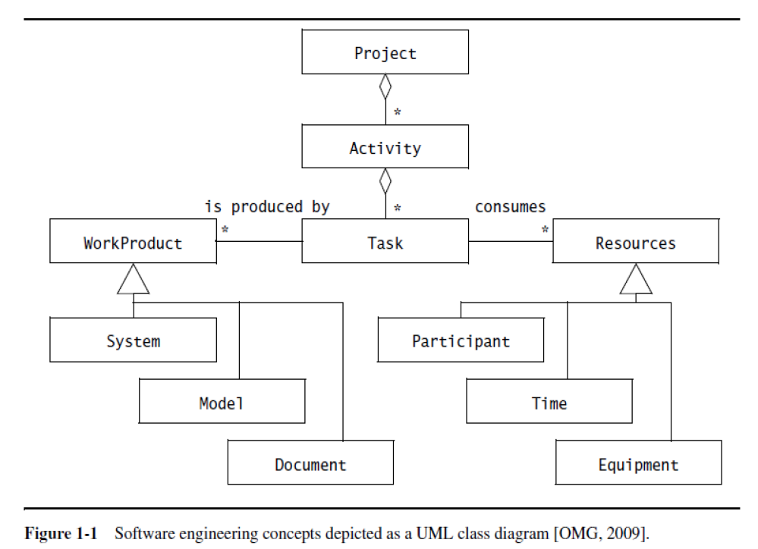
A graphical representation of these concepts is shown in Figure 1-1.
  Each rectangle represents a concept.
  The lines among the rectangles represent different relationships between the concepts.
For example, the diamond shape indicates aggregation: a Project includes a number of Activities, which includes a number of Tasks.
The triangle shape indicates a generalization relationship; Participants, Time, and Equipment are specific kinds of Resources.
Figure 1-1 is represented in the
Unified Modeling Language (UML) notation.

Slide 31
1.3.1 Participants and Roles

Slide 32
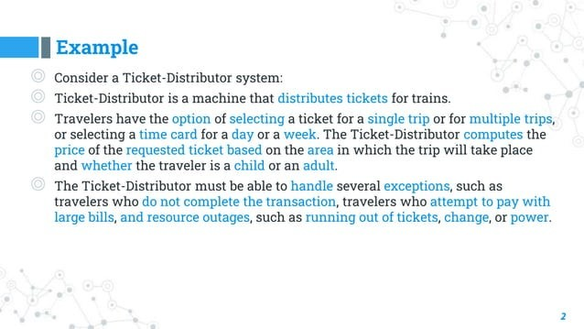
1.3.1 Participants and Roles

Slide 33
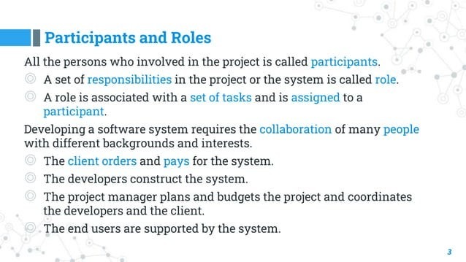

Slide 34
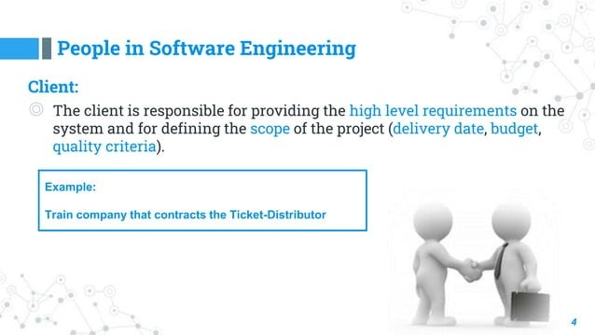

Slide 35
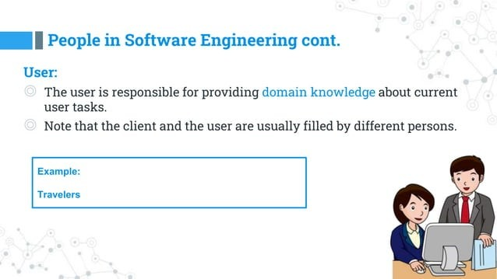

Slide 36
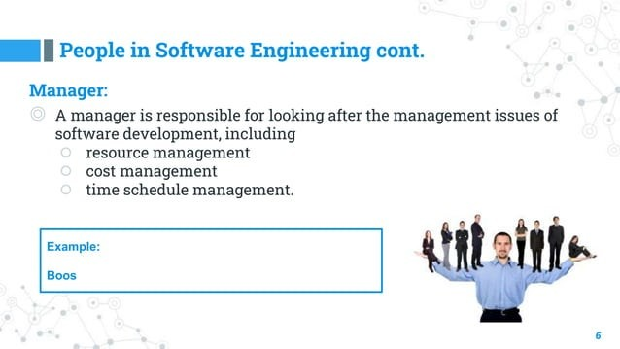

Slide 37
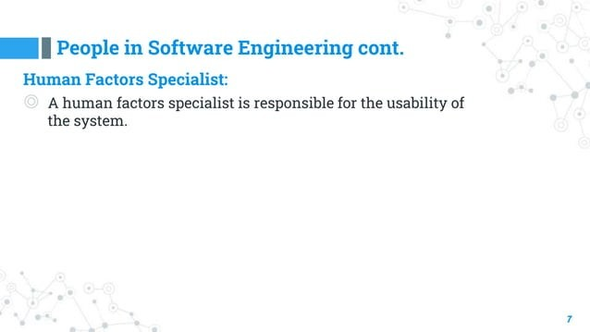

Slide 38
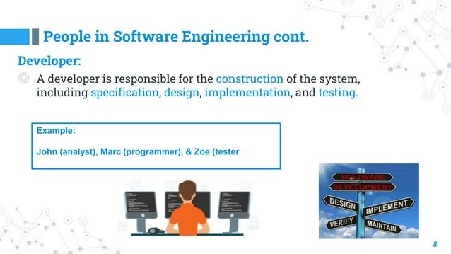

Slide 39
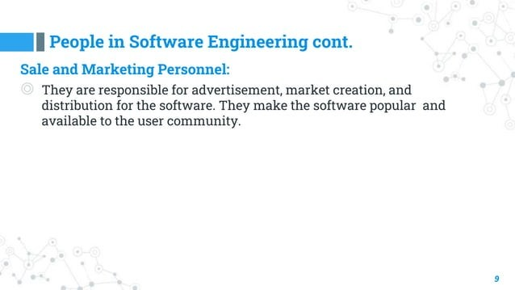

Slide 40
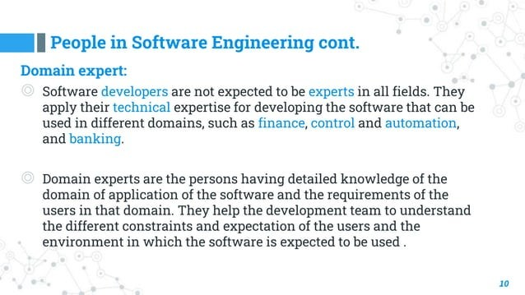

Slide 41
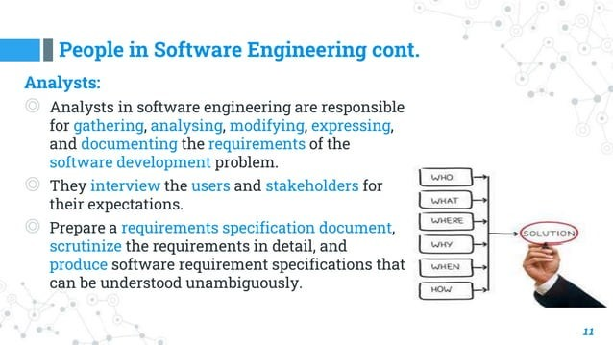

Slide 42
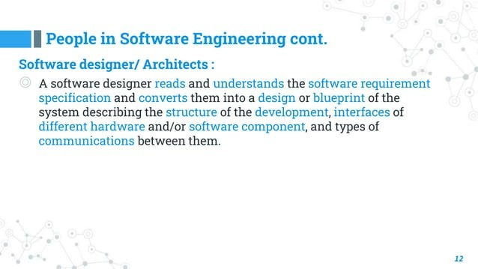

Slide 43
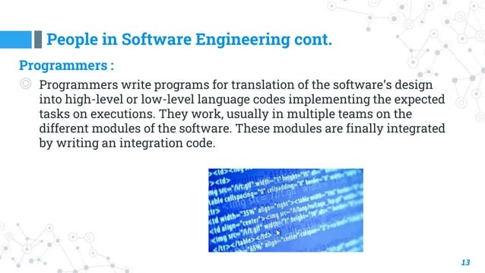

Slide 44
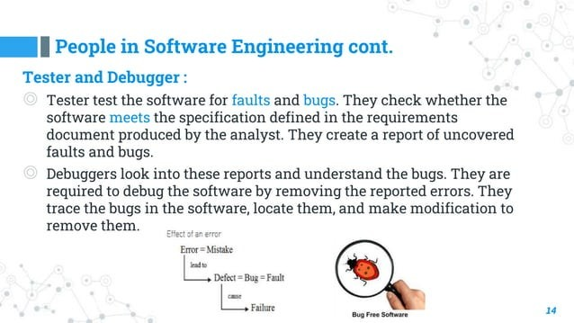

Slide 45
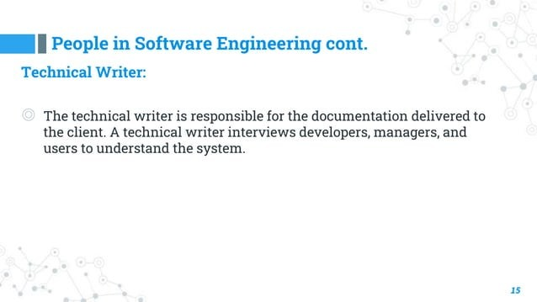

Slide 46
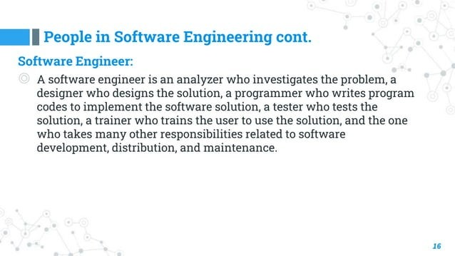

Slide 47
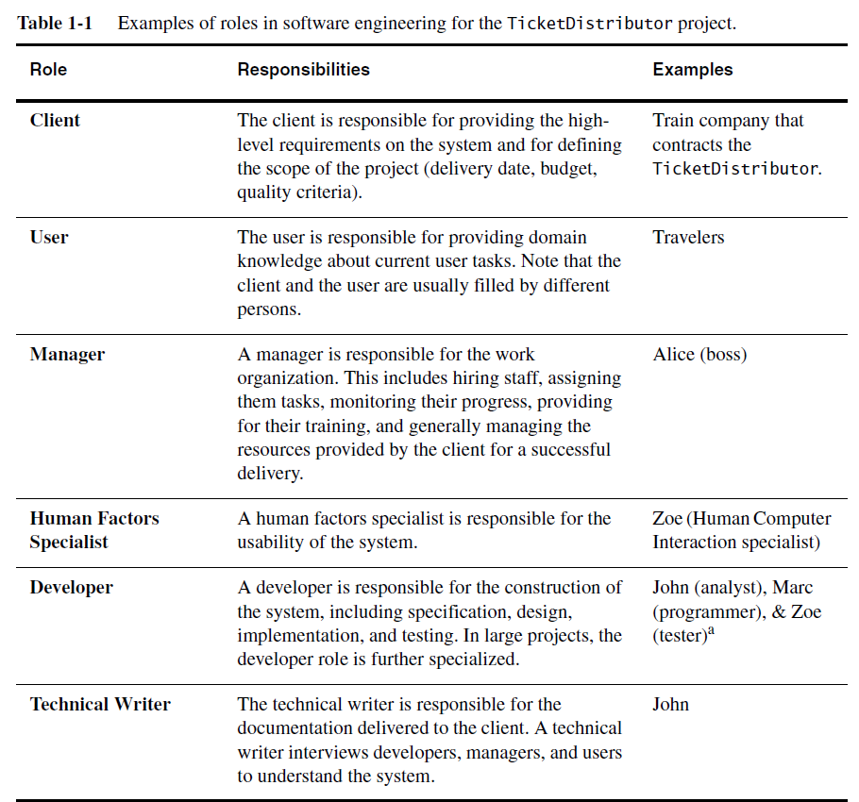
Treating the development of this TicketDistributor as a software engineering project,
Table 1-1 provides examples of roles for this example.

Slide 48
1.3.2 Systems and Models
  System: the underlying reality
    example: ticket distributor for a train
  Model: any abstraction of the reality
    example: requirement, analysis, design, implementation models
A TicketDistributor for an underground train is a system.
Blueprints for the TicketDistributor, schematics of its electrical wiring, and object models of its software are models of the TicketDistributor.
Note that a development project is itself a system that can be modeled. The project schedule, its budget, and its planned deadlines are models of the development project.

Slide 49
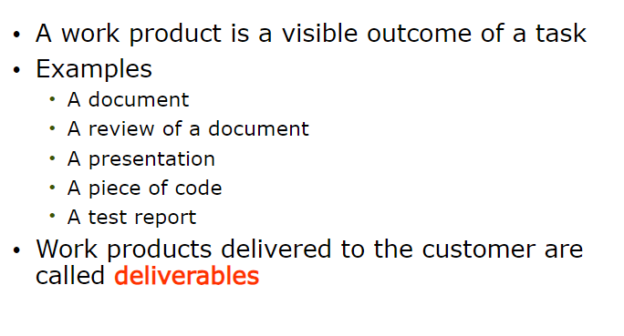
1.3.3 Work Products
A work product is an artifact that is produced during the development, such as
a document or a piece of software for other developers or for the client.
  ● We refer to a work product for the project’s internal consumption as an
  internal work product.
  ● We refer to a work product that must be delivered to a client as a deliverable.
  ● Deliverables are generally defined prior to the start of the project and specified
  by a contract binding the developers with the client.

Slide 50
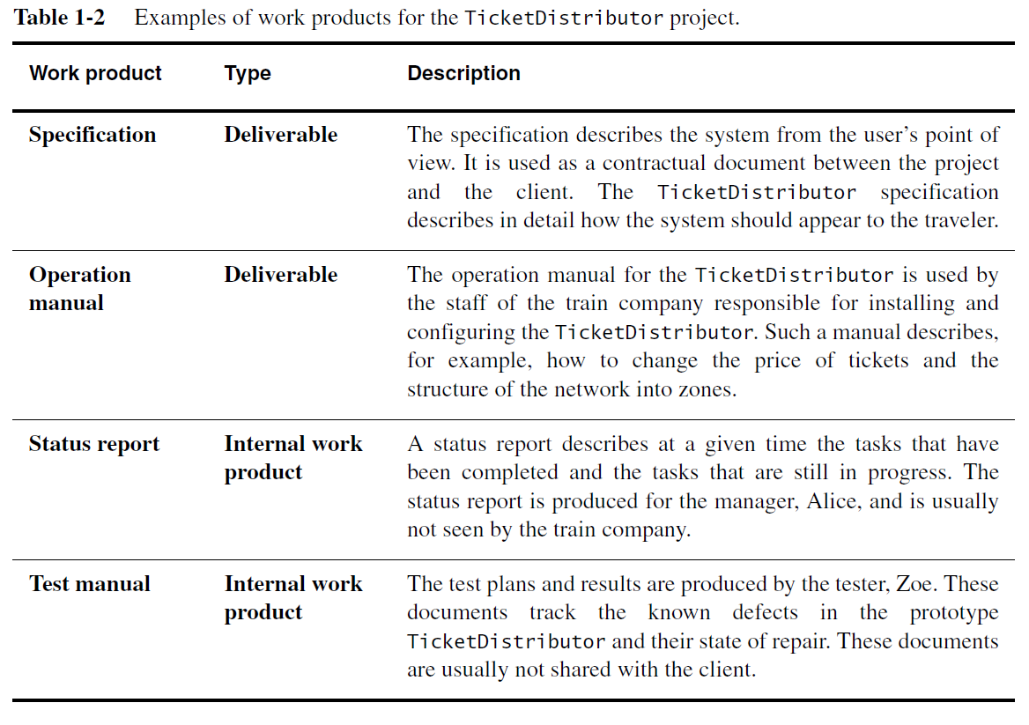

Slide 51
1.3.4 Activities, Tasks, and Resources
An activity is a set of tasks that is performed toward a specific purpose.
For example,
  Requirements elicitation is an activity whose purpose is to define with the client what the system will do.
  Delivery is an activity whose purpose is to install the system at an operational location.
  Management is an activity whose purpose is to monitor and control the project such that it meets its goals (e.g., deadline, quality, budget).
  Activities can be composed of other activities. The delivery activity includes a software installation activity and an operator training activity. Activities are also sometimes called phases.
A task represents an atomic unit of work that can be managed: A manager assigns it to a developer, the developer carries it out, and the manager monitors the progress and completion of the task. Tasks consume resources, result in work products, and depend on work products produced by other tasks.
Resources are assets that are used to accomplish work. Resources include time, equipment, and labor. When planning a project, a manager breaks down the work into tasks and assigns them to resources.

Slide 52
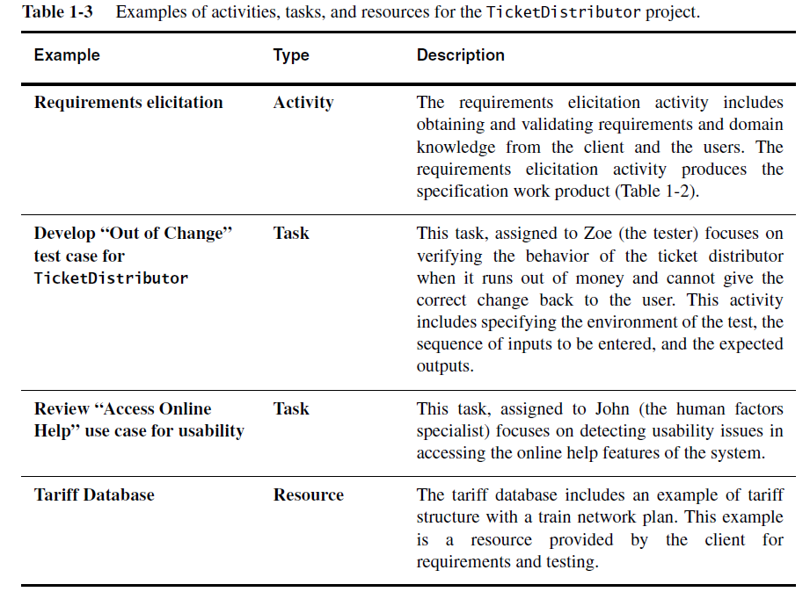

Slide 53
1.3.5 Functional and Nonfunctional Requirements
Requirements specify a set of features that the system must have.
A functional requirement is a specification of a function that the system must support.
The definition of a functional requirement is:
“Any Requirement Which Specifies What The System Should Do.”
In other words, a functional requirement will describe a particular behavior of
function of the system when certain conditions are met, for example: “Send email
when a new customer signs up” or “Open a new account”.
Some of the more typical functional requirements include:
● Business Rules
● Transaction corrections, adjustments and cancellations
● Administrative functions
● Authentication
● Authorization levels
● Audit Tracking
● External Interfaces
● Certification Requirements
● Reporting Requirements
● Historical Data
● Legal or Regulatory Requirements

Slide 54
A nonfunctional requirement is a constraint on the operation of the system that is not related directly to a function of the system.
what about Non-Functional Requirements? What are those, and how
are they different?
● Simply put, the difference is that non-functional requirements describe how the system works, while functional requirements describe what the system should do.
Some typical non-functional requirements are:
● Performance – for example Response Time, Throughput, Utilization,
Static Volumetric
● Scalability
● Capacity
● Availability
● Reliability
● Recoverability
● Maintainability
● Serviceability
● Security
● Regulatory
● Manageability
● Environmental
● Data Integrity
● Usability
● Interoperability

Slide 55
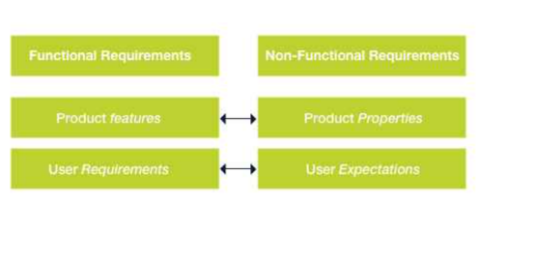
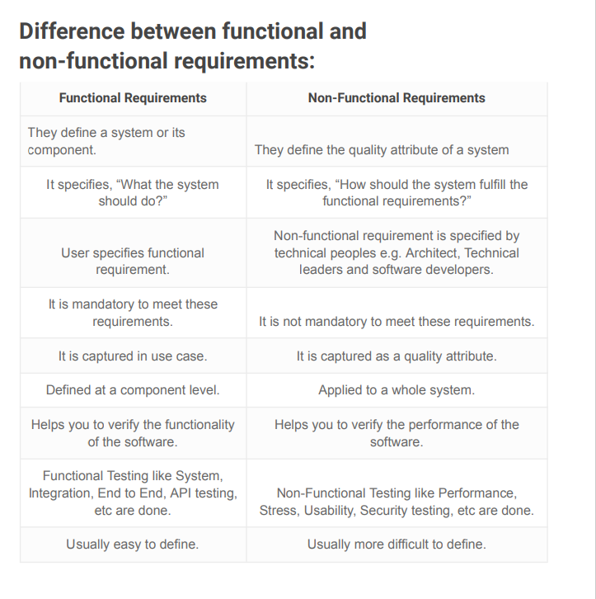

Slide 56
QUIZ ?
identify below tasks functional or non-functional requirements
Authentication of a user when he/she tries to log into the system.
Emails should be sent with a latency of no greater than 12 hours.
3. System shutdown in the case of a cyber attack.
4. Verification email is sent to user whenever he/she registers for the
5. Each request should be processed within 10 seconds.
6. The site should load in 3 seconds when the number of simultaneous
users are > 10000

Slide 57
Functional Requirements Example:
  1. Authentication of a user when he/she tries to log into the system.
  2. System shutdown in the case of a cyber attack.
  3. Verification email is sent to user whenever he/she registers for the
  first time on some software system.
Non-functional Requirements Example:
  1. Emails should be sent with a latency of no greater than 12 hours.
  2. Each request should be processed within 10 seconds.
  3. The site should load in 3 seconds when the number of simultaneous
  users are > 10000

Slide 58
1.3.6 Notations, Methods, and Methodologies
  Notation
    a graphical or textual set of rules for representing a model
    Example: UML for OO modeling, Z for system spec.
  Method
    A repeatable technique for solving a specific problem
    Example: sorting algorithm, version control
  Methodology
    a collection of methods for solving a class of problems
    decompose software process into activities
    examples: Unified software development process, Object Modeling Technique, Catalysis.

Slide 59
1.4 Software Engineering Development Activities
In this section, it includes the overview of Technical activities associated with object-oriented software engineering.
Development activities includes:
Requirements Elicitation (Section 1.4.1)
Analysis (Section 1.4.2)
System Design (Section 1.4.3)
Object Design (Section 1.4.4)
Implementation (Section 1.4.5)
Testing (Section 1.4.6).

Slide 60
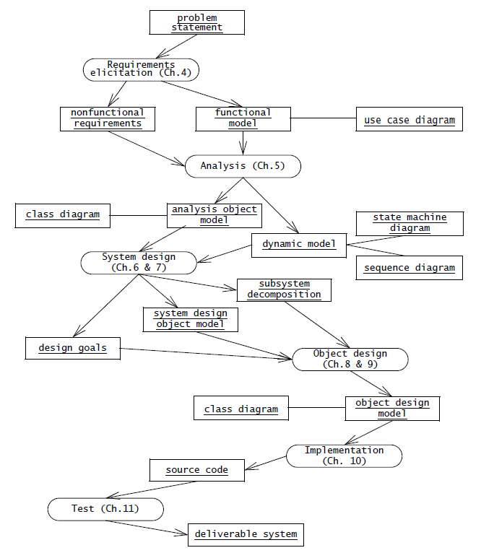
Figure 1-2 An overview of object-oriented software engineering development activities and their products. This diagram depicts only logical dependencies among work products. Object-oriented software engineering is iterative; that is, activities can occur in parallel and more than once.

Slide 61
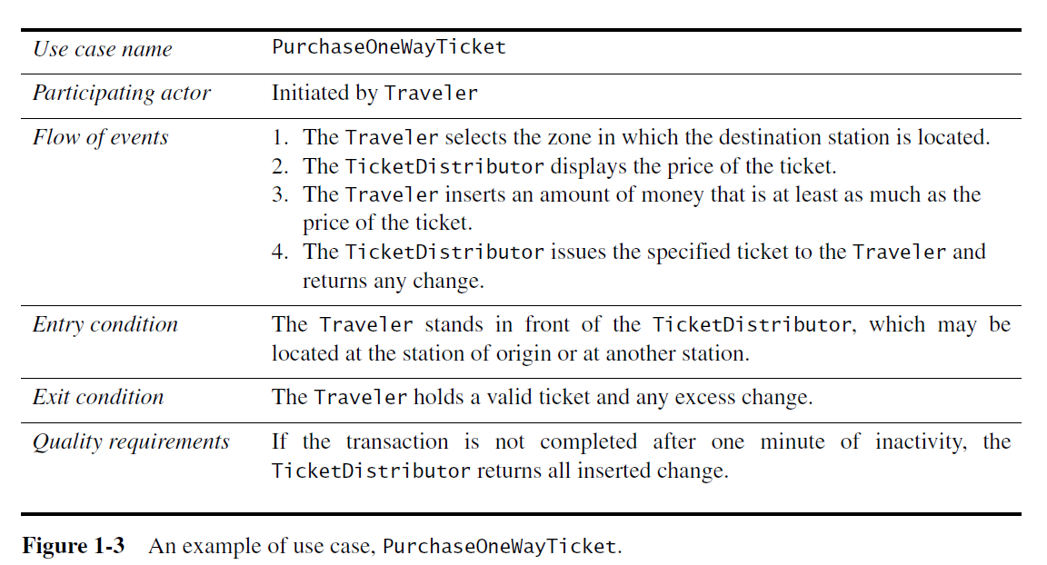
1.4.1 Requirements Elicitation
Requirement elicitation (Client and Developer)
  The client and developers define the purpose of the system
  Result: description of actors and use cases for functional requirement
  Use cases are general sequences of events that describe all the possible actions between an actor and the system for a given piece of functionality.
Figure 1-3 depicts a use case for the
TicketDistributor example

Slide 62
1.4.2 Analysis (Developer)
During analysis, developers aim to produce a model of the system that is correct, complete, consistent, and unambiguous.
Developers transform the use cases produced during requirements elicitation into an object model that completely describes the system.
During this activity, developers discover ambiguities and inconsistencies in the use case model that they resolve with the client.
The result of analysis is a system model annotated with attributes, operations, and associations.
The system model can be described in terms of its structure and its dynamic interoperation. Figure 1-4 depicts an example of dynamic model for the TicketDistributor.

Slide 63
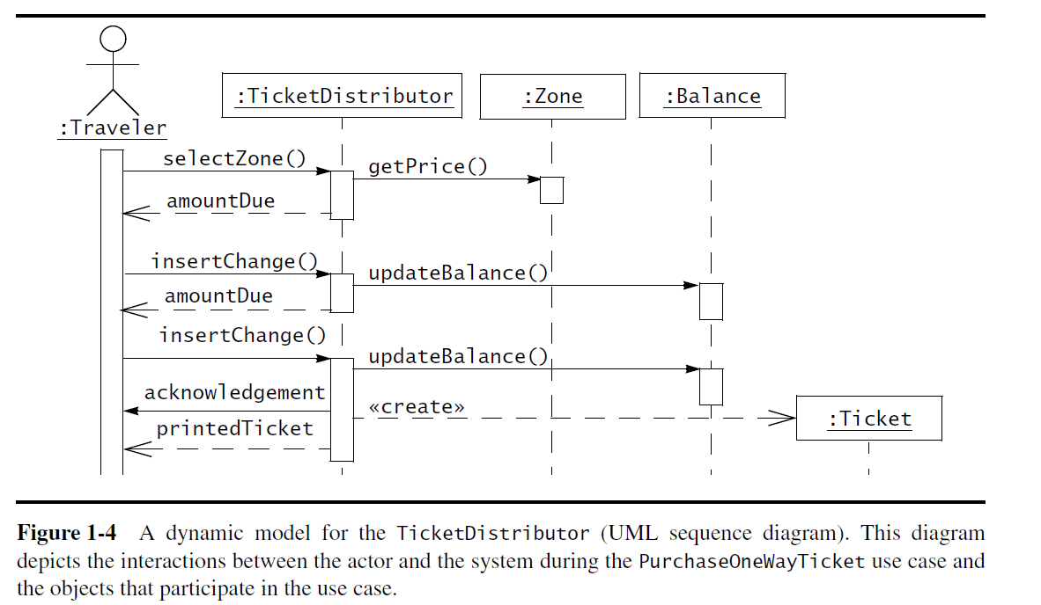

Slide 64
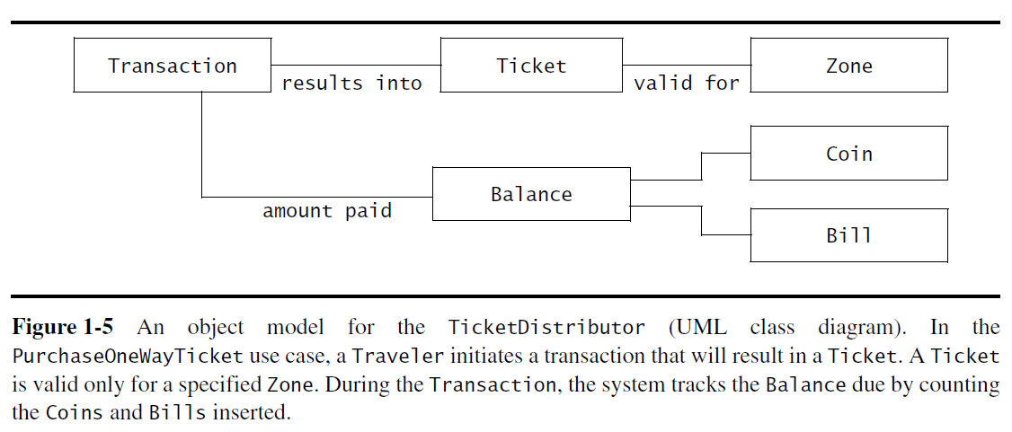
Figure 1-5 depicts an example of object model for the TicketDistributor.

Slide 65
1.4.3 System Design
Developers define the design goals of the project and
Decompose the system into smaller subsystems that can be realized by individual teams.
Developers also select strategies for building the system :
  hardware/software platform on which the system will run
  the persistent data management strategy
  the global control flow
  the access control policy
  the handling of boundary conditions
The result of system design is a clear description of each of these strategies :
  a subsystem decomposition, and
  a deployment diagram
  representing the hardware/software mapping of the system

Slide 66
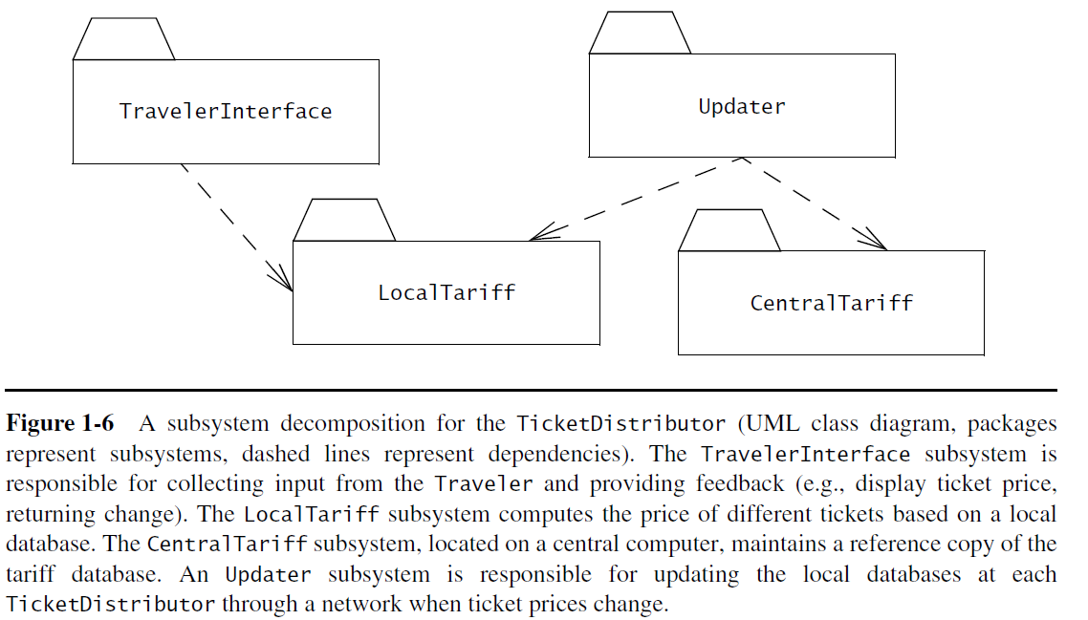

Slide 67
Take an analogy, a football game.
System design involves
  design of football ground,
  goal poles,
  grass on the ground,
  location of the ground,
  length/breadth of the ground,
  putting line marks on the ground,
  scoreboard,
  defining the playing teams,
  number of players to play etc.
object-oriented design
how the games need to be played is defined by a set of rules that need to be followed. Thus the players need to play the game within the defined rules. So
the more the player knows those rules the better they can play the game without making fouls.
Similarly, the rules for the object-oriented concepts are inheritance, composition, abstraction, encapsulation.

Slide 68
1.4.4 Object Design
Developers define solution domain objects to bridge the gap between the analysis model and the hardware/software platform defined during system design.
This includes precisely describing object and subsystem interfaces, selecting off-the-shelf components, restructuring the object model to attain design goals such as extensibility or understandability, and optimizing the object model for performance.
The result of the object design activity is a detailed object model annotated with constraints and precise descriptions for each element.
1.4.5 Implementation
During implementation, developers translate the solution domain model into source code.
This includes implementing the attributes and methods of each object and integrating all the objects such that they function as a single system.
The implementation activity spans the gap between the detailed object design model and a complete set of source code files that can be compiled.

Slide 69
1.4.6 Testing
During testing, developers find differences between the system and its models by executing the system (or parts of it) with sample input data sets.
During unit testing, developers compare the object design model with each object and subsystem.
During integration testing, combinations of subsystems are integrated together and compared with the system design model.
During system testing, typical and exception cases are run through the system and compared with the requirements model.
The goal of testing is to discover as many faults as possible such that they can be repaired before the delivery of the system.
The planning of test phases occurs in parallel to the other development activities: System tests are planned during requirements elicitation and analysis, integration tests are planned during system design, and unit tests are planned during object design

Slide 70
1.5 Managing Software Development
The activities involved in managing a software engineering includes:
  Communication (Section 1.5.1)
  Rationale Management (Section 1.5.2)
  Software Configuration Management (Section 1.5.3)
  Project Management (Section 1.5.4)
  Software Life Cycle (Section 1.5.5)
Management activities focus on:
  planning the project,
  monitoring its status,
  tracking changes, and
  coordinating resources such that a high-quality product is delivered on time and within budget.

Slide 71
Communication:
Communication includes:
  exchange of models and documents about the system and its application domain,
  reporting the status of work products,
  providing feedback on the quality of work products,
  raising and negotiating issues, and communicating decisions
Communication is the most critical and time-consuming activity in software engineering.
Misunderstandings and omissions often lead to faults and delays that are expensive to correct later in the development.
Communication is made difficult:
  by the diversity of participants’ backgrounds,
  by their geographic distribution,
  and by the volume, complexity, and evolution of the information exchanged.

Slide 72
Communication:
To deal with communication issues, project participants have many tools available.
conventions: When participants agree on notations for representing information, Examples of notations include UML diagrams, templates for writing documents and meeting minutes, and identification schemes for naming software components.
Examples of tools include Computer Aided Software Engineering (CASE) tools for maintaining models, word processors for generating documents, and interchange formats for publishing information

Slide 73
Rationale Management:
Rationale is the justification of decisions.
Given a decision:
  its rationale includes the problem that it addresses,
  the alternatives that developers considered,
  the criteria that developers used to evaluate the alternatives,
  the debate developers went through to achieve consensus, and
  The decision.
Rationale is the most important information developers need when changing the system.

Slide 74
Rationale Management:
If a criterion changes, developers can reevaluate all decisions that depend on this criterion.
If a new alternative becomes available, it can be compared with all the other alternatives that were already evaluated.
If a decision is questioned, they can recover its rationale to justify it.
Unfortunately, rationale is also the most complex information developers deal with during development, and thus, the most difficult to update and maintain.
To deal with this challenge, developers capture rationale during meetings and on-line discussions, represent rationale with issue models, and access rationale during changes.

Slide 75
Software Configuration Management:
Software configuration management is the process that monitors and controls changes in work products.
Requirements change as the client requests new features and as developers improve their understanding of the application domain.
The hardware/software platform on which the system is built changes as new technology becomes available.
The system changes as faults are discovered during testing and are repaired.
Software configuration management used to be in the realm of maintenance, when improvements are incrementally introduced in the system.
Changes during development can be dealt with using configuration management at all stages.
Configuration management enables developers to track changes.
The system is represented as a number of configuration items that are independently revised.
For each configuration item, its evolution is tracked as a series of versions. Selecting versions enables developers to roll back to a well-defined state of the system when a change fails

Slide 76
Project Management:
Project management ensure the delivery of a high-quality system on time and within budget.
This includes planning and budgeting the project during negotiations with the client, hiring developers and organizing them into teams, monitoring the status of the project, and intervening when deviations occur.
Software Life Cycle
Software engineering as a modeling activity.
Developers build models of the application and solution domains to deal with their complexity.
By ignoring irrelevant details and focusing only on what is relevant to a specific issue, developers can more
effectively resolve issues and answer questions.
The process of developing software can also be viewed as a complex system with inputs, outputs, activities, and resources.
It is not surprising, then, that the same modeling techniques applied to software artifacts are used for modeling software processes.
A general model of the software development process is called a software life cycle.

Slide 77
Software Engineering ?
Importance of Software Processes ?
1

Slide 78
Bottom Line
Writing code is easy
Engineering good software is HARD
  Humans are a big problem…
    Customers
    Developers
    Managers
  Large software systems take on a life of their own…
  As soon as you introduce more than one person into the process, complications arise… this includes a customer!
Following a process (ANY process) is key to making it work!

Slide 79
A process?
Organizations want a well-defined, well-understood, repeatable software development process.
Why?

Slide 80
A process?
Organizations want a well-defined, well-understood, repeatable software development process.
Why?
Organizations want a well-defined, well-understood, repeatable software development process.
Why?
  Find and repeat good practices
  Management
    know what to do next
    know when we’re done with current task
    know if we’re late
    estimate time to completion, costs
  New team members know what to do

Slide 81
The Software Process
A structured set of activities required to develop a software system.
Many different software processes but all involve:
  Specification – defining what the system should do;
  Design and implementation – defining the organization of the system and implementing the system;
  Validation – checking that it does what the customer wants;
  Evolution – changing the system in response to changing customer needs.
A software process model is an abstract representation of a process. It presents a description of a process from some particular perspective.
The form / iteration / timing / etc. of these activities defines different process families and methodologies

Slide 82
Software Process Descriptions
When we describe and discuss processes, we usually talk about the activities in these processes such as specifying a data model, designing a user interface, etc. and the ordering of these activities.
Process descriptions may also include:
  Products, which are the outcomes of a process activity;
  Roles, which reflect the responsibilities of the people involved in the process;
  Pre- and post-conditions, which are statements that are true before and after a process activity has been enacted or a product produced.

Slide 83
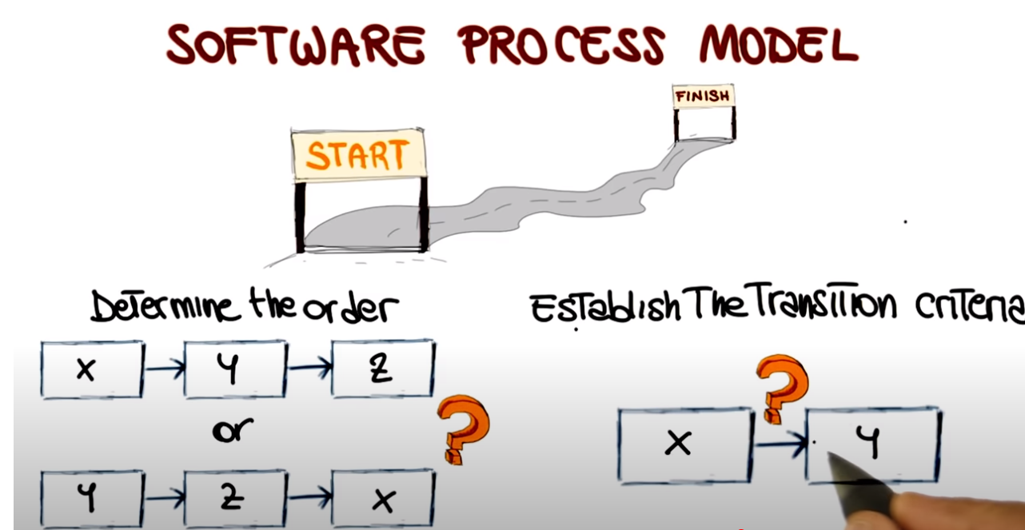

Slide 84
Software Process Models
Broadly speaking, process models and thus methodologies fall on a continuum
Agile Plan-Driven

Slide 85
Plan-driven and Agile Processes
Plan-driven processes are processes where all of the process activities are planned in advance and progress is measured against this plan.
  Plan drives everything!
In Agile Processes planning is incremental and it is easier to change the process to reflect changing customer requirements.
In practice, most practical processes include elements of both plan-driven and agile.
There are no right or wrong software processes.

Slide 86
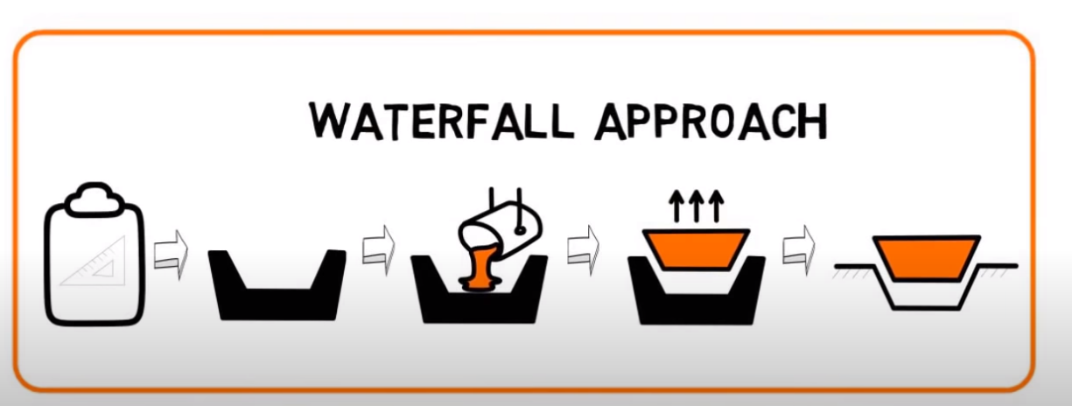

Slide 87
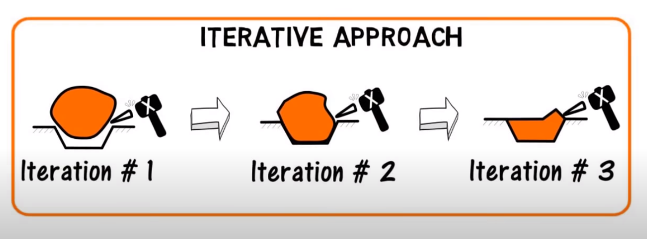

Slide 88
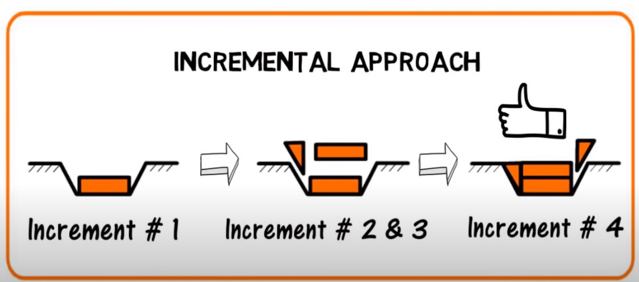

Slide 89
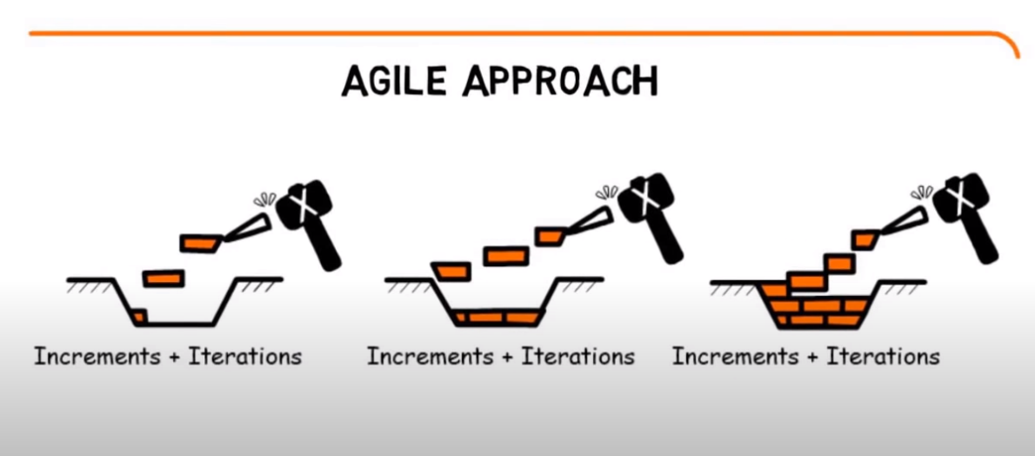

Slide 90
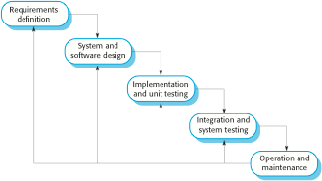
The Waterfall Model
Notice the feedback loops

Slide 91
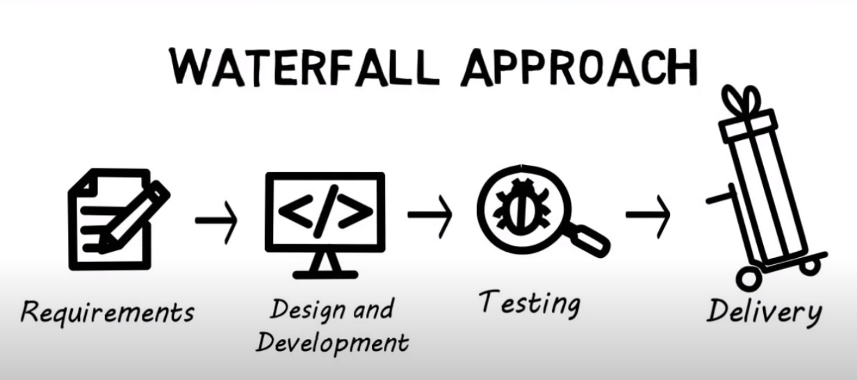

Slide 92
Waterfall Model Phases
There are separate identified phases in the waterfall model:
  Requirements analysis and definition
  System and software design
  Implementation and unit testing
  Integration and system testing
  Operation and maintenance
The main drawback of the waterfall model is the difficulty of accommodating change after the process is underway. In principle, a phase has to be complete before moving onto the next phase.
But many issues are true too, such as risk addressing.
War Stories but true.

Slide 93
Waterfall Model Problems
Inflexible partitioning of the project into distinct stages makes it difficult to respond to changing customer requirements.
  Therefore, this model is only appropriate when the requirements are well-understood and changes will be fairly limited during the design process.
  Few business systems have stable requirements.
The waterfall model is mostly used for large systems engineering projects where a system is developed at several sites.
  In those circumstances, the plan-driven nature of the waterfall model helps coordinate the work.

Slide 94
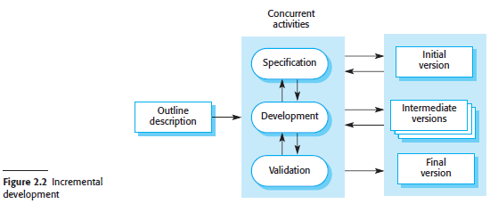
2.1.2 Incremental development
Incremental development is based on the idea of developing an initial implementation, getting feedback from users and others, and evolving the software through several versions until the required system has been developed.
This approach can be either plan-driven, agile or, more usually, a mixture of these approaches.
In a plan-driven approach, the system increments are identified in advance;
if an agile approach is adopted, the early increments are identified, but the development of later increments depends on progress and customer priorities.
Incremental software development is better because the requirements are likely to change during the development process.
By developing the software incrementally, it is cheaper and easier to make changes in the software as it is being developed.

Slide 95
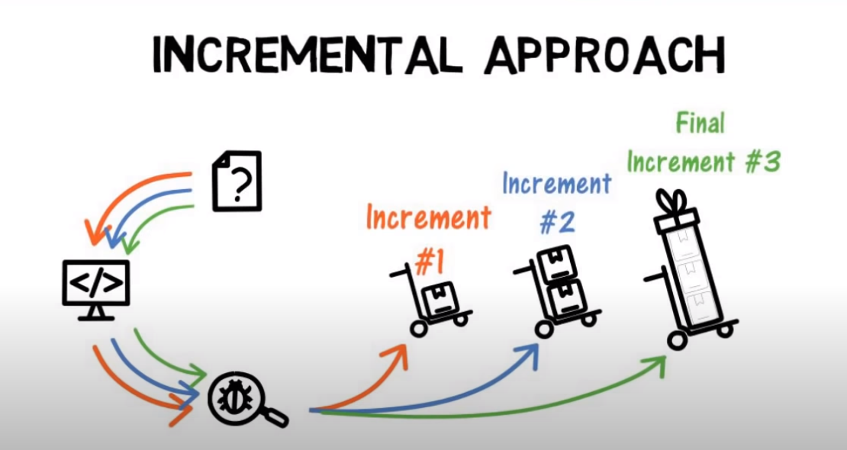

Slide 96
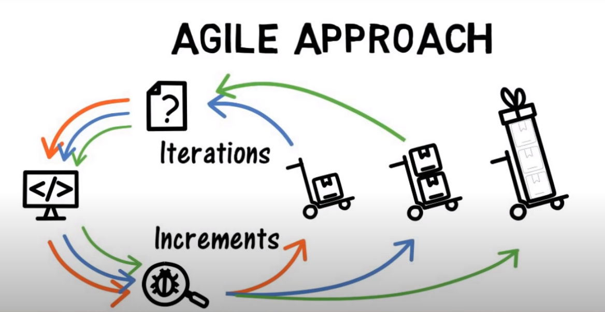

Slide 97
Incremental development has three major advantages over the waterfall model:
The cost of implementing requirements changes is reduced. The amount of analysis and documentation that has to be redone is significantly less than is required with the waterfall model.
It is easier to get customer feedback on the development work that has been done. Customers can comment on demonstrations of the software and see how much has been implemented. Customers find it difficult to judge progress from software design documents.
Early delivery and deployment of useful software to the customer is possible, even if all of the functionality has not been included. Customers are able to use and gain value from the software earlier than is possible with a waterfall process.
From a management perspective, the incremental approach has two problems:

Slide 98
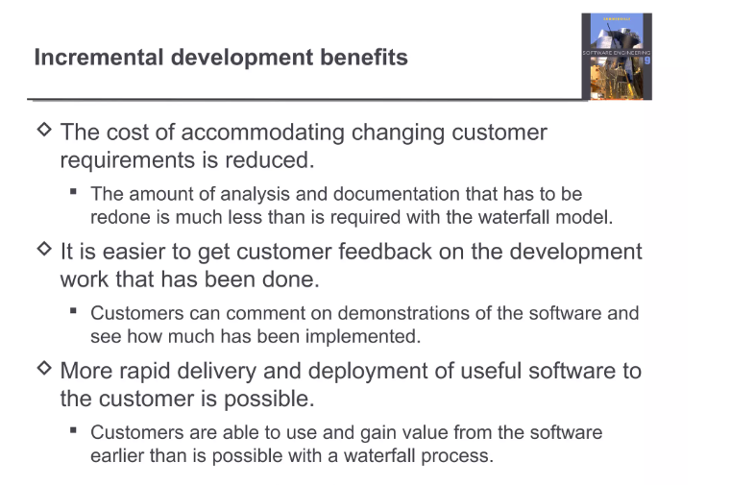

Slide 99
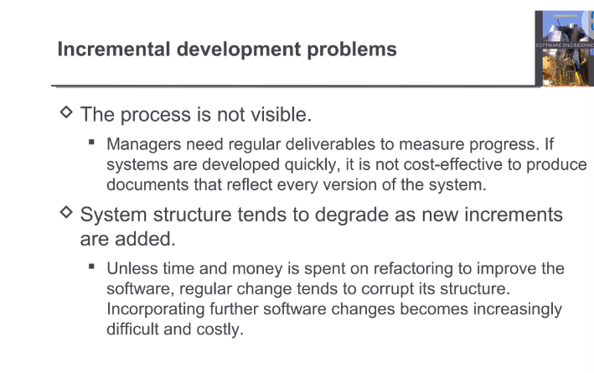

Slide 100
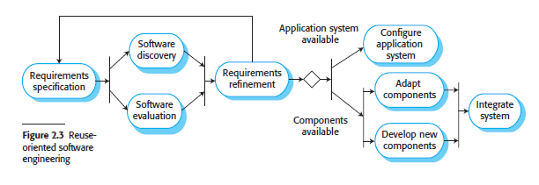
2.1.3 Integration and configuration
In the majority of software projects, there is some software reuse.
This often happens informally - people working on the project know, search for the code, modify them as needed and integrate them with the new code.
Reuse-oriented approaches rely on a base of reusable software components and an integrating framework for the composition of these components.
Three types of software components are frequently reused:
  Stand-alone application systems - configured for use in a particular environment, these systems are general-purpose systems they have to be adapted for use in a specific application.
  Collections of objects that are developed as a component or as a package to be integrated with a component framework such as the Java Spring framework.
  Web services that are developed according to service standards and that are available for remote invocation over the Internet.

Slide 101
Figure 2.3 shows a general process model for reuse-based development, based on integration and configuration.
The stages in this process are:
  Requirements specification
  Software discovery and evaluation
  Requirements refinement
  Application system configuration
  Component adaptation and integration

Slide 102
Requirements specification:
  initial requirements for the system are proposed
  do not have to be elaborated in detail.
  should include brief descriptions of essential requirements and desirable system features
Software discovery and evaluation:
  Given the software requirements, a search is made for components and systems that provide the required functionality.
  Candidate components and systems are evaluated if they meet the essential requirements.
Requirements refinement:
  the requirements are refined using information about the reusable components and applications that have been discovered.
  requirements are modified to reflect the available components, and the system specification is re-defined.
  Where modifications are impossible, the component analysis activity may be reentered to search for alternative solutions.
Application system configuration
  If an off-the-shelf application system that meets the requirements is available, it may then be configured for use to create the new system.
5. Component adaptation and integration
  If there is no off-the-shelf system, individual reusable components may be modified and new components developed. These are then integrated to create the system.

Slide 103
Process Activities
Real software processes are inter-leaved sequences of technical, collaborative and managerial activities with the overall goal of specifying, designing, implementing and testing a software system.
The four basic process activities (specified in your book) of specification, development, validation and evolution are organized differently in different development processes.
In the waterfall model, they are organized in sequence, whereas in incremental development they are inter-leaved.

Slide 104
Software Specification
Is: The process of establishing what services are required and the constraints on the system’s operation and development.
Requirements Engineering Process
  Feasibility study
    Is it technically and financially feasible to build the system?
    ROI, product Vision, what market share are we after? Urgency of development?
  Requirements elicitation and analysis
    What do the system stakeholders require or expect from the system?
    Recognition that the client must be satisfied. Have checkbook.
  Requirements Specification
    Defining the requirements in detail. These are the ‘whats’ of a system!!!
  Requirements Validation
    Checking the validity of the requirements
    Are they feasible, testable, sufficient, necessary, ...

Slide 105
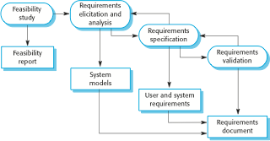
The Requirements Engineering Process

Slide 106
Software Design and Implementation
The process of converting the system specification into an executable system.
Software Design (inputs: specifications)
  Design a software structure that realizes the specification;
Implementation
  Translate this model / structure into an executable app;
  Programming is the implementation of the design.
The activities of design and implementation are closely related and may be inter-leaved and definitely are using many modern development processes. (more to come)

Slide 107
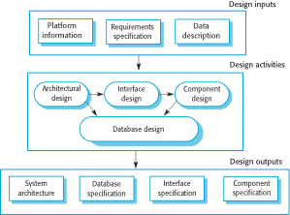
A General Model of the Design Process

Slide 108
Design Activities
Architectural design, where one identifies the overall structure of the system, the principal components (sometimes called sub-systems or modules or layers, etc…), their relationships and how they are distributed.
Example: Such as Model View Controller (MVC )pattern; others.
Interface design, where one defines the interfaces between system components. (interface to controller; controller to database; external device (sensor) to analyzer…)
Recognize that to the end user, the UI is the application.
Component design, where one takes each system component and design how it will operate.
This is what we are often used to
Database design, where one designs the system data structures and how these are to be represented in a database.

Slide 109
Software Validation
Verification and validation (V & V) is intended to show that a system conforms to its specification and meets the requirements of the system customer.
  Look up the difference between verification and
validation. Be able to explain clearly.
Involves checking and review processes and system testing.
System testing involves executing the system with test cases that are derived from the specification of the real data to be processed by the system.
Testing is the most commonly used V & V activity.

Slide 110

Stages of Testing
What does this mean??

Slide 111
Testing Stages
Development or component testing. (Unit testing)
  Individual components are tested independently;
  Components may be functions or objects or coherent groupings of these entities.
System testing
  Testing of the system as a whole. Testing of emergent properties is particularly important.
Acceptance testing
  Testing with customer data to check that the system meets the customer’s needs
Some models have various other kinds of testing; subsystem testing, integrated system testing, and much more.

Slide 112
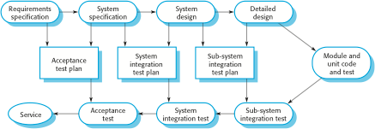
Testing Phases in a Plan-driven Software Process

Slide 113
Software Evolution
Software is inherently flexible and can change.
As requirements change through changing business circumstances, the software that supports the business must also evolve and change.
Although there has been a demarcation between development and evolution (maintenance) this is increasingly irrelevant as fewer and fewer systems are completely new (greenfield).

Slide 114
Key points
Understand the principles of software engineering
Understand what we mean by a software process
Note the two major classifications of processes and note also that there are numerous hybrid classifications within these.
Software processes are the activities involved in producing a software system.
Software process models are abstract representations of these processes.

Slide 115
Key points
Requirements engineering is the process of developing a software specification.
Design and implementation processes are concerned with transforming a requirements specification into an executable software system.
Software validation is the process of checking that the system conforms to its specification and that it meets the real needs of the users of the system.
Software evolution takes place when you change existing software systems to meet new requirements. The software must evolve to remain useful.

