Slide 1
Object Oriented Analysis & Design

Slide 2
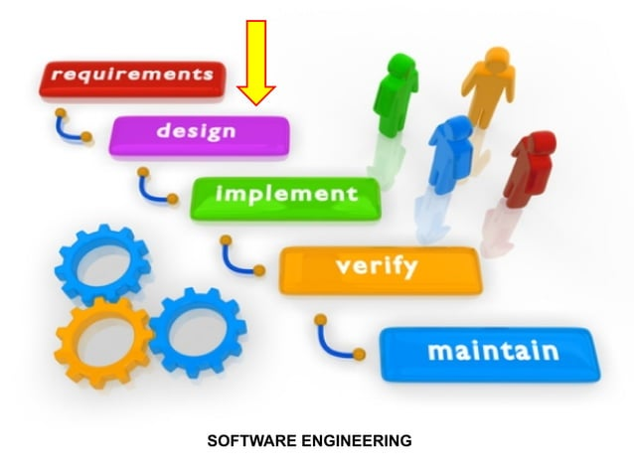

Slide 3
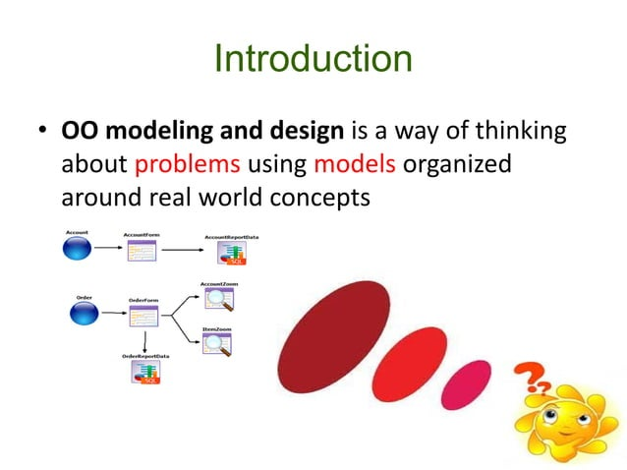

Slide 4
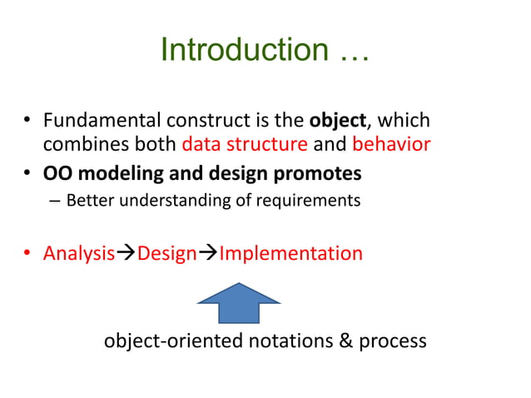

Slide 5
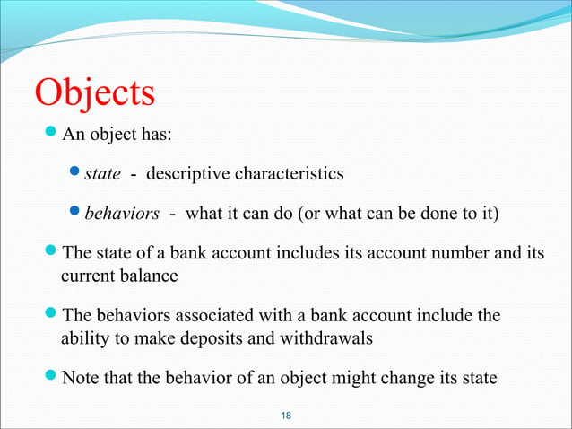

Slide 6
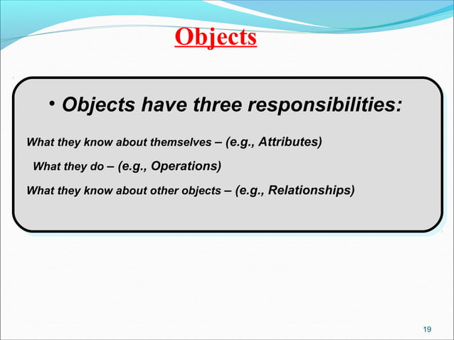

Slide 7
There are four aspects (characteristics) required by an OO approach
  Identity
  Classification
  Inheritance
  Polymorphism

Slide 8
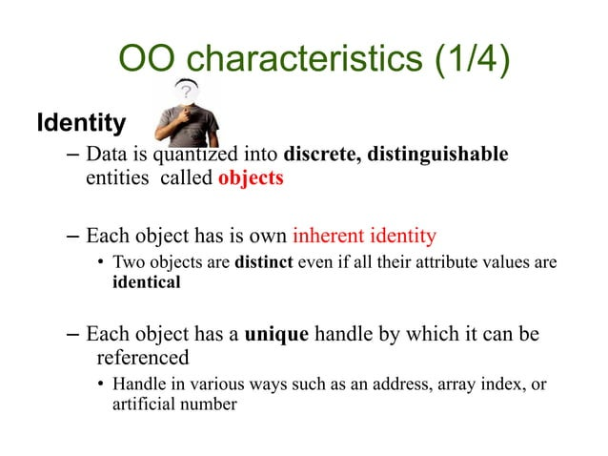

Slide 9
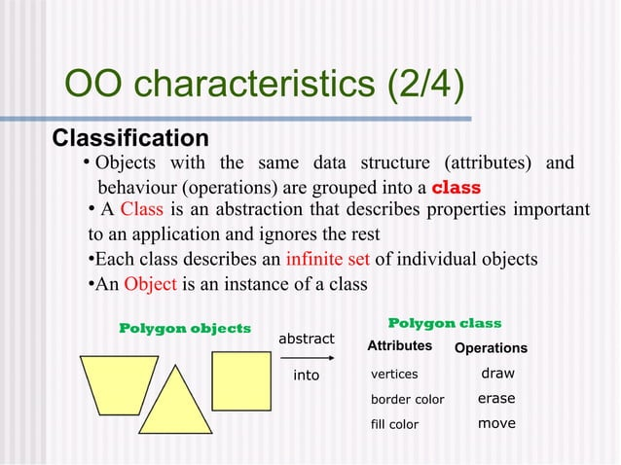

Slide 10
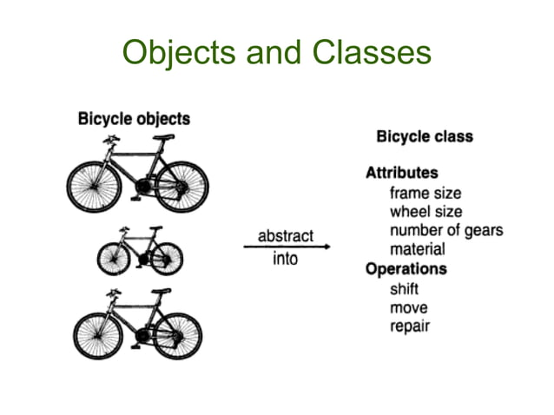

Slide 11
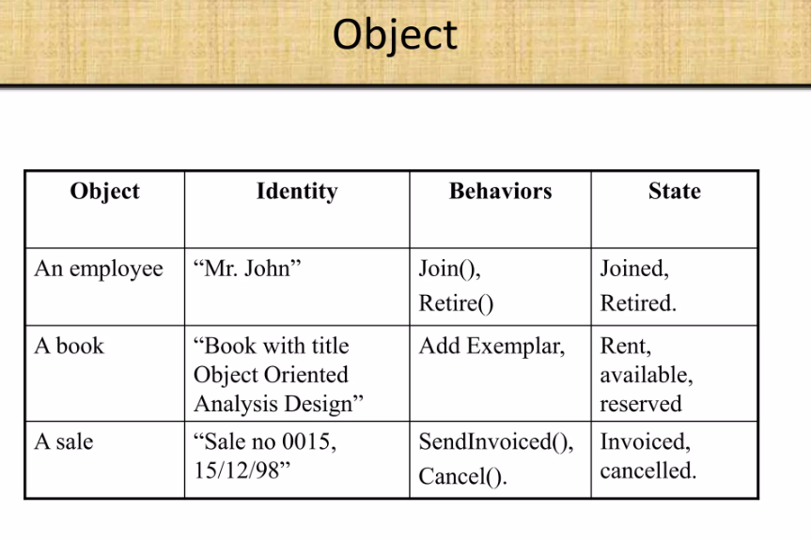

Slide 12
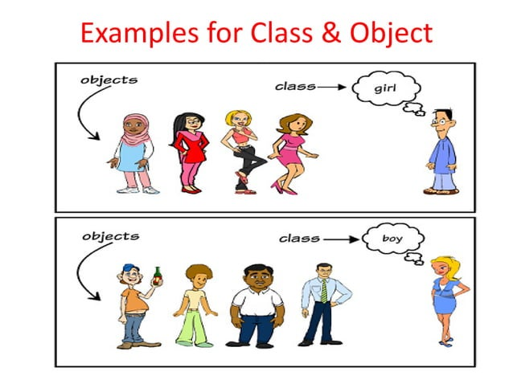

Slide 13
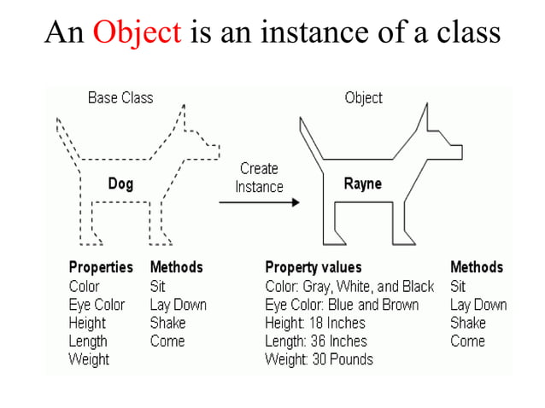

Slide 14
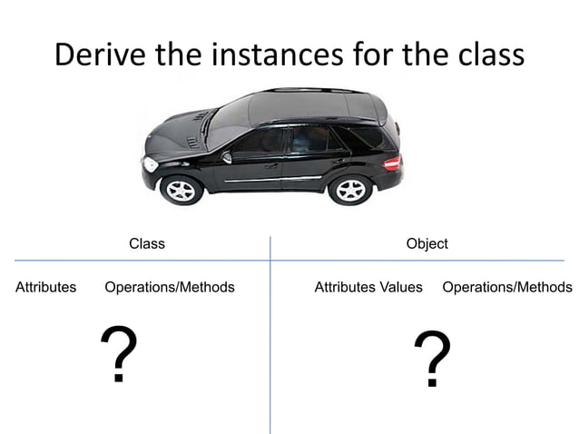

Slide 15
Prepare a list of classes that you would expect each of the following systems to handle.
A program for laying out a newspaper
b. A program to compute and store bowling scores
c. A telephone voice mail system with delivery options, message forwarding, and group lists
d. A controller for a video cassette recorder
e. A catalog store order entry system

Slide 16
Classes that you would expect in a program for newspaper layout include Page, Column, Line, Headline, and Paragraph.
b. Classes that you would expect in a program to compute and store bowling scores include Bowler, Frame, Pin, Score, and Ball Within Frame
c. Some classes for voice mail include Telephone, Greeting, Message, and Distribution List.
d. Classes for a controller for a video cassette recorder include Timer, Channel, Tapedeck, and TV.
e. For a catalog store order entry system, classes include Customer, Order, Store, and Item

Slide 17
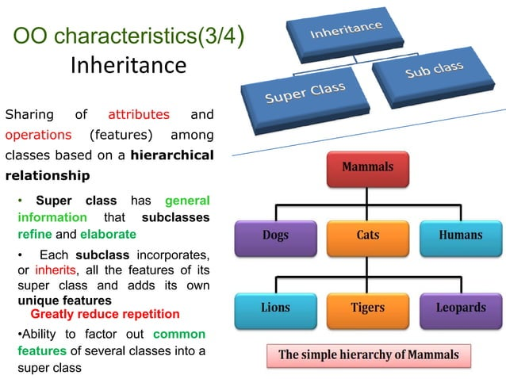

Slide 18
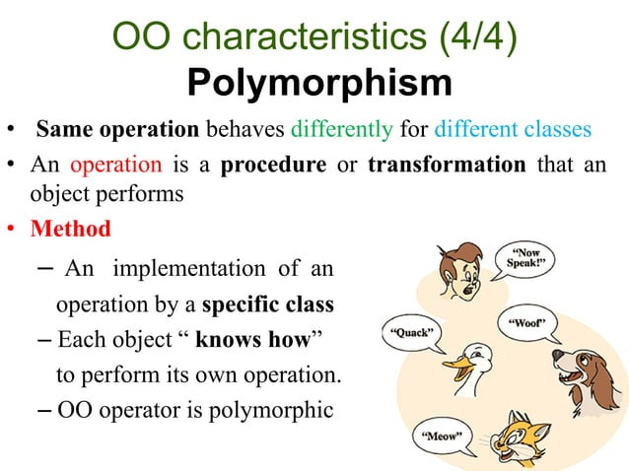

Slide 19
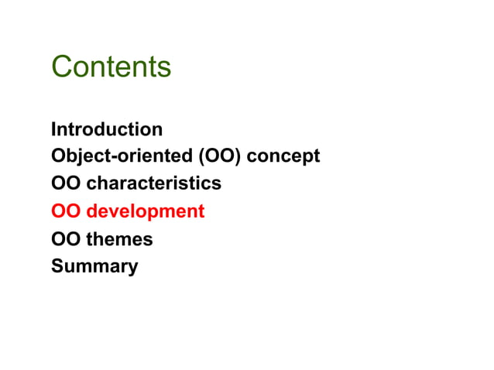

Slide 20
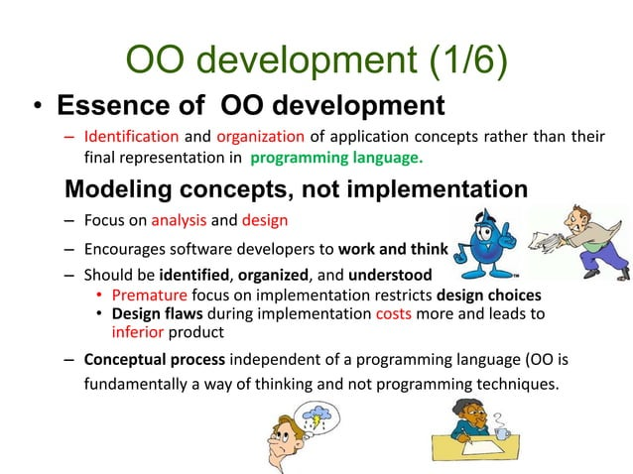

Slide 21
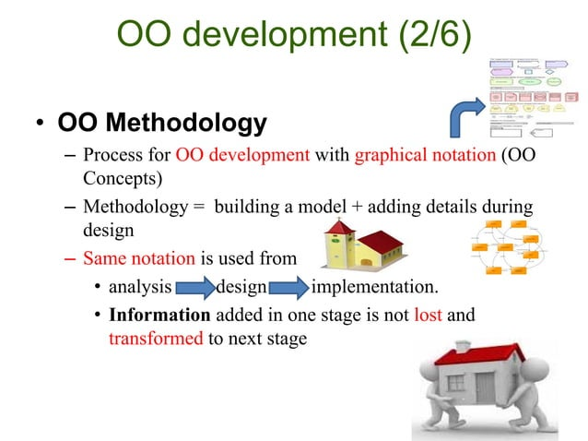

Slide 22
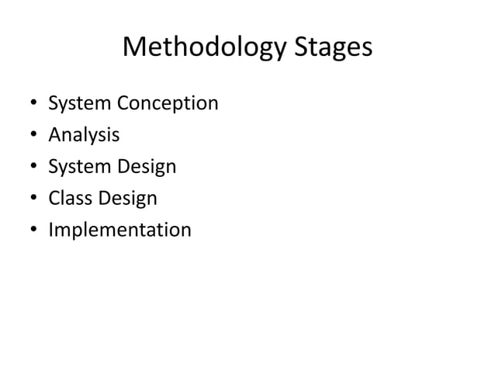

Slide 23
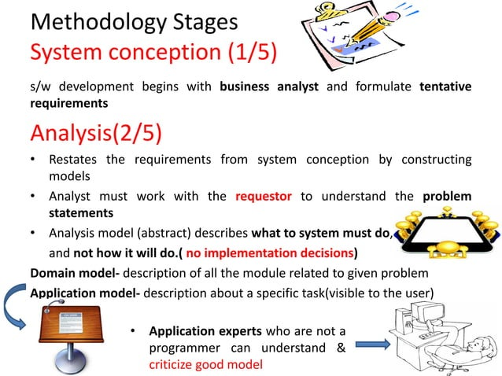

Slide 24
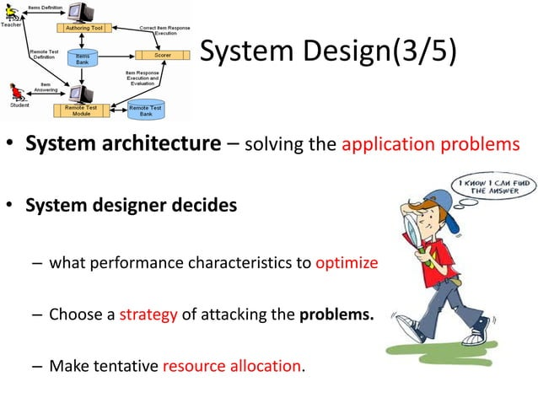

Slide 25
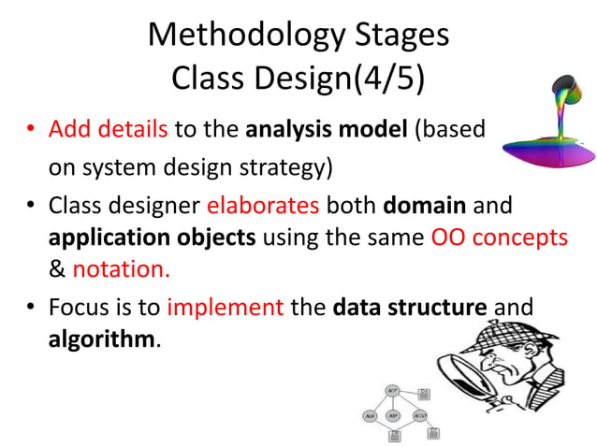

Slide 26
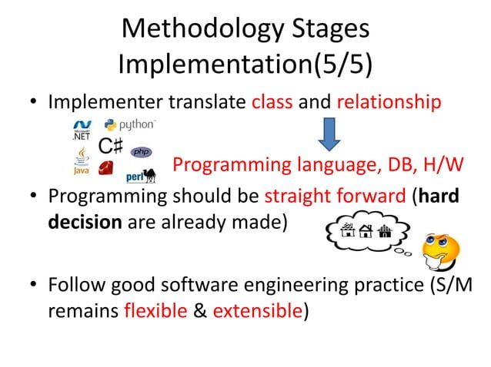

Slide 27
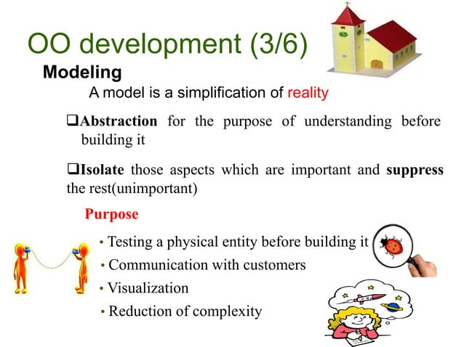

Slide 28
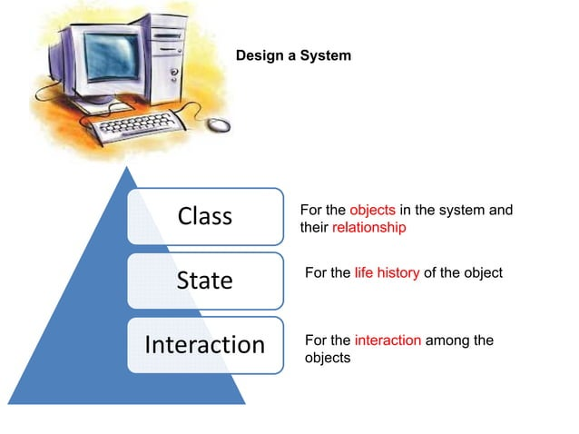

Slide 29
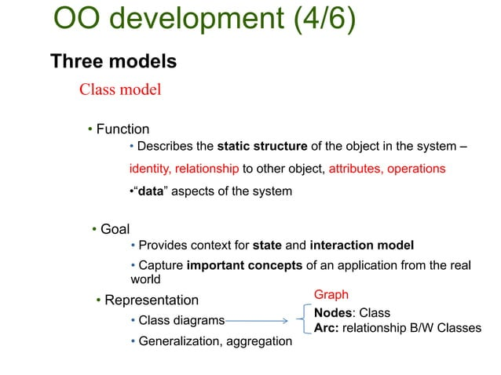

Slide 30
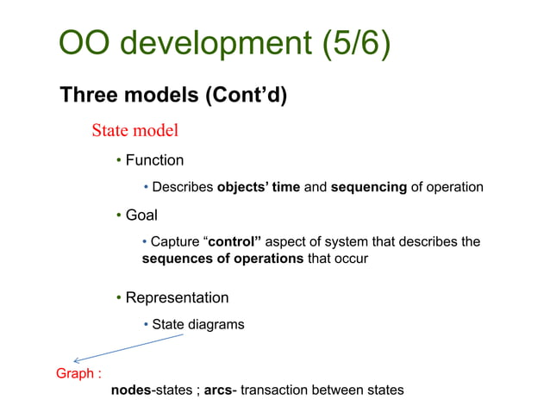

Slide 31
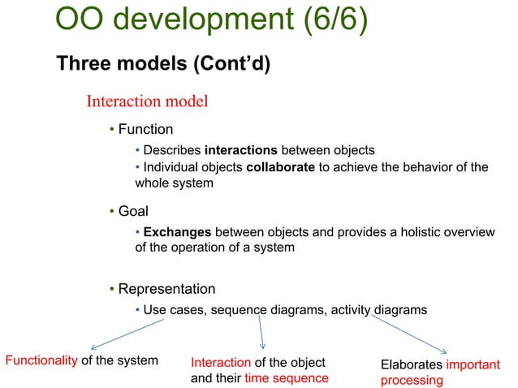

Slide 32
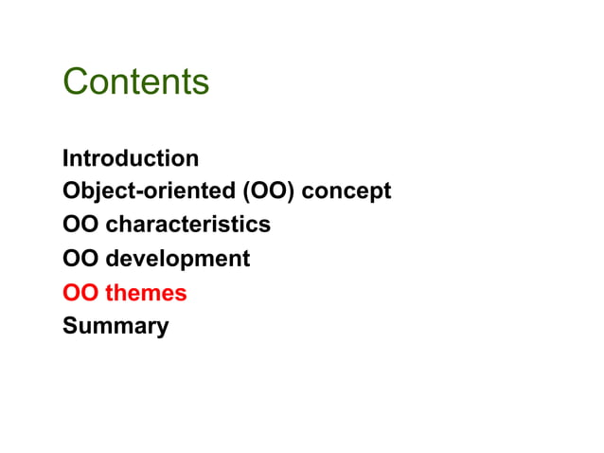

Slide 33
OO Themes
Abstraction
Encapsulation (Information hiding)
Combining data and behavior
Sharing
Emphasis on the essence of an object
Synergy

Slide 34
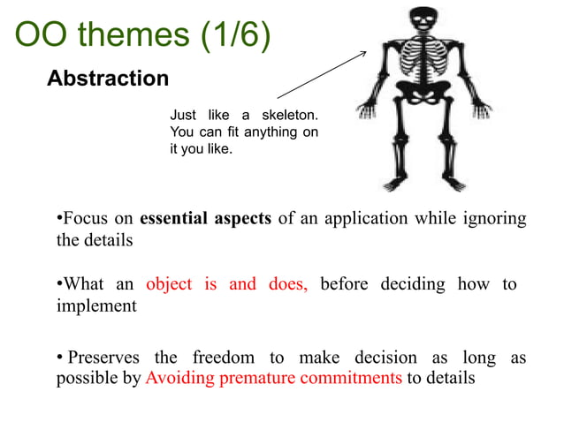

Slide 35
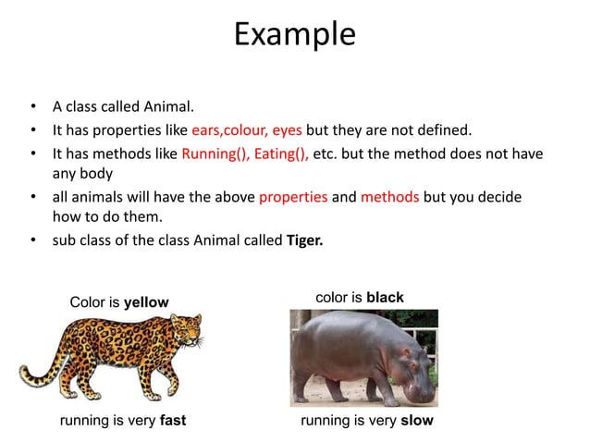

Slide 36
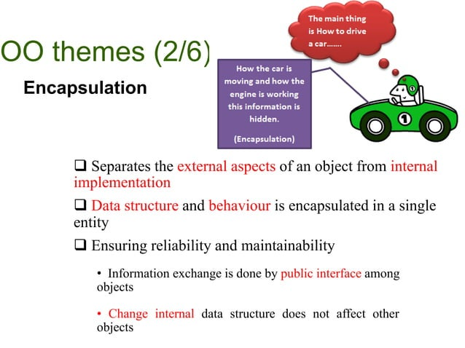

Slide 37
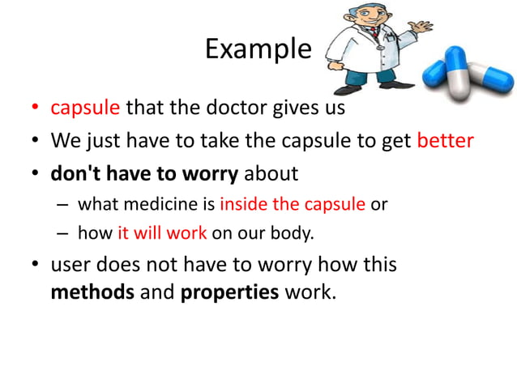

Slide 38
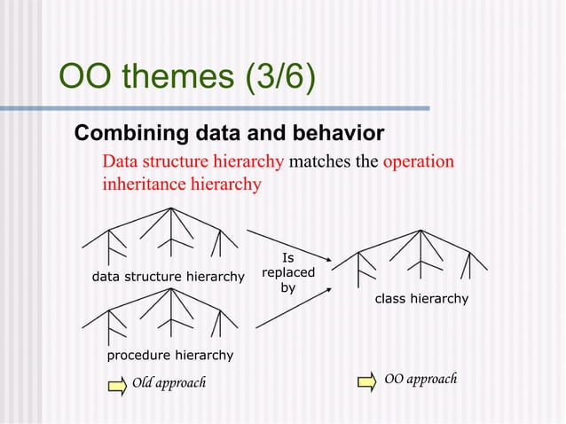

Slide 39
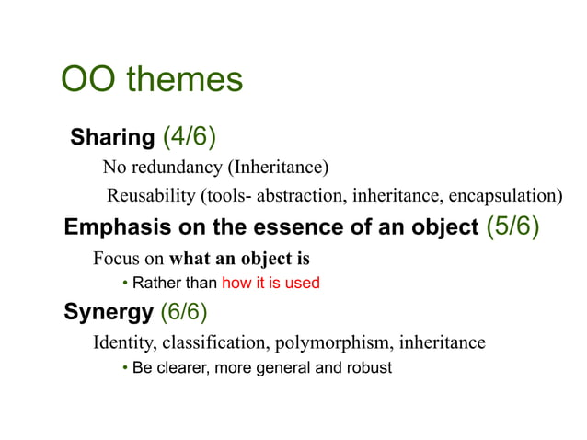

Slide 40
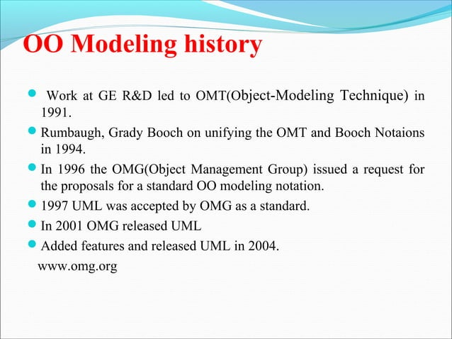

Slide 41


Slide 42
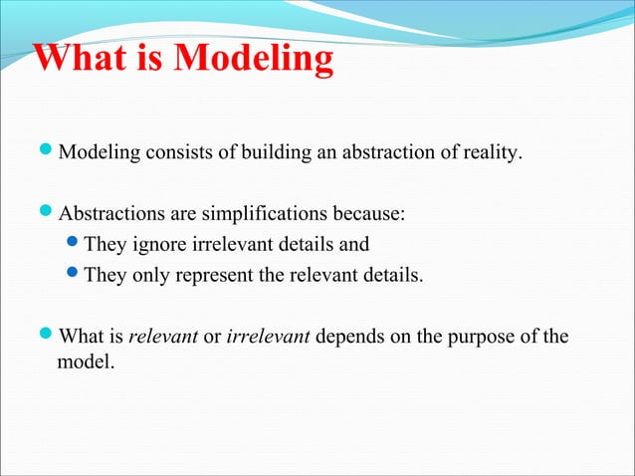

Slide 43
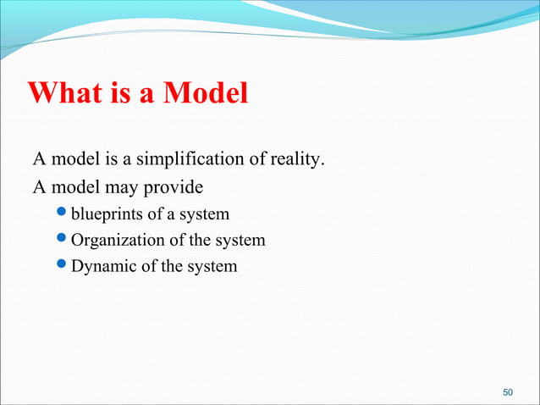

Slide 44
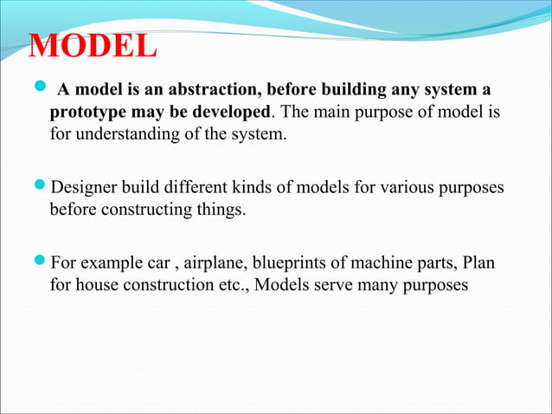

Slide 45
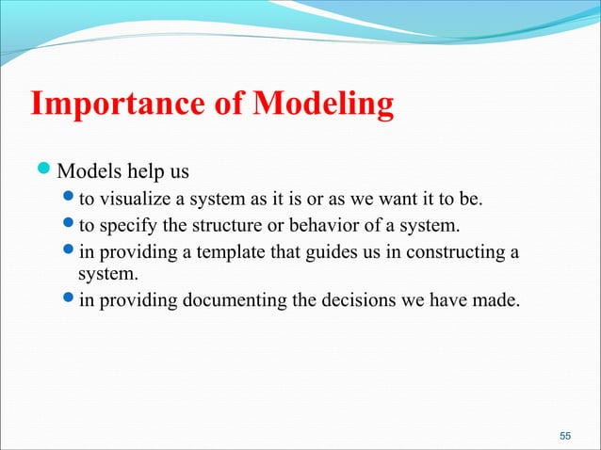

Slide 46
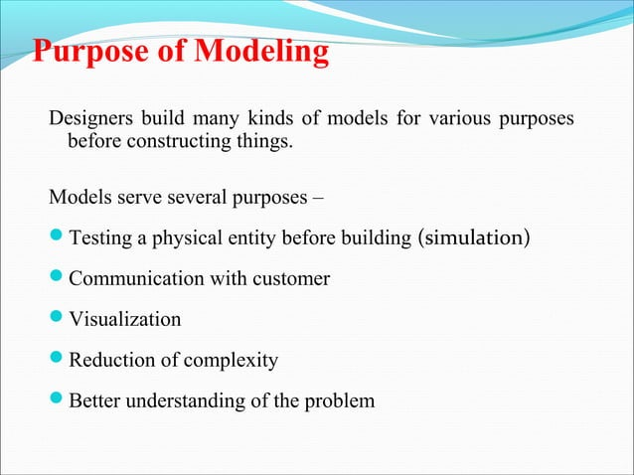

Slide 47
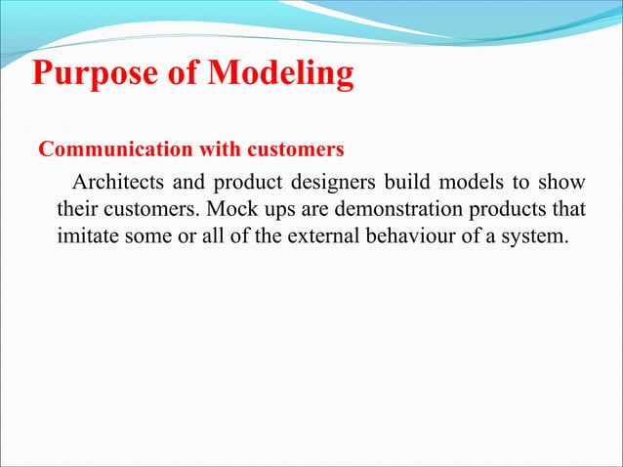

Slide 48
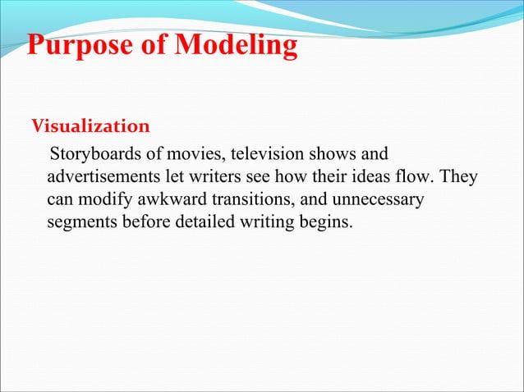

Slide 49
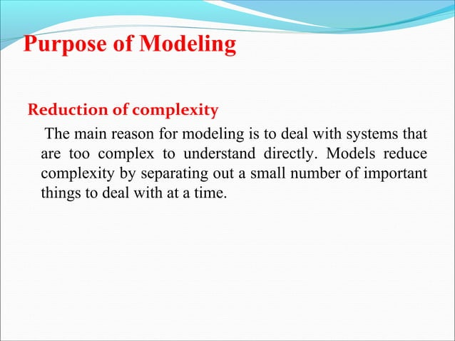

Slide 50
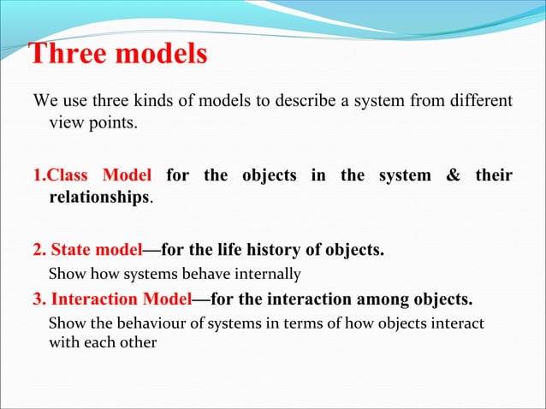

Slide 51
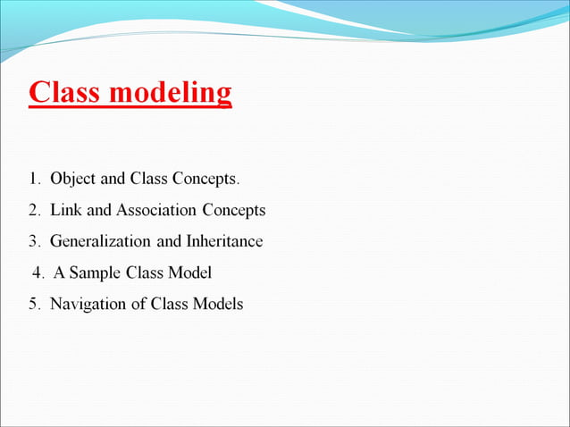

Slide 52
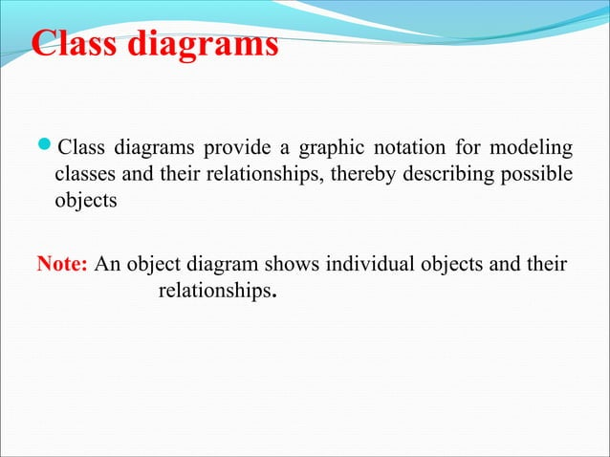

Slide 53
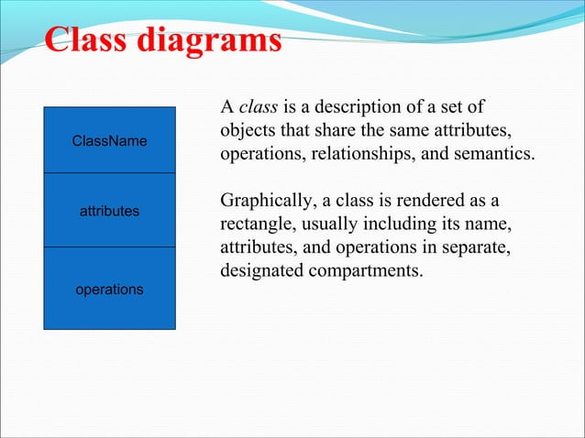

Slide 54
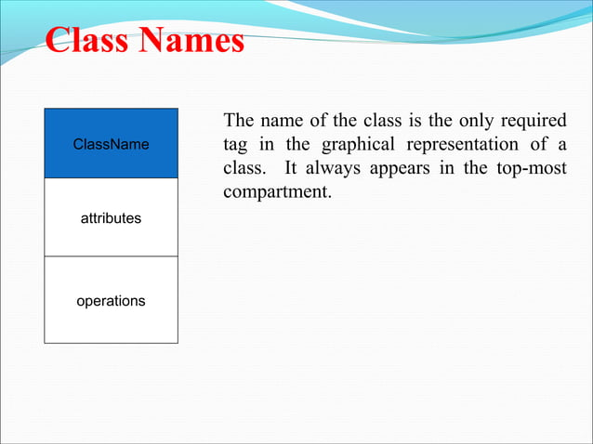

Slide 55
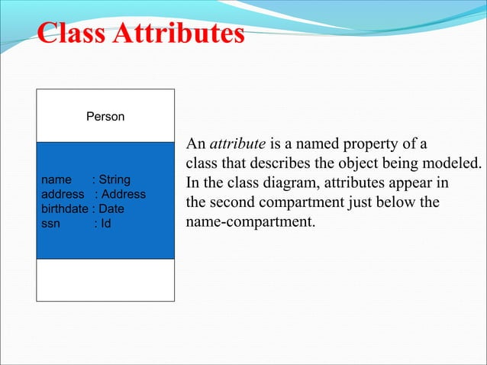

Slide 56
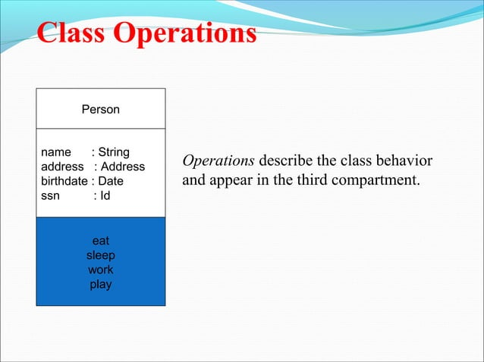

Slide 57


Slide 58


Slide 59



Slide 60


Slide 61



Slide 62

Values and Attributes
Some implementation media require that an object have a unique identifier. These identifiers are implicit in a class model—you need not and should not list them explicitly.
Figure below emphasizes the point. Most OO languages automatically generate identifiers with which to reference objects. You can also readily define them for databases. Identifiers are a computer artifact and have no intrinsic meaning.

Slide 63
Operations and Methods
An operation may have arguments in addition to its target object.
Such arguments may be placeholders for values, or for other objects.
The choice of a method depends entirely on the class of the target object and not on any object arguments that an operation may have.
When an operation has methods on several classes, it is important that the all methods have the same signature—the number and types of arguments and the type of result value.
For example, print should not have fileName as an argument for one method and filePointer for another.

Slide 64
Operations and Methods
The behavior of all methods for an operation should have a consistent intent.
It is best to avoid using the same name for two operations that are semantically different, even if they apply to distinct sets of classes.
For example, it would be unwise to use the name invert to describe both a matrix inversion and turning a geometric figure upside-down.
In a large project, some form of name scoping may be necessary to accommodate accidental name clashes, but it is best to avoid any possibility of confusion.

Slide 65

Operations and Methods
In Figure below, the class Person has attributes name and birthdate and operations change-Job and changeAddress. Name, birthdate, changeJob, and changeAddress are features of Person.
Feature is a generic word for either an attribute or operation.
Similarly, File has a print operation.
GeometricObject has move, select, and rotate operations. Move has argument delta, which is a Vector; select has one argument p, which is of type Point and returns a Boolean; and rotate has argument angle, which is an input of type float with a default value of 0.0.

Slide 66


Slide 67


Slide 68

Links and Associations
Figure below is an excerpt of a model for a financial application.

Slide 69
Links and Associations
The association name is optional, if the model is unambiguous.
Ambiguity arises when a model has multiple associations among the same classes (person works for company and person owns stock in company).
When there are multiple associations, you must use association names or association end names to resolve the ambiguity.
Associations are inherently bidirectional. The name of a binary association usually reads in a particular direction, but the binary association can be traversed in either direction.
For example, WorksFor connects a person to a company. The inverse of WorksFor could be called Employs, and it connects a company to a person. In reality, both directions of traversal are equally meaningful and refer to the same underlying association; it is only the names that establish a direction.

Slide 70
Links and Associations
Developers often implement associations in programming languages as references from one object to another.
A reference is an attribute in one object that refers to another object.
For example, a data structure for Person might contain an attribute employer that refers to a Company object, and a Company object might contain an attribute employees that refers to a set of Person objects.
Implementing associations as references is perfectly acceptable, but you should not model associations this way.
You should model all connections among classes as associations, even in designs for programs.

Slide 71
Links and Associations
The OO literature emphasizes encapsulation, that implementation details should be kept private to a class, and we certainly agree with this.
Associations are important, precisely because they break encapsulation.
Associations cannot be private to a class, because they transcend classes.
Failure to treat associations on an equal footing with classes can lead to programs containing hidden assumptions and dependencies.
Such programs are difficult to extend and the classes are difficult to reuse.

Slide 72


Slide 73


Slide 74


Slide 75


Slide 76
Multiplicity
Multiplicity specifies the number of instances of one class that may relate to a single instance of an associated class.
Multiplicity constrains the number of related objects.
The literature often describes multiplicity as being “one” or “many,” but more generally it is a (possibly infinite) subset of the nonnegative integers.
UML diagrams explicitly list multiplicity at the ends of association lines.
The UML specifies multiplicity with an interval, such as “1” (exactly one), “1..*” (one or more), or “3..5” (three to five, inclusive).
The special symbol “*” is a shorthand notation that denotes “many” (zero or more).

Slide 77
Many to many Multiplicity
A person may own stock in many companies. A company may have multiple persons holding its stock. In this particular case, John and Mary own stock in the GE company; Alice owns stock in the IBM company; Sue owns stock in both companies; Jeff does not own any stock. GE stock is owned by three persons; IBM stock is owned by two persons.

Slide 78

One to one Multiplicity
Each country has one capital city. A capital city administers one country.

Slide 79

Zero to one Multiplicity
A workstation may have one of its windows designated as the console to receive general error messages. It is possible, however, that no console window exists. (The word “console” on the diagram is an association end name).
Do not confuse “multiplicity” with “cardinality.”
Multiplicity is a constraint on the size of a collection; cardinality is the count of elements that are actually in a collection. Therefore, multiplicity is a constraint on the cardinality.

Slide 80


Multiplicity
A multiplicity of “many” specifies that an object may be associated with multiple objects.
However, for each association there is at most one link between a given pair of objects (except for bags and sequences).

Slide 81


Slide 82


Slide 83


Slide 84


Slide 85


Slide 86


Slide 87


Slide 88


Slide 89


Slide 90


Slide 91


Slide 92


Slide 93


Slide 94


Slide 95


Slide 96


Slide 97


Slide 98


Slide 99


Slide 100


Slide 101


Slide 102


Slide 103


Slide 104


Slide 105


Slide 106


Slide 107


Slide 108


Slide 109


Slide 110
Generalization and Inheritance
Generalization is the relationship between a class (the superclass) and one or more variations of the class (the subclasses).
Generalization organizes classes by their similarities and differences, structuring the description of objects. The superclass holds common attributes, operations, and associations; the subclasses add specific attributes, operations, and associations.
Each subclass is said to inherit the features of its superclass.
Generalization is sometimes called the “is-a” relationship, because each instance of a subclass is an instance of the superclass as well.
A large hollow arrowhead denotes generalization. The arrowhead points to the superclass.
The curly braces denote a UML comment, indicating that there are additional subclasses that the diagram does not show.

Slide 111

Generalization and Inheritance

Slide 112
Class Model Example (Credit Card Accounts)
Draw the class model for credit card accounts. An institution may issue many credit card accounts, each identified by an account number. Each account has a maximum credit limit, a current balance, and a mailing address. The account serves one or more customers who reside at the mailing address. The institution periodically issues a statement for each account. The statement lists a payment due date, finance charge, and minimum payment. The statement itemizes various transactions that have occurred throughout the billing interval: cash advances, interest charges, purchases, fees, and adjustments to the account. The name of the merchant is printed for each purchase.

Slide 113

Class Model Example (Credit Card Accounts)

