Slide 1
State Machine Diagrams
Unit 2

Slide 2
According to Bernd Textbook- Chapter 2
Three different models of the system:
Functional model: Use-case diagram – Functionality of the system from user’s point of view
Object model: Class Diagram- Describes the structure of the system in terms of objects, attributes, associations and operations.
Dynamic model: Interaction Diagrams, State Machine Diagrams and Activity Diagrams, describes the internal behaviour of the system.

Slide 3
According to Rumbaugh Text Book
The Three Models
Class Model: Class diagrams
State Model: State diagram
Interaction model: Use cases, sequence diagrams and activity diagrams

Slide 4
What is State Machine Diagrams?
Provides the dynamic view/behaviour of the aspects of the system.
Depicts data and behavior of a single object throughout its lifetime.
State Diagrams can describe a single object and illustrate how that object behaves in response to a series of events in your system.
UML State Machine Diagram is used to describe the different/various states that an object may be in and transitions between those states.
Given a state, a transition represents a future state the object can move to and the conditions associated with the change of state.

Slide 5

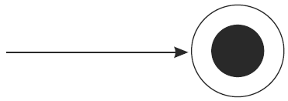
Notations used in State Chart
Initial state
The initial state symbol is used to indicate the beginning of a state machine diagram or starting point of object lifespan .
Final state
This symbol is used to indicate the end of a state machine diagram.

Slide 6

Decision box
It contains a condition, Diamond shape. Depending upon the result, decision is taken for program execution.
Transition
A transition is a change in one state into another state which is occurred because of some event. A transition causes a change in the state of an object. Each transition line is labeled with the event that causes the transition.

Slide 7
Transitions between states occur as follows:
  An element is in a source state
  An event occurs
  An action is performed
  The element enters a target state
Events/Action–
trigger to move from one state to another state or internal transition compartment of a state.
Events pass information, which is elaborated by Objects operations.

Slide 8

Activity
Activity is associated with states, which is a ongoing computation.
Activity may run to completion or continue indefinitely.
An Activity will be terminated by an event that causes a transition from the state in which the activity is defined.
State box
It is a specific moment in the lifespan of an object.
It is denoted using a rectangle with round corners. The name of a state is written inside the rounded rectangle.

Slide 9
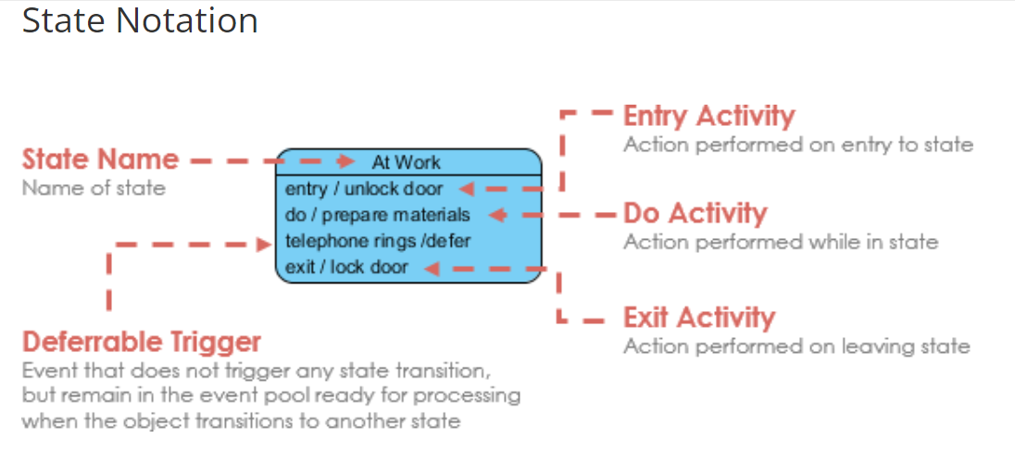

Slide 10
State Diagram
A state has several parts:
  Name : A textual string that distinguishes the state from other states; a state may be anonymous, meaning that it has no name.
  Entry/exit effects : Actions executed on entering and exiting the state, respectively.
  Internal transitions : Transitions that are handled without causing a change in state.
  Deferred events - (infrequently used) : A list of events that are not handled in that state but, rather, are postponed and queued for handling by the object in another state.

Slide 11
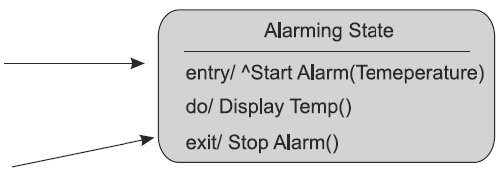
Notations used in State Chart
In some cases, there is a need to represent the entry/do with activities inside the state. This can be represented as shown in Fig below :
In the above state icon, the entry/send event, do/activity and exit/activity pairs have been represented.

Slide 12
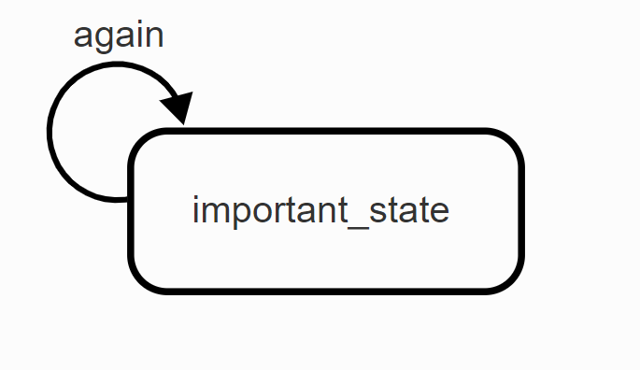
Self transition
A self transition is a transition that starts and ends in the same state. When a self transition is taken, the state in question is exited and entered again.
A self transition is depicted as a segment of a circle, here with the event again attached to it.

Slide 13
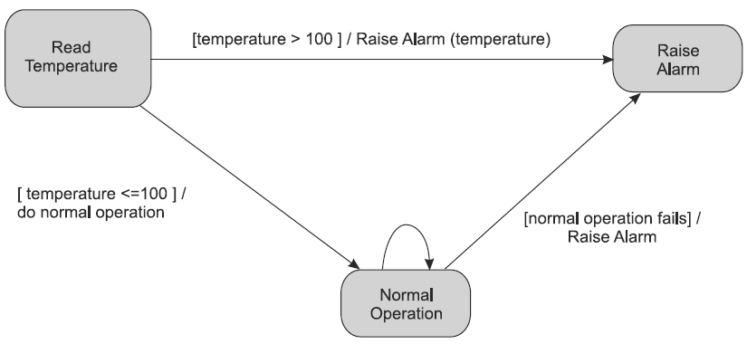
Notations used in State Chart
Consider the following sample for self-transition and guarded conditions shown in Fig below :
In Fig., the guarded conditions [temperature >100] and temperature<=100] are provided as transition labels from ‘Read Temperature’ state.
A self-transition at ‘Normal Operation’ state makes the system to be in the same state until the normal operation fails.

Slide 14
Characteristics of Action and Activities
States can trigger actions.
Five triggers for actions: On Entry, Do, On Event, On Exit, and Include
An activity captures complex behavior that may run for a long duration –
An activity may be interrupted by events, in which case it does not complete.

Slide 15
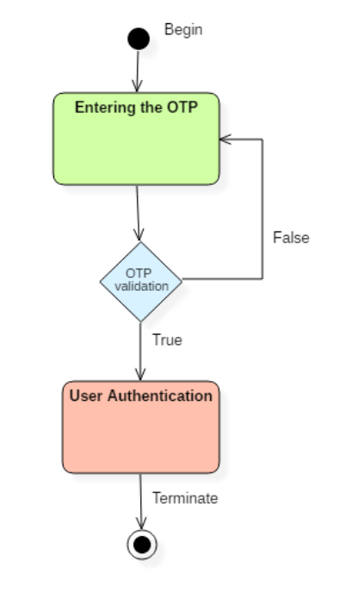

Slide 16
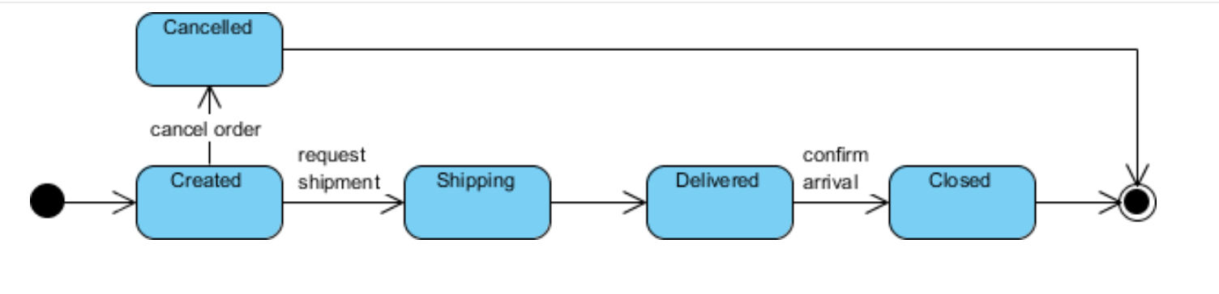
Event
Initial State
State
Transition
Final State

Slide 17
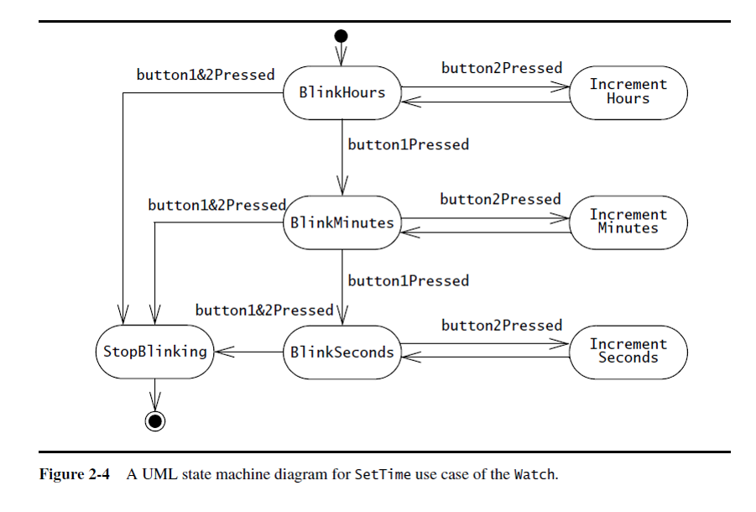
For example, Figure 2-4 is a state machine diagram for the Watch. A small black circle initiates that BlinkHours is the initial state. A circle surrounding a small black circle indicates that StopBlinking is a final state. The state machine diagram focuses on the transitions between states as a result of external events for an individual object.

Slide 18
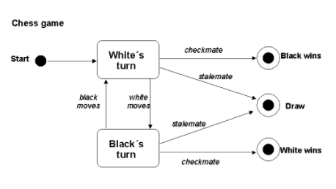

Slide 19
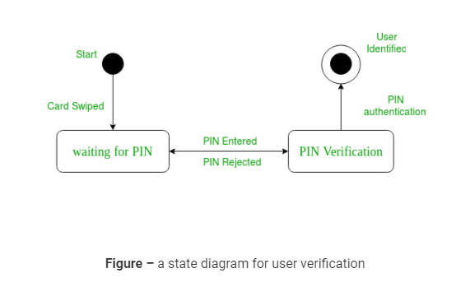

Slide 20
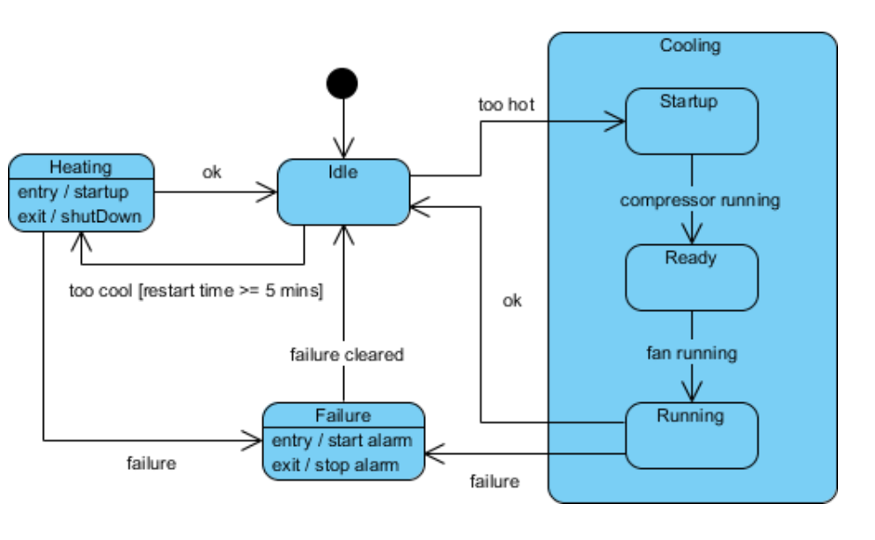
Example - Heater

Slide 21
Idle state receives Too Hot event
Idle state receives Too Cool event
Cooling/Startup state receives Compressor Running event
Cooling/Ready state receives Fan Running event
Cooling/Running state receives OK event
Cooling/Running state receives Failure event
Failure state receives Failure Cleared event
Heating state receives OK event
Heating state receives Failure event

Slide 22
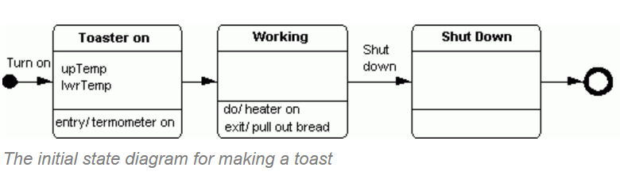

Slide 23
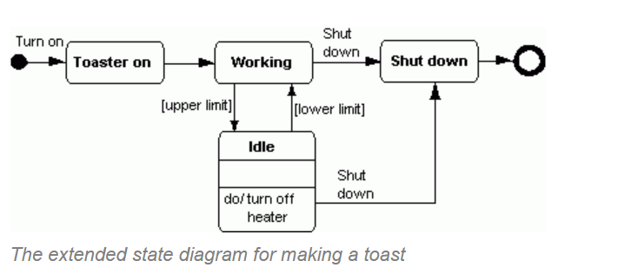

Slide 24
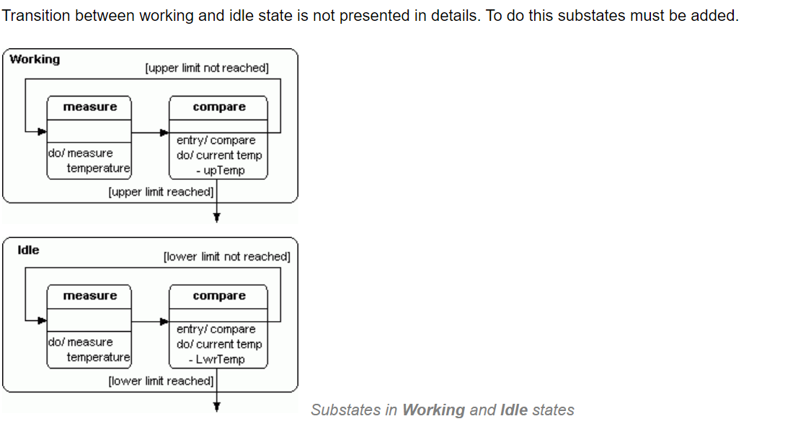

Slide 25
State diagram for an online order
Example of how an online ordering system might look like :
On the event of an order being received, we transit from our initial state to Unprocessed order state.
The unprocessed order is then checked.
If the order is rejected, we transit to the Rejected Order state.
If the order is accepted and we have the items available we transit to the fulfilled order state.
However if the items are not available we transit to the Pending Order state.
After the order is fulfilled, we transit to the final state. In this example, we merge the two states i.e. Fulfilled order and Rejected order into one final state.

Slide 26
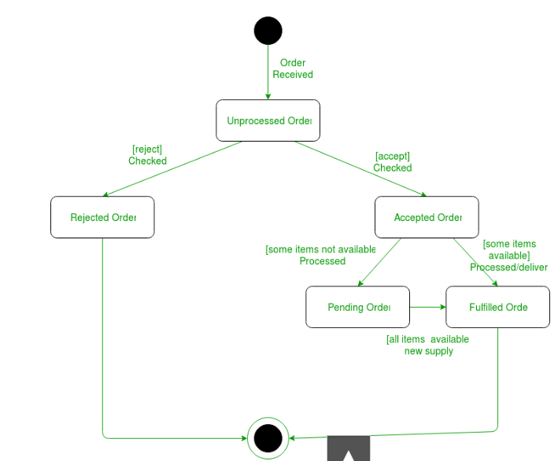

Slide 27
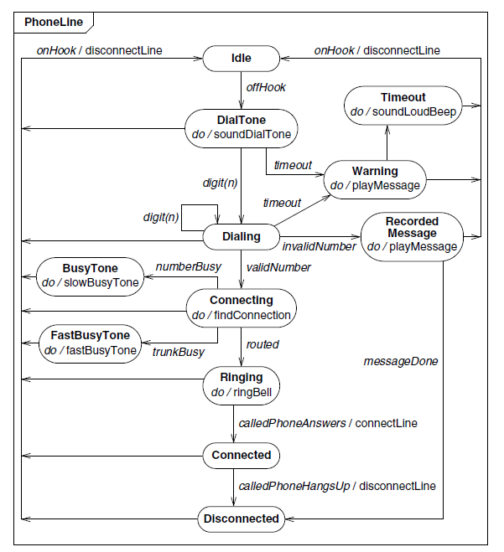
State diagram for phone line with activities.

Slide 28
References
https://www.lucidchart.com/pages/uml-state-machine-diagram
https://slideplayer.com/slide/17479895/
https://www.youtube.com/watch?v=TzTl4pdEYWE&ab_channel=5MinutesEngineering
https://www.youtube.com/watch?v=TM4xTNRH1bw&ab_channel=5MinutesEngineering
https://www.visual-paradigm.com/guide/uml-unified-modeling-language/what-is-state-machine-diagram/

