Slide 1
Project planning
1

Slide 2
Topics covered
✧ Project scheduling
✧ Agile planning
2

Slide 3
Project scheduling
3

Slide 4
Project scheduling
✧ Project scheduling is the process of deciding how the work in a project will be organized as separate tasks, and when and how these tasks will be executed.
✧ You estimate the calendar time needed to complete each task, the effort required and who will work on the tasks that have been identified.
✧ You also have to estimate the resources needed to complete each task, such as the disk space required on a server, the time required on specialized hardware, such as a simulator, and what the travel budget will be.
4

Slide 5
Project scheduling activities
✧ Split project into tasks and estimate time and resources required to complete each task.
✧ Organize tasks concurrently to make optimal use of workforce.
✧ Minimize task dependencies to avoid delays caused by one task waiting for another to complete.
✧ Dependent on project managers intuition and experience.
5

Slide 6
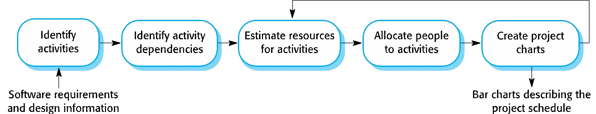
The project scheduling process
6

Slide 7
Scheduling problems
✧ Estimating the difficulty of problems and hence the cost of developing a solution is hard.
✧ Productivity is not proportional to the number of people working on a task.
✧ Adding people to a late project makes it later because of communication overheads.
✧ The unexpected always happens. Always allow contingency in planning.
7

Slide 8
Schedule presentation
✧ Graphical notations are normally used to illustrate the project schedule.
✧ These show the project breakdown into tasks. Tasks should not be too small. They should take about a week or two.
✧ Calendar-based
Bar charts are the most commonly used representation for project schedules. They show the schedule as activities or resources against time.
✧ Activity networks
Show task dependencies
8

Slide 9
Project activites
✧ Project activities (tasks) are the basic planning element.
Each activity has:
a duration in calendar days or months,
an effort estimate, which shows the number of person-days or person-months to complete the work,
a deadline by which the activity should be complete,
a defined end-point, which might be a document, the holding of a review meeting, the successful execution of all tests, etc.
9

Slide 10
Milestones and deliverables
✧ Milestones are points in the schedule against which you can assess progress, for example, the handover of the system for testing.
✧ Deliverables are work products that are delivered to the customer, e.g. a requirements document for the system.
10

Slide 11
Tasks, durations, and dependencies
Task | Effort (person-days) | Duration (days) | Dependencies
T1 | 15 | 10
T2 | 8 | 15
T3 | 20 | 15 | T1 (M1)
T4 | 5 | 10
T5 | 5 | 10 | T2, T4 (M3)
T6 | 10 | 5 | T1, T2 (M4)
T7 | 25 | 20 | T1 (M1)
T8 | 75 | 25 | T4 (M2)
T9 | 10 | 15 | T3, T6 (M5)
T10 | 20 | 15 | T7, T8 (M6)
T11 | 10 | 10 | T9 (M7)
T12 10/12/2014 | 20 Ch | 10 apter 23 Project Planning | T10, T11 (M8) 31

Slide 12
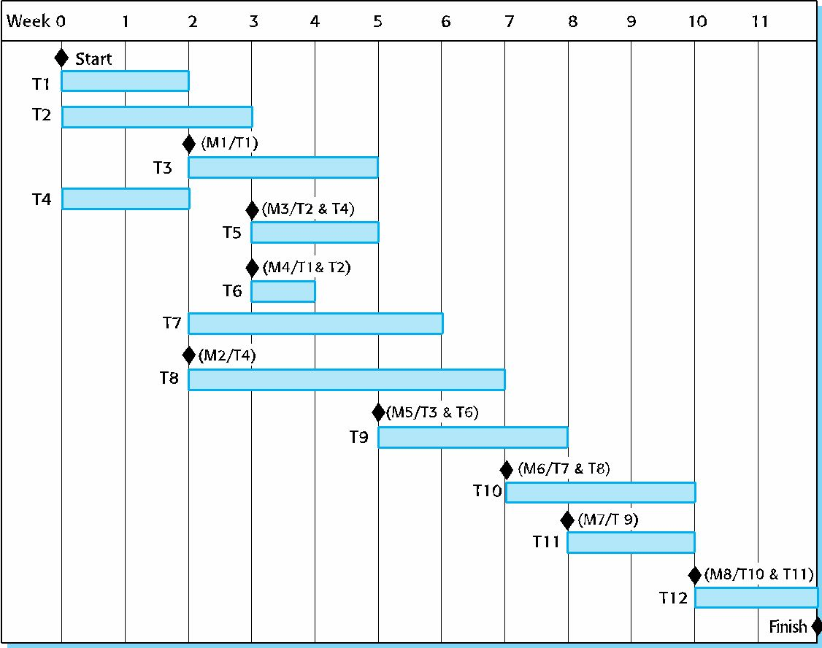
Activity bar chart

Slide 13
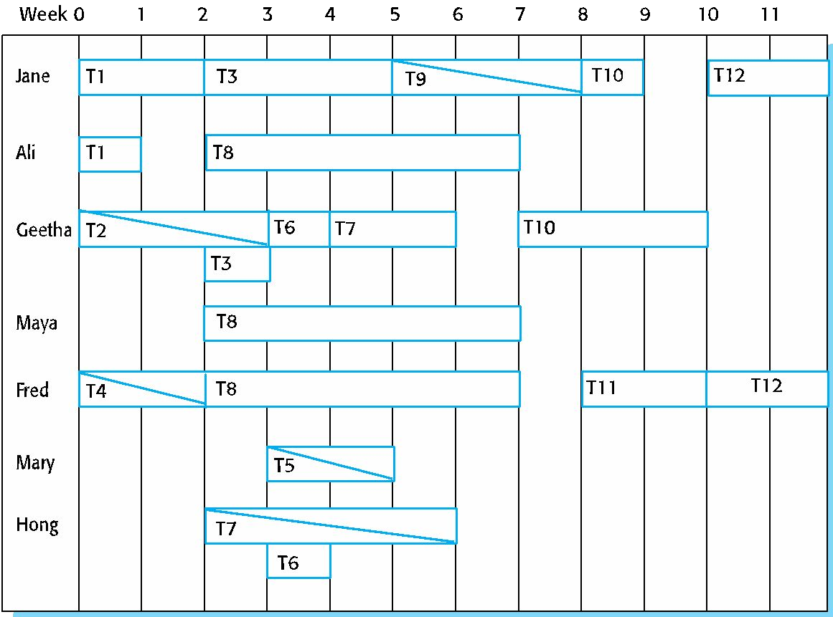
Staff allocation chart

Slide 14
Agile planning

Slide 15
Agile planning
✧ Agile methods of software development are iterative approaches where the software is developed and delivered to customers in increments.
✧ Unlike plan-driven approaches, the functionality of these increments is not planned in advance but is decided during the development.
The decision on what to include in an increment depends on progress and on the customer’s priorities.
✧ The customer’s priorities and requirements change so it makes sense to have a flexible plan that can accommodate these changes.

Slide 16
Agile planning stages
✧ Release planning, which looks ahead for several months and decides on the features that should be included in a release of a system.
✧ Iteration planning, which has a shorter term outlook, and focuses on planning the next increment of a system. This is typically 2-4 weeks of work for the team.

Slide 17
Approaches to agile planning
✧ Planning in Scrum
Covered in Chapter 3
✧ Based on managing a project backlog (things to be done) with daily reviews of progress and problems
✧ The planning game
Developed originally as part of Extreme Programming (XP)
Dependent on user stories as a measure of progress in the project

Slide 18
Story-based planning
✧ The planning game is based on user stories that reflect the features that should be included in the system.
✧ The project team read and discuss the stories and rank them in order of the amount of time they think it will take to implement the story.
✧ Stories are assigned ‘effort points’ reflecting their size and difficulty of implementation
✧ The number of effort points implemented per day is measured giving an estimate of the team’s ‘velocity’
✧ This allows the total effort required to implement the system to be estimated

Slide 19
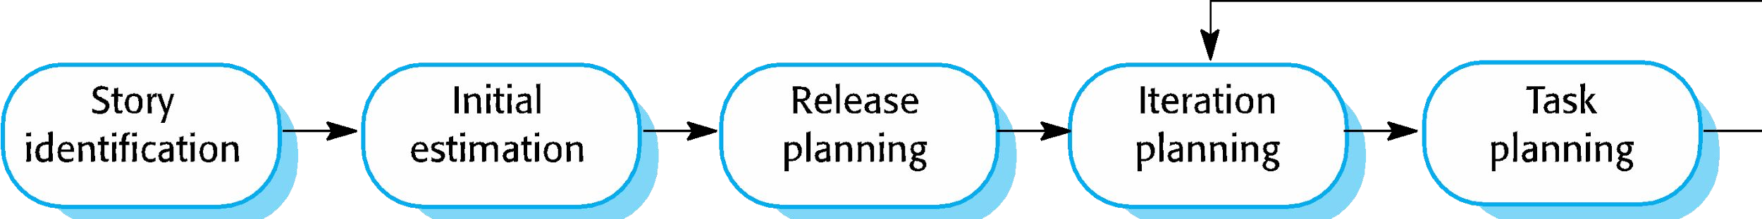
The planning game

Slide 20
Release and iteration planning
✧ Release planning involves selecting and refining the stories that will reflect the features to be implemented in a release of a system and the order in which the stories should be implemented.
✧ Stories to be implemented in each iteration are chosen, with the number of stories reflecting the time to deliver an iteration (usually 2 or 3 weeks).
✧ The team’s velocity is used to guide the choice of stories so that they can be delivered within an iteration.

Slide 21
Task allocation
✧ During the task planning stage, the developers break down stories into development tasks.
A development task should take 4–16 hours.
All of the tasks that must be completed to implement all of the stories in that iteration are listed.
The individual developers then sign up for the specific tasks that they will implement.
✧ Benefits of this approach:
The whole team gets an overview of the tasks to be completed in an iteration.
Developers have a sense of ownership in these tasks and this is likely to motivate them to complete the task.

Slide 22
Software delivery
✧ A software increment is always delivered at the end of each project iteration.
✧ If the features to be included in the increment cannot be completed in the time allowed, the scope of the work is reduced.
✧ The delivery schedule is never extended.

Slide 23
Agile planning difficulties
✧ Agile planning is reliant on customer involvement and availability.
✧ This can be difficult to arrange, as customer representatives sometimes have to prioritize other work and are not available for the planning game.
✧ Furthermore, some customers may be more familiar with traditional project plans and may find it difficult to engage in an agile planning process.

Slide 24
Agile planning applicability
✧ Agile planning works well with small, stable development teams that can get together and discuss the stories to be implemented.
✧ However, where teams are large and/or geographically distributed, or when team membership changes frequently, it is practically impossible for everyone to be involved in the collaborative planning that is essential for agile project management.

