Slide 1
UNIT 1
Shobana T S
Assistant Professor
Dept. of ISE, BMSCE

Slide 2
The Machine Learning Landscape
PART 1

Slide 3
Intro to Machine Learning
Data is new oil
Battle for ownership of data to drive benefits from it – Google, Microsoft, Facebook, twitter.
180 zettabytes of data by 2025
Real-time flows of often unstructured data from social media and all types of sensors.
Using real-time data they create personalized models/applications using AL, ML such as Google translate, Alexa.
This creates a “cognitive” services, some of which are revenue-generating.
These users generate more data
This helps improve personalized services
Data Network Effect
This attracts even more users

Slide 4
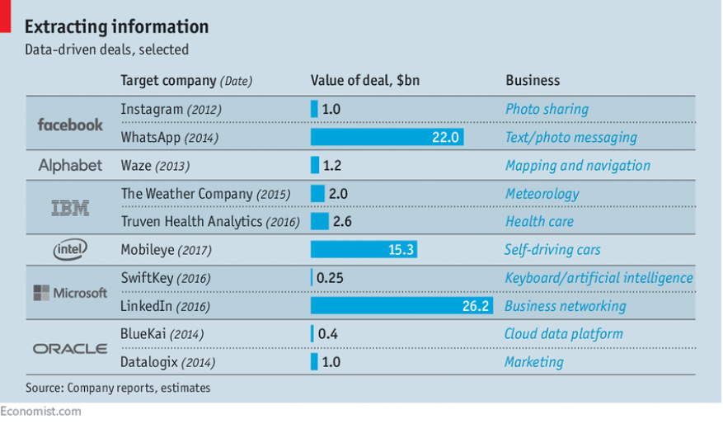
Data – the new asset class

Slide 5
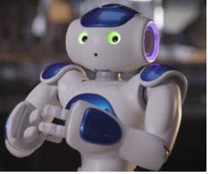
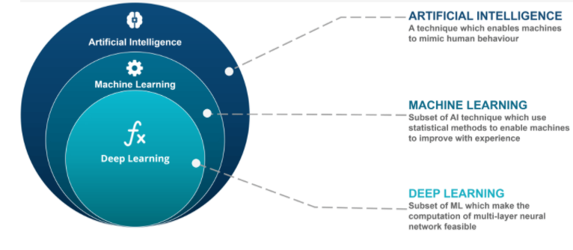
Artificial Intelligence
Intelligence in Machines: simulating human intelligence
Application: Robotics, Computer Vision, Image Recognition, Chatbots – Natural Language Processing (NLP), Text Analysis, Data Mining, Self-Driving Cars, Fraud detection in Banking
Examples: Alexa Chatbot, Google Assistance on Android phone, Google Translators
Source : IBM Watson

Slide 6
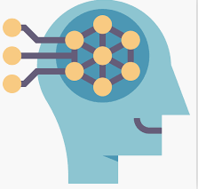
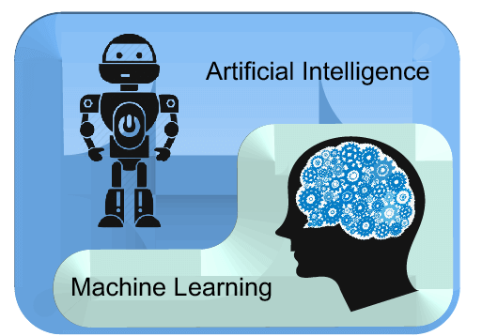
Machine Learning
Branch of field of Artificial Intelligence
Machines learn by observing historical data.
Build algorithms that allow computers to learn to perform tasks.
ML makes machine intelligent

Slide 7
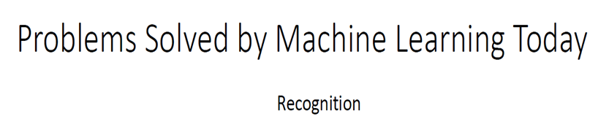
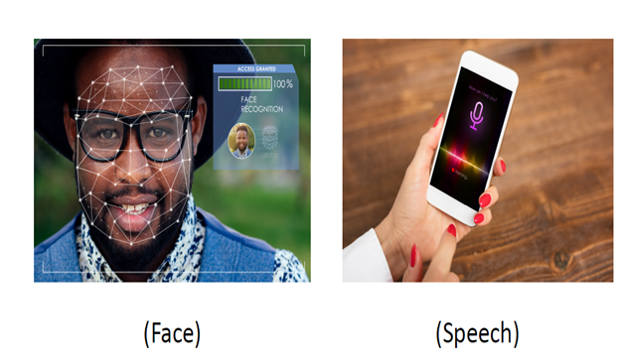

Slide 8
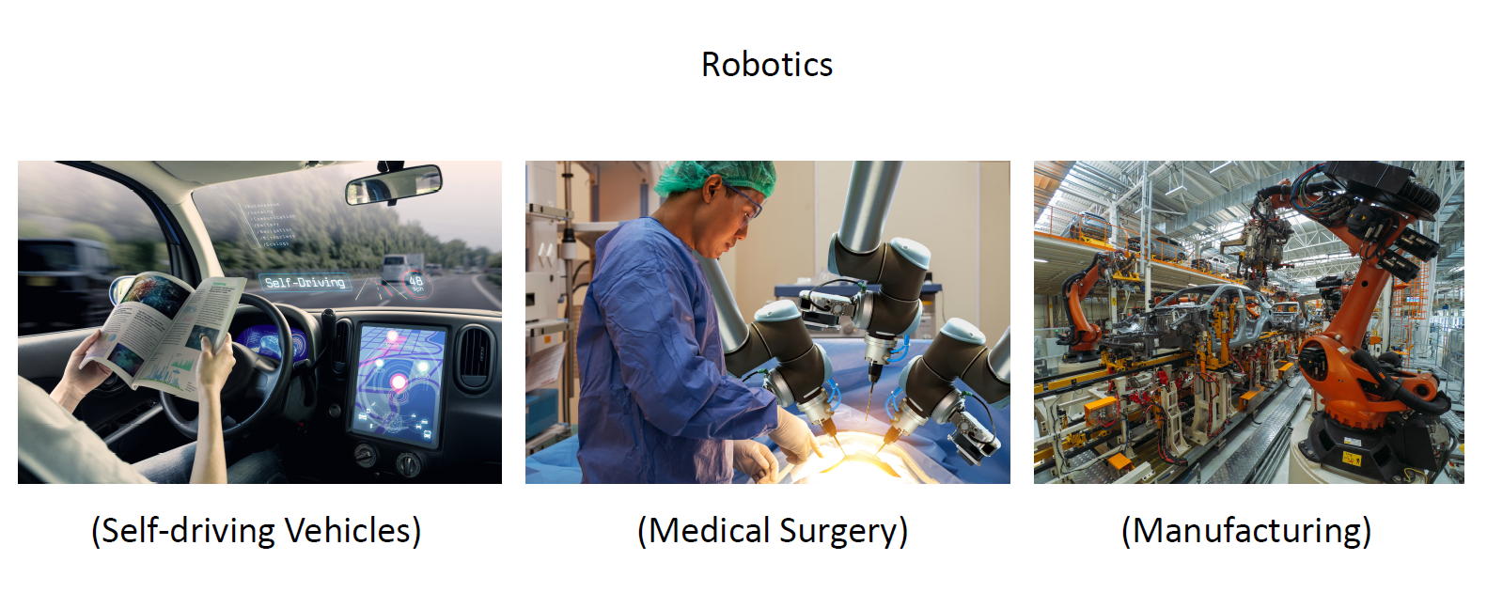

Slide 9
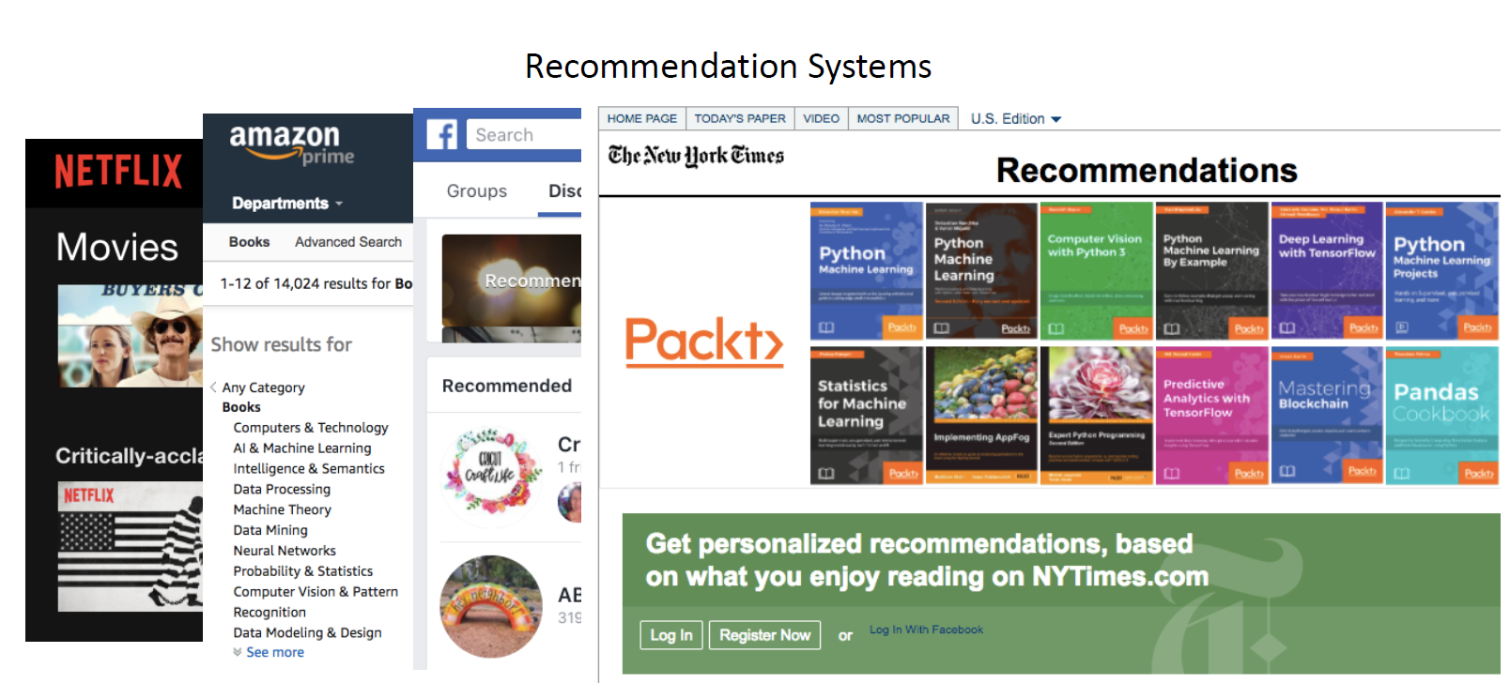

Slide 10
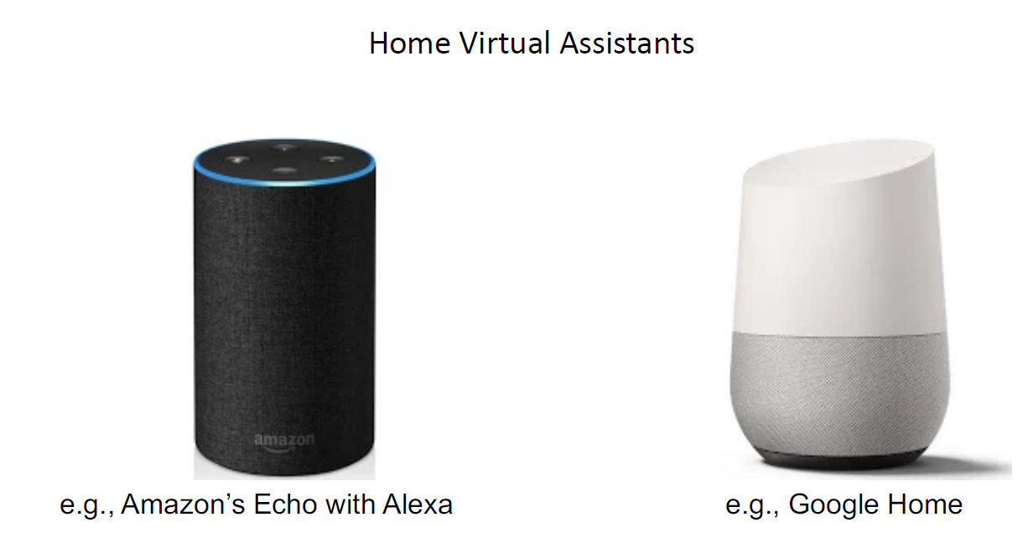

Slide 11

Accurate results in Google Search

Slide 12
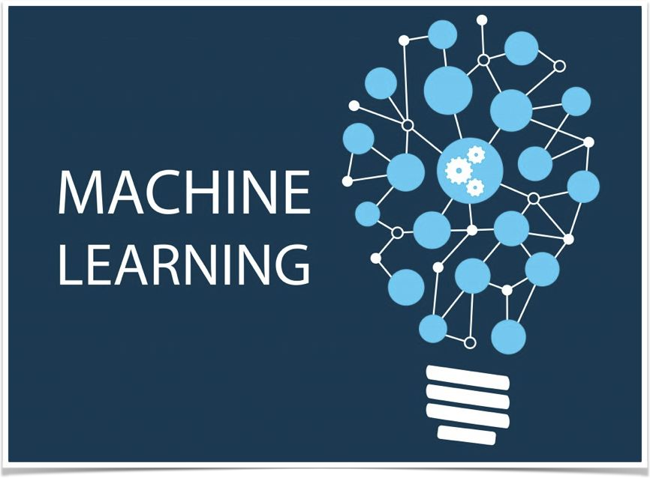
What is Machine Learning
Machine Learning is the science (and art) of programming computers so they can learn from data.
[Machine Learning is the] field of study that gives computers the ability to learn without being explicitly programmed.
—Arthur Samuel, 1959
A computer program is said to learn from experience E with respect to some task T and some performance measure P, if its performance on T, as measured by P, improves with experience E.
—Tom Mitchell, 1997

Slide 13
What Is Machine Learning?
Let us understand it with real use case...

Slide 14
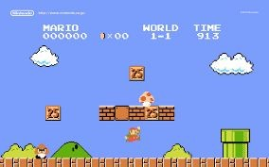
Have You Played Mario?
How much time did it take you to learn & win the princess?

Slide 15
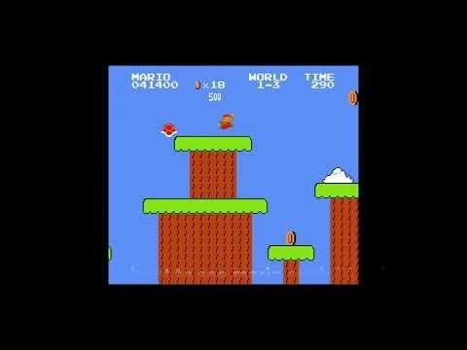
How About Automating it?

Slide 16

What do we need to
Gather Data
And automatically solving the problem?
₊Intelligence
Data

Slide 17


Gather Data
Collect
Cleaning
Process

Slide 18
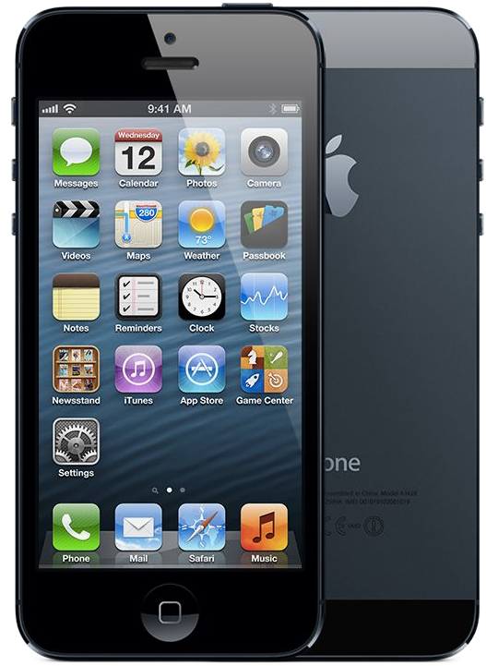


Collect Data - IOT
Phone & Devices
Cheaper, faster and smaller
Connectivity
Wifi, 4G, NFC, GPS

Slide 19


Intelligence - Traditional vs ML.
How you would write a spam filter?

Slide 20
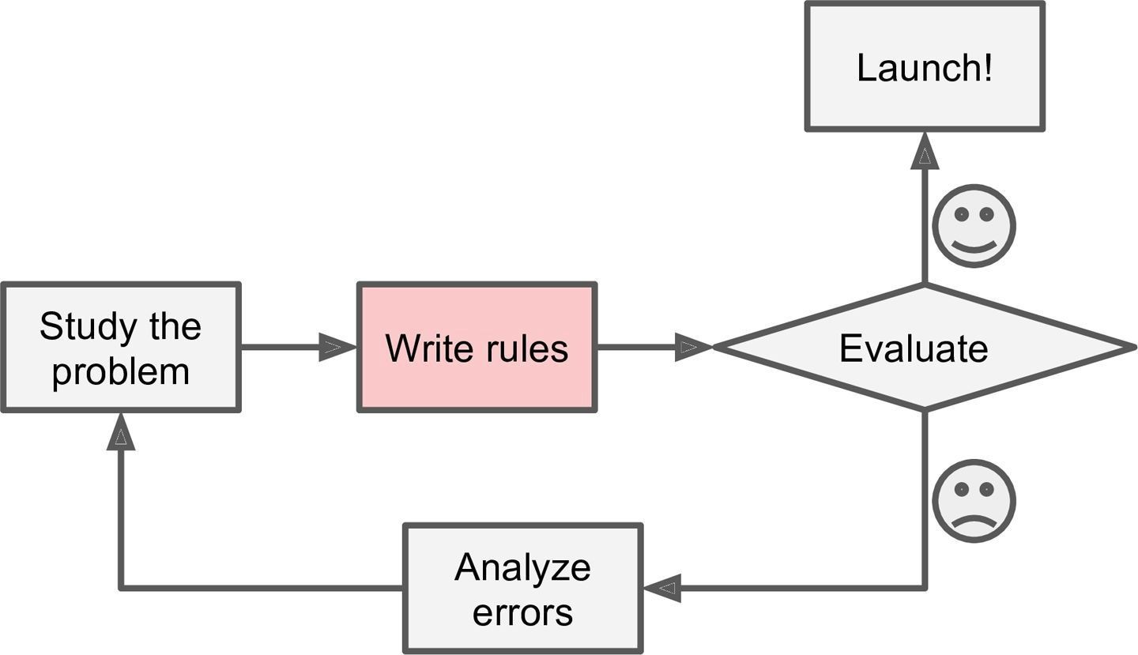
Intelligence - Spam Filter - Traditional Approach
1
2
3

Slide 21
Intelligence - Spam Filter - Traditional Approach
Problems?
Problem is not trivial
  Program will likely become a long list of complex rules
  Pretty hard to maintain
If spammers notice that
  All their emails containing “4U” are blocked
  They might start writing “For U” instead
  If spammers keep working around spam filter, we will need to keep writing new rules forever

Slide 22
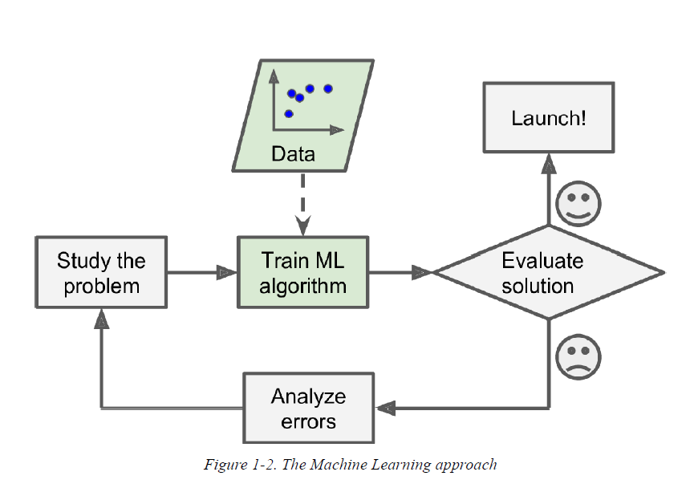
Intelligence - Spam Filter - ML Approach

Slide 23
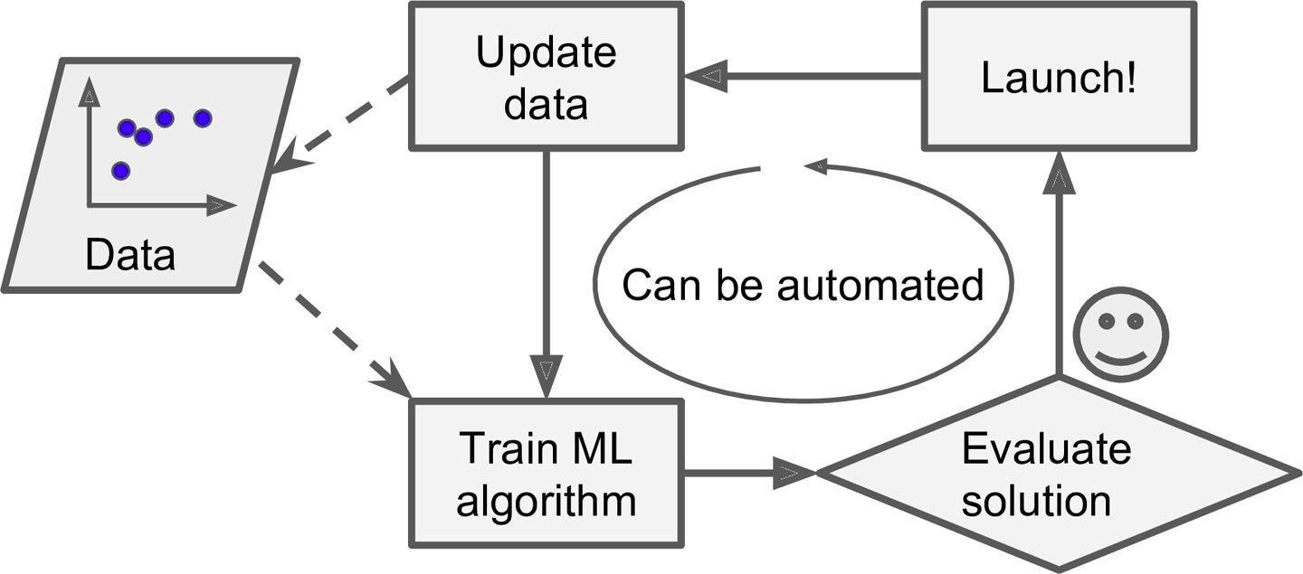
Intelligence - Spam Filter - ML Approach
Unlike traditional approach, ML techniques automatically notice that
  “For U” has become unusually frequent in spam flagged by users and it starts flagging them without our intervention

Slide 24
Intelligence - Spam Filter - ML Approach
Can help humans learn
ML algorithms can be inspected to see what they have learned
Spam filter after enough training
  Reveals combinations of words that it believes are best predictors of spam
  May reveal unsuspected correlations or new trend and
  Lead to a better understanding of the problem for humans

Slide 25
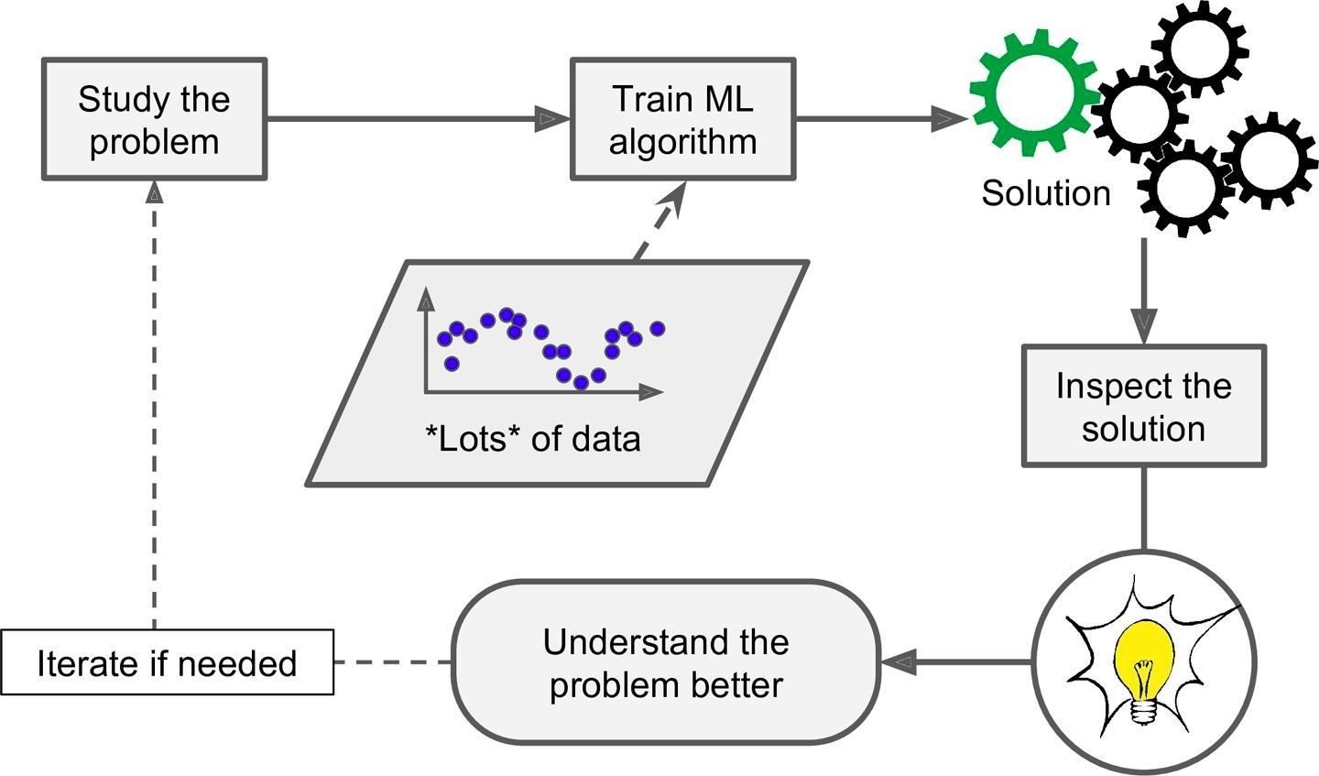
Intelligence - Spam Filter - ML Approach
Can help humans learn

Slide 26
To summarize, Machine Learning is great for:
Problems for which existing solutions require a lot of fine-tuning: Machine Learning algorithm can often simplify code and perform better than the traditional approach.
Complex problems for which using a traditional approach yields no good solution: the best Machine Learning techniques can perhaps find a solution.
Fluctuating environments: a Machine Learning system can adapt to new data.
Getting insights about complex problems and large amounts of data.

Slide 27













Machine Learning - Types
Classification
Supervised
Regression
Human Supervision?
Unsupervised
Clustering
Reinforcement
Machine Learning
Online
Learn Incrementally?
Batch Processing
Instance Based
How they generalize?
Model based

Slide 28
Machine Learning - Supervised Learning
Classification
The training data we feed to the algorithm includes
  The desired solutions, called labels
Classification of spam filter is a supervised learning task

Slide 29
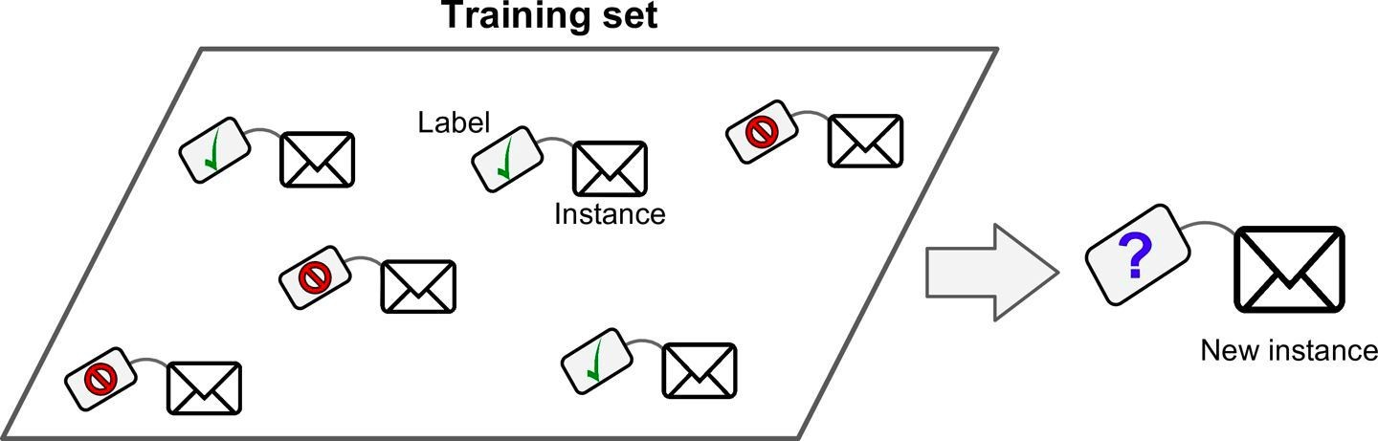
Machine Learning - Supervised Learning
Classification
Classify new email as Ham or Spam
Spam filter
  Is trained with many example emails called training data.
  Each email in the training data contains the label if it is spam or ham(not spam)
  Models then learns to classify new emails if they are spam or ham

Slide 30
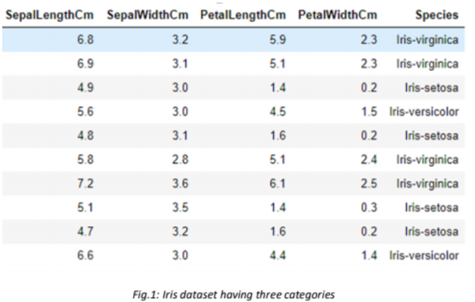

Slide 31
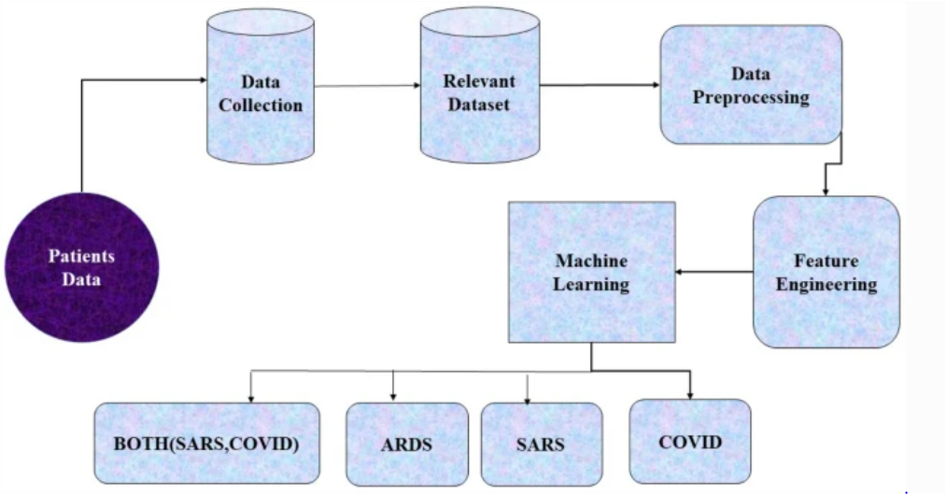

Slide 32
Machine Learning - Supervised Learning
Regression
Predict a target numeric value, price of the car
  Given a set of features called predictors such as Mileage, age, brand etc
To train the model
  We have to give many examples of cars including their predictors and labels(prices)

Slide 33
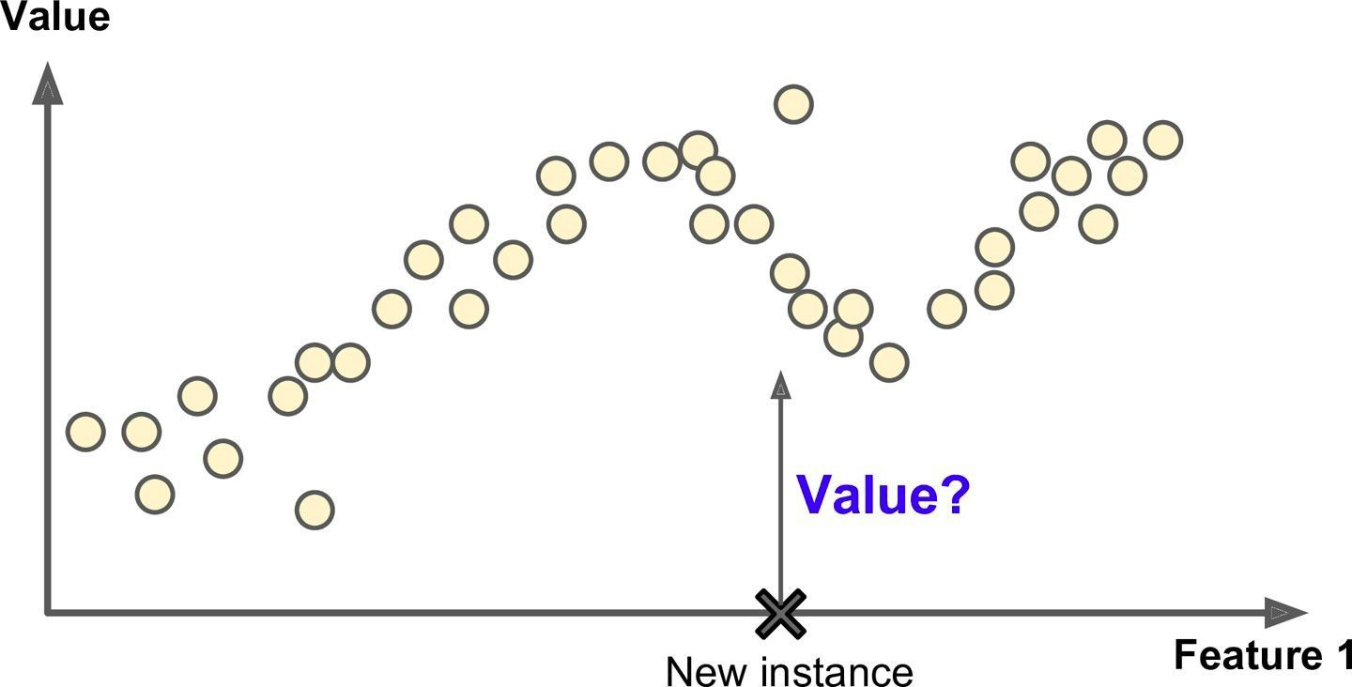
Machine Learning - Supervised Learning
Regression - Predict the price of the car (Value)

Slide 34
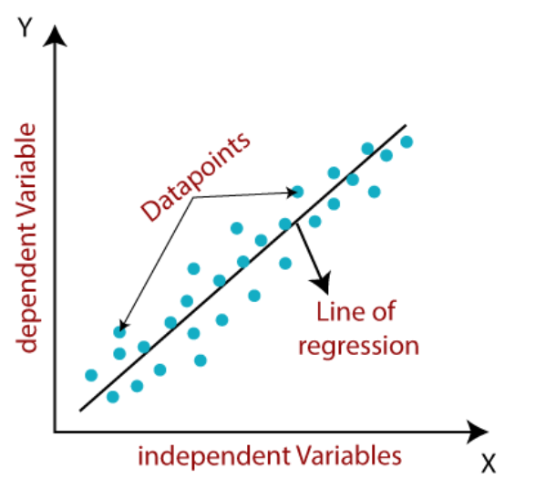

Slide 35
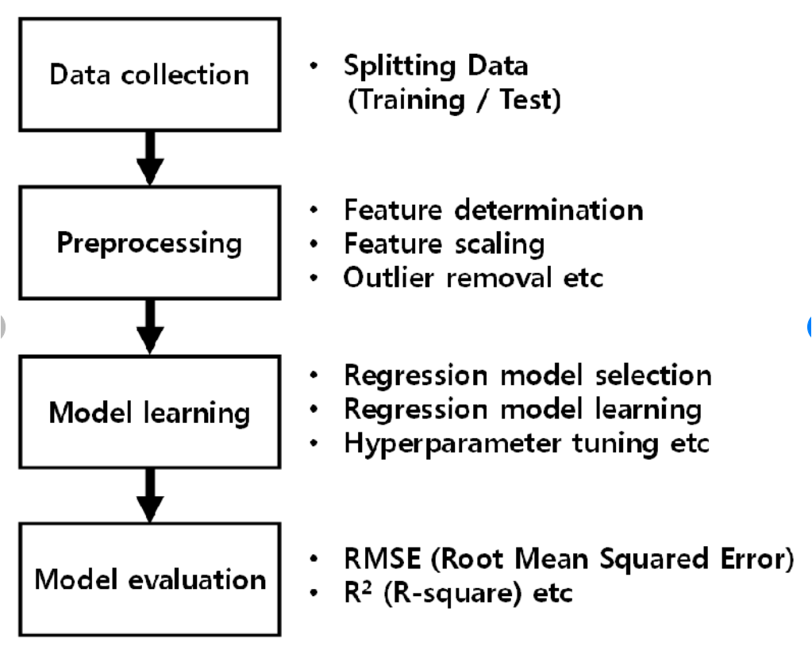

Slide 36
Most important supervised learning algorithms
k-Nearest Neighbors
Linear Regression
Logistic Regression
Support Vector Machines (SVMs)
Decision Trees and Random Forests
Neural networks

Slide 37
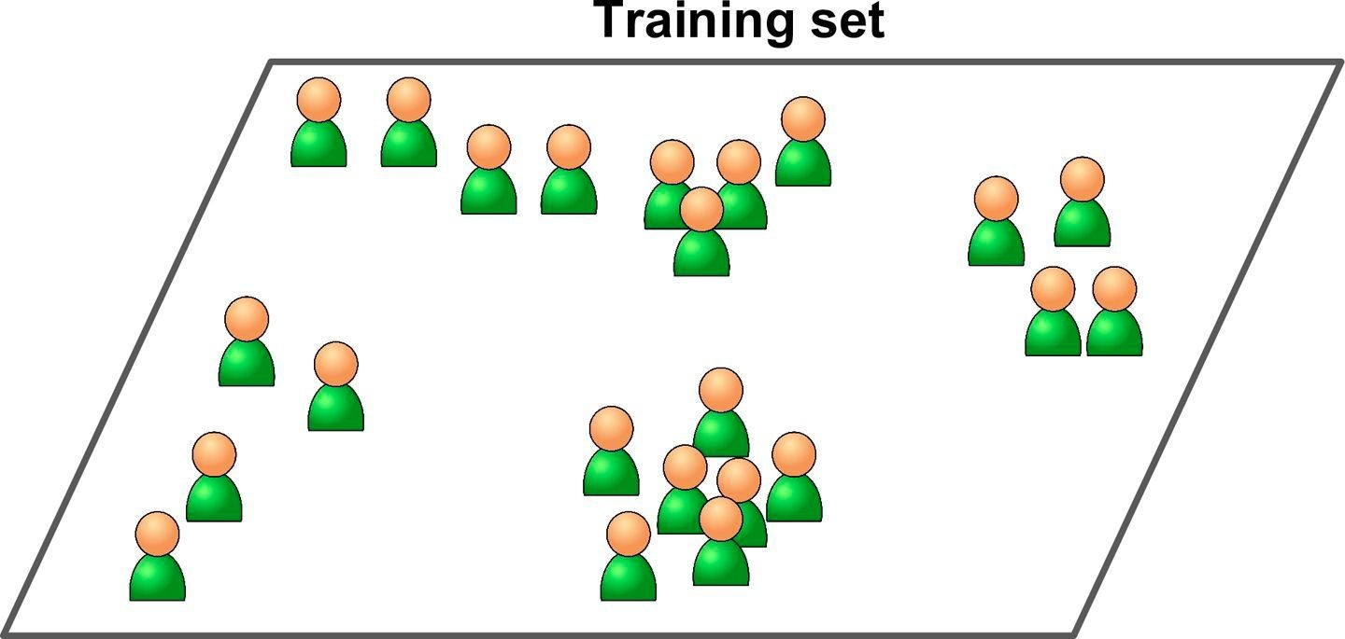
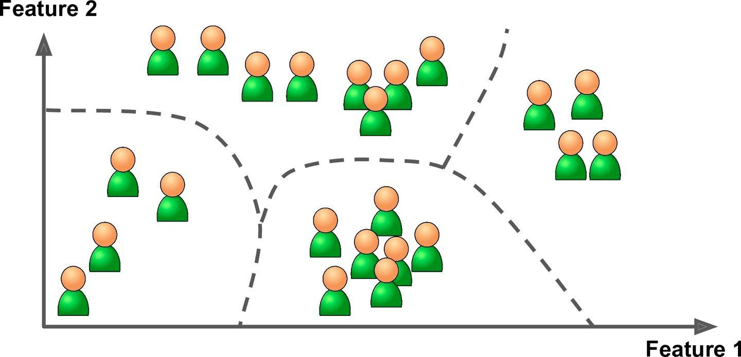
Machine Learning - Unsupervised Learning
The training data is unlabeled
The system tries to learn without a teacher

Slide 38
Most important unsupervised learning algorithms
Clustering
  K-Means
  DBSCAN
  Hierarchical Cluster Analysis (HCA)
Anomaly detection and novelty detection
  One-class SVM
  Isolation Forest
Visualization and dimensionality reduction
  Principal Component Analysis (PCA)
  Kernel PCA
  Locally Linear Embedding (LLE)
  t-Distributed Stochastic Neighbor Embedding (t-SNE)
Association rule learning
  Apriori
  Eclat

Slide 39
Machine Learning - Unsupervised Learning
Clustering - Detect group of similar visitors in your blog

Slide 40
Machine Learning - Unsupervised Learning
Clustering
It may notice that
  40% visitors are comic lovers and read the blog in evening
  20% visitors are sci-fi lovers and read the blog during weekends
This data helps us in targeting our blog posts for each group

Slide 41
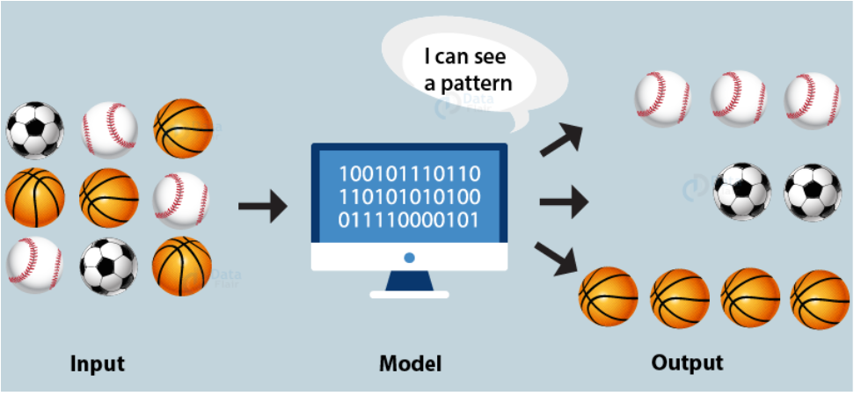

Slide 42
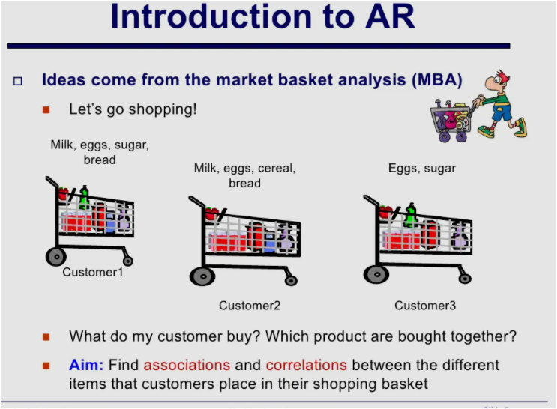

Slide 43
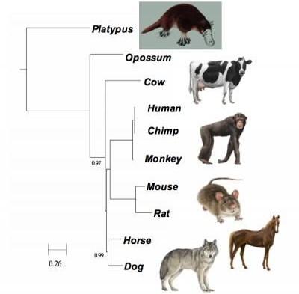
Machine Learning - Unsupervised Learning
Hierarchical Clustering - Bring similar elements together
In the form of a tree
Nodes closer to each other are similar

Slide 44
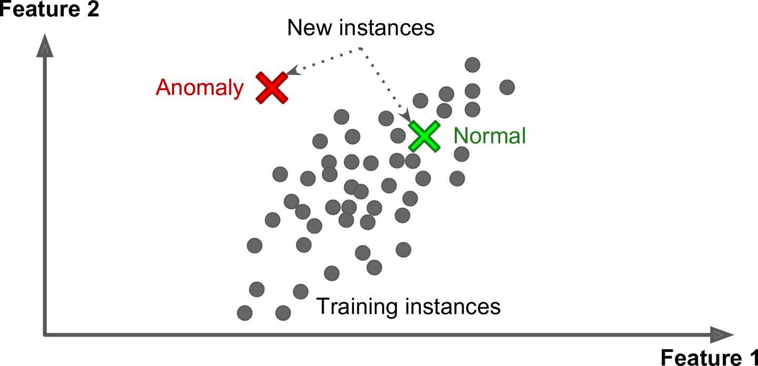
Machine Learning - Unsupervised Learning
Anomaly Detection - Detecting unusual credit card transactions to prevent fraud

Slide 45
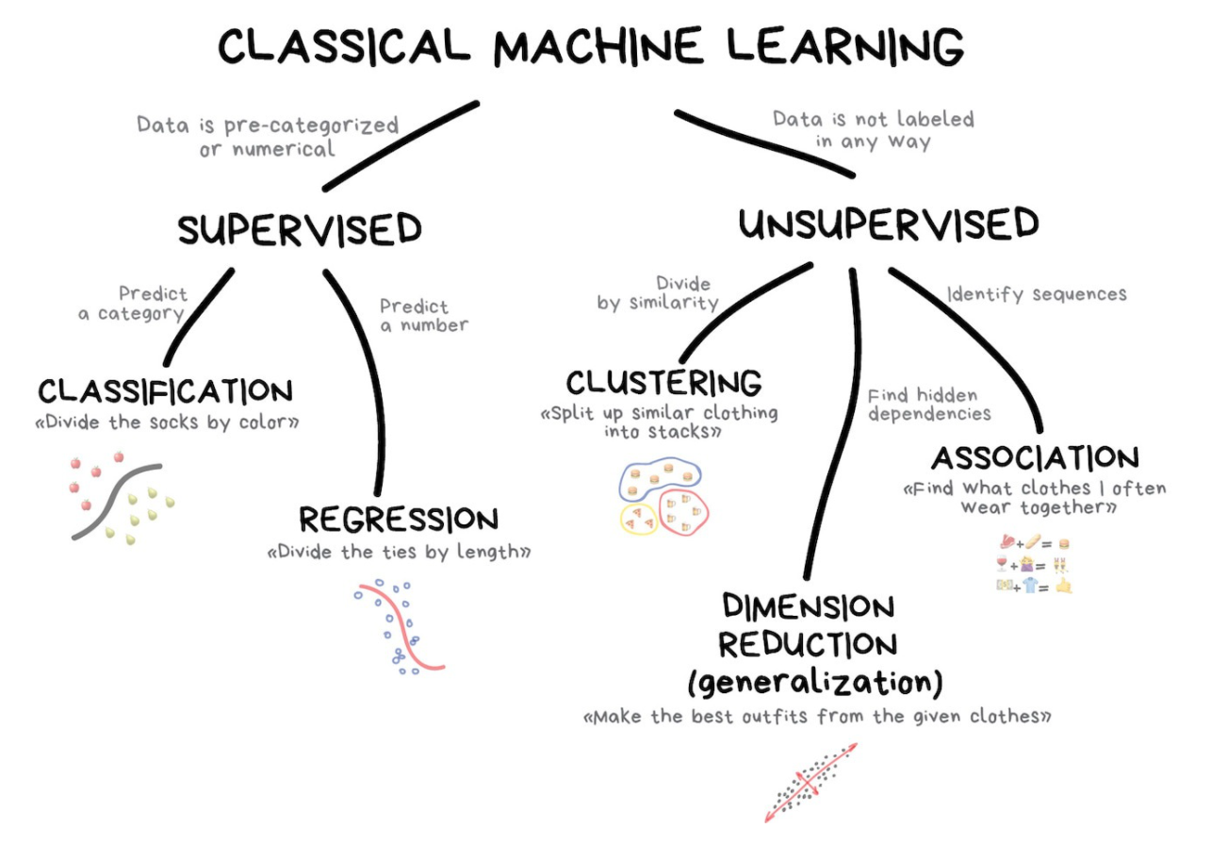

Slide 46
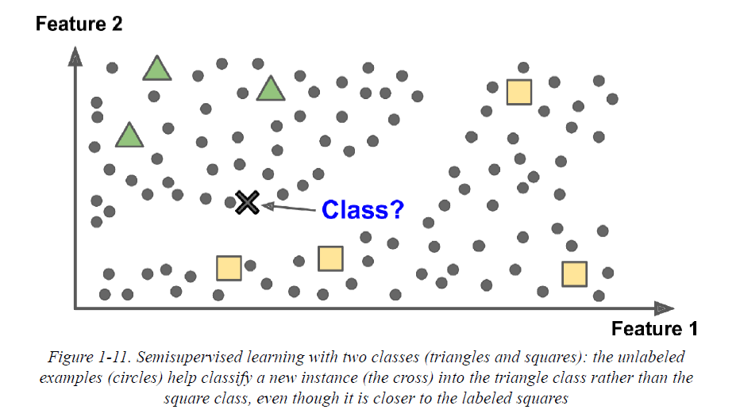
Semisupervised learning

Slide 47
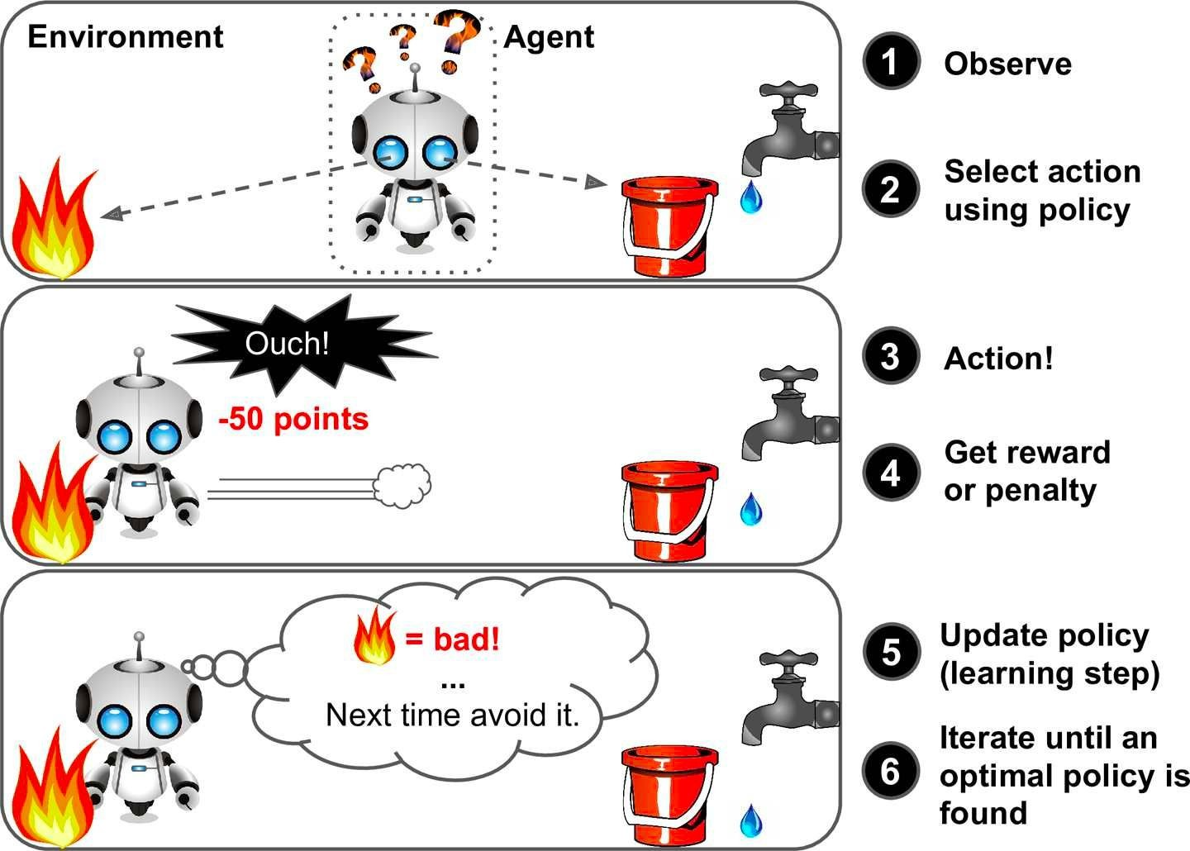
Machine Learning - Reinforcement Learning

Slide 48
Machine Learning - Reinforcement Learning
The learning system an agent in this context
  Observes the environment
  Selects and performs actions and
  Get rewards or penalties in return
  Learns by itself what is the best strategy (policy) to get most reward over time

Slide 49
Machine Learning - Reinforcement Learning
Applications
Used by robots to learn how to walk
DeepMind’s AlphaGo
  AlphaGo is the first computer program to defeat a professional human Go player

Slide 50
Machine Learning - Batch Learning
Offline learning
System is incapable of learning incrementally
  It must be trained offline using all the available data
Takes lot of time and computing resources
  everytime training happens on the entire data
Once the system is trained, it gets
  Pushed to production
  Runs without learning anymore
  Just applies what it has learned offline

Slide 51
Machine Learning - Batch Learning
How to train the system with new data?
We can not train the system incrementally
We have to train the new system
  From scratch on the full dataset
  Stop the old system and
  Replace it with the newly trained system

Slide 52
Machine Learning - Batch Learning
Limitations
Since we have to train new system every time new data is available
  Takes lot of computing resources
  If the data is huge then
  Training from scratch is nearly impossible
  Becomes showstopper for lot of practical use cases

Slide 53
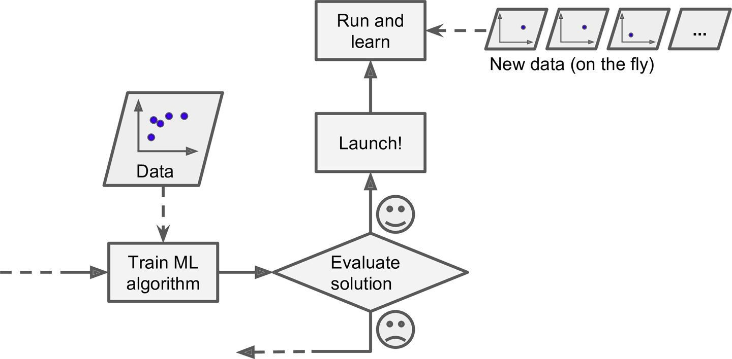
Machine Learning - Online Learning

Slide 54
Machine Learning - Online Learning
Train system incrementally
  By feeding new data sequentially
System can learn from new data on the fly
It tunes some parameters to fit the model to the training set (i.e., to make good predictions on the training set), and then it will be able to make good predictions on new cases as well.
Good for systems where data is a continuous flow
  Stock prices

Slide 55
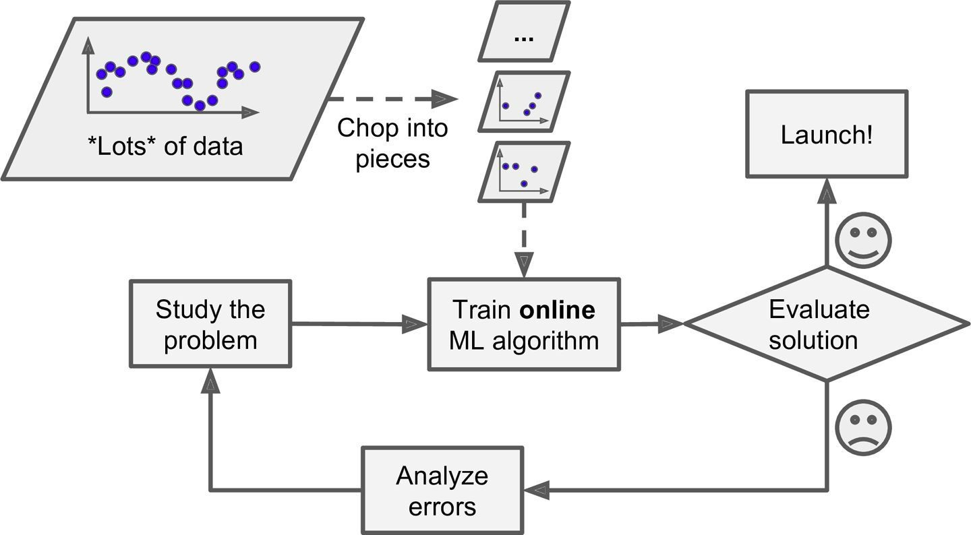
Machine Learning - Online Learning
Using online learning to handle huge datasets

Slide 56
Machine Learning - Online Learning
Using online learning to handle huge datasets
Can be used to train huge datasets
  That can not be fit in one machine
  The training data gets divided into batches and
  System gets trained on each batch incrementally

Slide 57
Machine Learning - Online Learning
Challenges in online learning
Closely monitor the system
  Turn off the learning if there is a performance drop
  Or monitor the input data and remove anomalies

Slide 58
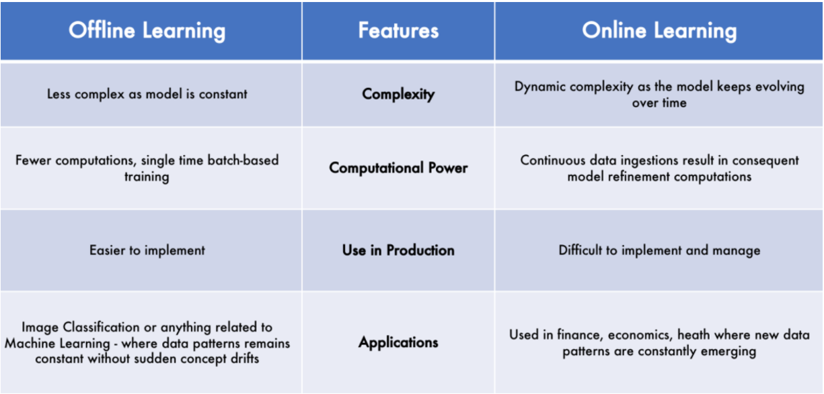

Slide 59
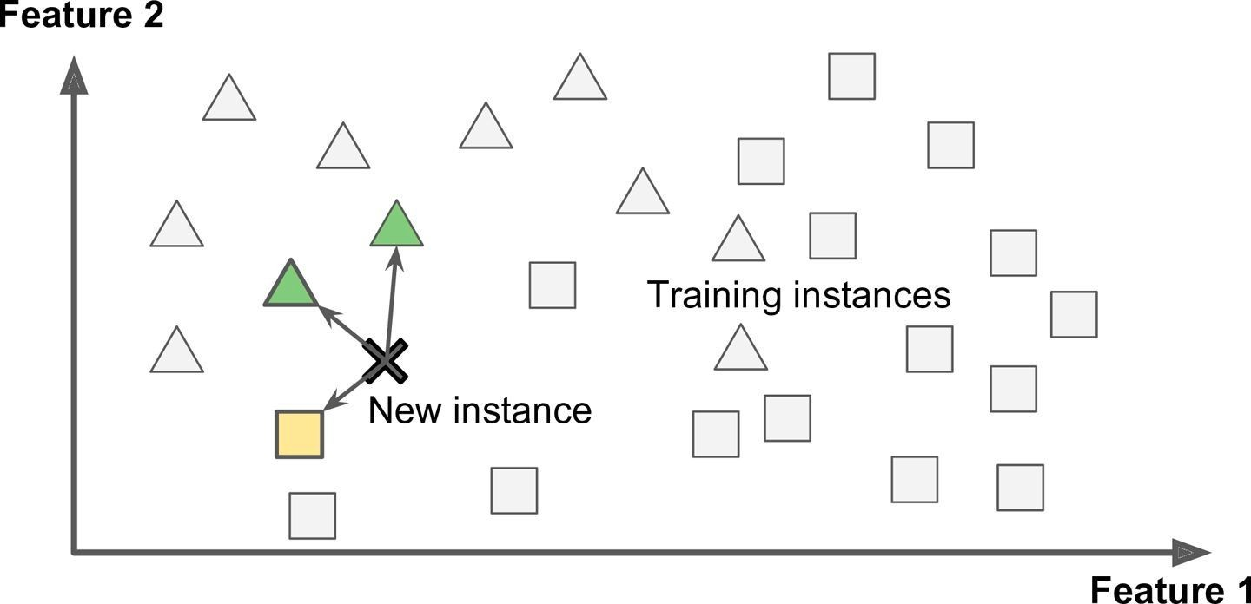
Machine Learning - Instance-based Learning

Slide 60
Machine Learning - Instance-Based Learning
Most trivial form of learning is
  Learn by heart
The system learns the examples by heart
Then generalizes to new cases using a similarity measure

Slide 61
Machine Learning - Instance-Based Learning
Example
Spam filter flags emails
  That are identical to known spam emails (emails marked spam by users)
  Also the emails which are similar to known spam emails
  This requires measure of similarity between two emails
  A basic similarity measures between two emails can be
    Count the number of words they have in common

Slide 62
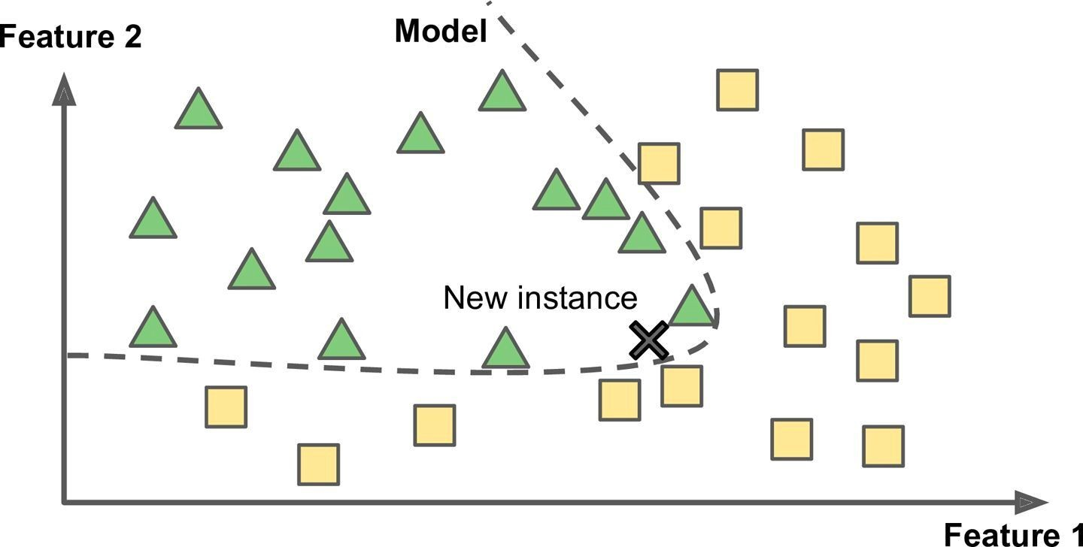
Machine Learning - Model-based Learning

Slide 63

Machine Learning - Model-Based Learning
Another way to generalize from a set of examples
  Build a model of these examples
  And then use model to make predictions
  This is called inference
  Hope that model will generalize well

Slide 64
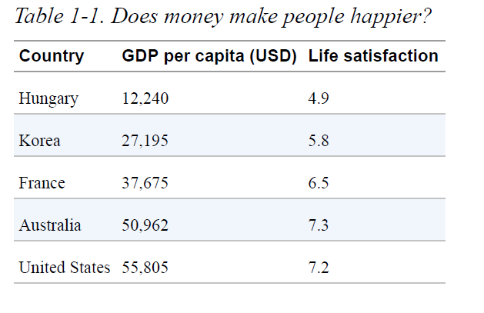
Suppose you want to know if money makes people happy. This stats about gross domestic product (GDP) per capita from the IMF’s website

Slide 65
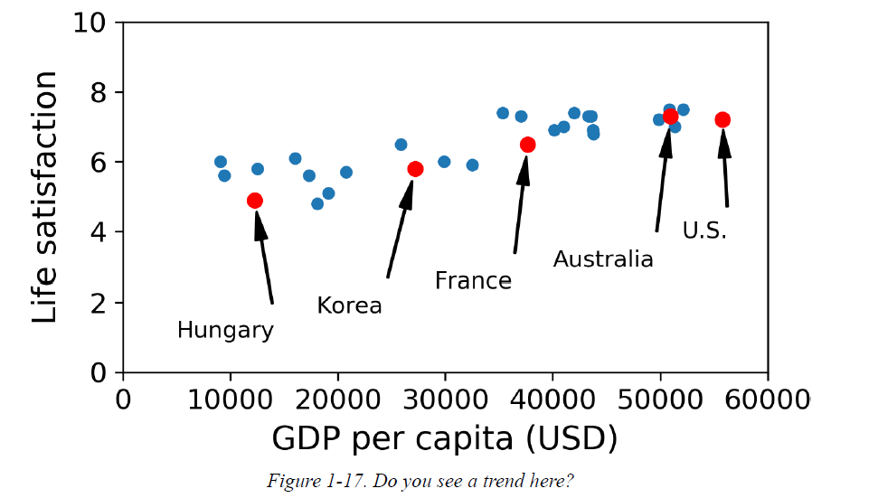
It looks like life satisfaction goes up more or less linearly as the country’s GDP per capita increases.
Selected a linear model of life satisfaction with just one attribute, GDP per capita.

Slide 66
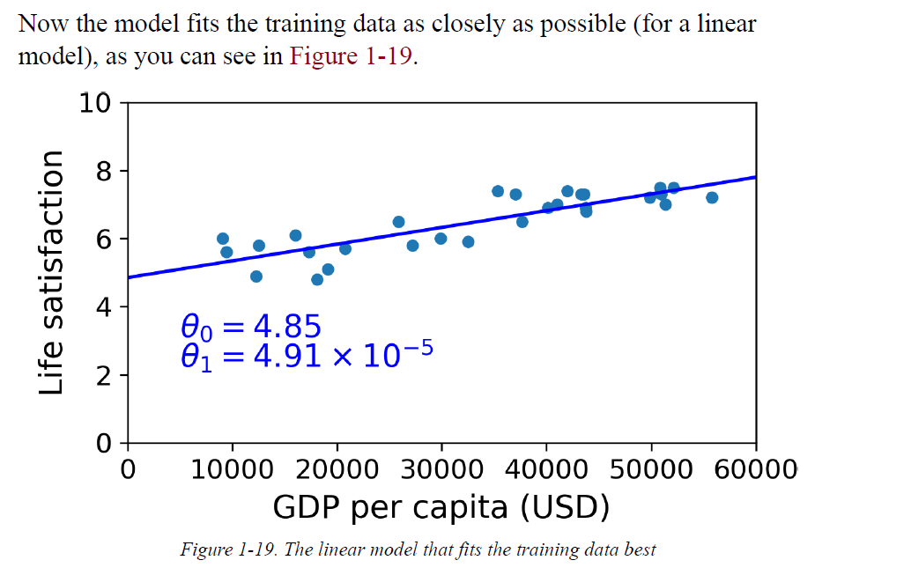

Slide 67
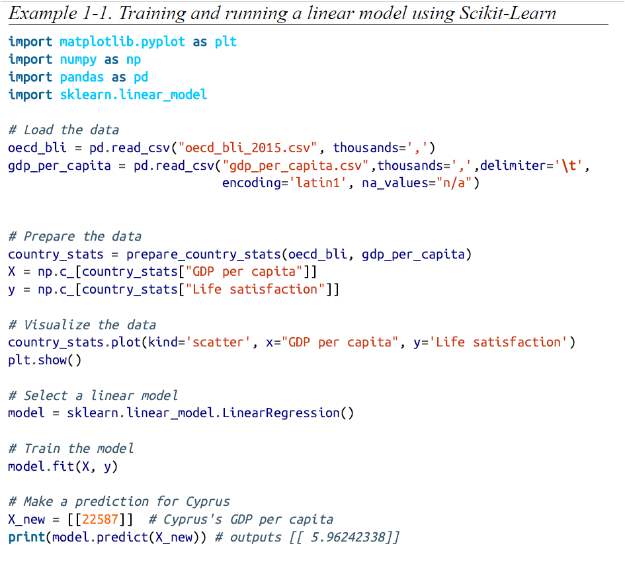

Slide 68
Main Challenges of Machine Learning
These challenges are due to either “bad algorithm” or “bad data”.
Insufficient Quantity of Training Data
Nonrepresentative Training Data
Poor-Quality Data
Irrelevant Features
Overfitting the Training Data
Underfitting the Training Data
Stepping Back

Slide 69
1. Insufficient Quantity of Training Data
Machine Learning algorithms takes a lot of data for most to work properly.
For very simple problems it typically need thousands of examples, and for complex problems such as image or speech recognition it may need millions of examples.

Slide 70
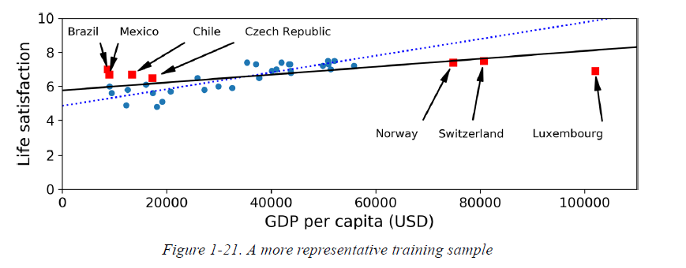
2. Nonrepresentative Training Data
It is crucial to use a training set that is representative of the all the cases you want to generalize to. This is applicable for instance-based learning or model-based learning.
For example, the set of countries we used earlier for training the linear model was not perfectly representative; a few countries were missing.
Figure 1-21 shows what the data looks like when you add the missing countries.
By using a nonrepresentative training set, we trained a model that is unlikely to make accurate predictions.
It is crucial to use a training set that is representative of the cases we want
to generalize to.
sampling noise: if sample is too small
sampling bias: for very large samples can be nonrepresentative if the sampling method is flawed

Slide 71
3. Poor-Quality Data
Patterns will not be detected if the training data is full of errors, outliers, and noise. System is less likely to perform well.
It is often well worth the effort to spend time cleaning up your training data.
Clean-up training data:
If some instances are clearly outliers, it may help to simply discard them or try to fix the errors manually.
If some instances are missing a few features
  (e.g., 5% of your customers did not specify their age),
  We must decide whether we want to ignore this attribute altogether,
  Ignore these instances,
  Fill in the missing values (e.g., with the median age), or
  train one model with the feature and one model without it.

Slide 72
4. Irrelevant Features:
System will only be capable of learning if the training data contains enough relevant features.
The feature engineering involves the following steps:
Feature selection : selecting the most useful features to train on among existing features.
Feature extraction :combining existing features to produce a more useful one
Creating new features by gathering new data

Slide 73
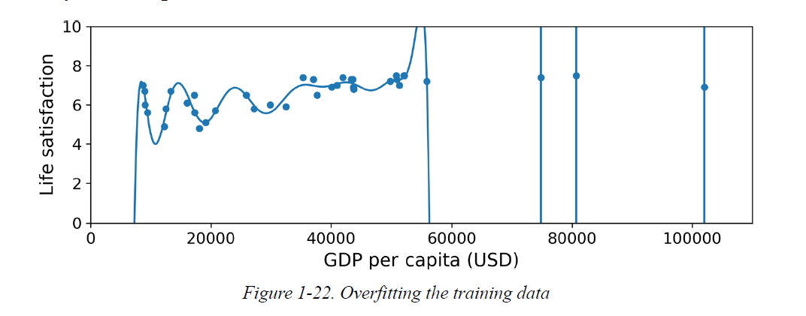
5. Overfitting the Training Data
It means that the model performs well on the training data, but it does not generalize well on test data.
Example: A person is visiting a foreign country and the taxi driver rips you off. We might be tempted to say that all taxi drivers in that country are thieves.
How to Prevent Overfitting?
Cross-validation
Train with more data
Early stopping
Regularization
Ensembling.

Slide 74
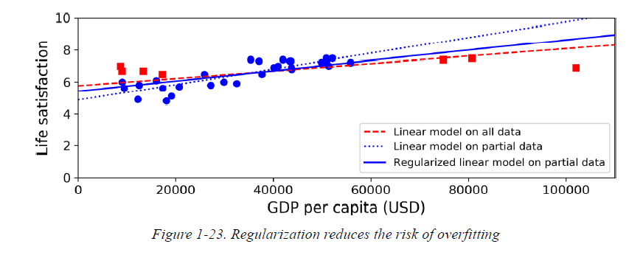
Risk of overfitting is reduced using regularization.
The regularization parameter is a control on your fitting parameters.
The dotted line represents the original model that was trained on the countries represented as circles.
The dashed line is our second model trained with all countries (circles and squares).
The solid line is a model trained with the same data as the first model but with a regularization constraint.

Slide 75
The amount of regularization to apply during learning can be controlled by a hyperparameter.
A hyperparameter is a parameter of a learning algorithm (not of the model). As such, it is not affected by the learning algorithm itself; it must be set prior to training and remains constant during training.
If you set the regularization hyperparameter to a very large value, you will get an almost flat model (a slope close to zero); the learning algorithm will almost certainly not overfit the training data, but it will be less likely to find a good solution.
Tuning hyperparameters is an important part of building a Machine Learning system.

Slide 76
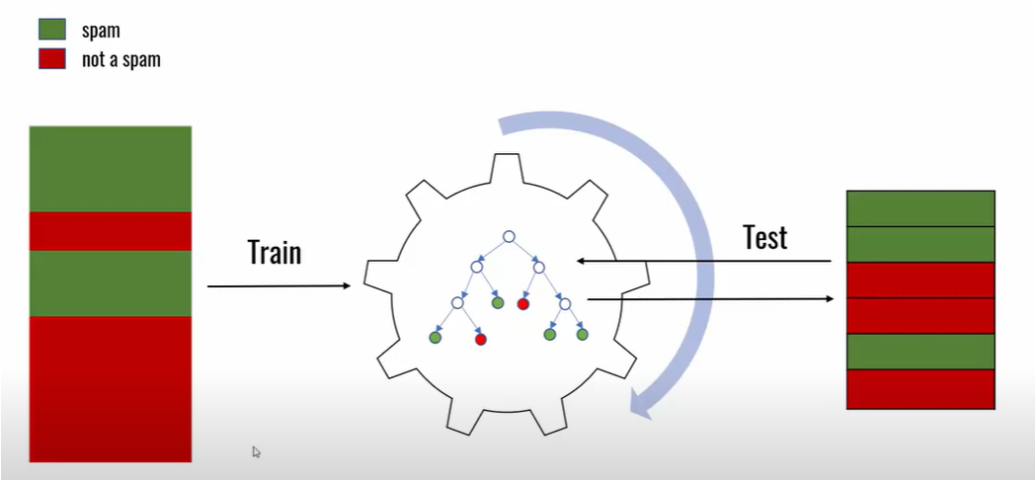
Cross-Validation

Slide 77
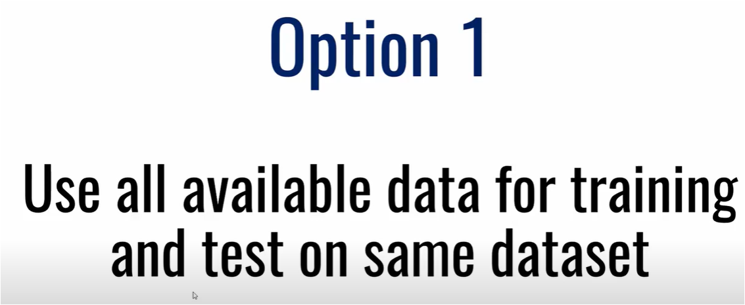

Slide 78
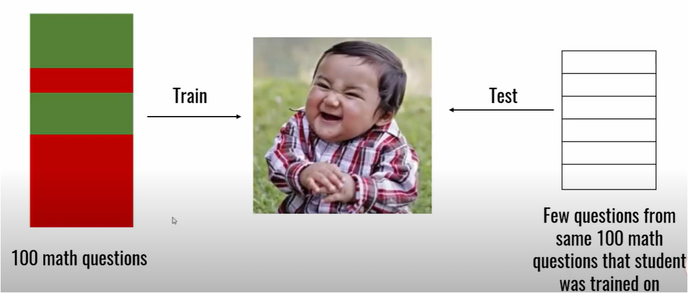

Slide 79
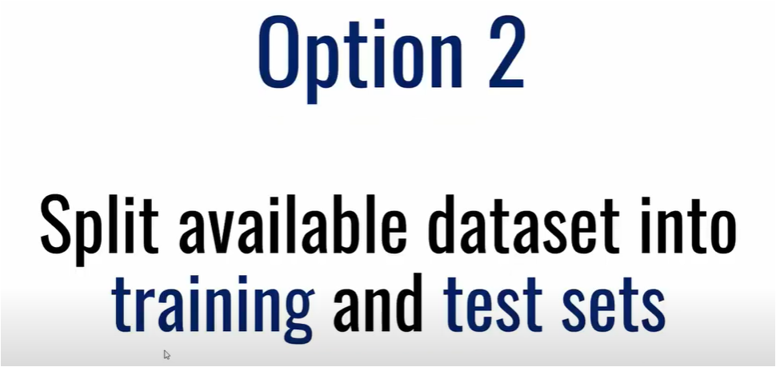

Slide 80
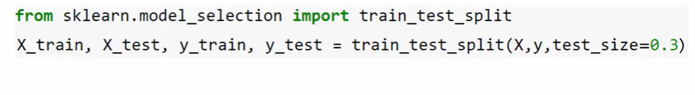


Slide 81


Slide 82


Slide 83

5-fold Cross Validation

Slide 84
6. Underfitting the Training Data
Underfitting occurs when a statistical model or machine learning algorithm cannot capture the underlying trend of the data.
underfitting occurs when the model or the algorithm does not fit the data well enough.
How to Prevent Underfitting?
Select a more powerful model, with more parameters.
Feed better features to the learning algorithm (feature engineering).
Reduce the constraints on the model (e.g., reduce the regularization hyperparameter).

Slide 85


Slide 86

Overfitting, Underfitting in Classification
Assume we have three models ( Model A , Model B , Model C) with the following error rates on training and testing data.

Slide 87
For Model A, The error rate of training data is too high as a result of which the error rate of Testing data is too high as well. It has a High Bias and a High Variance, therefore it’s underfit. This model won’t perform well on unseen data.
For Model B, The error rate of training data is low and the error rate of Testing data is low as well. It has a Low Bias and a Low Variance, therefore it’s an ideal model. This model will perform well on unseen data.
For Model C, The error rate of training data is too low. However, the error rate of Testing data is too high as well. It has a Low Bias and a High Variance, therefore it’s overfit. This model won’t perform well on unseen data.

Slide 88

Overfitting, Underfitting in Regression

Slide 89
In the first image, we try to fit the data using a linear equation. The model is rigid and not at all flexible. Due to the low flexibility of a linear equation, it is not able to predict the samples (training data), therefore the error rate is high and it has a High Bias which in turn means it’s underfitting. This model won’t perform well on unseen data.
In the second image, we use an equation with degree 4. The model is flexible enough to predict most of the samples correctly but rigid enough to avoid overfitting. In this case, our model will be able to do well on the testing data therefore this is an ideal model.

Slide 90
In the third image, we use an equation with degree 15 to predict the samples. Although it’s able to predict almost all the samples, it has too much flexibility and will not be able to perform well on unseen data. As a result, it will have a high error rate in testing data. Since it has a low error rate in training data (Low Bias) and high error rate in training data (High Variance), it’s overfitting.

Slide 91


Slide 92
Testing and Validating
Split the data into 2sets
  Training set -train your model using the training set
  Test set-test it using the test set.
Generalization error (or out-of-sample error):
  The error rate on new cases is called generalization error this done by evaluating your model on the test set.
  This value tells us how well our model will perform on instances it has never seen before.
  If the training error is low (i.e., your model makes few mistakes on the training set) but the generalization error is high, it means that your model is overfitting the training data.

Slide 93

Hyperparameter Tuning and Model Selection
A hyperparameter is a parameter whose value is used to control the learning process.
Hyperparameters are important because they directly control the behavior of the training algorithm and have a significant impact on the performance of the model is being trained.

Slide 94
Suppose we are finding between two types of models (say, a linear model and a polynomial model):
how can you decide between them?
One option: is to train both and compare how well they generalize using the test set.
Suppose that the linear model generalizes better, but we want to apply some regularization to avoid overfitting.
how do you choose the value of the regularization hyperparameter?

Slide 95
One option: We train 100 different models using 100 different values for the hyperparameter.
The best hyperparameter value produces a model with the lowest generalization error —say, just 5% error.
But this model when launched into production, unfortunately it does not perform as well as expected and produces 15% errors.
What just happened?

Slide 96
The problem is that we measured the generalization error multiple times on the test set, and adapted the model and hyperparameters to produce the best model for that particular set.
This means that the model is unlikely to perform as well on new data.
A common solution to this problem is called holdout validation.
Simply hold out part of the training set to evaluate several candidate models and select the best one.
The new held-out set is called the validation set (or sometimes the development set, or dev set).

Slide 97
Train multiple models with various hyperparameters on the reduced training set (i.e., the full training set minus the validation set), and we select the model that performs best on the validation set.
After this holdout validation process, we train the best model on the full training set (including the validation set), and this gives us the final model.
Lastly, we evaluate this final model on the test set to get an estimate of the generalization error.

Slide 98
if the validation set is too small, then model evaluations will be imprecise.
if the validation set is too large, then the remaining training set will be much smaller than the full training set.
One way to solve this problem is to perform repeated cross-validation, using many small validation sets. Each model is evaluated once per validation set after it is trained on the rest of the data. By averaging out all the evaluations of a model, you get a much more accurate measure of its performance.
There is a drawback, however: the training time is multiplied by the number of validation sets.

Slide 99
Data Mismatch
The large amount of data is used for training the model, but this data probably won’t be perfectly representative of the data that will be used in production.
For example:
Create a mobile app to take pictures of flowers and automatically determine their species.
The pictures download from the web will be different from the pictures taken using the app on a mobile device.
Thumb rule: the most important rule to remember is that the validation set and the test set must be as representative as possible of the data you expect to use in production.

Slide 100
But after training your model on the web pictures, if you observe that the performance of the model on the validation set is disappointing, you will not know whether this is because
  model has overfit the training set, or
  whether this is just due to the mismatch between the web pictures and the mobile app pictures.
One solution is to hold out some of the training pictures (from the web) in yet another set that Andrew Ng calls the traindev set.
After the model is trained you can evaluate it on the train-dev set.
Case 1: If it performs well, then the model is not overfitting the training set. If it performs poorly on the validation set, the problem must be coming from the data mismatch.
Soln: try to tackle this problem by preprocessing the web images to make them look more like the pictures that will be taken by the mobile app, and then retraining the model
Case 2: if the model performs poorly on the train-dev set, then it must have overfit the training set.
Soln: try to simplify or regularize the model, get more training data, and clean up the training data.

Slide 101

Building a cat classifier for door camera devices

Slide 102
We get 10,000 images from camera, these images have a low resolution.
We get another 200,000 cat pictures by crawling the web. These images are properly framed and have a higher resolution.
Goal: We are only interested in our final model doing well on images from the door camera.
But we have only 10,000 of these images and using only these images would result in a very small training set. We will have to use the 200,000 images obtained from Google. Since the Google images belong to a different distribution we have a data mismatch problem.

Slide 103

Option 1 (Bad Idea)
One option is to randomly shuffle images from both the sources and divide it into the training, dev and test sets.
We can have 205,000 randomly shuffled images in the training set and 2,500 randomly shuffled images each in the dev and test set.

Slide 104
Advantage:
Training, dev/validation set and test set are all from the same distribution.
Disadvantage
A major portion of our dev/validation set comprises images from Google. And we are not aiming for the correct target (the door camera images).

Slide 105

Option 2 (Good Idea)
dev and test set comprise samples from only the door camera images (2500 each).
The training set will have all the remaining images (205,000 images).
In this way, we can ensure that we are aiming the correct target – the images from the door camera.

Slide 106

The disadvantage of the second approach is that we have a mismatched training and dev set.
Let’s discuss why would this be a problem. Suppose a mismatched training and dev set gives the following –
we are overfitting the training set or mismatch between web pictures and camera pictures.

Slide 107
One solution is to hold out some of the training pictures (from the web) in yet another set that Andrew Ng calls the traindev set.

Slide 108
The Training-Dev Set
To solve the problem of data mismatch, we can use a training-dev set.
The training-dev set has the same distribution as the training set but it is not used for training.
So, in this case, of the 10,000 door camera images, we will have 2,500 images each in the training-dev set, the dev set and the test set and the rest 202,500 images in the training set.

Slide 109


Let’s take some examples to get this more clear
Since the training-dev set has the same distribution as the training set and the training-dev error is higher, it is safe to assume that we have a variance problem.

Slide 110


Here, the training error and the training-dev error are very close but there is a high dev error. This shows that our model is suffering from a data mismatch problem.

Slide 111
How to address the data mismatch problem?
Pre-process the web images to make them look more like the pictures that will be taken from camera.
Regularize the model, get more training data and clean up the training data.

Slide 112
Time for Questions….
What is a labeled training set?
What are the two most common supervised tasks?
What type of Machine Learning algorithm would you use to allow a robot to walk in various unknown terrains?

Slide 113
Answers….
What is a labeled training set?
A labeled training set is a training set that contains the desired solution (a.k.a. a label) for each instance.
What are the two most common supervised tasks?
The two most common supervised tasks are regression and classification.
What type of Machine Learning algorithm would you use to allow a robot to walk in various unknown terrains?
Reinforcement Learning

Slide 114
Thank you
☺

