Slide 1
UNIT 1
SHOBANA T S
Assistant Professor
Dept. of ISE, BMSCE

Slide 2
End–to-End Machine Learning Project
PART 2

Slide 3



Slide 4
Look at the Big Picture
  Build a model of housing price using California census data
Data includes metrics such as the population, median income, and median housing price for each block group in California.
Block groups are the smallest geographical unit.
A block group typically has a population of 600 to 3,000 people and it is called as “districts”.

Slide 5
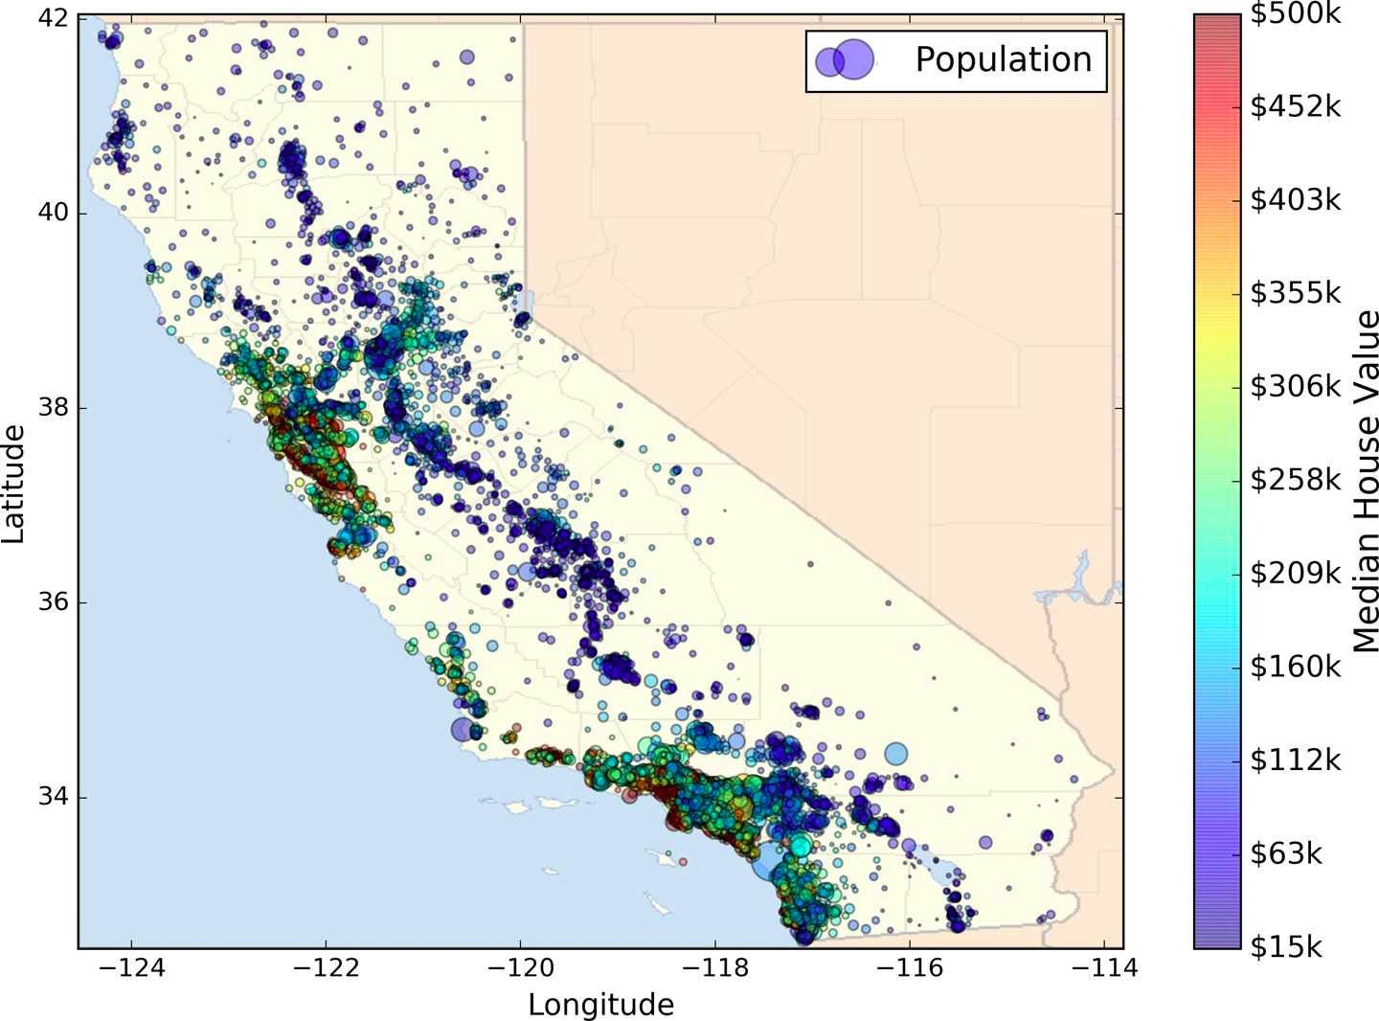

Slide 6
●
●
●
○
○
○
○

Slide 7
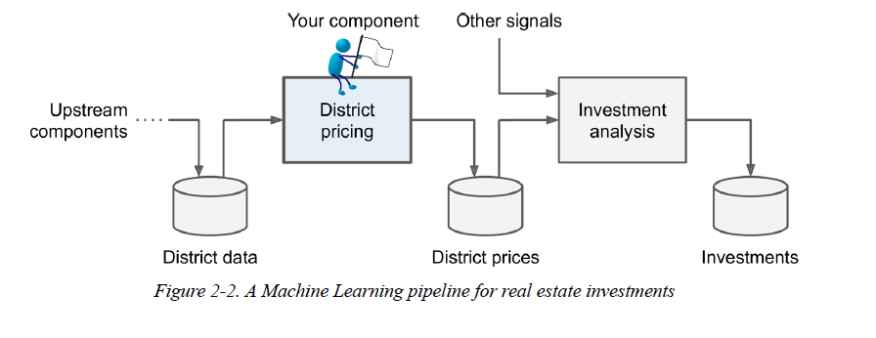
●
○
●
○
○

Slide 8
●
●
●
○
○
○
○
○

Slide 9

●

Slide 10


○
○
○
○
○
- Multiple Regression Problem
Univariate Regression Problem – Predict a single value for each district.

Slide 11
Univariate linear regression focuses on determining relationship between one independent (explanatory variable) variable and one dependent variable. Univariate simply means we only have one feature in our data to work with. Putting both together, univariate linear regression is commonly employed to describe the relationship between a single independent variable (x) and a dependent variable (y).
Y=mx+c
Example: Height and weight of a person
Multivariate Linear Regression is used when there is a need to predict the value of a variable which is based on the value of two more variables.
For example: let's say a person decides to buy a car. Then before coming up with a decision, he shall look at few aspects such as price, looks, maintenance friendliness, size, color, engine model, fuel capacity, mileage capacity, etc.
y = β0 + β1.x1 + β2.x

Slide 12
●
●
●

Slide 13

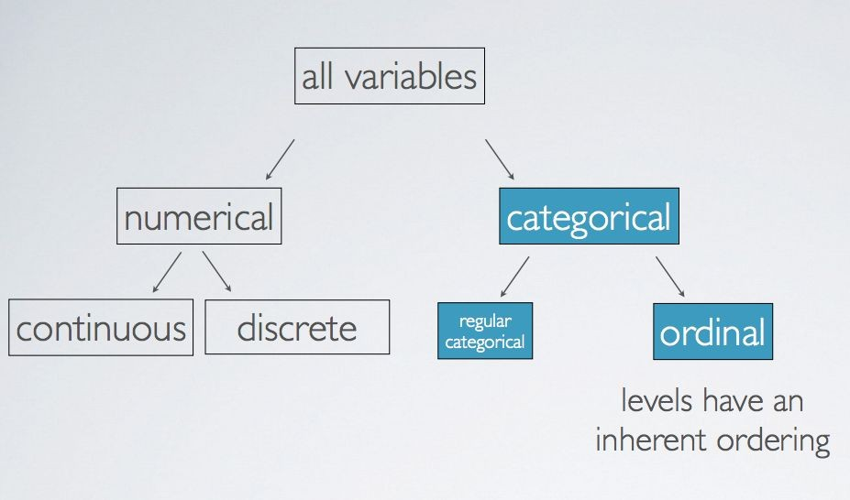

Slide 14
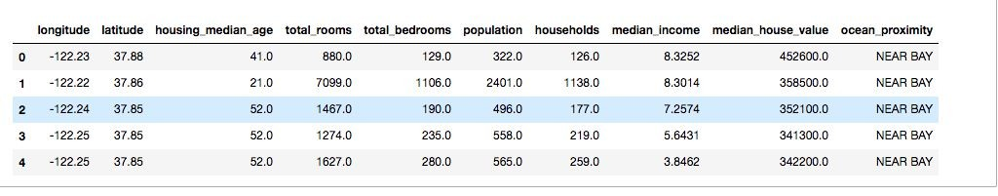

1.

Slide 15


Slide 16
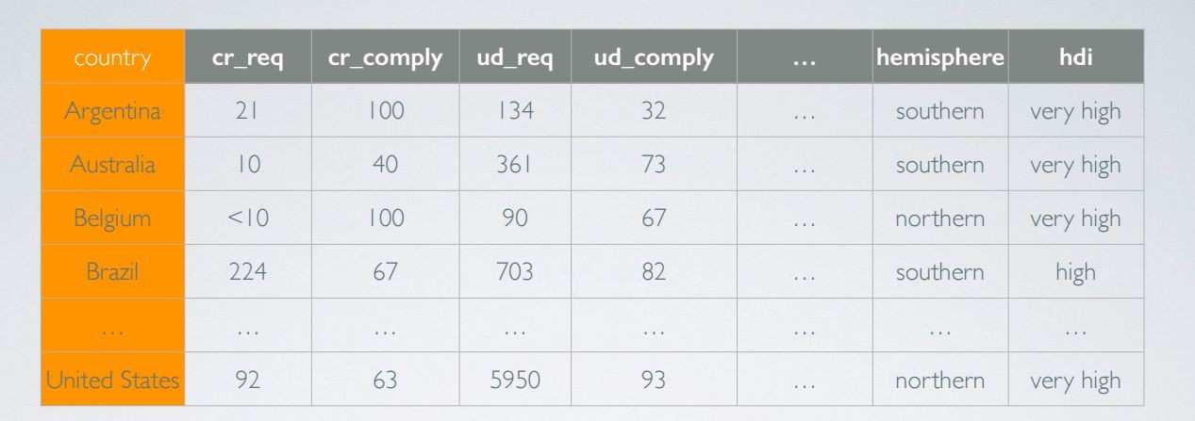



A.

Slide 17



Slide 18
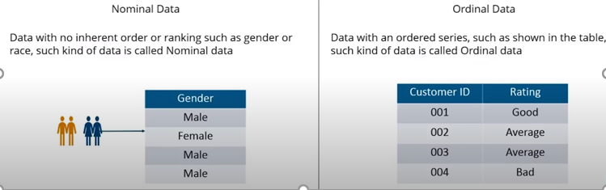
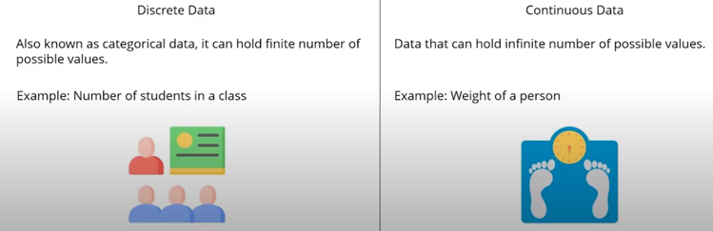

Slide 19
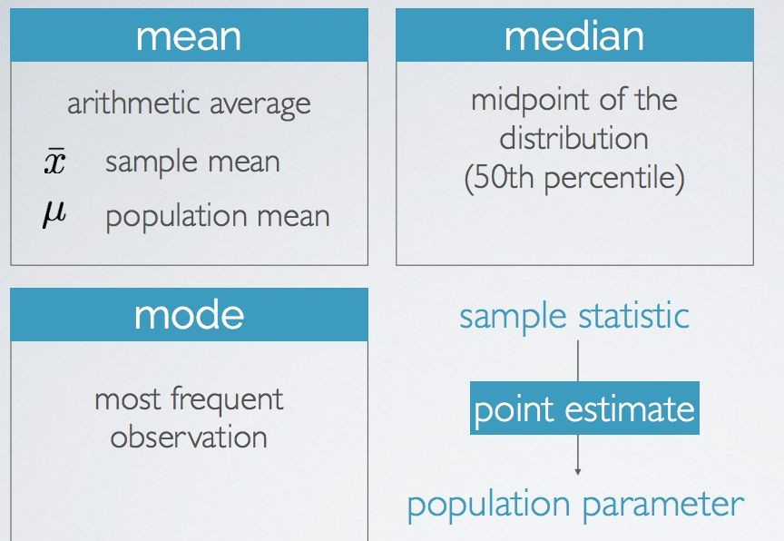

Slide 20
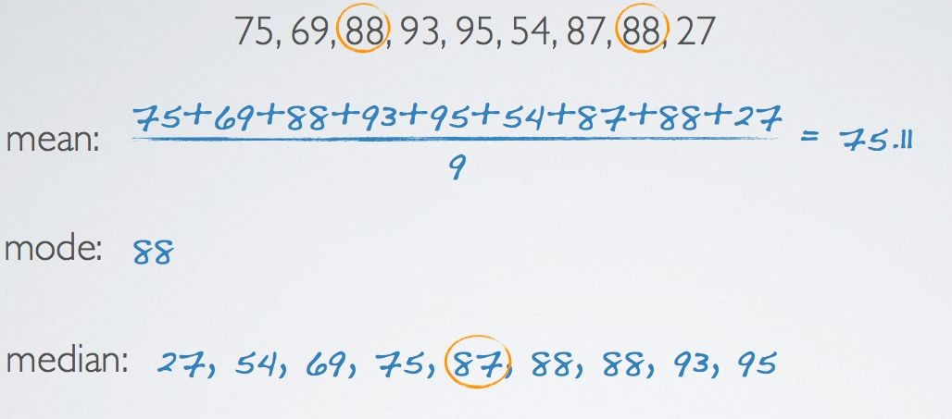

Slide 21





●
●
○

Slide 22




Slide 24
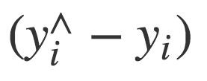

Slide 25
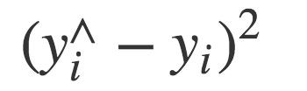

Slide 26

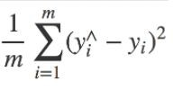

Slide 27
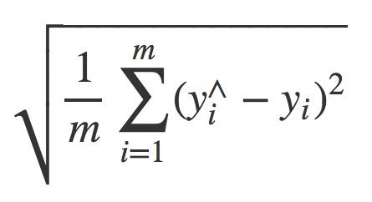

Slide 29
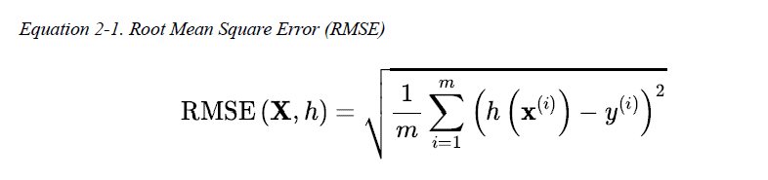
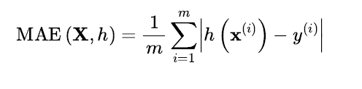
Performance Measure
To measure the distance between two vectors we use RMSE and MAE : the real data and the predicted data
RMSE is generally the preferred performance measure
In case of many outliers, we use Mean absolute error (MAE): This measures the absolute average distance between the real data and the predicted data.

Slide 30
Other Performance Measures

Slide 31
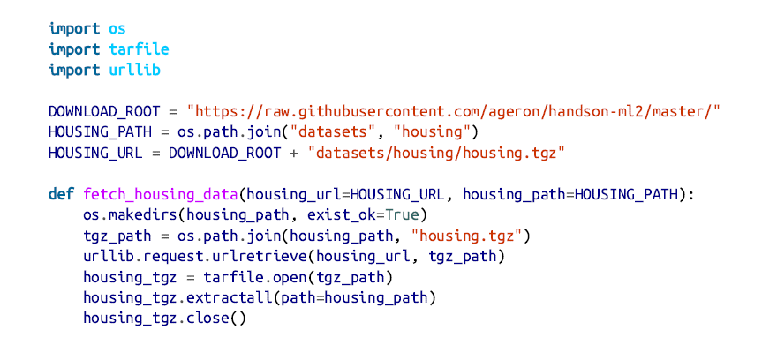
Get the data – download the file

Slide 32
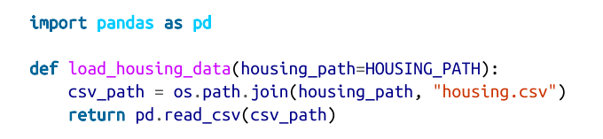

Load the data
This function returns a pandas DataFrame object containing all the data.

Slide 33
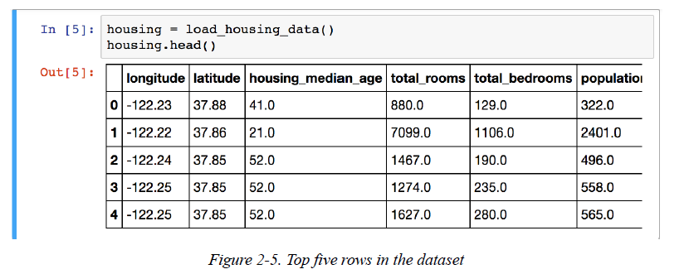
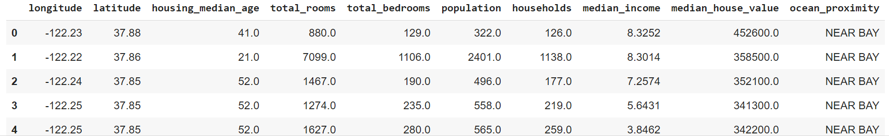
Take a Quick Look at the Data Structure

Slide 34
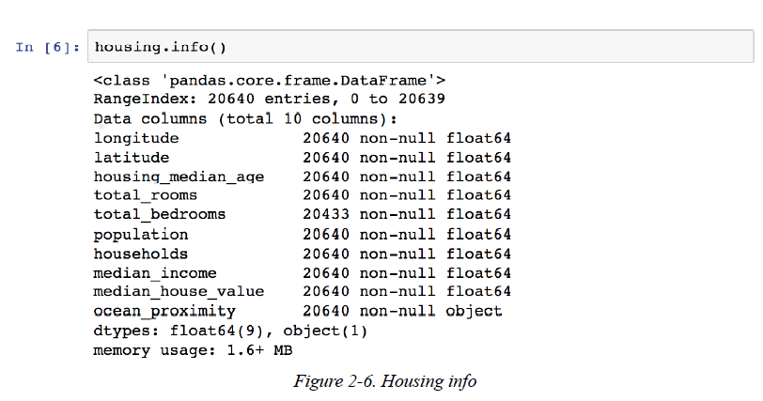
The info() method is useful to get a quick description of the data, in particular the total number of rows, each attribute’s type, and the number of nonnull values.
There are 20,640 instances in the dataset.
Notice that the total_bedrooms attribute has only 20,433 nonnull values, meaning that 207 districts are missing this feature. We will need to take care of this.

Slide 35
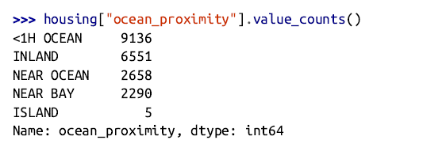
ocean_proximity-
type is object, so it could hold any kind of Python object. But since you loaded this data from a CSV file, it must be a text attribute.
column has repetitive values, which means that it is a categorical attribute.
To find out what categories exist and how many districts belong to each category by using the value_counts() method.

Slide 36
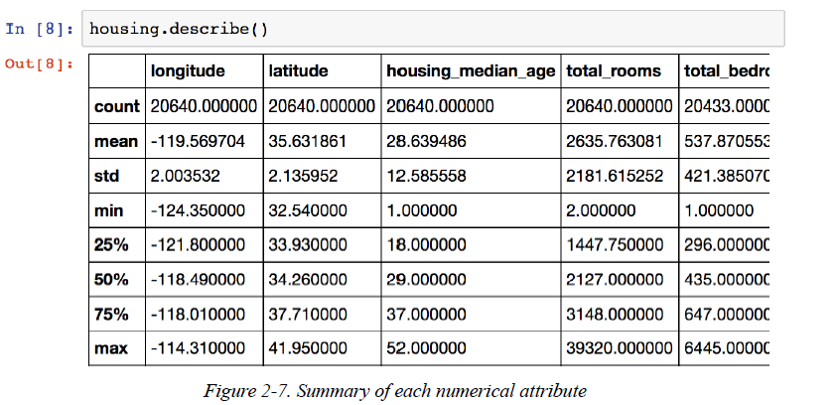
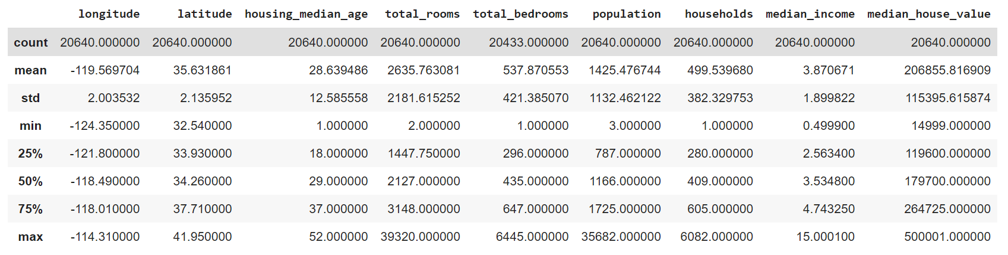
The describe() method shows a summary of the numerical attributes
The 25%, 50%, and 75% rows show the percentiles: a percentile indicates the value below which a given percentage of observations in a group of observations fall. For example,
** 25th percentile is called 1st quartile ** - 25% of the districts have a housing_median_age lower than 18.
** 50th percentile is called median ** - 50% of the districts have a housing_median_age lower than 29.
** 75th percentile is called 3rd quartile ** - 75% of the districts have a housing_median_age lower than 37.

Slide 37

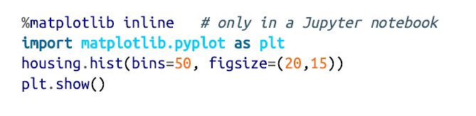
Plot a histogram to get a feel of the type of data you are dealing with.
A histogram shows,
the number of instances (on the vertical axis)
that have a given value range (on the horizontal axis).
hist() method- will plot a histogram for each numerical attribute.

Slide 38
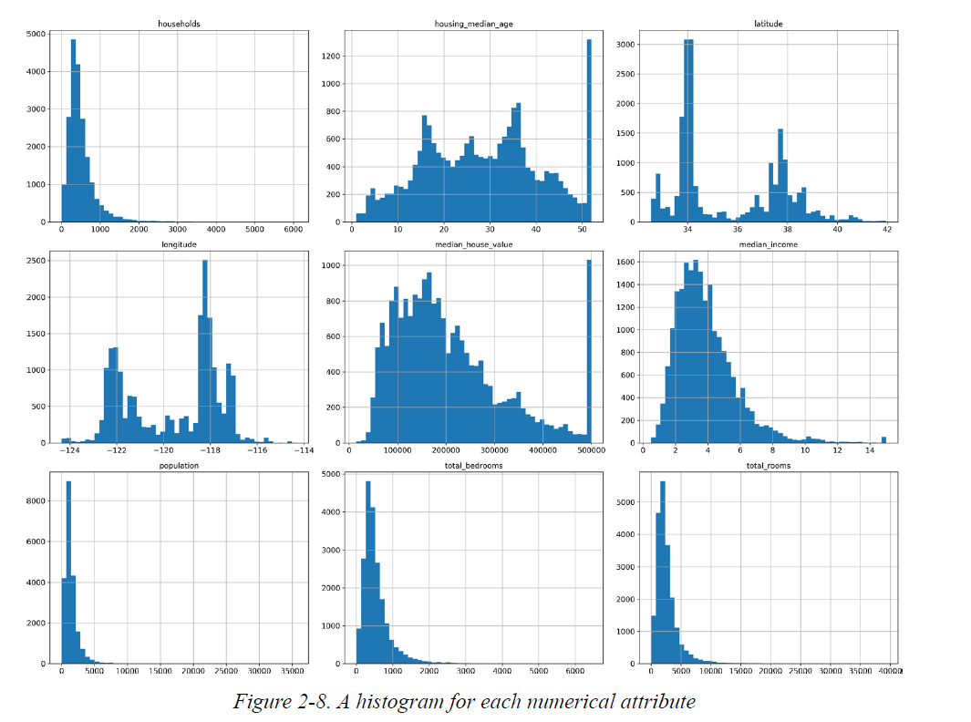

Slide 39

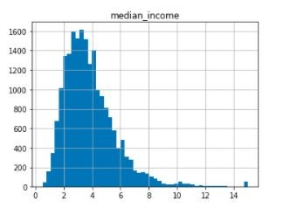

Slide 40



●
●
○
○

Slide 41
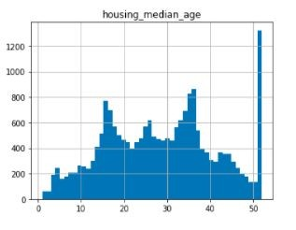
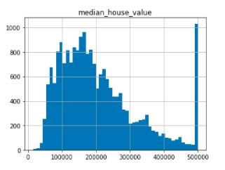

Slide 42

●
○
○
●

Slide 43
●
●
○
○
○

Slide 44
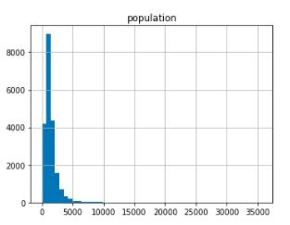
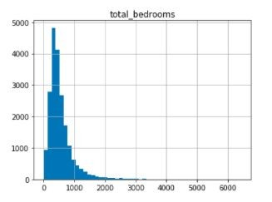

Slide 45
●
●
●

Slide 46
●
○
○
●

Slide 47
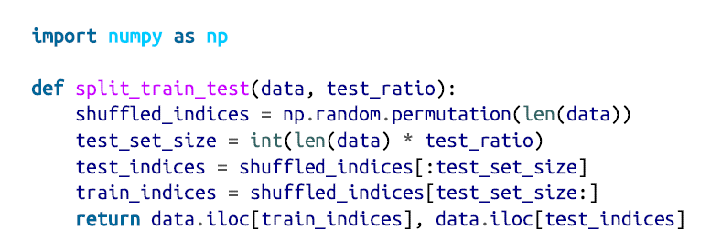
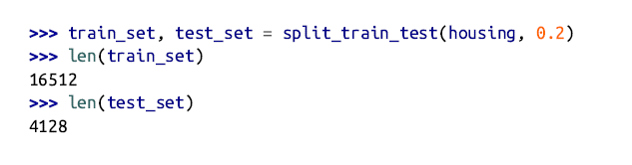

Slide 48
split_train_test
Answer:
It works!!! But it will generate a different test set when we run the program again.
Solution:
Use random number generator’s seed with np.random.seed(42) and np.random.permutation() so that it always generates the same shuffled indices.
But both these solutions will break the next time you fetch an updated dataset.
To have a stable train/test split even after updating the dataset,
A common solution is to use each instance’s identifier to decide whether or not it should go in the test set (assuming instances have a unique and immutable identifier).

Slide 49
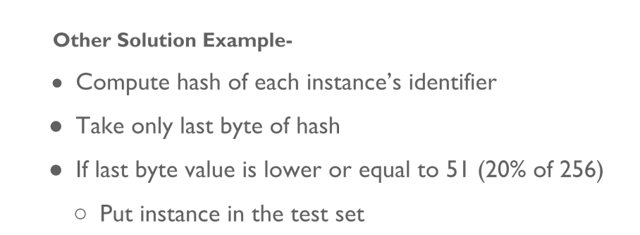
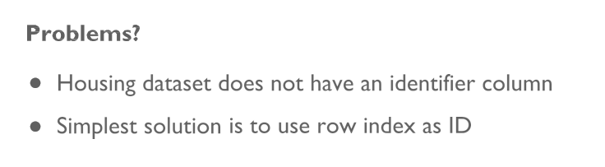

Slide 50
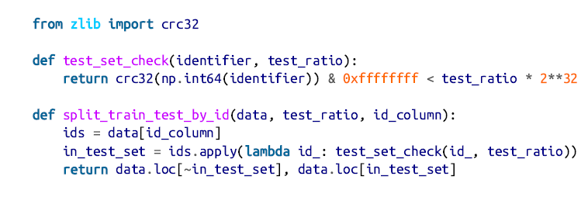
For example:
We could compute a hash of each instance’s identifier and put that instance in the test set.
If the hash is lower than or equal to 20% of the maximum hash value. This ensures that the test set will remain consistent across multiple runs, even if we refresh the dataset.
The new test set will contain 20% of the new instances, but it will not contain any instance that was previously in the training set.

Slide 51

The housing dataset does not have an identifier column. The simplest solution is to use the row index as the ID:
The crc32 function outputs an unsigned 32-bit number, and the code tests if the CRC value is lower than the test_ratio times the maximum 32-bit number.
The & 0xffffffff mask, masking with the 0xffffffff mask normalises the value to a signed.

Slide 52
So basically, either version turns the identifier into an integer, and the hash is used to make that integer reasonably uniformly distributed in a range.
So the two different methods produce different outputs, but as long as the CRC32 and MD5 hashes produce reasonably uniformly distributed hash values, then either will give you a fair 20% sampling rate.
Problems with row index
Row index make sure that new data gets appended to the end of the dataset.
No row ever gets deleted.

Slide 53

Row index is not working
We need to use the most stable features to build a unique identifier.
For example: a district’s latitude and longitude are guaranteed to be stable for a few million years, so we could combine them into an ID.

Slide 54
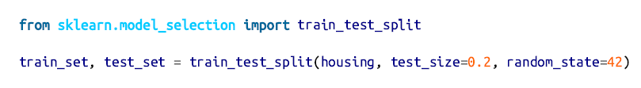
Scikit-Learn provides a few functions to split datasets into multiple subsets.
train_test_split() pretty much the same thing as the function split_train_test() but with a couple of additional features.
random_state parameter that allows to set the random generator seed.
We can pass multiple datasets with an identical number of rows, and it will split them on the same indices.
Till now, we have considered purely random sampling methods that generally works on large datasets.
we are at risk of introducing a significant sampling bias.

Slide 55

●

Slide 56
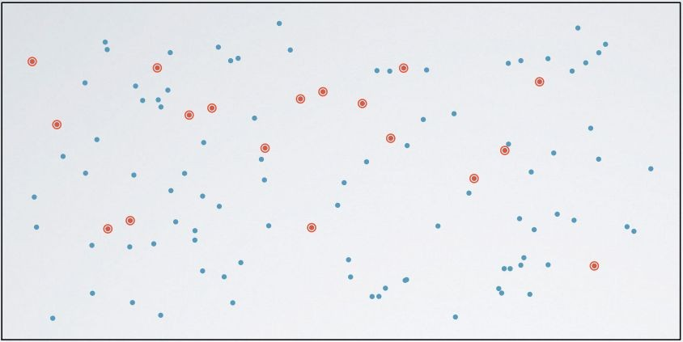
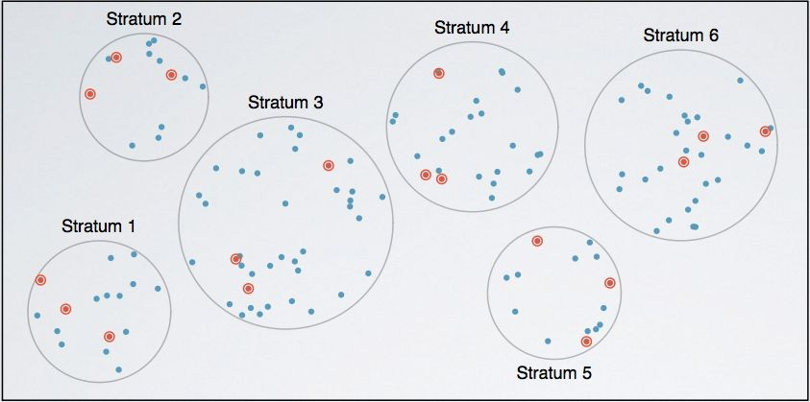

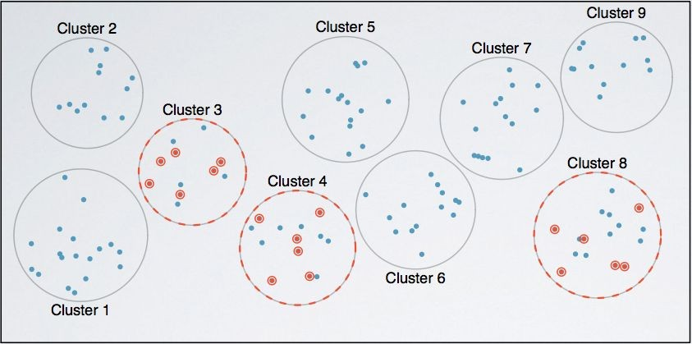


Slide 57




●
○
○
●
○
○
○
●
●
●
●

Slide 58

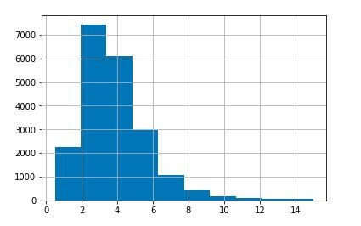
●
○
●
○
●
>>> housing["median_income"].hist()

Slide 59



●
●
○
●
○
○
●
○
○

Slide 60
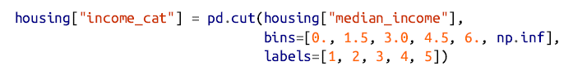
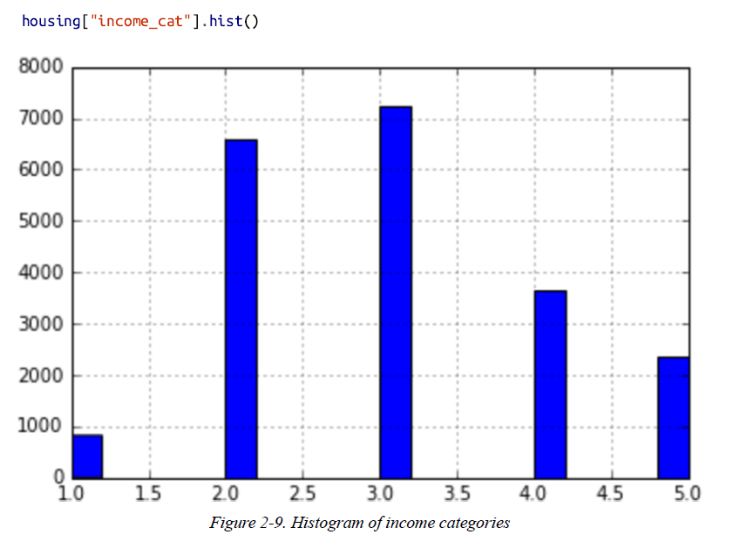
pd.cut() function to create an income category attribute with five categories (labeled from 1 to 5):
category 1 ranges from 0 to 1.5 (i.e., less than $15,000),
category 2 from 1.5 to 3, and so on:

Slide 61
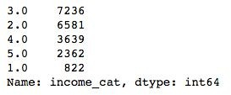


>>> housing["income_cat"].value_counts()

Slide 62
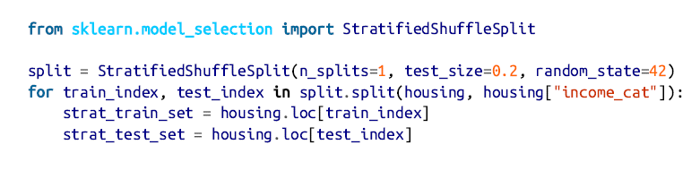
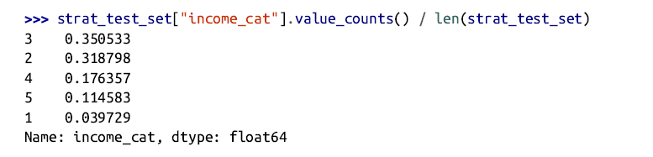
Stratified sampling based on the income category using Scikit-Learn’s StratifiedShuffleSplit class
Lets look at the income category proportions in the test set:

Slide 63
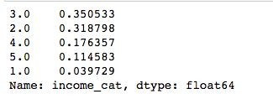
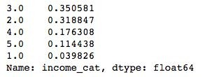
>>>
strat_test_set["income_cat"].value
_counts() / len(strat_test_set)
>>>
housing["income_cat"].value_counts () / len(housing)

Slide 66

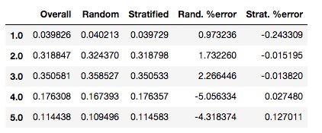
●

Slide 67

●

Slide 68


Slide 69

●
●

Slide 70

Discover and Visualize the Data
Goal : understand the dataset little more in depth.
Test set is kept aside and we are only exploring the training set.
Let’s create a copy of training set so that we can play with it without harming the original training set:

Slide 71

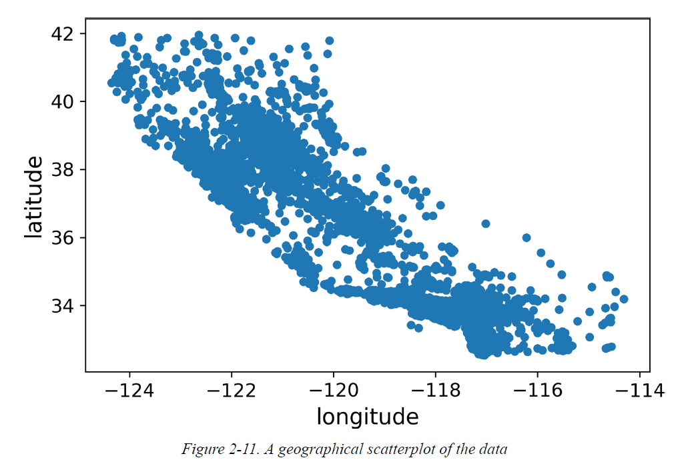
Visualizing Geographical Data
Since there is geographical information of latitude and longitude, we create a scatterplot of all districts to visualize the data.

Slide 72
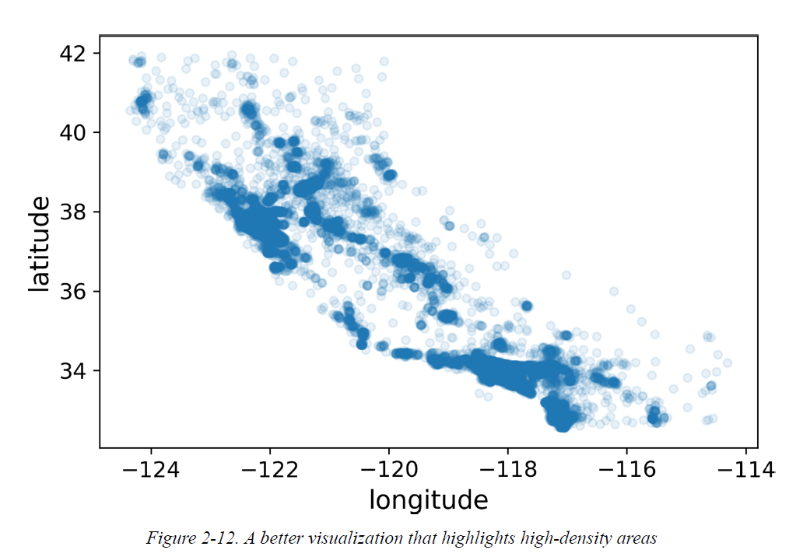
It is hard to see any particular pattern.
Setting the alpha option to 0.1 makes it much easier to visualize the places where there is a high density of data points.
The alpha blending value, between 0 (transparent) and 1 (opaque).

Slide 73


Lets look at pattern in depth:
  option s(The marker size in points)- The radius of each circle represents the district’s population.
  option c (The marker colors)- the color represents the price.
  option cmap -predefined color map called jet ranges from blue (low values) to red (high prices):

Slide 74


Looking for Correlations
Since the dataset is not too large, we can compute the standard correlation coefficient (also called Pearson’s r) between every pair of attributes using the corr() method:
Let’s look at how much each attribute correlates with the median house value:

Slide 75



The correlation coefficient ranges from –1 to 1.
strong positive correlation - When coefficient is close to 1.
Example: the median house value tends to go up when the median income goes up.
strong negative correlation -When the coefficient is close to–1
Example: a small negative correlation between the latitude and the median house value.
No linear correlation - coefficients close to 0.

Slide 76


Slide 77


Another way to check for correlation between attributes is to use the pandas scatter_matrix() function.
This function plots every numerical attribute against every other numerical attribute.
Example: 11 numerical attributes, plots (which would not fit on a page).

Slide 78


Slide 79


The most promising attribute to predict the median house value is the median income.
correlation scatterplot
A horizontal line around $450,000, $350,000, and $280,000.
We must remove the corresponding districts to prevent our algorithms from learning to reproduce these data quirks.

Slide 80
Observations:
  Correlation is very strong; we can clearly see the upward trend, and the points are not too dispersed.
  the price cap is clearly visible as a horizontal line at $500,000.
  Quirks should be cleaned up before feeding the data to a Machine Learning algorithm

Slide 81
Experimenting with Attribute Combinations
Try out various attribute combinations.
For example:
The total number of rooms in a district is not very useful if we don’t know how many households there are.
What we really want is: The number of rooms per household.
The total number of bedrooms by itself is not very useful:
We probably want to compare it to the number of bedrooms per household.
Population per household seems an interesting attribute combination Number of people per household.

Slide 82


The number of rooms per household is also more informative than the total number of rooms in a district—obviously the larger the houses, the more expensive they are.

Slide 83


Prepare the Data for Machine Learning
Algorithms
●
○
○
○
○
●
○
○

Slide 84

Data Cleaning
●
●

Slide 85

●
○
○
○
●
○
○
○
When using drop only, it drops the columns/rows you define
When using dropna, it removes all entries with NaN values (or null in general)

Slide 86



●
○
●
●
○

Slide 87


The median can only be computed on numerical attributes, we need to create a copy of the data without the text attribute ocean_proximity.
Fit the imputer instance to the training data using the fit() method:
The imputer has computed the median of each attribute and stored the result in its statistics_ instance variable.

Slide 88


Use the “trained” imputer to transform the training set by replacing missing values with the learned medians.
Result is a plain NumPy array containing the transformed features. Putting it back into a pandas DataFrame.

Slide 89



Handling Text and Categorical Attributes

Slide 90

we use Scikit-Learn’s OrdinalEncoder class to convert categorical attribute to numbers.

Slide 91

List of categories can be obtained using the categories_ instance variable.
It is a list containing a 1D array of categories for each categorical attribute
One issue with this representation
  ML algorithms will assume that two nearby values are more similar than two distant values
  for example, categories 0 and 4 are clearly more similar than categories 0 and 1
these labels are ordered in an alphabetical manner because of these numbers, a machine learning model can interpret this ordering

Slide 92

To fix this issue, a common solution is to create one binary attribute per category:
  one attribute = 1
    when the category is “<1H OCEAN” and 0 otherwise
  another attribute =1
    when the category is “INLAND” and 0 otherwise
    and so on.
This is called one-hot encoding, because only one attribute will be equal to 1 (hot), while the others will be 0 (cold).
The new attributes are sometimes called dummy attributes.
Scikit-Learn provides a OneHotEncoder class to convert categorical values into one-hot vectors:

Slide 93

Advan
When we have categorical attributes with thousands of categories better to go with one-hot encoding.
Output
  Is a SciPy sparse matrix instead of a NumPy array.
  matrix with thousands of columns, and the matrix is full of 0s except for a single 1 per row.
Drawback:
  Tons of memory to store zeros would be very wasteful.
Overcome drawback of One-hot encoding:
  Convert sparse matrix to NumPy array by calling the toarray() method

Slide 94


Custom Transformers
●
○
○

Slide 95
How to create a custom transformer
  Create a Class
  Implement three methods,
    fit() – performs some calculation such as mean
    transform() – replaces the nan with previously computed mean
    fit_transform() - means to do some calculation and then do transformation

Slide 96
Feature Scaling
Machine Learning algorithms don’t perform well when the input numerical attributes have very different scales.
Let’s observe the housing dataset,
  The total number of rooms ranges from about 6 to 39,320
  While median incomes ranges from 0 to 15
There are two common ways to get all attributes to have the same scale:
  Minmax scaling
  standardization

Slide 97




Min-max scaling or normalization :
  shifted and rescaled to range from 0 to 1.
  Scikit-Learn provides a transformer called MinMaxScaler.
  subtract the min value and divide by the max minus the min.

Slide 98


Standardization
  first it subtracts the mean value (mean=0) and then it divides by the standard deviation.
  Scikit- Learn provides a transformer called StandardScaler for standardization.
  standardization does not bound values to a specific range

Slide 99

Transformation Pipelines
A pipeline is used to help automate machine learning workflows
There are many data transformation steps that need to be executed in the right order.
Scikit-Learn provides the Pipeline class for data transformation steps that need to be executed in the right order.
Syntax:
The Pipeline constructor takes a list of name defining a sequence of steps.

Slide 100

The Pipeline constructor takes a list of name/estimator pairs defining a sequence of steps.

Slide 101
First we import the ColumnTransformer class,
We get the list of numerical column names and the list of categorical column names, and then we construct a ColumnTransformer.
The constructor requires a list of tuples, where each tuple contains
    a name,
    a transformer, and
    a list of names.
Numerical columns should be transformed using the num_pipeline
categorical columns should be transformed using a OneHotEncoder.
Finally, ColumnTransformer is applied to the housing data: it applies each transformer to the appropriate columns and concatenates the output.

Slide 102


Select and Train a Model
Training and Evaluating on the Training Set
Done! You now have a working Linear Regression model. Let’s try it out on a
few instances from the training set:

Slide 103

It works, although the predictions are not exactly accurate.
Let’s measure this regression model’s RMSE on the whole training set using Scikit-Learn’s mean_squared_error() function:
This is not a great score, most districts median_housing_values range between $120,000 and $265,000, so a typical prediction error of $68,628 is not very satisfying. This is an example of a model underfitting the training data.
The main ways to fix underfitting are to select a more powerful model, to feed the training algorithm with better features, or to reduce the constraints on the model.

Slide 104


Let’s train a DecisionTreeRegressor. This is a powerful model, capable of finding complex nonlinear relationships in the data.
The model is trained, let’s evaluate it on the training set:
No error at all? Could this model really be absolutely perfect?
The model has badly overfit the data.

Slide 105

Better Evaluation Using Cross-Validation
Scikit-Learn’s K-fold cross-validation feature
It randomly splits the training set into 10 distinct subsets called folds, then it trains and evaluates the Decision Tree model 10 times, picking a different fold for evaluation every time and training on the other 9 folds.
The result is an array containing the 10 evaluation scores:

Slide 106

It seems to perform worse than the Linear Regression model!

Slide 107

Fine-Tune Your Model
1) Grid Search

Slide 108

●

Slide 109

This param_grid tells Scikit-Learn to first evaluate all 3 × 4 = 12 combinations of n_estimators and max_features hyperparameter values specified in the first dict.
Then try all 2 × 3 = 6 combinations of hyperparameter values in the second dict, but this time with the bootstrap hyperparameter set to False.
The grid search will explore 12 + 6 = 18 combinations of RandomForestRegressor hyperparameter values, and it will train each model 5 times(since we are using five-fold cross validation).
There will be 18 × 5 = 90 rounds of training!
We can get the best combination of parameters

Slide 110
2) Randomized Search
The grid search approach is fine when you are exploring relatively few combinations, like in the previous example.
But when the hyperparameter search space is large, it is often preferable to use RandomizedSearchCV instead.
It evaluates a given number of random combinations by selecting a random value for each hyperparameter at every iteration.
Benefits
If you let the randomized search run for, say, 1,000 iterations, this approach will explore 1,000 different values for each hyperparameter

