Slide 1
Unit 2
TRAINING MODELS

Slide 2
Linear Regression
What is Linear Regression?
Linear Regression is a machine learning algorithm based on supervised learning.
It initially comes from statistics.
It’s a technique to understand a relationship between two variables by setting a linear equations.
Two variables – Dependent variable ‘Y’ and independent variable ‘X’.
It performs a regression task.

Slide 3
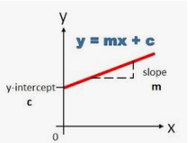
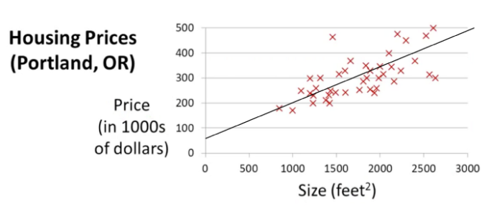

The equation of any straight line, called a linear equation,
              y = mx + c
  Where,
  M is the slope of the line and
  C is the y-intercept
  Slope decides the rotation of line

Slide 4
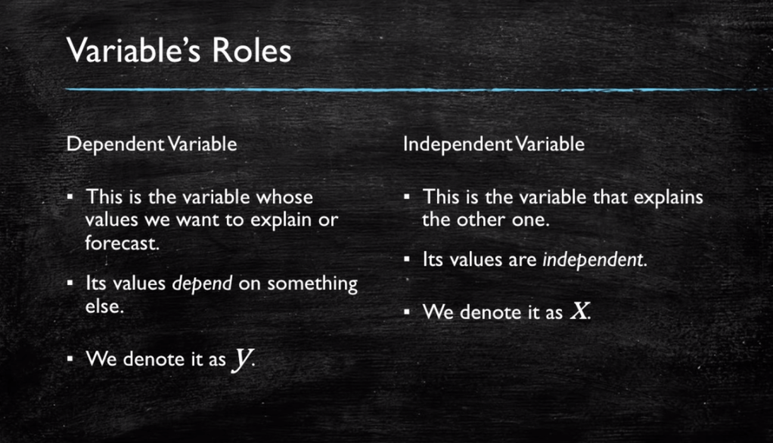

Slide 5
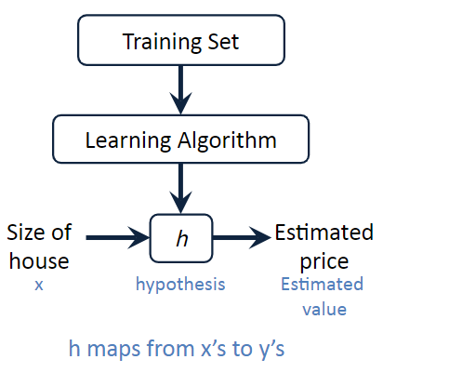
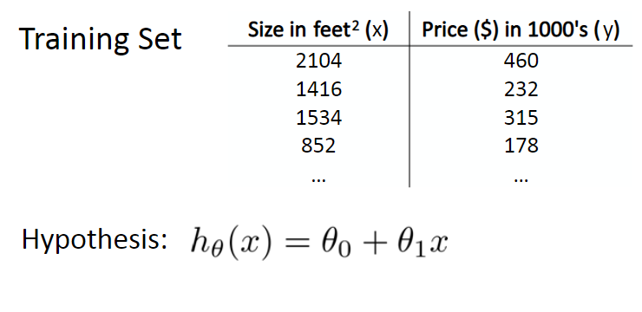

Slide 6
Types of Regression
Linear Regression
Multiple Linear Regression
Polynomial Regression
Decision Tress Regression
Random Forest
SVM Regression

Slide 7
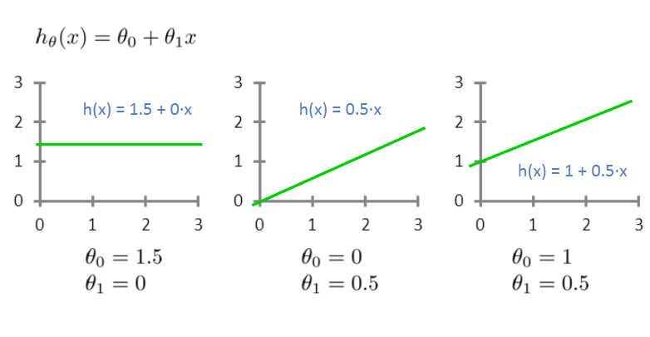

Slide 8
If data points follow linear pattern, we are able to find the two variable M, C to predict how a dependent variable Y is affected in relation with independent X variable.
We can use linear regression in a way to represent relation, we all ready know from our example to forecast new observations.
All our new data point will not be on the line, by calculating the distance error between points and line we can find the best fit, lowest the error which will be our final line.
This is where the machine learning minimization algorithm will come in.
Making prediction is as solving the equation for specific set of inputs.

Slide 9


GDP v/s Life satisfaction
As an example how a GDP(Gross domestic product) has an affect on the Life satisfaction of the citizen using linear regression.
Y=MX + C
life_satisfaction = C + M * GDP
GDP_per_capita - input feature
and are the model’s parameters
A linear model makes a prediction by simply computing a weighted sum of the input features, plus a constant called the bias term (also called the intercept term)

Slide 10
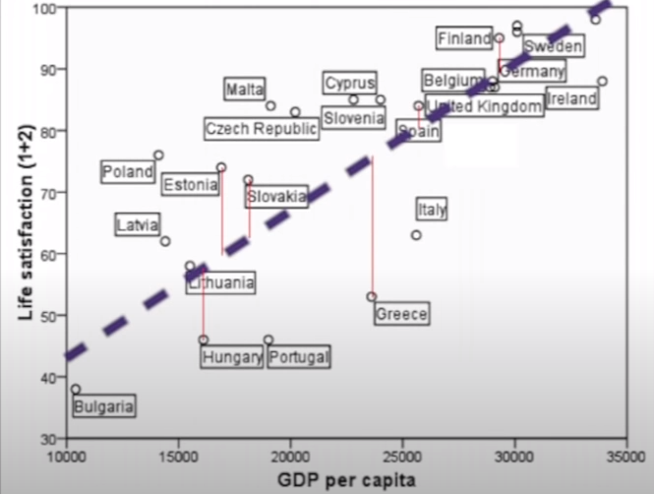

Slide 11
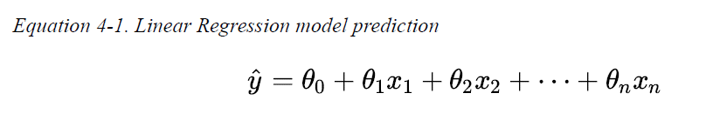
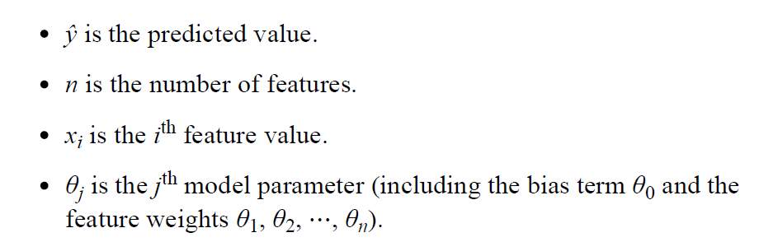

Slide 12
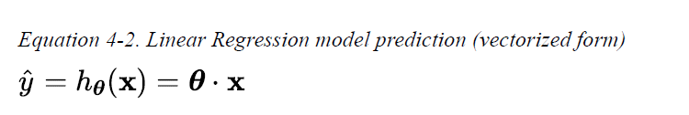
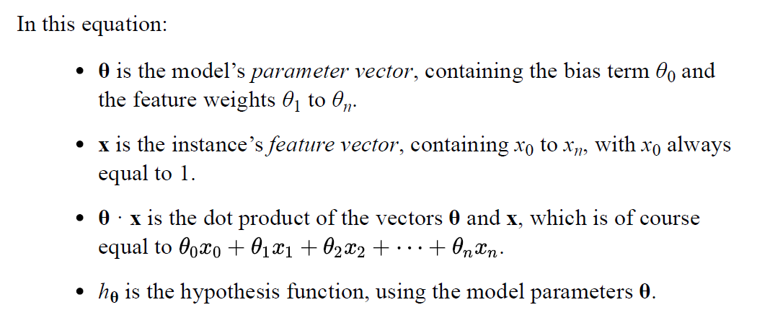
Re-writing the equation in vectorized form,

Slide 13
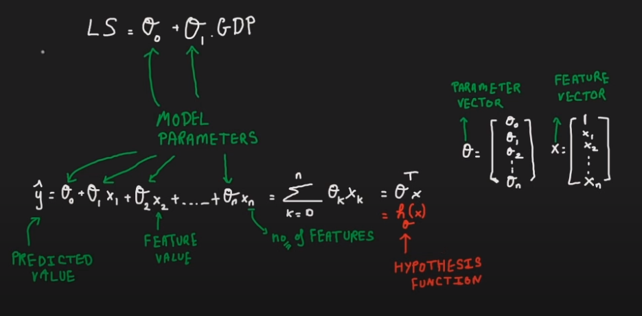

Slide 14
How do we train a Linear regression model
Training a model means setting its parameters, so that the model best fits the training set.
First need a measure of how well the model fits the training data.
The most common performance measure of a regression model is the Root Mean Square Error (RMSE).
Therefore, to train a Linear Regression model, we need to find the value of θ that minimizes the RMSE.
Simply minimize the mean squared error (MSE) than the RMSE, and it leads to the same result.

Slide 15
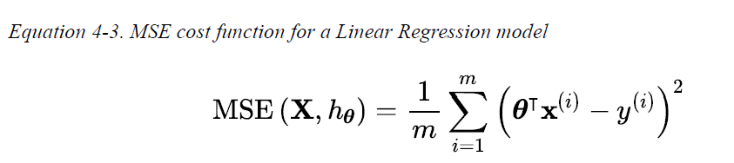
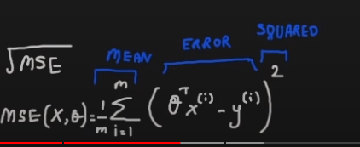
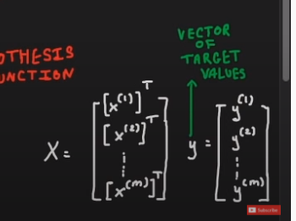

Slide 16
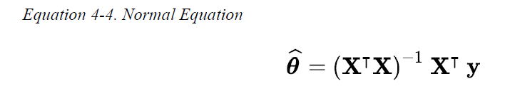
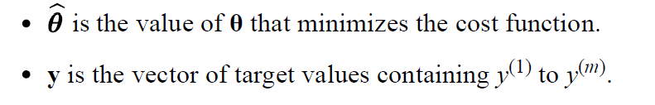
The Normal Equation
A mathematical equation to find the value of θ that minimizes the cost function, is a closed-form solution. This is called the Normal Equation

Slide 17
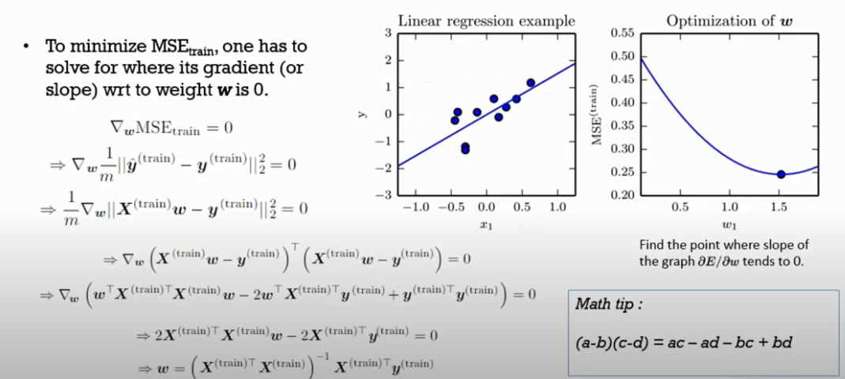

Slide 18



Computational Complexity
The Normal Equation computes the inverse of which is an (n + 1) × (n + 1) matrix (where n is the number of features).
The computational complexity of inverting such a matrix is typically about
If we double the number of features, you multiply the computation time by roughly
The Normal Equation approach get very slow when the number of features grows large (e.g., 100,000). On the positive side, both are linear with regard to the
number of instances in the training set (they are O(m)), so they handle large training sets efficiently, provided they can fit in memory.

Slide 19
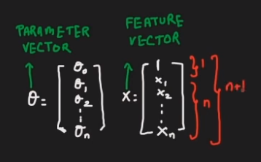
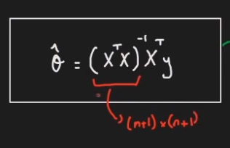
Computational Complexity

Slide 20
What Is Gradient Descent?
Gradient Descent is a generic optimization algorithm capable of finding optimal solutions to a wide range of problems.
The general idea of Gradient Descent is to tweak parameters iteratively in order to minimize a cost function.
We start with a random point on the function and move in negative direction of the gradient of the function to reach the local/global minima.

Slide 21


Gradient Descent
Question - If you are lost in the mountains in a dense fog and you can only feel the slope of the ground below your feet. Which strategy will you take to reach to the bottom of the valley quickly?
Your Current position
Bottom of the valley

Slide 22
Gradient Descent
Answer
Take a step
If the step is downhill, keep walking on the same direction
Else reverse the direction
Repeat the steps until you reach to the bottom
Your Current position
Bottom of the valley

Slide 23
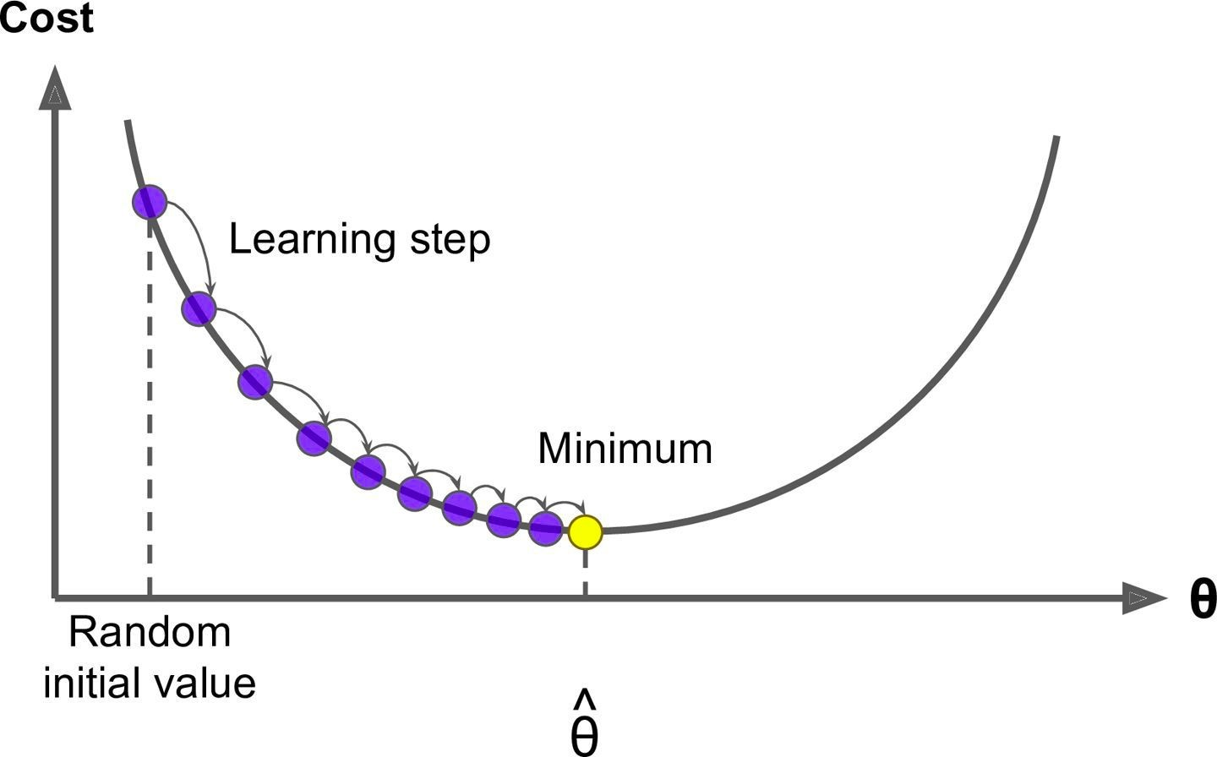
Gradient Descent

Slide 24
Gradient Descent
Gradient Descent
  Measures the local gradient of the cost function
  With regards to the parameter vector θ and
  It goes in the direction of descending gradient
  Until the gradient becomes zero

Slide 25
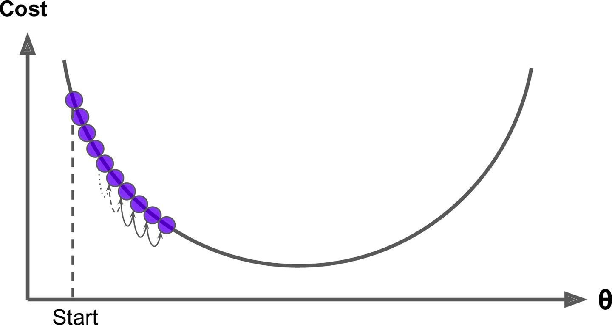
Learning Rate
In Gradient Descent
  The size of the steps - also called as learning rate plays an important role.
If the learning rate is too small
  Then the algorithm will have to go through many iterations to converge
  Which will take a long time to converge

Slide 26
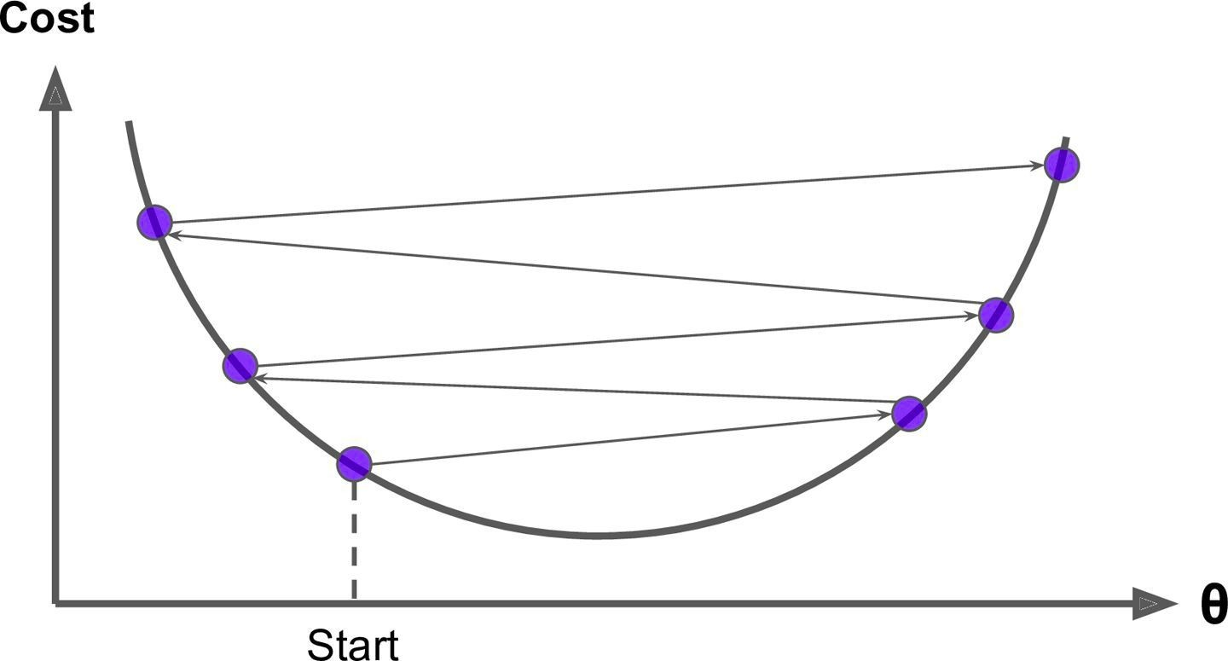
If the learning rate is too high
  We might jump across the valley and end up on the other side, possibly even higher up than you were before
  This might make the algorithm diverge with
  Larger and larger values, failing to find a good solution

Slide 27
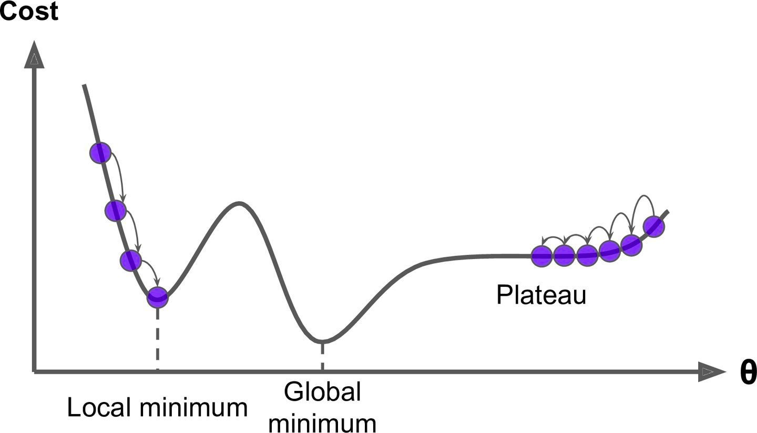
Gradient Descent
The two main challenges with Gradient Descent.
Global and Local Minimum
Not all cost functions are regular bowls
There may be holes, ridges, plateaus, and all sorts of irregular terrains, making convergence to the minimum very difficult

Slide 28
Gradient Descent
Global and Local Minimum
If we start from left then Gradient Descent
  Converges to a local minimum
  Which is not as good as the global minimum

Slide 29
Gradient Descent
Global and Local Minimum
If we start from right then Gradient Descent
  Will take a very long time to cross the plateau and
  If we stop too early then
  We will never reach the global minimum

Slide 30
Gradient Descent
Global and Local Minimum
MSE cost function is a convex function
  If we pick any two points on the curve
  The line segment joining them never crosses the curve
  No local minima, just one global minimum
Convex Function

Slide 31
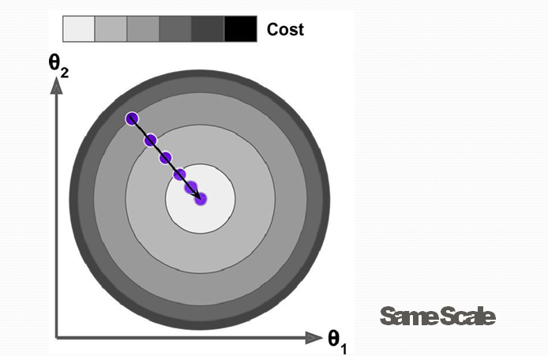
Feature Scaling
When using Gradient Descent, we should ensure that
  All features have a similar scale
  Using Scikit-Learn’s StandardScaler class
  Else it will take much longer to converge
See the below diagram where feature 1 and 2 have same scales
Gradient Descent algorithm goes straight toward the minimum
  Thereby reaching it quickly

Slide 32
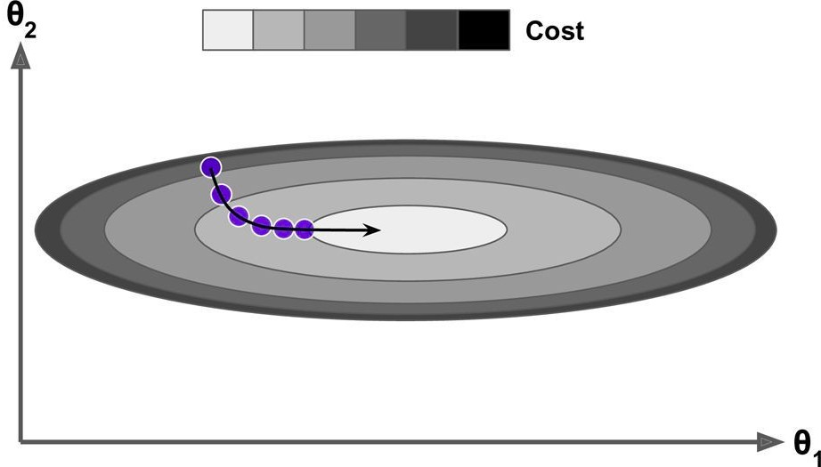
Feature Scaling - Different Scales / Not scaled
See the below diagram where feature 1 and 2 have different scales
Gradient Descent algorithm goes almost orthogonal to
  The direction of the global minimum and
  It ends with a long march down an almost flat valley
  It will eventually reach the minimum, but it will take a long time
Different Scale

Slide 33
Gradient Descent
Again remember that training a model means
  Searching for a best possible model’s parameters
  Like θ0, θ1 and others
  That minimizes the cost function like MSE
Algorithm will have to search in more dimensions if
  Model has more features
  And search becomes complex

Slide 34
Let’s implement Gradient descent using some known algorithms such as
  Batch Gradient Descent
  Stochastic Gradient Descent
  Mini-batch Gradient Descent

Slide 35
Batch Gradient Descent
Partial Derivative
To implement Gradient Descent
  First initialize model parameters(θ1, θ2 …..) - Random Initialization
  For each of the weights, we change one weight and keeping others fixed and calculate the change in cost.
  This is called a Partial Derivative
It is like asking
  What is the slope of the mountain under my feet if I face east?
  And then asking the same question facing north
  And so on for all other dimensions

Slide 36
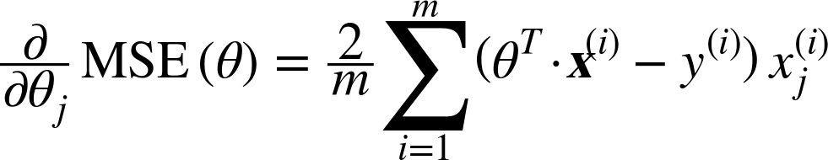
Batch Gradient Descent
Partial Derivative of Cost Function
In general, we compute the gradient of the cost function
  With regards to each model parameter θj (Theta j)
Below is the equation for finding partial derivative of the cost function with respect to parameter θj (Theta j)
In this equation
  We calculate partial derivative of each parameter θj (Theta j) individually

Slide 37
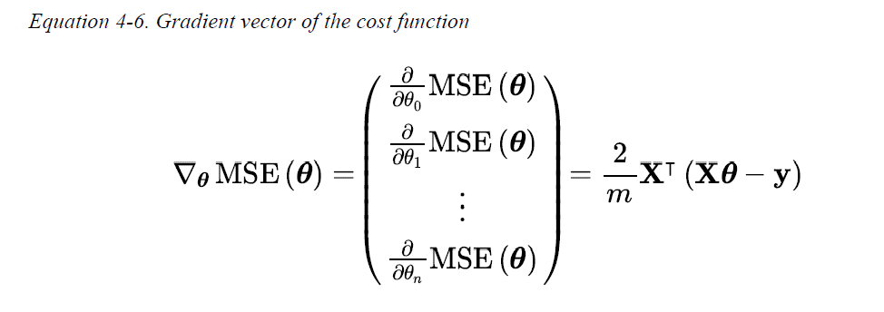
  Instead we can compute them all in one go
Gradient Vector of the Cost Function
The gradient vector ∇θMSE(θ)
  Contains all the partial derivatives of the cost function
  (one for each model parameter)
This formula involves calculations over the full training set X at every step
This is why the name Batch Gradient Descent

Slide 38
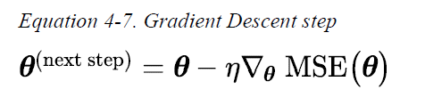
Gradient Vector of the Cost Function
Since Batch Gradient Descent uses entire training data at every step
  It is terribly slow on large training sets
But Gradient Descent scales well with the number of features
It is faster to train Linear Regression model when there are thousand of features
  Using Gradient Descent than using the Normal Equation
Gradient Descent Step
Once we have the gradient vector, which points uphill,
  Just go in the opposite direction to go downhill
We can calculate the size of the downhill step using below equation

Slide 39
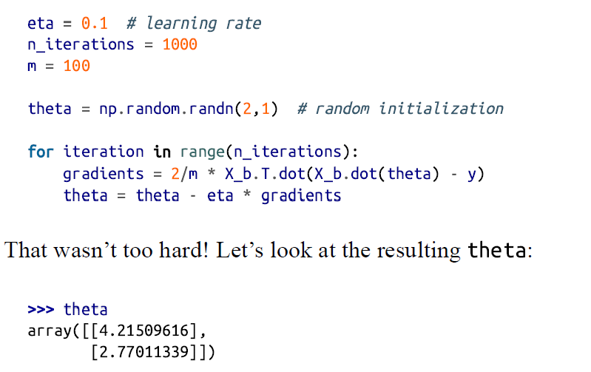

Slide 40
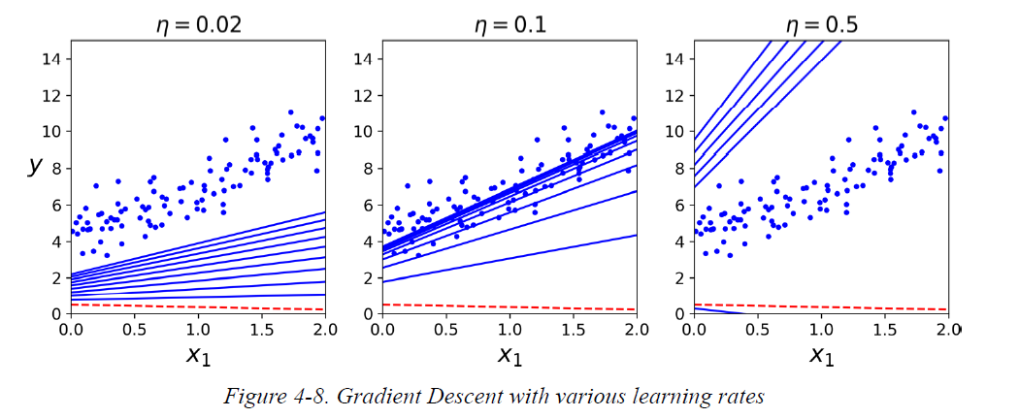
How the learning rate affects Gradient Descent?

Slide 41
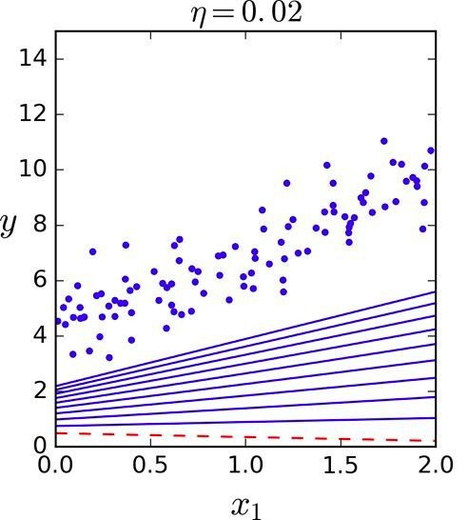
Batch Gradient Descent
Different Learning Rates
Learning rate is too low (0.02)
Algorithm will take a lot of time to reach the solution

Slide 42
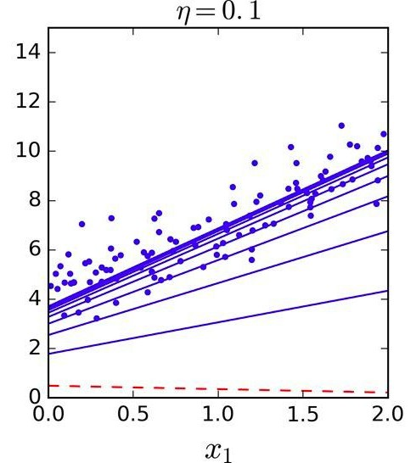
Batch Gradient Descent
Different Learning Rates
Learning rate is good (0.1)
In few iterations only, it converged to good solution

Slide 43
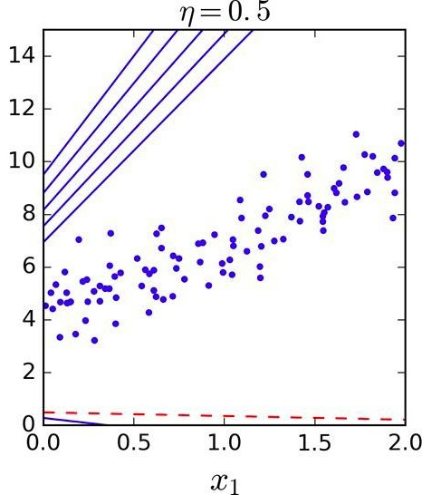
Batch Gradient Descent
Different Learning Rates
Learning rate is too high (0.5)
The algorithm diverges
  Jumping all over the place and
  Getting further and further away from the solution at every step

Slide 44
Batch Gradient Descent
Then how to set number of iterations?
Find Number of Iterations
If number of iterations are too low
  Then we may not get optimal solution when the algorithm stops
If number of iterations are too high
  Then our time may be wasted and
  Algorithm may never converge

Slide 45

Batch Gradient Descent
Find Good Learning Rate - Solution
Set a very large number of iterations and
Interrupt the algorithm when the gradient vector becomes tiny
  When norm of a gradient vector becomes smaller than ϵ - tolerance
Norm of vector (x1, x2 --- xn)
Stop when

Slide 46
Stochastic Gradient Descent - SGD
Problem with Batch Gradient Descent
Batch Gradient Descent
  Slow when the training set is large
  As it uses the whole training set to compute the gradient at every step
Stochastic Gradient Descent
  Just picks a random instance in the training set at every step and
  Computes the gradients based only on that single instance
This makes the algorithm much faster
  As very little data gets manipulate at every iteration
Also huge training sets can be trained
  As only one instance needs to be in memory at each iteration

Slide 47
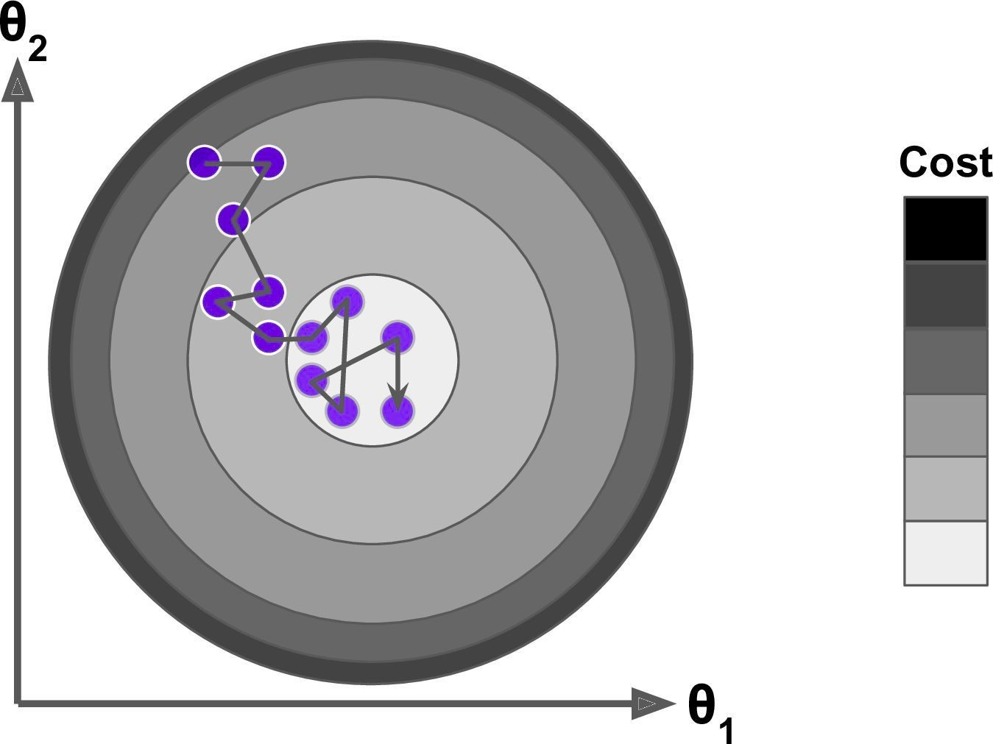
Stochastic Gradient Descent - SGD
Instead of gently decreasing until it reaches the minimum
  The cost function bounces up and down, decreasing only on average
  Over time it ends up very close to the minimum
  But once it gets there it continues to bounce around, never settling down
Once the algorithm stops
  The final parameter values are good, but not optimal
  As algorithm never settles down

Slide 48
Stochastic Gradient Descent - SGD
When the cost function is very irregular then
  SGD has a better chance of finding the global minimum than Batch Gradient Descent
  As randomness may help algorithm to jump out of local minima

Slide 49
Stochastic Gradient Descent - SGD
As seen earlier that randomness in SGD
  Is good to escape from local minimum
  But bad as algorithm can never settle at minimum
What is the solution?

Slide 50
Stochastic Gradient Descent - SGD
Simulated Annealing
One solution is to gradually reduce the learning rate
The steps start out large
  This helps make quick progress and escape local minima
Then steps get smaller and smaller
  This helps the algorithm to settle at the global minimum
This process is called Simulated Annealing
  Because it resembles the process of annealing in metallurgy where molten metal is slowly cooled down

Slide 51
Stochastic Gradient Descent - SGD
Learning Schedule
The function that determines the learning rate
  At each iteration is called the learning schedule
If the learning rate is reduced too quickly
  We may get stuck in a local minimum Or
  Even end up frozen halfway to the minimum
If the learning rate is reduced too slowly
  We may jump around the minimum for a long time and
  End up with a suboptimal solution if we halt training too early

Slide 52
Stochastic Gradient Descent - SGD
Implement SGD
Let’s implement SGD
By convention we iterate by rounds of m iterations
  Each round is called an epoch
m -> number of instances in the training set
See Stochastic Gradient Descent section in notebook for the implementation

Slide 53
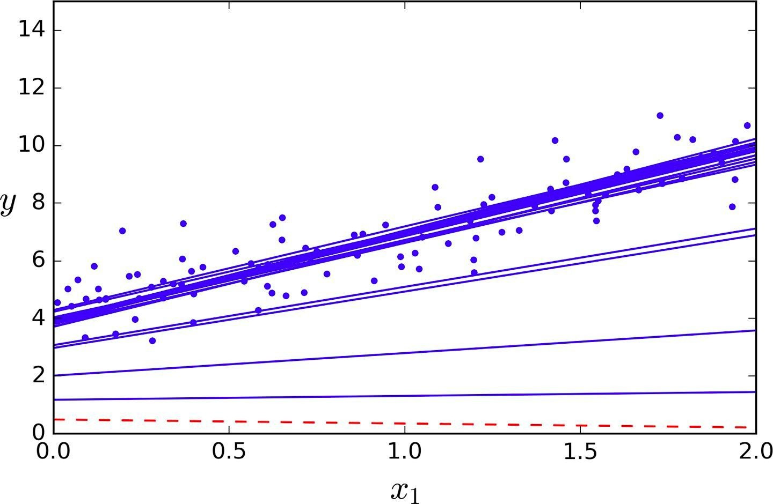
Stochastic Gradient Descent - SGD
Implement SGD
SGD first 10 steps. Notice how irregular the steps are

Slide 54
Note that since instances are picked randomly, some instances may be picked several times per epoch, while others may not be picked at all. If you want to be sure that the algorithm goes through every instance at each epoch, another approach is to shuffle the training set (making sure to shuffle the input features and the labels jointly), then go through it instance by instance, then shuffle it again, and so on. However, this approach generally converges more slowly.

Slide 55
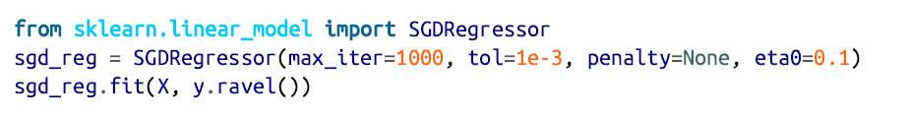
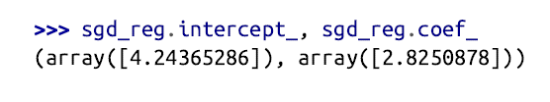
To perform Linear Regression using Stochastic GD with Scikit-Learn, you can use the SGDRegressor class, which defaults to optimizing the squared error cost function.

Slide 56
Mini-batch Gradient Descent
Instead of computing the gradients based on the full training set (as in Batch GD) or based on just one instance (as in Stochastic GD).
Mini-batch GD computes the gradients on small random sets of instances called mini-batches.
The main advantage of Minibatch GD over Stochastic GD is that you can get a performance boost from hardware optimization of matrix operations, especially when using GPUs.
The algorithm’s progress in parameter space is less erratic than with Stochastic GD, especially with fairly large mini-batches. As a result, Minibatch GD will end up walking around a bit closer to the minimum than Stochastic GD—but it may be harder for it to escape from local minima

Slide 57
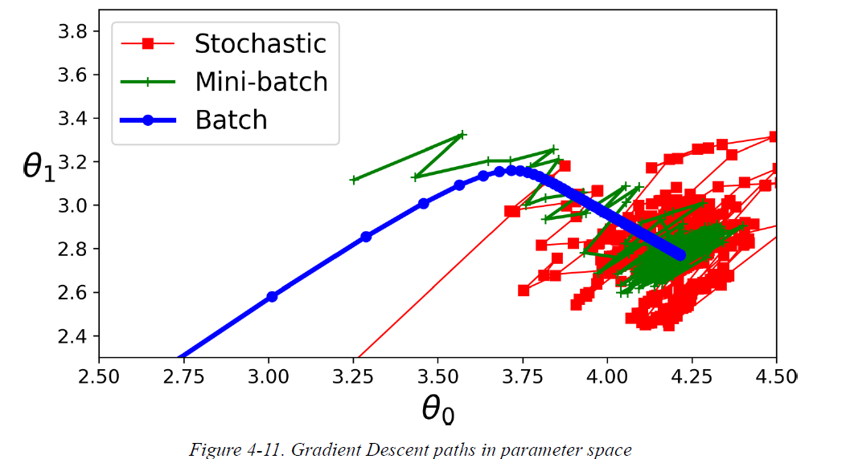

Slide 58
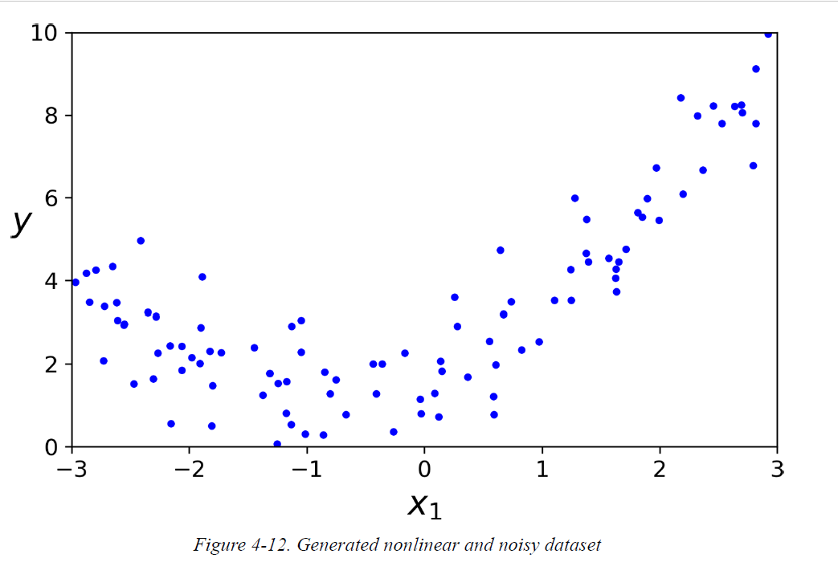
What is Polynomial Regression
Polynomial regression is a form of regression analysis in which the relationship between the independent variable x and the dependent variable y is modelled as an nth degree polynomial in x.
What if your data is more complex than a straight line?

Slide 59
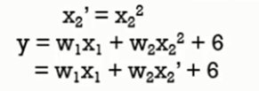

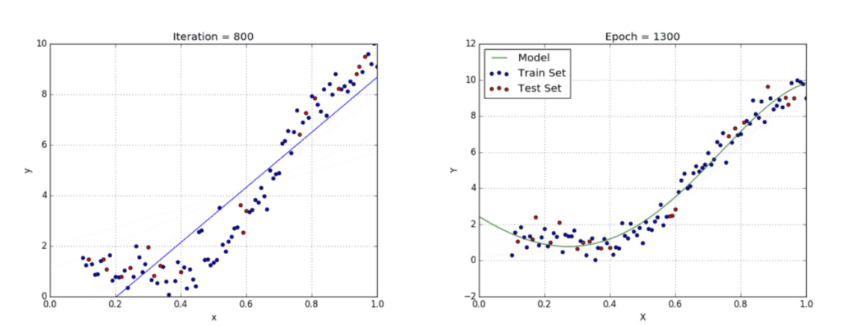
A simple way to do
  A linear model to fit nonlinear data
  Add powers of each feature as new features
  And train a linear model on extended set of features
  This is called polynomial regression
This technique is called Polynomial Regression.

Slide 60
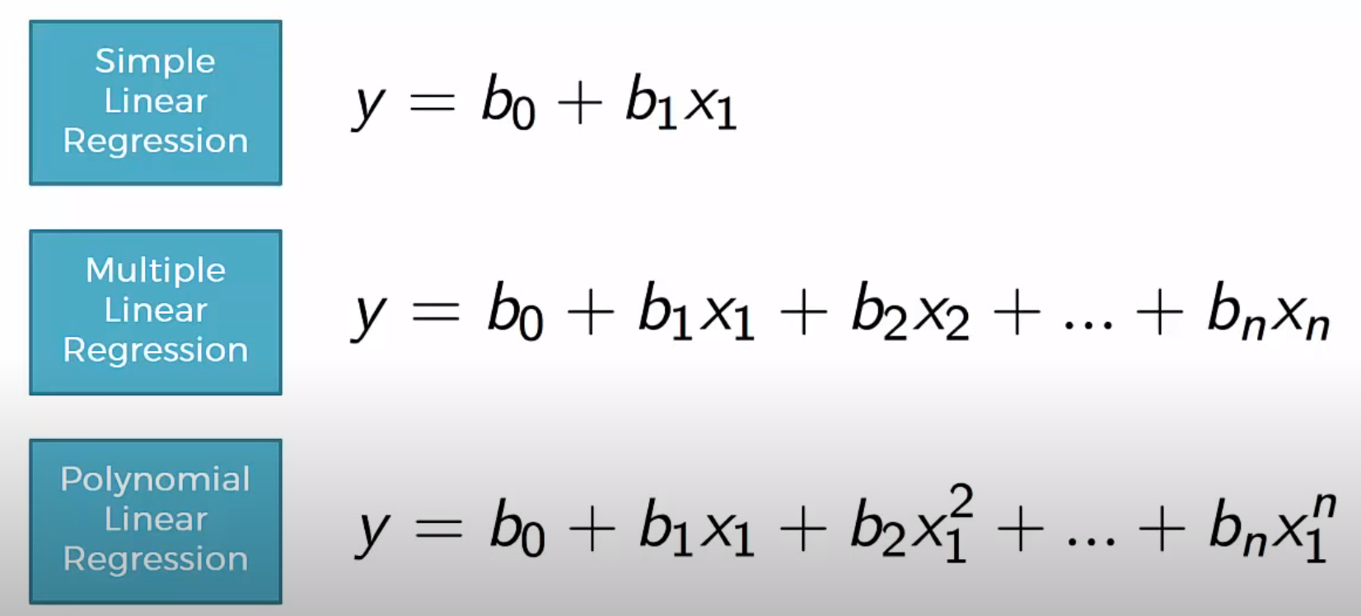

Slide 61
Advantages:
  Polynomial provides the best approximation of the relationship between the dependent and independent variable.
  Polynomial basically fits a wide range of curvature.
Disadvantages:
  These are too sensitive to the outliers.
  The presence of one or two outliers in the data can seriously affect the results of the nonlinear analysis.

Slide 62
Logistic Regression
It’s a basic classification problem and some regression algorithms can be used for classification (and vice versa).
Logistic Regression (also called Logit Regression) is commonly used to estimate the probability that an instance belongs to a particular class.
e.g., what is the probability that this email is spam?

Slide 63
Logistics Regression as Binary Classifier:
positive class (labeled “1”): If the estimated probability is greater than 50%, then the model predicts that the instance belongs to that class.
negative class(labeled “0”): and otherwise it predicts that it does not.

Slide 64
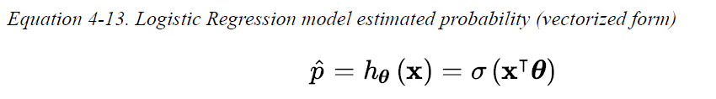
Estimating Probabilities
A Logistic Regression model computes a weighted sum of the input features(plus a bias term).
The logistic—noted σ(·)—is a sigmoid function (i.e., S-shaped) that outputs a number between 0 and 1.

Slide 65
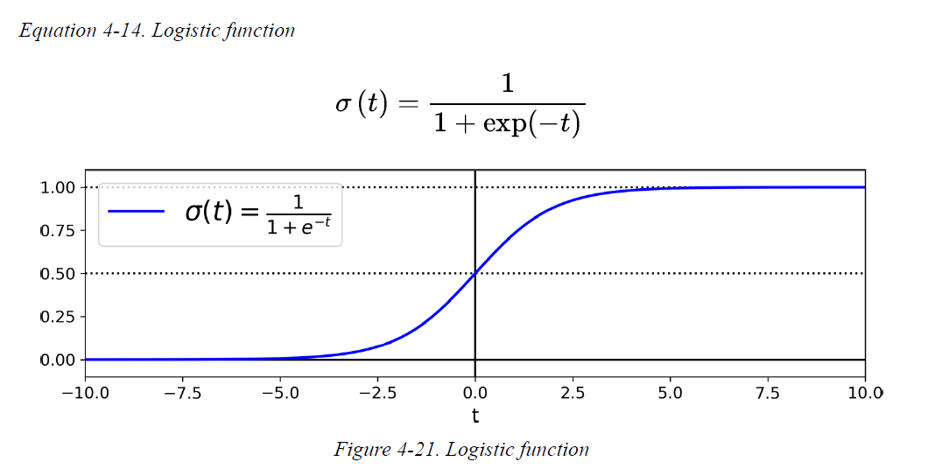
It is defined as shown in Equation

Slide 66

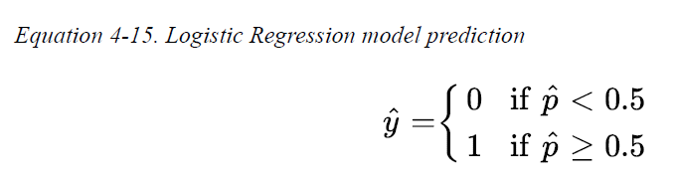

The probability that an instance x belongs to the positive class, it can make its prediction ŷ.
A Logistic Regression model predicts:
  1 if is positive, σ(t) ≥ 0.5 when t ≥ 0
  0 if it is negative, σ(t) < 0.5 when t < 0

Slide 67
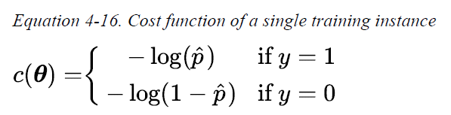
Training and Cost Function
How Logistic Regression model is trained?
The objective of training is to set the parameter vector θ so that the model estimates,
  high probabilities for positive instances (y = 1) and
  low probabilities for negative instances (y = 0).
This idea is captured by the cost function shown in below Equation for a single training instance x.

Slide 68
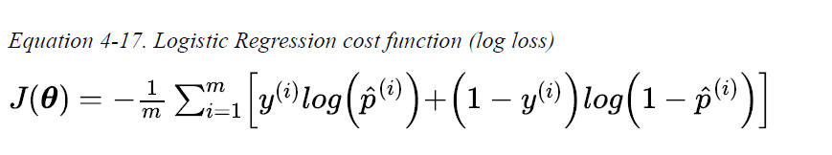
–log(t) grows very large when t approaches 0.
so the cost will be large if the model estimates a probability close to 0 for a positive instance and it will also be very large if the model estimates a probability close to 1 for a negative instance.
– log(t) is close to 0 when t is close to 1, so the cost will be close to 0 if the estimated probability is close to 0 for a negative instance or close to 1 for a positive instance.
The cost function over the whole training set is the average cost over all training instances. It can be written in a single expression called the log loss,

Slide 69
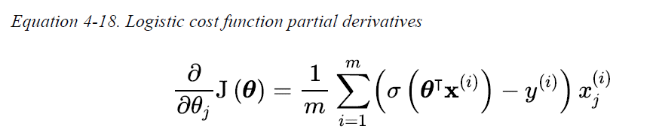
The bad news is that there is no known closed-form equation to compute the value of θ that minimizes this cost function i.e there is no equivalent of the Normal Equation.
The good news is that this cost function is convex, so Gradient Descent (or any other optimization algorithm) is guaranteed to find the global minimum.
The partial derivatives of the cost function with regard to the j model parameter θ are given by following equation,

Slide 70
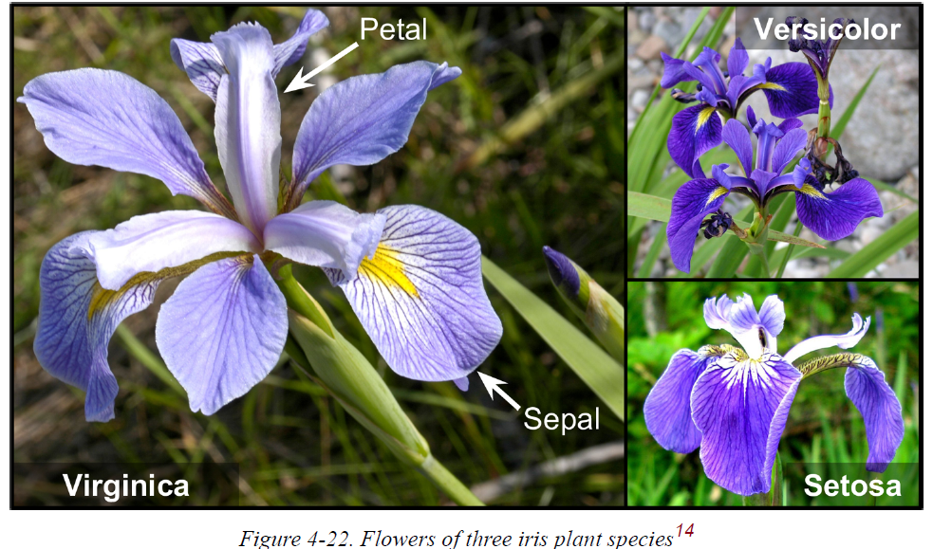
Decision Boundaries
iris dataset - This is a famous dataset that contains the sepal and petal length and width of 150 iris flowers of three different species: Iris setosa, Iris versicolor, and Iris virginica

Slide 71


